Slide 1
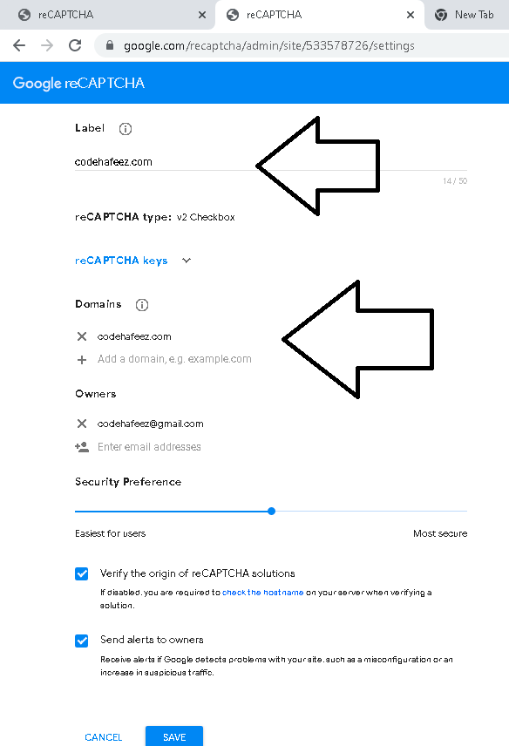
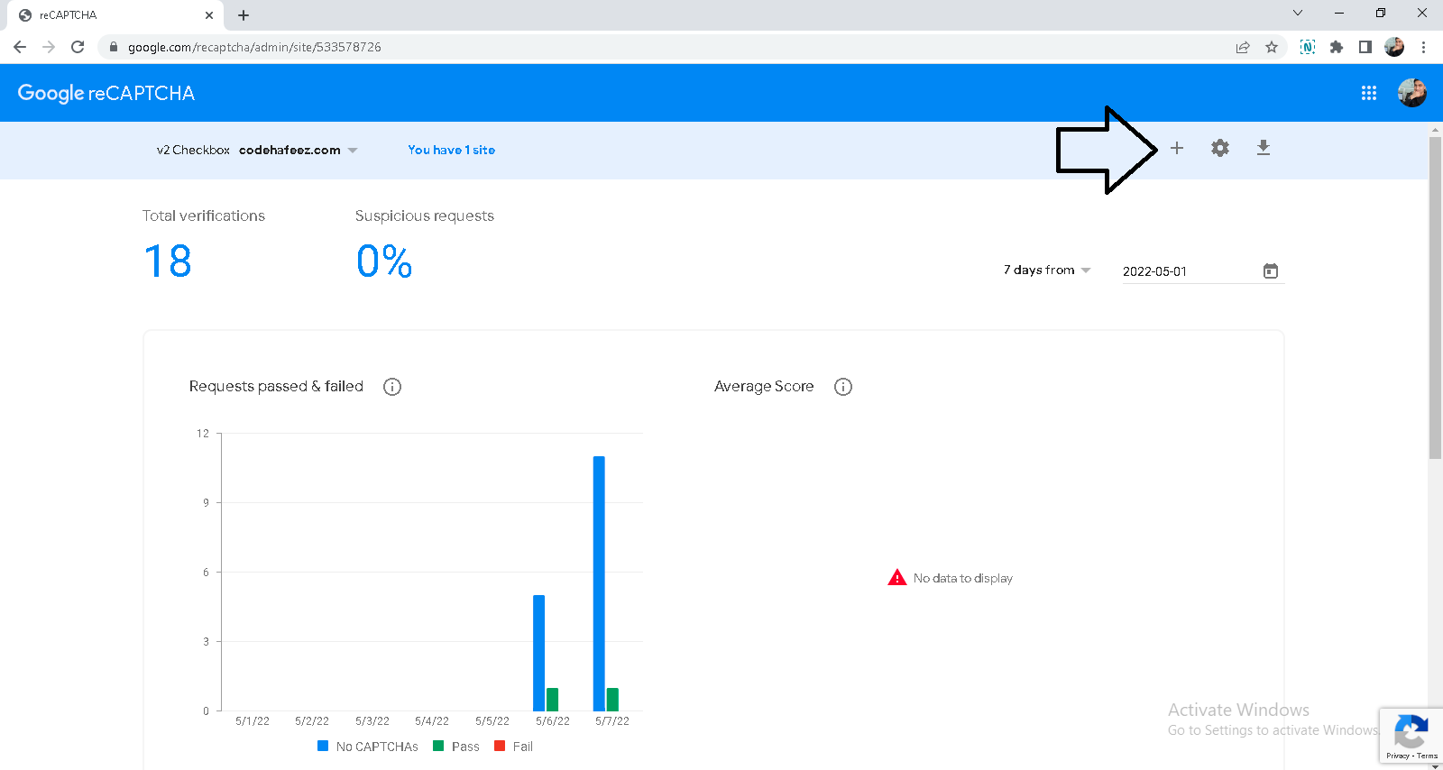
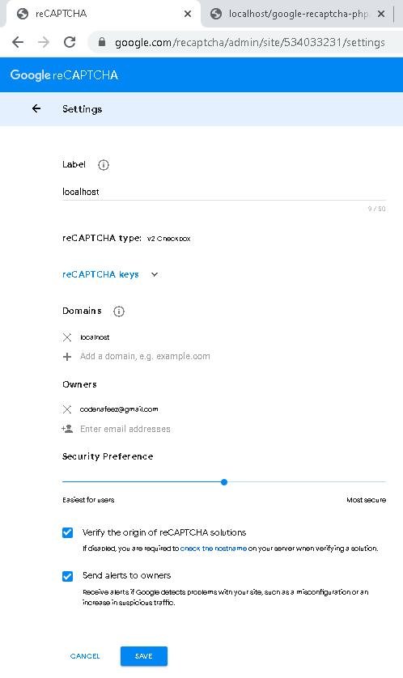
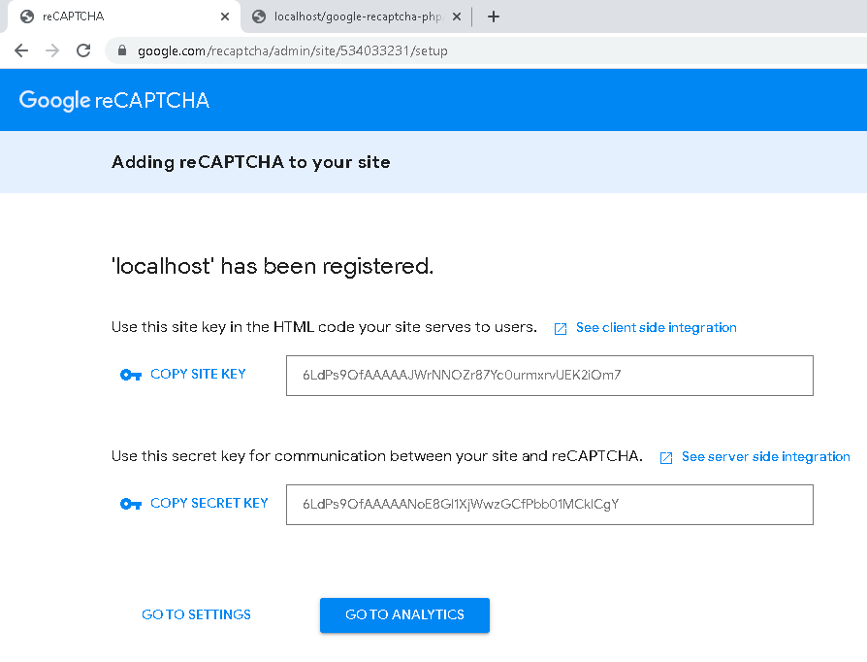
https://www.google.com/recaptcha/admin/

Slide 2
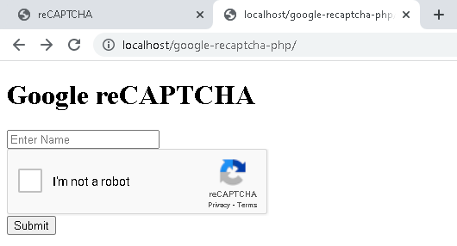
// action.php
<?php
if (isset($_POST['submit_btn'])) {
$name = $_POST['name'];
$recaptcha = $_POST['g-recaptcha-response'];
$secret_key = '6LdPs9QfAAAAANoE8GI1XjWwzGCfPbb01MCklCgY';
$url = 'https://www.google.com/recaptcha/api/siteverify?secret='. $secret_key . '&response=' . $recaptcha;
$response = file_get_contents($url);
$response = json_decode($response);
if ($response->success == true) {
echo '<script>alert("Google reCAPTACHA verified")</script>';
} else {
echo '<script>alert("Error in Google reCAPTACHA")</script>';
}
}
?>
// index.php
<!DOCTYPE html>
<html lang="en">
<head>
<meta charset="UTF-8">
<meta http-equiv="X-UA-Compatible" content="IE=edge">
<meta name="viewport" content="width=device-width, initial-scale=1.0">
<!-- Google reCAPTCHA CDN -->
<script src="https://www.google.com/recaptcha/api.js" async defer>
</script>
</head>
<body>
<h1>Google reCAPTCHA</h1>
<form action="action.php" method="post">
<input type="text" name="name" id="name" placeholder="Enter Name" required>
<!-- div to show reCAPTCHA -->
<div class="g-recaptcha"data-sitekey="6LdPs9QfAAAAAJWrNNOZr87Yc0urmxrvUEK2iQm7"></div>
<button type="submit" name="submit_btn">Submit</button>
</form>
</body>
</html>

