Slide 1




Technical Debt in R Packages
It Will Never Work in Theory
April 2023
Zadia Codabux
University of Saskatchewan, Canada
zadiacodabux@ieee.org
@zadiacodabux
https://www.cs.usask.ca/faculty/zadiacodabux/

Slide 2
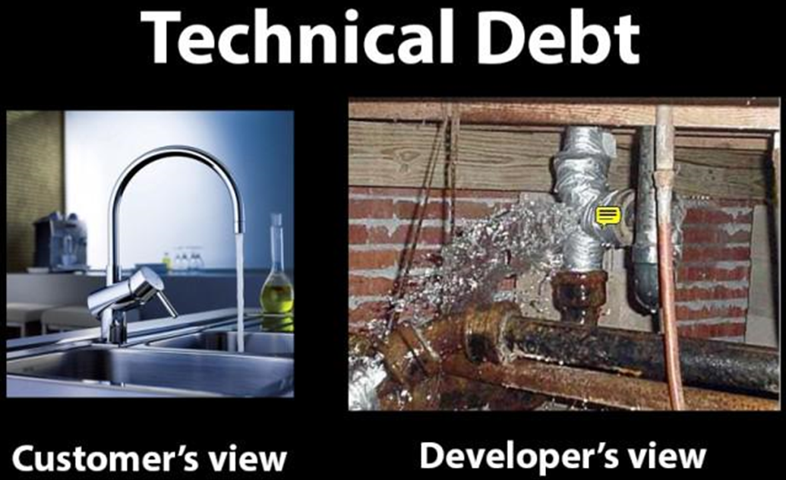
Source: Google Images

Slide 3
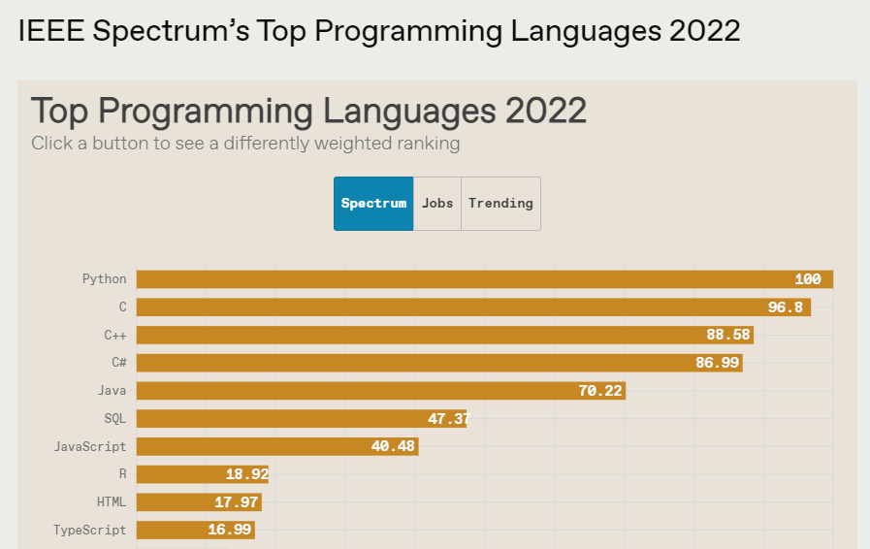
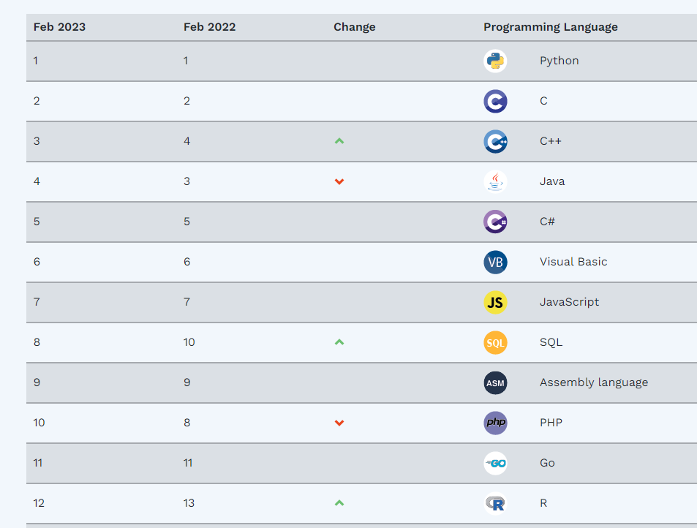
https://www.tiobe.com/tiobe-index/
https://pypl.github.io/PYPL.html
https://spectrum.ieee.org/top-programming-languages-2022

Slide 4
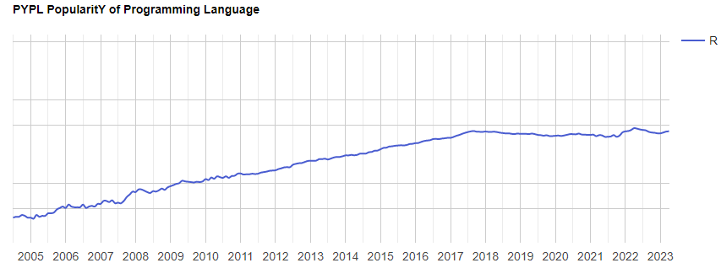
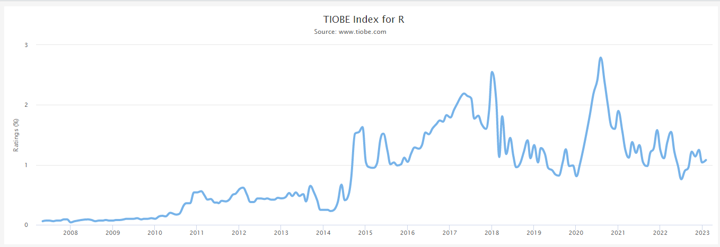
https://www.tiobe.com/tiobe-index/
https://pypl.github.io/PYPL.html
https://spectrum.ieee.org/top-programming-languages-2022

Slide 5
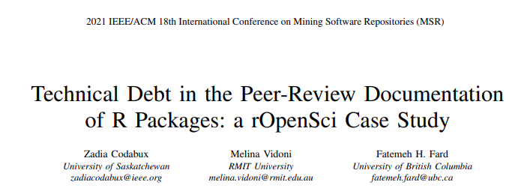

Slide 6
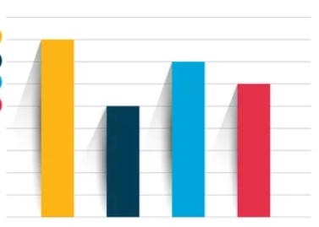
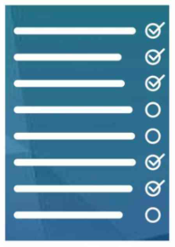

Goal: To investigate Technical Debt (TD) in the documentation of the
peer-review process of R packages.
TD Types
TD Types Distribution
TD Types based on User Roles
Zadia Codabux, Melina Vidoni, Fatemeh H. Fard, Technical Debt in the Peer-Review Documentation of R Packages: a rOpenSci Case Study, Mining Software Repositories Conference, 2021

Slide 7
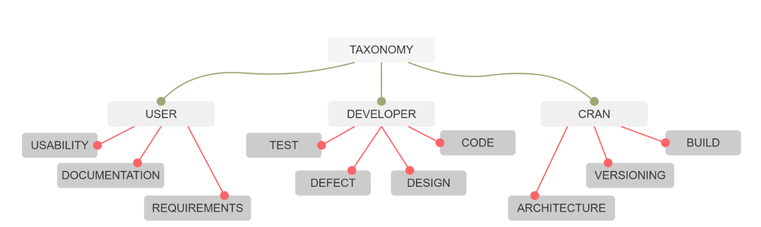
Results
TD Types
Zadia Codabux, Melina Vidoni, Fatemeh H. Fard, Technical Debt in the Peer-Review Documentation of R Packages: a rOpenSci Case Study, Mining Software Repositories Conference, 2021

Slide 8
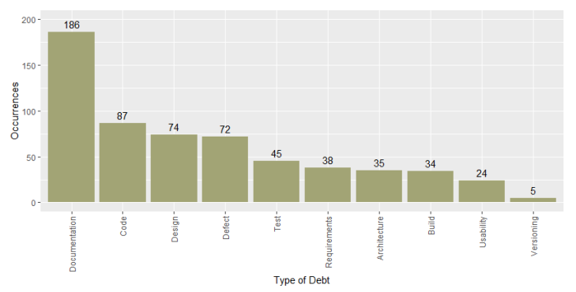
Results
TD Types Distribution
Zadia Codabux, Melina Vidoni, Fatemeh H. Fard, Technical Debt in the Peer-Review Documentation of R Packages: a rOpenSci Case Study, Mining Software Repositories Conference, 2021

Slide 9
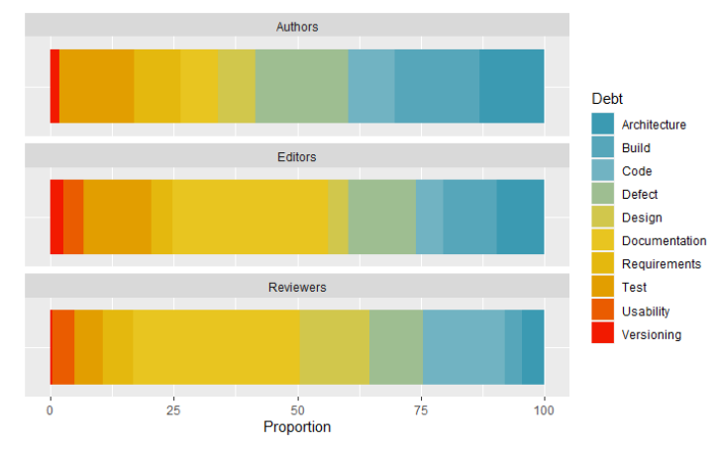
Results
TD Types based on User Roles
Zadia Codabux, Melina Vidoni, Fatemeh H. Fard, Technical Debt in the Peer-Review Documentation of R Packages: a rOpenSci Case Study, Mining Software Repositories Conference, 2021

Slide 10
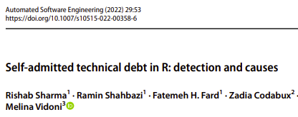

Slide 11


Goal: Automatic detection and causes of Self Admitted TD (SATD) in R Packages
Best Performing Model:
SATD & SATD Types
Detection
Causes of SATD
Rishab Sharma, Ramin Shahbazi, Fatemeh H. Fard, Zadia Codabux, Melina Vidoni, Self-Admitted Technical Debt in R: Detection and Causes, Automated Software Engineering, 2022

Slide 12
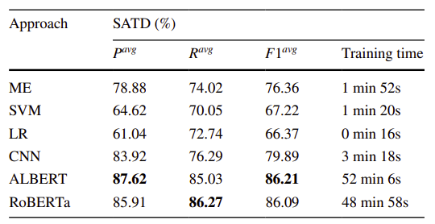
Results
SATD Detection
Rishab Sharma, Ramin Shahbazi, Fatemeh H. Fard, Zadia Codabux, Melina Vidoni, Self-Admitted Technical Debt in R: Detection and Causes, Automated Software Engineering, 2022

Slide 13
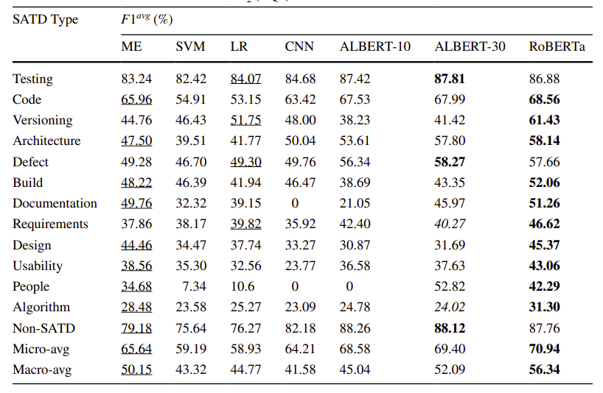
Results
SATD Types Detection
Rishab Sharma, Ramin Shahbazi, Fatemeh H. Fard, Zadia Codabux, Melina Vidoni, Self-Admitted Technical Debt in R: Detection and Causes, Automated Software Engineering, 2022

Slide 14
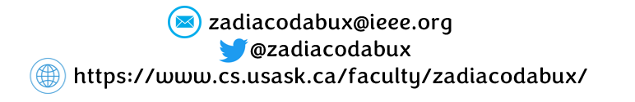
Takeaways
Documentation debt is the most recurrent, yet the least valued
Not all users give the same importance to the different debt types
Challenging debt types to detect: Requirement & Algorithm

