Slide 1
It Will Never Work in Theory
April 2023 Lightning Talks
Understanding conceptual transfer in students learning new programming languages
By Ethel Tshukudu, PhD
University of Botswana
tshukudue@ub.ac.bw

Slide 2
Motivation and Aims
Difficulties students face during transition
PhD research
Conceptual transfer in students learning new programming languages
Explore and Investigate how transfer occurs in relative novice programmers during code comprehension
Drew heavily from natural language theories
psycholinguistic model-Lexical representation and development in a second language- Jiang Nan
Ringbom cross-linguistic similarities)

Slide 3
Research design
*Semantic transfer based on syntax similarities plays a role
Phase 1-Exploring transfer(Qualitative study)
Phase 2-Model of PL transfer
Phase 3-Model Validation (Quantitative-4 studies)
*Transfer interventions can lead to improved conceptual transfer and understanding
Phase 4-Teachers’ experiences and transfer interventions(Qualitative)
Phase 5-Transfer pedagogy (Qualitative and quantitative-2 studies)

Slide 4
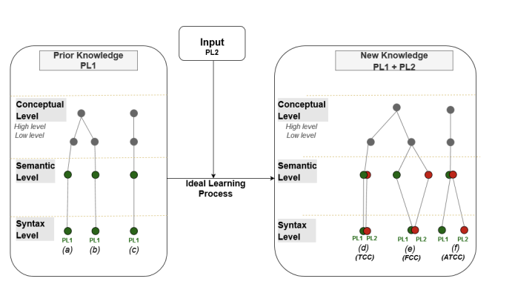
Contributions
Model of PL transfer:
validated in one context (Python-Java).
Similar syntax + similar semantics =positive transfer
Similar syntax + different semantics=negative transfer
Different syntax +similar semantics=minimal or no transfer

Slide 5
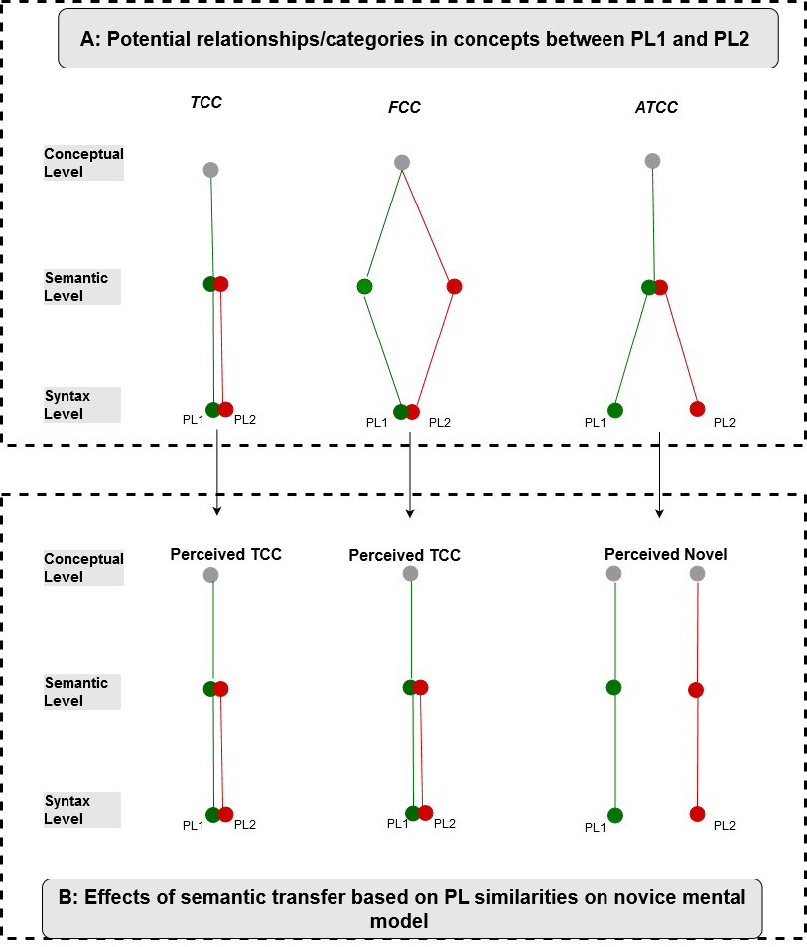
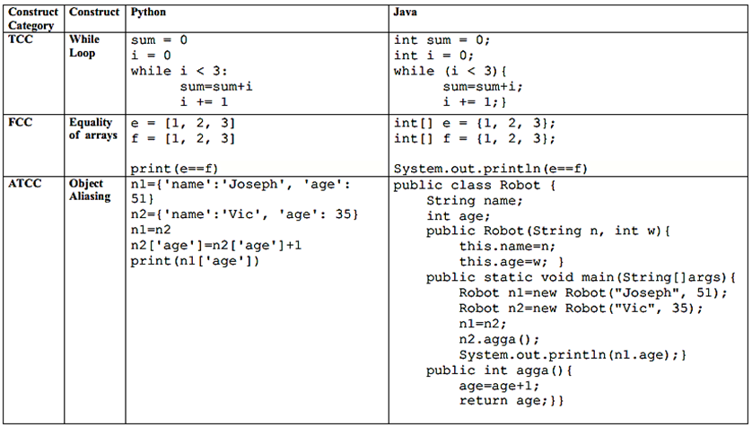
EXAMPLE: True Carryover Concept (TCC)
Potential relationship between languages
A construct with
similar syntax
similar underlying semantics in PL1 and PL2.
For example, a while loop in Python and Java.
Effects of semantic transfer

Slide 6
EXAMPLE False Carryover Concept (FCC)
Potential relationship between languages
A construct with
similar syntax
Different semantics in PL1 and PL2.
For example, equality of arrays in Python 3 and Java
Effects of semantic transfer

Slide 7
EXAMPLE: Abstract True Carryover Concept (ATCC)
Potential relationship between languages
A construct with
Different syntax
Same semantics in PL1 and PL2.
Examples are constructs, whose implementation details are hidden such as data abstraction (objects) in Java which at a low level can represent data structures like Python dictionaries but has structured data and behavior
Effects of semantic transfer

Slide 8
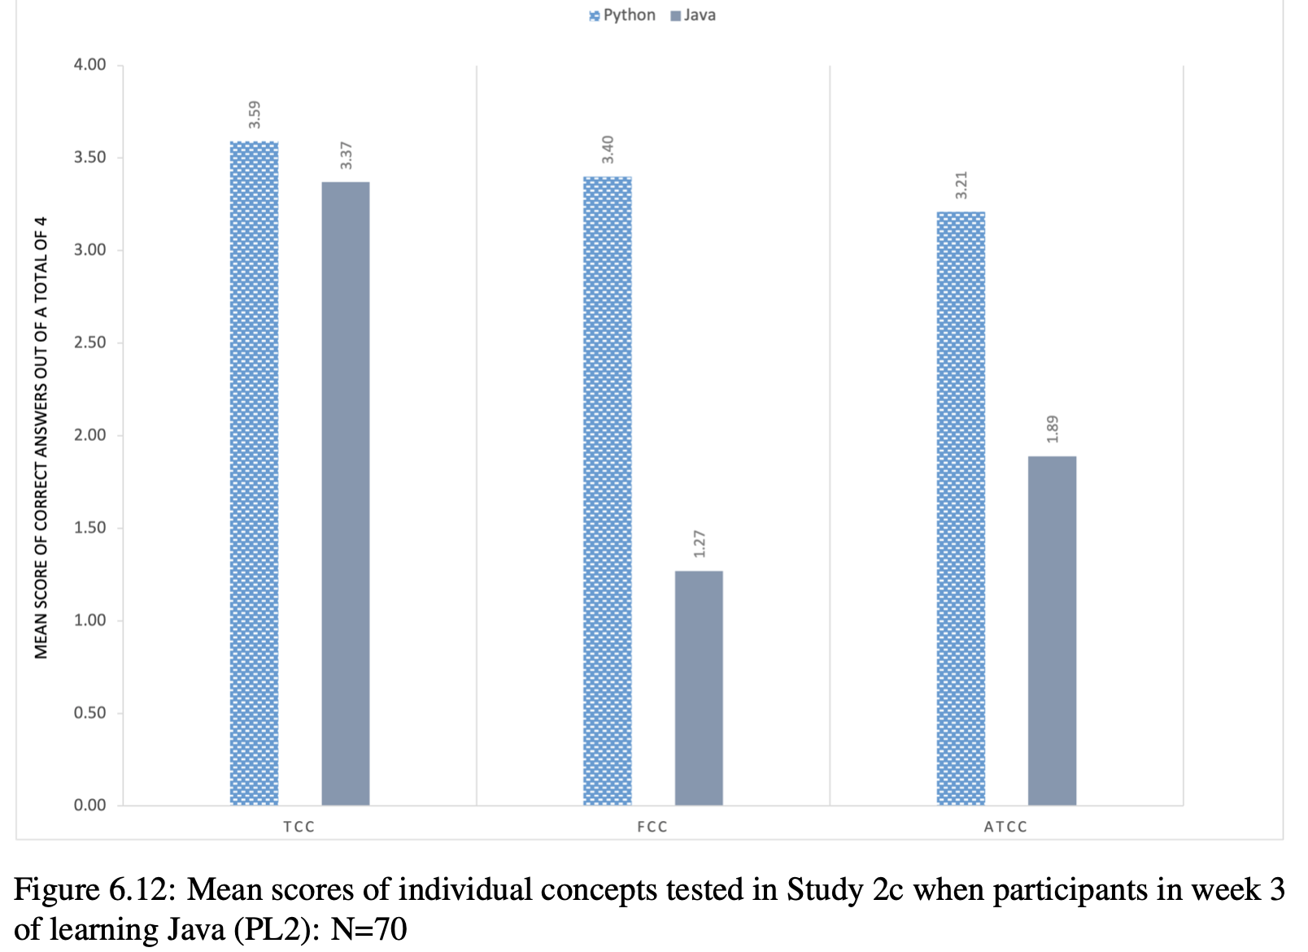
VALIDATION OF THE MODEL
Second year students
European universities
Python-Java
Similarities between programming languages
play a significant role in semantic and
conceptual transfer between programming
languages.

Slide 9

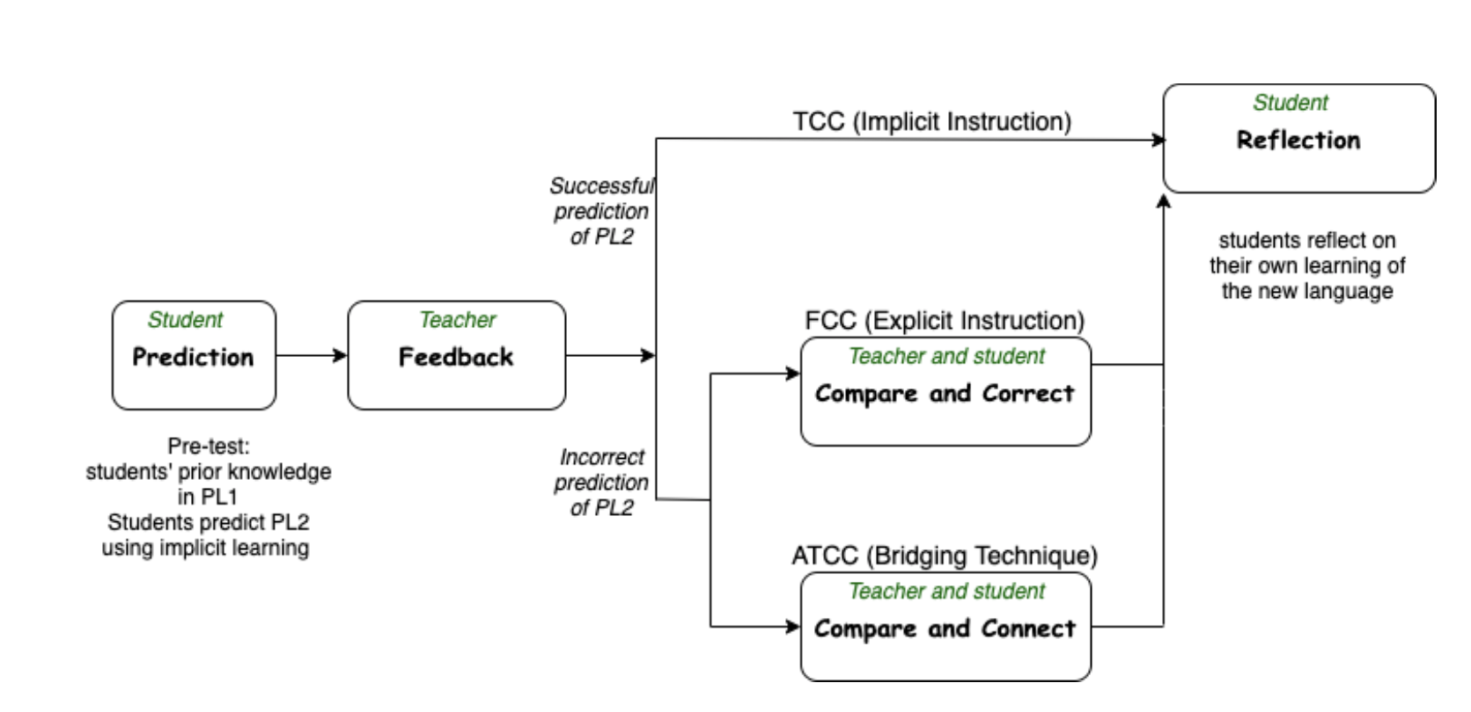

Contributions
Pedagogy of transfer:
This thesis also shows how the MPLT was used to shape the design of a transfer pedagogy in the class- room.
Teacher preparation: Data showing teachers are not aware of the issues hence professional development may be needed

Slide 10
Deep learning from the thesis
Multiple Programming Languages in the Curriculum
Recommended by ACM and IEE guidelines for undergrad CS
K-12 also
Relative Novices’ Fragile Knowledge (inert, partial and misplaced by Perkins et al)
Educators focus on problem solving
Educators overestimate knowledge of PL1
Second language educators assumes a lot of knowledge that is not in place
Deepening Conceptual Understanding through Second Language Learning
Finding gaps in knowledge
Opportunity to teach hidden concepts e.g. scoping, aliasing etc
Allowing students to fail and correct
Comparisons
Correcting and connecting

Slide 11
NEXT STEPS and questions
Questions:
I often get asked :
Which is the best first PL to start with?
Transfer in other language contexts?
Question to you:
Who is my research relevant to?
Pure relative novices not CS majors?
CS majors (CS0 and CS1)?
Anyone?
Next Steps:
Further validation of the model in new contexts
Further validation of the pedagogy in new contexts
Exploring more deepening conceptual understanding

Slide 12
MAIN Thesis publications
Ethel Tshukudu and Quintin Cutts. 2020. Semantic Transfer in Pro- gramming Languages: Exploratory Study of Relative Novices. In Proceedings of the 2020 ACM Conference on Innovation and Technology in Computer Science Education. 307–313. [29].
Ethel Tshukudu and Quintin Cutts. 2020. Understanding Conceptual Transfer for Students Learning New Programming Languages. In Proceedings of the 2020 ACM Conference on International Computing Education Research. 227–237. [30]
Ethel Tshukudu and Quintin Cutts. [n. d.]. Understanding conceptual transfer in second and subsequent programming languages. In Cambridge Computing Education Research Symposium. 18. [31]
Ethel Tshukudu and Siri Annethe Moe Jensen. 2020. The Role of Explicit Instruction on Students Learning their Second Programming Language. UKICER ’20: United Kingdom Ireland Computing Education Research conference. 10–16 [33]
Ethel Tshukudu, Quintin Cutts, Olivier Goletti, Alaaeddin Swidan, and Fe- lienne Hermans. 2021. Teachers’ Views and Experiences on Teaching Second and Subse- quent Programming Languages . In Proceedings of the 17th ACM Conference on Interna- tional Computing Education Research (ICER 2021), Au- gust 16–19, 2021, Virtual Event, USA. ACM, New York, NY, USA, 12 pages. https://doi.org/10.1145/3446871.3469752
Ethel Tshukudu, Quintin Cutts, Mary Ellen Foster. 2021. Evaluating a Pedagogy for Improving Conceptual Transfer and Understanding in a Second Program- ming Language Learning Context . KoliCalling ’21:

Slide 13
Thank you
By Ethel Tshukudu, PhD
University of Botswana
tshukudue@ub.ac.bw
Website: https://www.csedbotswana.org/

