Slide 1


Can genetic improvement enhance online code snippets?
Sherlock A. Licorish
University of Otago
Dunedin, New Zealand
sherlock.licorish@otago.ac.nz
It Will Never Work in Theory (NWIT), April 25, 2023

Slide 2
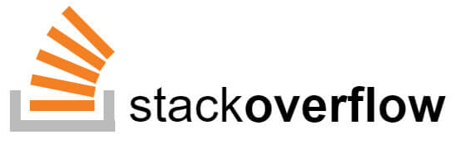
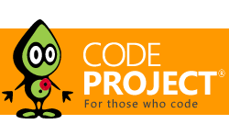

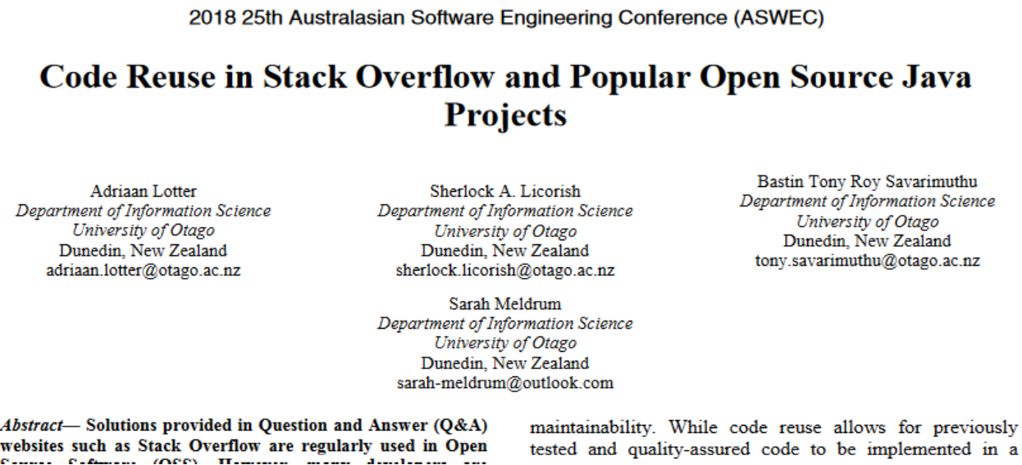
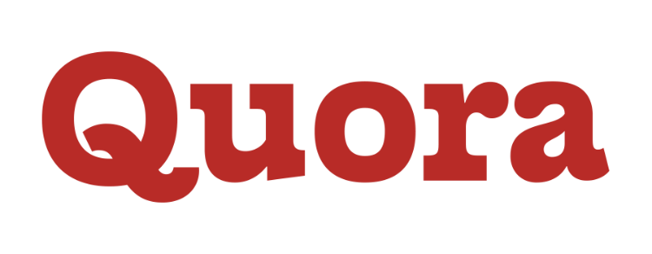

Situation

Slide 3

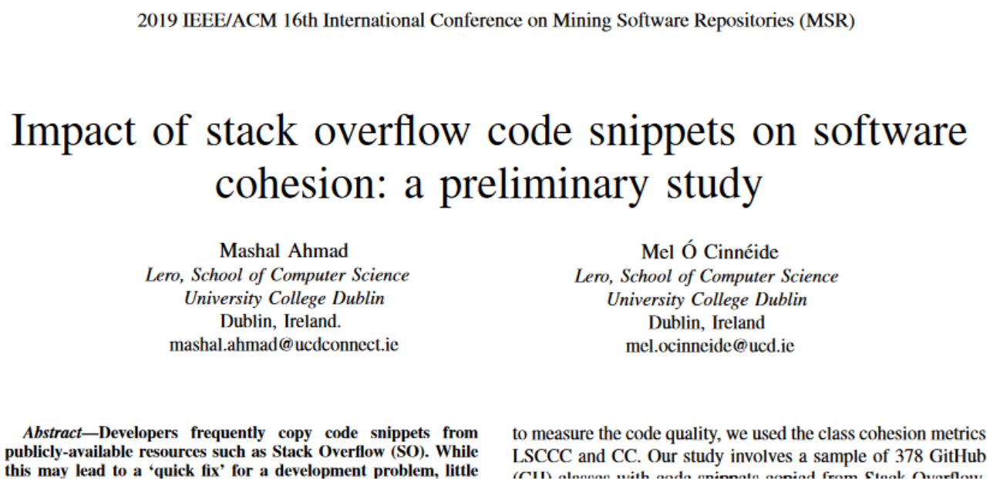
Challenge
Snippets online can often be incorrect, insecure, and incomplete
We have observed errors in Stack Overflow code
These observations extend to students’ work, across multiple universities
Errors have also been reported by open source developers, proprietary developers, and end users… the software development community
“App explanation: the sprit of stack overflow is coders helping coders”
NissanConnect EV mobile app

Slide 4
Academic Community’s Awareness
But we still use online code snippets!

Slide 5
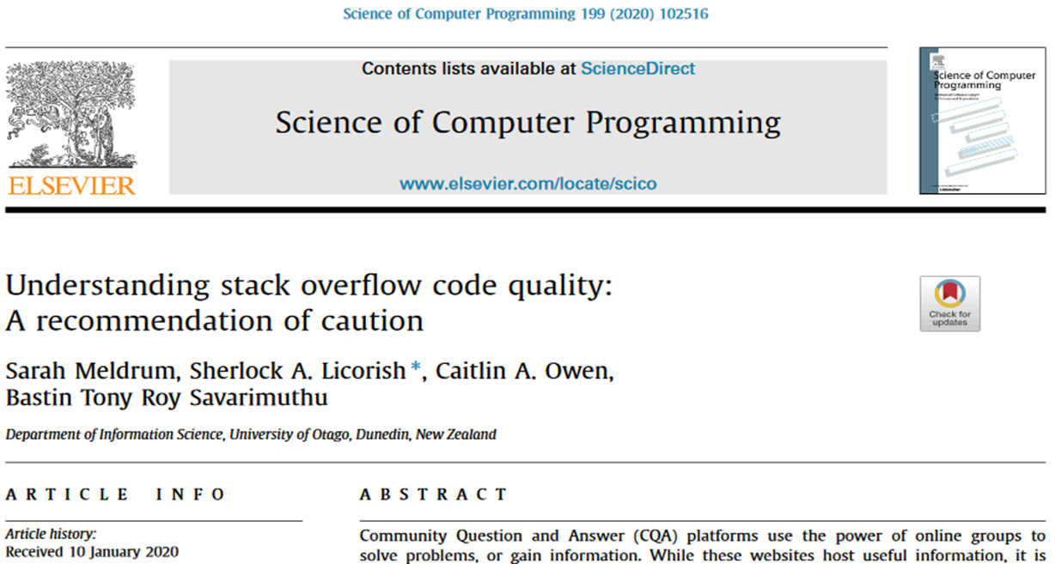
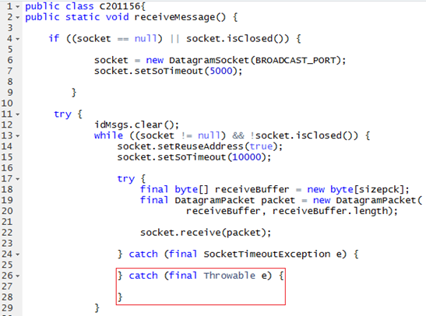
Current State of Play

Slide 6
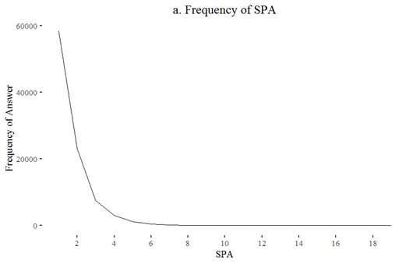
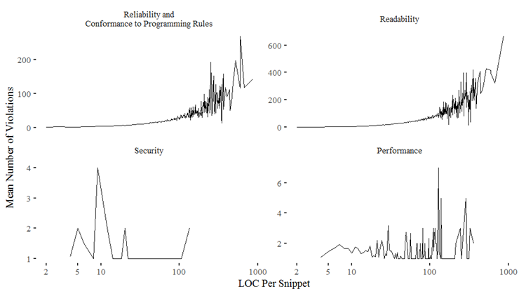
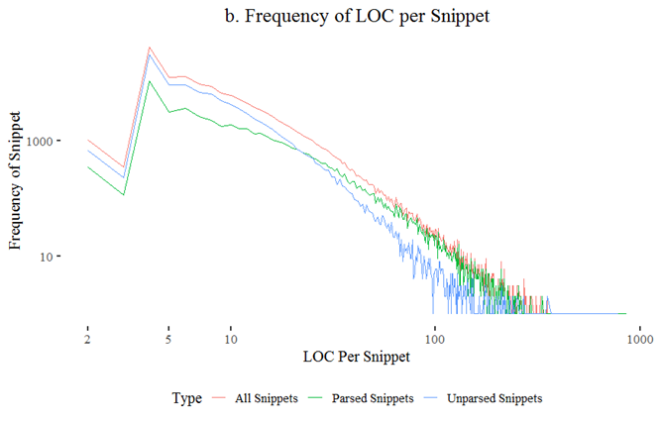
Current State of Play
Question: Can genetic improvement enhance online code snippets?

Slide 7


Preliminary Agenda
Snippets (8,010) extracted from Stack Overflow for 2014, 2015, and 2016 using Stack Overflow’s data explorer
Answer posts which contained at least one “<code>” tag and were from a question tagged from Java were then sampled
Static checker PMD is used to identify faults, https://pmd.github.io/
Genetic improvement tool GIN is used for code repair, https://github.com/gintool/gin
We focus on performance related faults in Stack Overflow’s code

Slide 8
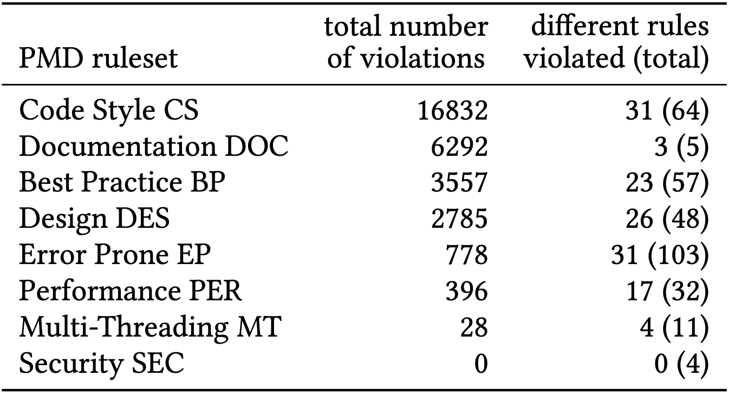
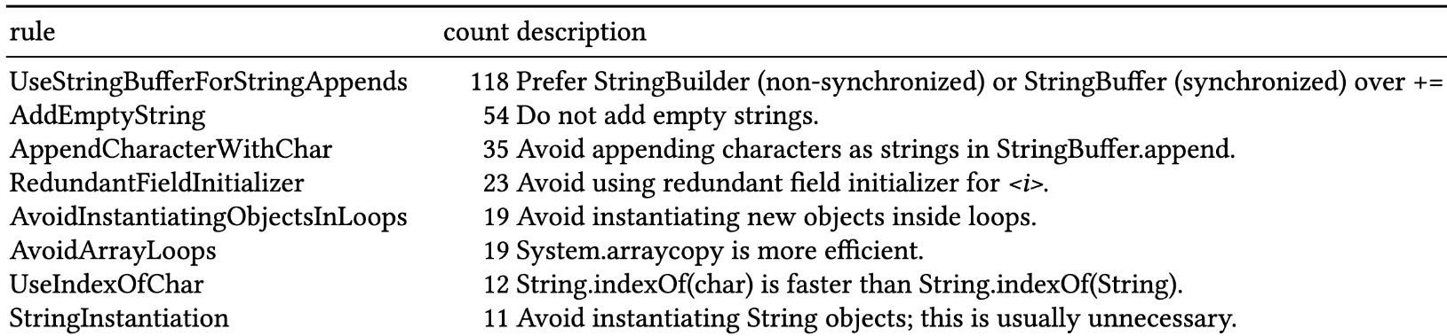
Characterizing PMD’s Treatment of 8,010 Snippets
PMD finds 30,668 rule violations in 3,034 snippets, covering 135 of its 324 rules:
Examples of performance related rule violations:

Slide 9
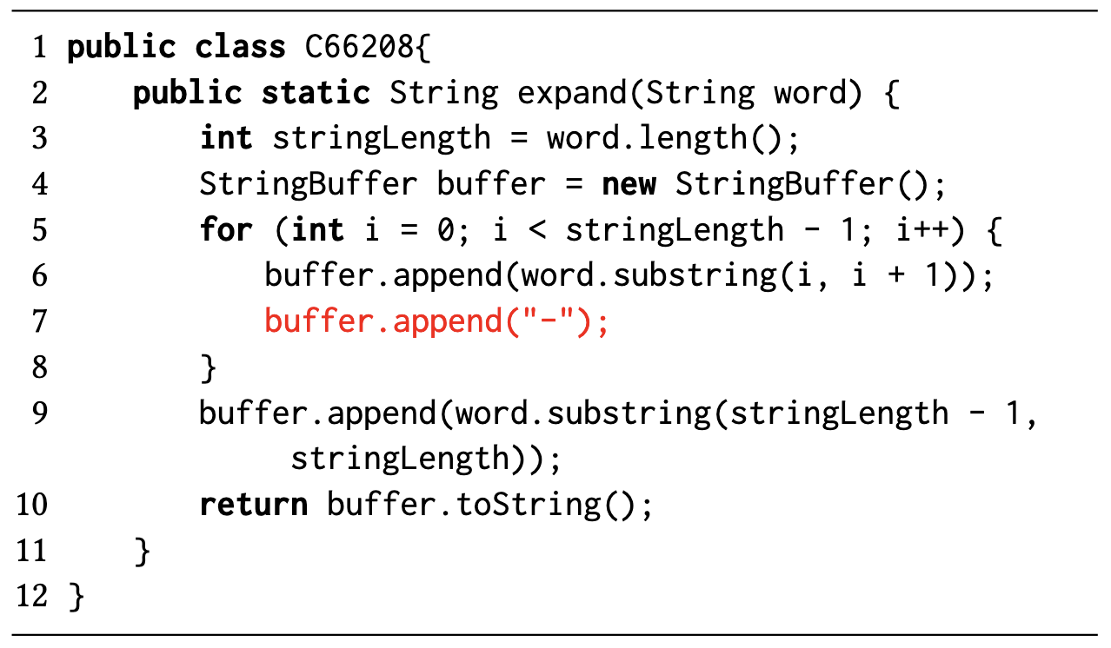
Characterizing GIN’s Single-edit Space
GIN’s RandomSampler samples and runs 17,986 unique single-edit patches (DeleteLine, ReplaceLine, CopyLine, and SwapLine; and DeleteStatement, ReplaceStatement, CopyStatement, and SwapStatement; in total 31.4% compile)
770 patched files no longer have any performance issues – according to PMD
58 patches (from 44 unique files) produce compilable code without performance issues
- 36 are Delete edits that delete the offending code
- most others either replace or modify the offending code
Non-uniform effects of edits types
- Copy edits attract disproportionally many violations
- Delete edits perform best against the AvoidInstantiatingObjectsInLoops violations
Example: Code snippet C66208 with error AppendCharacterWithChar, mutation DeleteStatement(64). The deleted statement is shown in red.
For more examples, see the GI@GECCO paper “Dissecting Copy/Delete/Replace/Swap mutations: Insights from a GIN Case Study”.

Slide 10
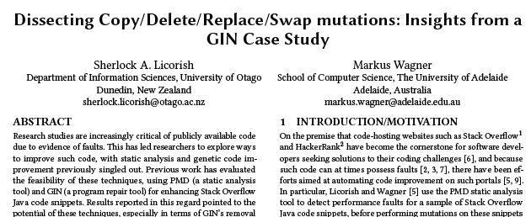
Next Steps
Better static analysis:
- Mitigate false positive and trivial warnings
- Improve parsing of non-compilable code
- Crowd-source rules
Better automated program improvement:
- Bias sampling towards desired effects
- Better code transformations
- Other non-functional properties
Threat: GIN is normally accompanied by unit test suites to assess the validity of mutants. This work does not adopt such tests, and thus our successful patches that cleared performance issues and resulted in compilable code could have been inflated.

Slide 11






Thanks!
Sarah Meldrum
Caitlin Owen
Tony Savarimuthu
Markus Wagner
The Science for Technological Innovation National Science Challenge Funding
Commerce Research Grant Funding
Thank you!

Slide 12
Genetic improvement enhances online code snippets!
Your thoughts?
Sherlock A. Licorish
University of Otago
Dunedin, New Zealand
sherlock.licorish@otago.ac.nz
It Will Never Work in Theory (NWIT), April 25, 2023

