Slide 1
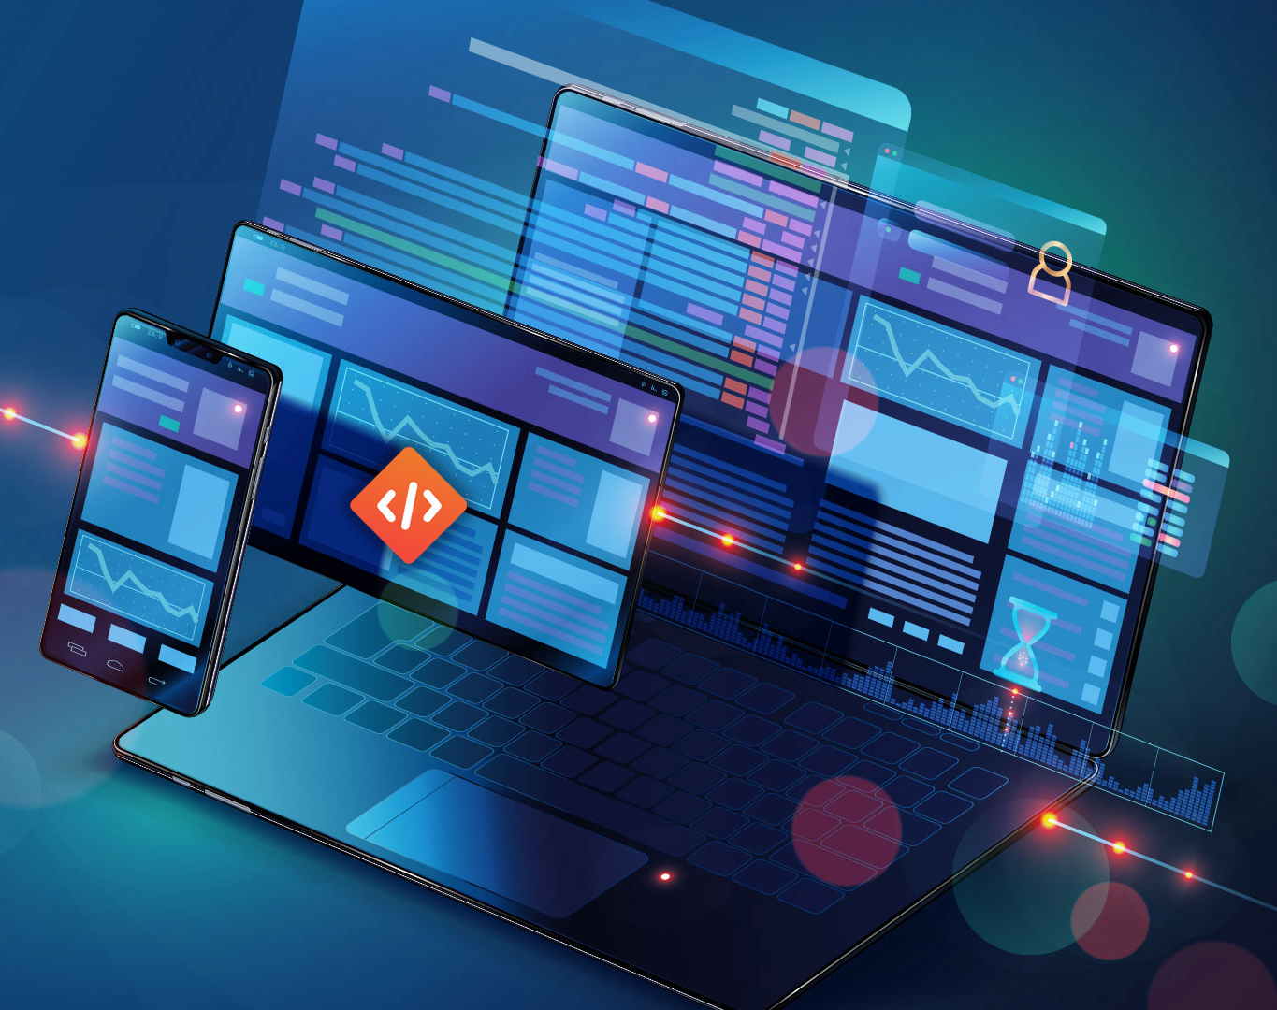

How Novice Testers Perceive and Perform Unit Testing
Gina Bai
Assistant Professor of the Practice
*Images from google.com

Slide 2
Guess: How much (in USD) does the poor software quality cost the United States in 2022?
≥ $2.41 trillion
https://www.it-cisq.org/the-cost-of-poor-quality-software-in-the-us-a-2022-report/

Slide 3
“Most of our new grad hires have limited experience with automated testing, and that’s a daily activity at Google. Every change that you are going to make to the codebase is going to come with unit tests. That is the rule.”
Titus Winters. “The Gap between Industry and CS Edu.” ITiCSE 2022

Slide 4
Purpose of Testing
Level 0 There is no difference between testing and debugging
Level 1 The purpose of testing is to show correctness
[Ammann & Offutt, Introduction to Software Testing (Edition 2)]
[Bai, Smith, Stolee. ITiCSE ‘21]

Slide 5
Purpose of Testing
Level 0 There is no difference between testing and debugging
Level 1 The purpose of testing is to show correctness
Level 2 The purpose of testing is to show that the software does not work.
Level 3 The purpose of testing is not to prove anything specific, but to reduce the risk of using the software.
Level 4 Testing is a mental discipline that helps all IT professionals develop higher-quality software.
[Ammann & Offutt, Introduction to Software Testing (Edition 2)]

Slide 6


Representative Questions
One of my tests failed, is it okay? Should I fix the test to make it pass? Does the failure indicate a bug in the source code? Or in my testing code?
Amy
I was wondering how many test cases do I need to write? Do I need to test everything? I’ve already found one bug in the code. When can I stop testing?
Bob
[Bai, Smith, Stolee. ITiCSE ‘21]

Slide 7


Representative Questions
I found some code examples on StackOverflow, but it’s giving me a compile error, and I don’t know how to fix it. Can I just delete it?
Charlie
I found the bug, but I don’t know how to show that in unit tests… Can I just describe it in comments?
Daniel
[Bai, Smith, Stolee. ITiCSE ‘21]

Slide 8
Challenges
Novices find it challenging to determine what and how to test.
Novices have no consensus on good unit tests, and hence
Novices find it challenging to determine when to stop testing,
Novices tend to only test happy paths.
Novices often create test cases that mismatch the program specifications.
Novices face implementation barriers
[Bai, Smith, Stolee. ITiCSE ‘21]

Slide 9
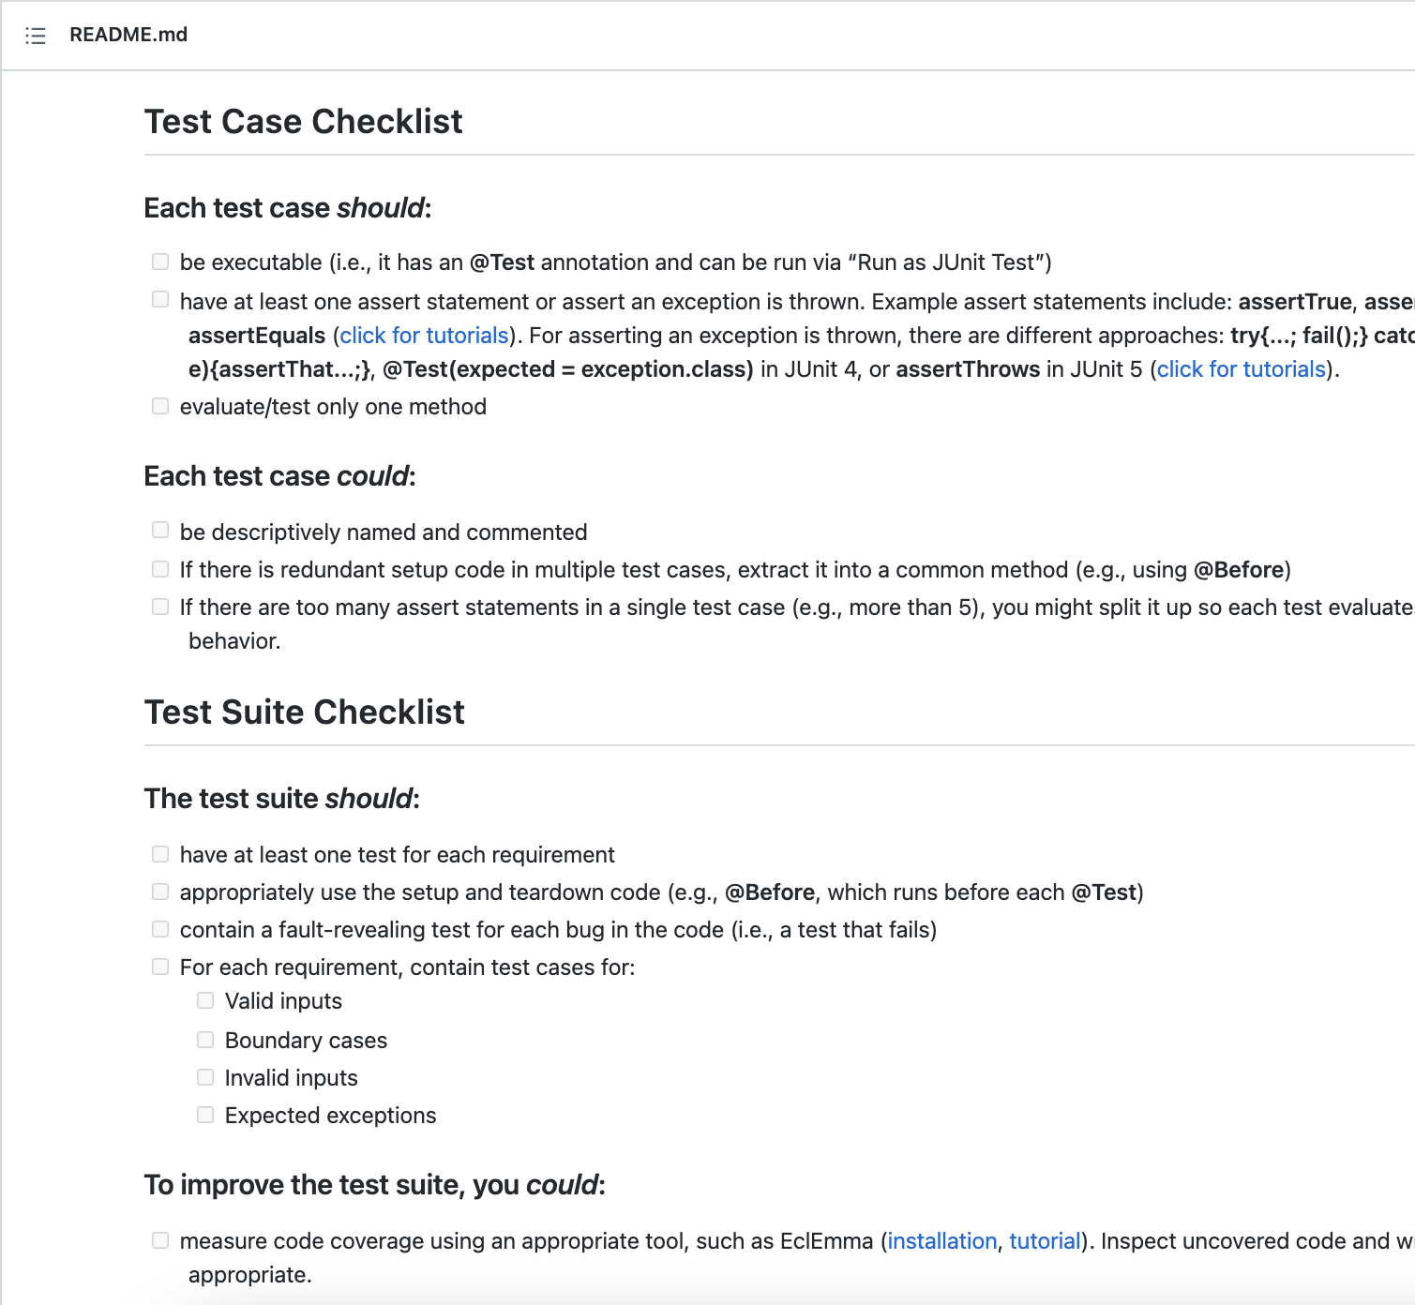
[Bai, Presler-Marshall, Price, Stolee. ITiCSE ‘22]
Testing Checklist
Static
Lightweight
Transferable

Slide 10
Testing Checklist
[Bai, Presler-Marshall, Price, Stolee. ITiCSE ‘22]
Syntax and tutorials
Test Class Components
Contains
Testing strategies
Tutorial information
Equivalence Class Partitioning
Boundary Value Analysis

Slide 11
Testing Checklist
Syntax Errors
[Bai, Presler-Marshall, Price, Stolee. ITiCSE ‘22]
No Assertions
Bad Naming
Assertion Roulette
Poor Requirement Coverage
Misinterpretation of Failing Tests
Addresses
Common mistakes
Common test smells
Testing Happy Path Only

Slide 12
Effectiveness
Our study shows that…
The lightweight testing checklist is at least as effective as a coverage tool, e.g., EclEmma, for writing quality tests.
Novices who have lower prior knowledge of unit testing may benefit more from the checklist
[Bai, Presler-Marshall, Price, Stolee. ITiCSE ‘22]

Slide 13
Takeaways
Most novices see no difference between testing and debugging, and many of them believe the goal of testing is to show correctness.
Novices face various challenges when performing testing.
The tool support does not need to be sophisticated to be effective.

