Slide 1

Never Work in Theory - Virtual
April 2023
Proofreading the Proofreader:
The Benefits of Unit Tests for Software Models
Allison Sullivan The University of Texas at Arlington

Slide 2
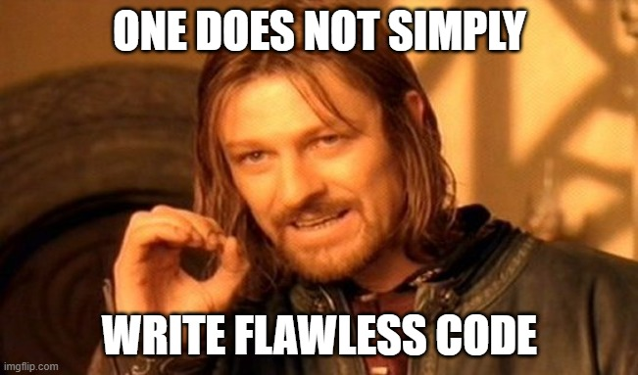
Software Modeling
Problem:
Sullivan: Proofreading the Proofreader

Slide 3
Software Modeling
Problem:
Solution:
one sig List { header: lone Node }
sig Node { link: lone Node }
pred acyclic(){
no List.header or
some n : List.header.*link | no n.link
}
run acyclic for 3
Sullivan: Proofreading the Proofreader
Notes:
Automated reasoning and correction of design-level properties before systems are built
Architects can guarantee changes are safe before modifying the implementation
Stakeholders can remove ambiguity about the system being built
Developers can produce better self-diagnosing code

Slide 4
A Software Model
An Alloy Model:
one sig List { header: lone Node }
sig Node { link: lone Node }
pred acyclic(){
no List.header or some n : List.header.*link | no n.link
}
run acyclic for 3
Show me all acyclic lists with up to 3 nodes
Discovered Scenario:
L0
L0
L0
header
header
N0
N0
N0
N1
Sullivan: Proofreading the Proofreader
Notes:
Scenario Finding IDEs
Bounded search
Ask solver: show all the different scenarios (program states) in which the good behavior holds
Ask solver: show me ways I prevent bad behavior (counterexamples)

Slide 5
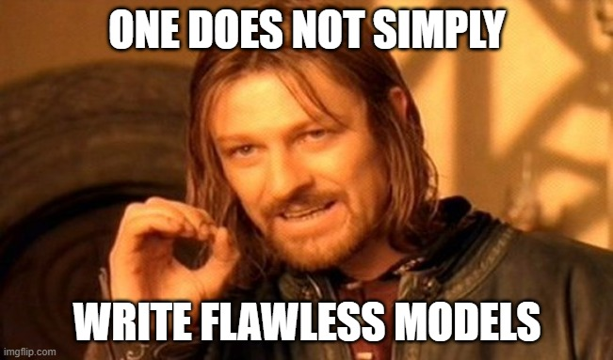
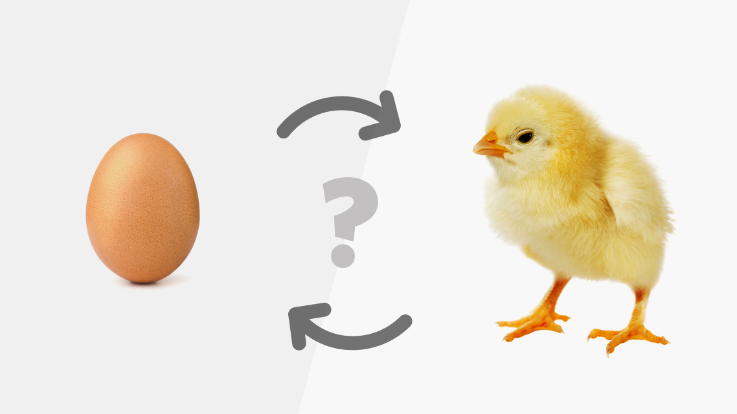
Software Modeling
New Problem:
Sullivan: Proofreading the Proofreader

Slide 6
New Solution: Unit Tests for Models
An Alloy Model:
one sig List { header: lone Node }
sig Node { link: lone Node }
pred acyclic(){
no List.header or some n : List.header.*link | no n.link
}
run acyclic for 3
Discovered Scenario: Unit Test
 | List = L0 Node = N0 header = L0->N0 acyclic
L0
L0
header
N0
Sullivan: Proofreading the Proofreader

Slide 7
New Solution: Unit Tests for Models
An Alloy Model:
one sig List { header: lone Node }
sig Node { link: lone Node }
pred acyclic(){
no List.header or some n : List.header.*link | no n.link
}
run acyclic for 3
Discovered Scenario: Unit Test
 | List = L0 Node = N0 header = L0->N0 link = N0->N0 !acyclic
L0
L0
header
N0
link
Sullivan: Proofreading the Proofreader
Notes:
Test automation in a modeling language is EASIER than in imperative languages like Java, C, C++

Slide 8
Ex: Mutation Testing
public int min(int x, int y) {
int v;
if(x >= y)
v = x;
else
v = y;
return v;
}
public int min(int x, int y) {
int v;
if(x < y)
v = x;
else
v = y;
return v;
}
Mutant 1.
public int min(int x, int y) {
int v;
if(x <= y)
v = x;
else
v = y;
return v;
}
Original
link
Mutant 2.
Sullivan: Proofreading the Proofreader
Notes:
Mutant 1: killed with x=0, y=1 – the orig outputs 0, the mutant outputs 1
Reachability: the test causes the faulty (mutated) statement to be reached
Infection: the test causes the faulty statement to result in an incorrect state
Mutation Testing for Imperative Languages
Cannot automate discovering equivalent mutant
Have to create a test with reachability and propagation

Slide 9
Ex: Mutation Testing
pred acyclic(){
no List.header or some n : List.header.*link | no n.link
}
pred acyclicMUTATED(){
no List.header or some n : List.header.*link | some n.link
}
check {acyclic[] <=> acyclicMUTATED} for 3
Ask: Do these two properties differ? (detect equivalent mutant)
If yes, show me a scenario where they differ. (test to kill mutant)
Answer:
L0
header
N0
link
Sullivan: Proofreading the Proofreader
Notes:
Mutation Testing for Declarative Languages
Ask the SAT solver if the two mutants are equivalent
Ask the SAT solver for an input that kills a mutant

Slide 10
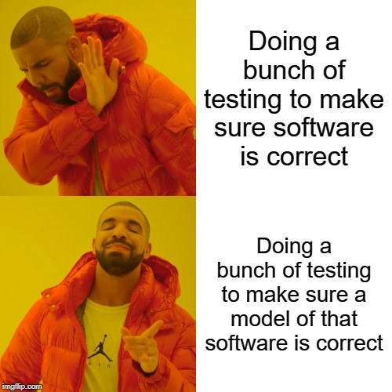
What you can walk away with:
Software models can be intimidating, but enable a really robust automated testing environment
If working with a non-traditional language, consider investing in unit testing
Thank you! Any questions?
Allison Sullivan
The University of Texas at Arlington
allison.sullivan@uta.edu
Doing a bunch of testing to make sure software is correct
Doing a bunch of testing to make sure a model of that software is correct
Sullivan: Proofreading the Proofreader
Notes:
Software models have a lingering stigma that they are hard to use and don’t scale
Scalability has been a focus of research and drastically improved – Amazon TLA+, SMT
“Hard to use” – less addressed, our solution is unit tests and beyond

