Slide 1
On the Theory and Practice of Vulnerability Remediation
Ariana Mirian
University of California, San Diego
April 26, 2023
Notes:
Hi folks, I’m super excited to be here today. My name is Ariana and I just defended my PhD at the University of California, San Diego
And so this work was possible in large part because of a collaboration with the IT team, where I’ve been working as an embedded security researcher within their operations team
My work has been broadly on understanding and improving security processes via large-scale measurement and today I’m going to talk about the theory and practice of vulnerability remediation
And a specific type of developer from a security lens: system administrators

Slide 2

Many organizations have moved infra to the cloud
Notes:
Many organizations, especially newer ones, have moved organizational infra into the cloud

Slide 3

But there are many orgs with legacy machines
Notes:
But not ALL orgs have done this – in fact, there are many orgs that have legacy machines, or bare metal, that are holding up pieces of infrastrcutre

Slide 4



Notes:
And so in an ideal world each piece of infrastructure in an organization is up to date security wise

Slide 5

Notes:
But the reality is that these disparate physical systems that can affect the safety posture of an organization have a large number of vulnerabilities that an attacker can utilize to get into the system and thus into the organization itself

Slide 6
Patching isn’t a new problem, but it persists
Notes:
Patching isn’t a new problem, but it persists
There are advents that have made patching an easier process, such as automation and outsourcing
And a lot of these advents optimize for the machine, not the human.

Slide 7
What if we tune the process for the human?
Notes:
What if we tuned this process for the human in the loop? What if we took the process and technologies that are being employed, and examine holistically how to make this process easier for the people to do their jobs? In other terms,

Slide 8
How can we make patching a more effective process?
Notes:
What if we tuned this process for the human in the loop? What if we took the process and technologies that are being employed, and examine holistically how to make this process easier for the people to do their jobs? So we asked this question in our organization, at UCSD. And in order to start addressing this problem, we have to

Slide 9
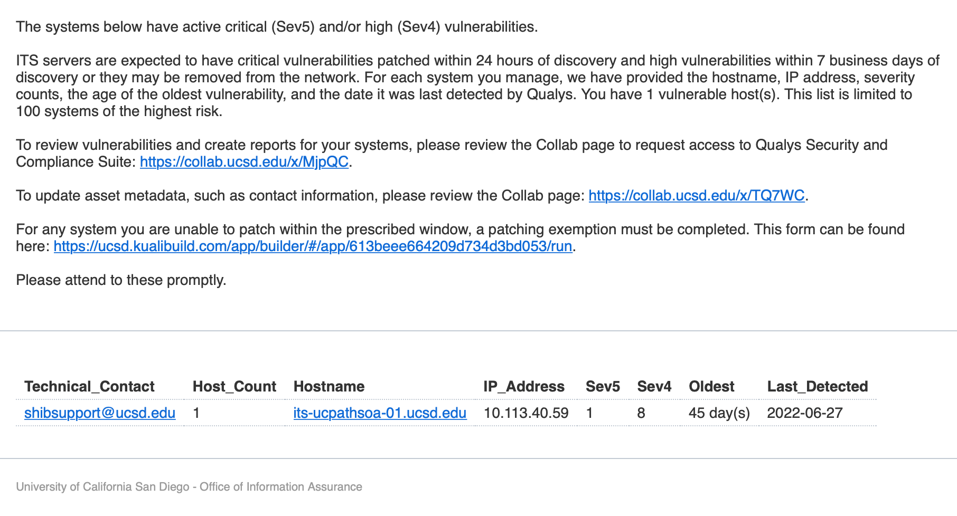
Weekly report meant to fill in gaps
Did not list vulnerabilities themselves
Required cognitive effort and time
Notes:
I started by tackling this first question and addressing the pipeline first. I worked with the security engineer to understand their former process and difficulties they faced. They were sending a weekly report that was meant to fill in the gaps and give people information, but the notification itself had a lot of key aspects that were inefficient.
For example, it didn’t list the servers or bugs, asked folks to log in, and was a long laundry lis
Looking at related work, I realized that there were a few small changes we could implement to try and effect more efficient patching – and by efficient I mean bring up the patch rate but also time to patch.
We changed it to focus only on one vuln, listed the vuln and it’s attributes, and also gave instructions on how to patch.

Slide 10
Weekly report meant to fill in gaps
Did not list vulnerabilities themselves
Required cognitive effort and time
Notes:
I started by tackling this first question and addressing the pipeline first. I worked with the security engineer to understand their former process and difficulties they faced. They were sending a weekly report that was meant to fill in the gaps and give people information, but the notification itself had a lot of key aspects that were inefficient.
For example, it didn’t list the servers or bugs, asked folks to log in, and was a long laundry lis
Looking at related work, I realized that there were a few small changes we could implement to try and effect more efficient patching – and by efficient I mean bring up the patch rate but also time to patch.
We changed it to focus only on one vuln, listed the vuln and it’s attributes, and also gave instructions on how to patch.

Slide 11
Old notification was not ideal
Did not list vulnerabilities or additional details
Required system admins to perform extra steps to get necessary information
Adds an amount of friction in order to execute

Slide 12
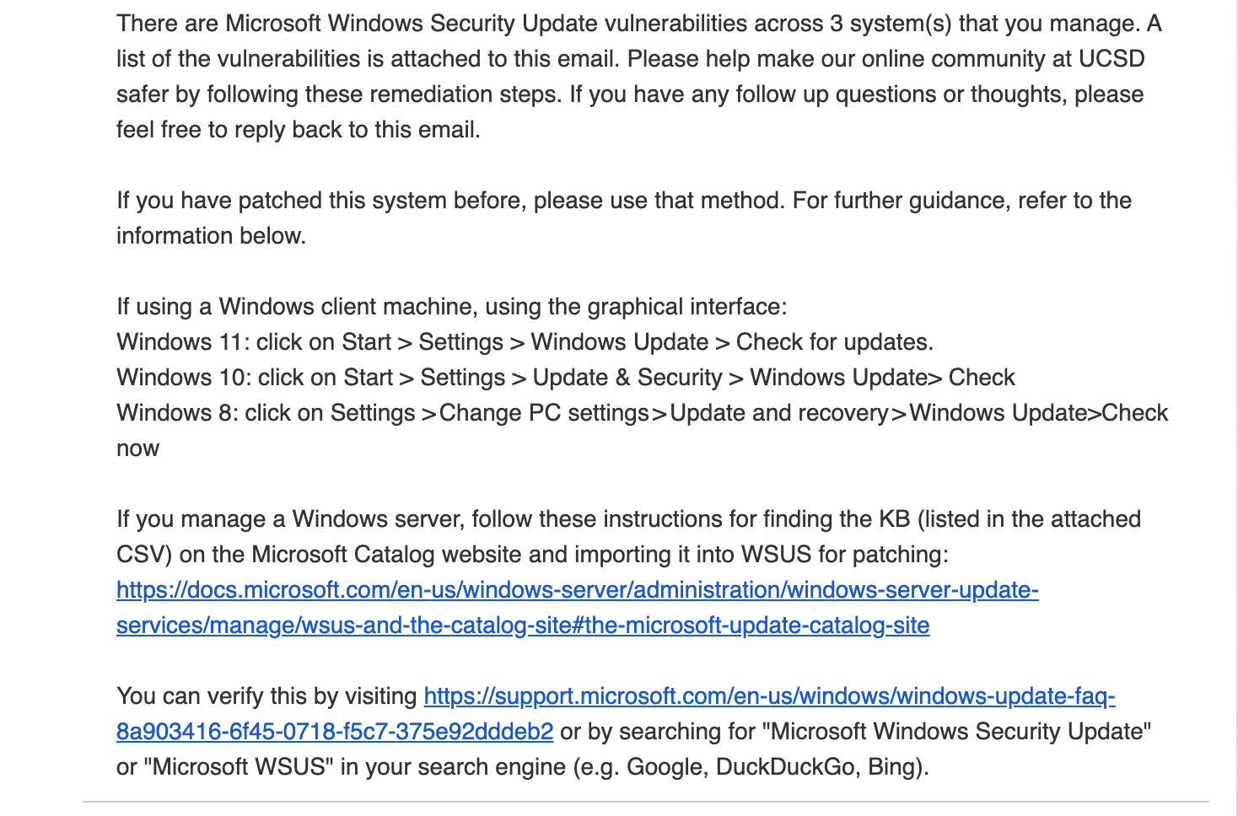

Slide 13
Notes:
Apply basic behavioral science principles to reduce cognitive load and increase chance for sys admin action

Slide 14
How do we make patching a more efficient process?
Examined old notification
Propose changes to reduce effort and time from system administrators
Craft new notifications
Actionable items
Focus on one vulnerability
List all machines and the vulnerability type in an attached CSV
Analyze subsequent data

Slide 15


Notes:
This answered the question of how to improve the process. But the next step was the measurement – working with the datasets available, I created a pipeline that can be automatically run to analyze in real time what the patch rate was for each contact, each vuln, each week. Aggregate is important but so are the detailts
TODO: graphic with multiple servers, then right side shows the increase
From there, we launched and saw that the patch rate went from 3% to X%
Now, each measurement study has it’s caveats. We didn’t have data from the old notifications beginning patch rate because the data had been deleted due to retention policies. So we were comparing a pretty stale notification (warning fatigue) to a new one. That being said, this was a huge improvement and got people’s attention.

Slide 16
Increase from 3% patching to 78%
Notes:
This answered the question of how to improve the process. But the next step was the measurement – working with the datasets available, I created a pipeline that can be automatically run to analyze in real time what the patch rate was for each contact, each vuln, each week. Aggregate is important but so are the detailts
TODO: graphic with multiple servers, then right side shows the increase
From there, we launched and saw that the patch rate went from 3% to X%
Now, each measurement study has it’s caveats. We didn’t have data from the old notifications beginning patch rate because the data had been deleted due to retention policies. So we were comparing a pretty stale notification (warning fatigue) to a new one. That being said, this was a huge improvement and got people’s attention.

Slide 17
Why was the patch rate ONLY at 78%?
Notes:
But this begged the question – why did the patch rate not INCREASE above 47%? We started to look at the data in different ways – for example, some contacts were consistently good at patching, so there could be targeted interventions. We found that certain vulns patched more than others, which could say something about the difficulty (and thus the support that sys admins needs)

Slide 18
Notes:
But this begged the question – why did the patch rate not INCREASE above 47%? We started to look at the data in different ways – for example, some contacts were consistently good at patching, so there could be targeted interventions. We found that certain vulns patched more than others, which could say something about the difficulty (and thus the support that sys admins needs)

Slide 19

Some contacts are much better at patching
Notes:
But this begged the question – why did the patch rate not INCREASE above 47%? We started to look at the data in different ways – for example, some contacts were consistently good at patching, so there could be targeted interventions. We found that certain vulns patched more than others, which could say something about the difficulty (and thus the support that sys admins needs)

Slide 20

Some contacts are much better at patching
Certain vuln families get patched more
Notes:
But this begged the question – why did the patch rate not INCREASE above 47%? We started to look at the data in different ways – for example, some contacts were consistently good at patching, so there could be targeted interventions. We found that certain vulns patched more than others, which could say something about the difficulty (and thus the support that sys admins needs)

Slide 21

Some contacts are much better at patching
Certain vuln families get patched more
Some vuln families take more time to patch
Notes:
But this begged the question – why did the patch rate not INCREASE above 47%? We started to look at the data in different ways – for example, some contacts were consistently good at patching, so there could be targeted interventions. We found that certain vulns patched more than others, which could say something about the difficulty (and thus the support that sys admins needs)

Slide 22
Conducted semi-structured interviews with system administrators to add qualitative view to quantitative data
Notes:
Lots of ways to analyze this with data, but we decided to introduce an additional method into this study and talk to the system administrators themselves in semi structured interviews.
This work is ongoing, but we found out that a lot of teams already have processes in place that mean they see the email, acknowledge it, and then wait until the monthly patch cycle, which makes sense.
BUt that didnt line up with our metric, which is did they patch within the two weeks between notifications. When we changed the metric to see if they patched within the month, it jumped up to X%.
Moreover, this interviews uncovered that many of these system administrators use the exception process, which is NOT build into this notification pipeline, which brought up a systemic mismatch between the two processes that could be more tightly coupled to bring harmony and have the metric be more accuate.
Not only improved the process, but uncovered systemic differences in infrastructure, and figured out what are the RIGHT metrics.
Lots of ongoing progress and hopefully more results in the next month or two as we finish our qualitative analysis of the interviews.

Slide 23
Conducted semi-structured interviews with system administrators to add qualitative view to quantitative data
Monotonicity of email made it easy to ignore
Many teams have exceptions
Notifications fall outside of their patch cycle
Notes:
Lots of ways to analyze this with data, but we decided to introduce an additional method into this study and talk to the system administrators themselves in semi structured interviews.
This work is ongoing, but we found out that a lot of teams already have processes in place that mean they see the email, acknowledge it, and then wait until the monthly patch cycle, which makes sense.
BUt that didnt line up with our metric, which is did they patch within the two weeks between notifications. When we changed the metric to see if they patched within the month, it jumped up to X%.
Moreover, this interviews uncovered that many of these system administrators use the exception process, which is NOT build into this notification pipeline, which brought up a systemic mismatch between the two processes that could be more tightly coupled to bring harmony and have the metric be more accuate.
Not only improved the process, but uncovered systemic differences in infrastructure, and figured out what are the RIGHT metrics.
Lots of ongoing progress and hopefully more results in the next month or two as we finish our qualitative analysis of the interviews.

Slide 24
Conducted semi-structured interviews with system administrators to add qualitative view to quantitative data
Positive sentiment towards new notification
Room for improvement/better integrations
Notes:
Lots of ways to analyze this with data, but we decided to introduce an additional method into this study and talk to the system administrators themselves in semi structured interviews.
This work is ongoing, but we found out that a lot of teams already have processes in place that mean they see the email, acknowledge it, and then wait until the monthly patch cycle, which makes sense.
BUt that didnt line up with our metric, which is did they patch within the two weeks between notifications. When we changed the metric to see if they patched within the month, it jumped up to X%.
Moreover, this interviews uncovered that many of these system administrators use the exception process, which is NOT build into this notification pipeline, which brought up a systemic mismatch between the two processes that could be more tightly coupled to bring harmony and have the metric be more accuate.
Not only improved the process, but uncovered systemic differences in infrastructure, and figured out what are the RIGHT metrics.
Lots of ongoing progress and hopefully more results in the next month or two as we finish our qualitative analysis of the interviews.

Slide 25
Increasing efficacy of patching
Applied basic principles to reduce work for sys admins
Increase patch rate from 3% to 78%
Interviews found positive sentiment towards new notification, and discrepancies in different systems
Notes:
Not only improved the process, but uncovered systemic differences in infrastructure, and figured out what are the RIGHT metrics.
Lots of ongoing progress and hopefully more results in the next month or two as we finish our qualitative analysis of the interviews.

Slide 26




Questions?
arianamirian.com
arianamirian28@gmail.com
@arimirian
@amirian@infosec.exchange
Notes:
TODO: fix formatting

Slide 27
On the Theory and Practice of Vulnerability Remediation
Ariana Mirian
University of California, San Diego
April 26, 2023
Notes:
Hi folks, I’m super excited to be here today. My name is Ariana and I just defended my PhD at the University of California, San Diego, where I work with Stefan Savage and Geoff Voelker.
My thesis work has been broadly on understanding and improving security processes via large-scale measurement and today I’m going to talk about

