Slide 1
Things Software Developers Should Learn about Learning
Lauren Margulieux
Associate Professor

Slide 2
This Talk is For…
Students and Junior Engineers
Engineers learning new tools or skills
Mentors
Recruitment and hiring
Developers of new tools

Slide 3
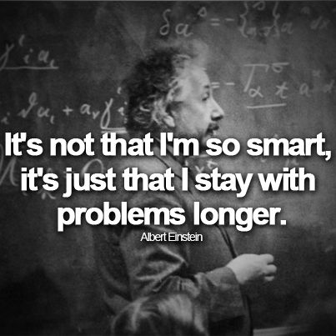
Experts Recognize, Beginners Reason
The value of expertise is pattern recognition
Takeaway: If beginners can’t do something now, practice identifying patterns and practice the component steps to automate them

Slide 4
Predictors of programming ability are unclear
Mindset: aptitude vs. practice
Failed predictors of aptitude
Prior experience
Personal Characteristics
Preferences
Best predictors related to rate of learning
Takeaway: Many perceived predictors of programming ability have no empirical evidence

Slide 5
Understanding a Concept Goes from Abstract to Concrete and Back
Takeaway: Cycle between abstract concepts and concrete examples to learn

Slide 6
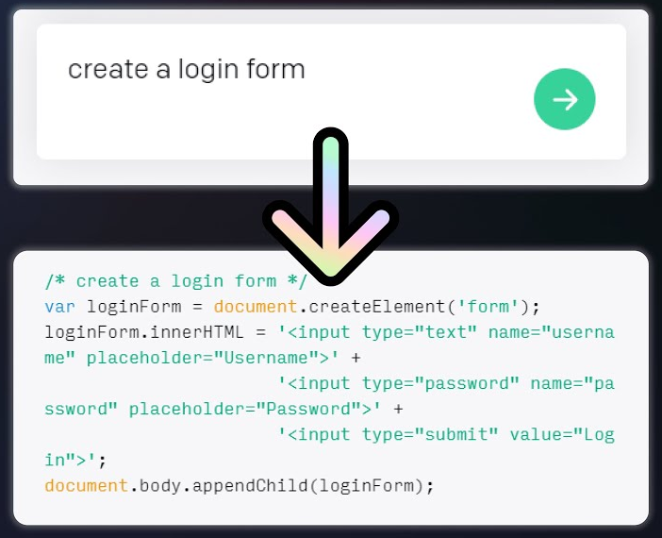
The Internet and AI Have Not Made Learning Obsolete
The Internet and generative AI (OpenAI Codex, GitHub Copilot) are good at low-level details, but using them has a cost
Takeaway: Developers still need to learn the conceptual information that is offloaded to tools

Slide 7

What You Can Do to Support Learning
Learners - Practice identifying and applying patterns
Hirers – Consider how you predict programming aptitude
Mentors - Provide concrete examples and abstract concepts
Mentees – Aggregate examples to discover underlying principles
Learn low-level skills before relying on AI tools

Slide 8
Paper coming soon to Communications of the ACM lmargulieux@gsu.edu

