Slide 1
Crafting Strong Identifier Names
Christian Newman & SCANL Lab

Slide 2
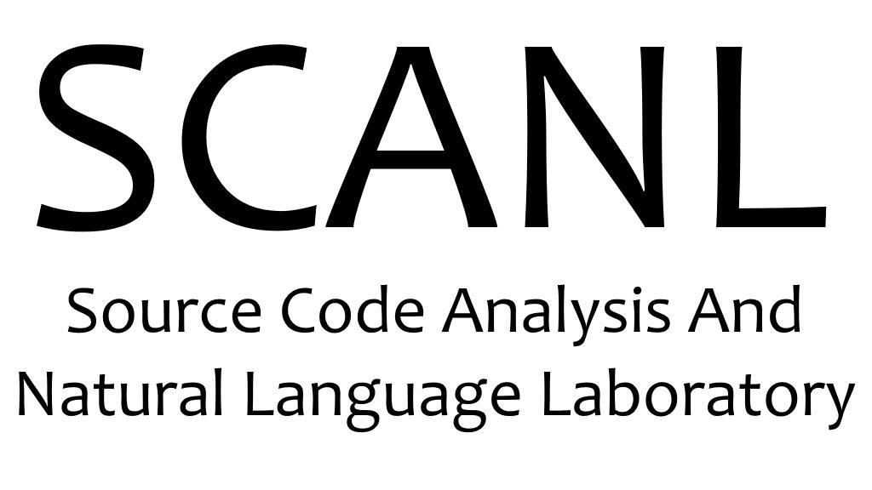
SCANL Lab
We study the latent connection between source code behavior and the natural language elements used to describe that behavior
Lab Founders: Christian D. Newman, Reem S. Alsuhaibani, Michael J. Decker, and Emily Hill
Members: Anthony Peruma, Tejal Vishnoi, Satyajit Mohapatra, Shimon Johnson, and Dishant Kaushik
Collaborators: Mohamed Wiem Mkaouer, Marcos Zampieri, Timothy J. Sheldon
For more information on our tools, datasets, and research:
https://scanl.org/
Notes:
My name is Christian Newman, I’m faculty in the Department of Software Engineering at Rochester Institute of Technology, and I’m the head researcher at SCANL lab.

Slide 3
Identifiers
boolean isArraysAreEquals()
void getVobs()
List<int> arru8NumberList
String to_string()
void sort()
long query_Timeout_In_Ms
String[] method_Name_Prefixes
bool is_First_frame
List<int> all_invocation_matchers
Notes:
Today I want to talk to you about identifiers. You can see some examples here on the slide– there’s quite a collection, but they should look familiar to you in a way. Some are 1 token, others have 2 or more tokens, some of them start with prepositions or verbs, some are method names, others function-local variable names. But the realy question I wanna ask you here is

Slide 4
Are they high-quality?
What makes an identifier high-quality?
Quality based on group naming conventions
Quality based on education
Quality based on who is doing the comprehending
Domain knowledge, programming knowledge, general experience
Quality is at least partially subjective
There are no objective quality metrics for identifiers
Notes:
Are these high quality?
I’m sure everyone has an opinion, or would if you saw more of the code, perhaps. But the fact is that we’d have to get people together and talk about it– there’s no objective way to say whether they’re good or not.
We have a lot of ways to estimate quality. Naming conventions, our experiences, our education, our understanding of the problem domain, etc. But let’s be honest, this is close to creative writing.

Slide 5
But we’ve all seen it
“pclHldr doesn’t make any sense, what is pcl??”
“Why does this use str, and it’s not a string?”
“Ugh hungarian notation is the worst”
“Why is this identifier named ‘a’???”
We know a bad identifier name when we see it.
Sometimes it’s bad enough to approach being objectively bad
Notes:
And yet, there’s something to a good name. We’ve all seen bad names– we know what we don’t like when we see it. Might even get into a debate about it, might even argue about what specifically makes it bad and disagree.

Slide 6
Metrics would be v.helpful
Program comprehension is critically important
Identifiers must be understood before any other coding activity
All developers rely on identifiers
Students and novices
Onboarding new developers
Experienced developers
Senior developers and architects
Everyone relies on program comprehension to learn, do their job, and express code behavior
Notes:
But comprehension is at the core of software development. Comprehending the code precedes every other activity from adding features to bug fixing to maintenance.
It’s critical that we have a way to ensure that the way we describe code behavior does not degrade comprehension.
Different groups of people will probably prefer different types of identifiers.
A new programming student, due to lack of experience with the language of software development, is looking at a foreign language.
Whereas an expert understands programming colloquialisms and idioms. The same difference can be seen between domain experts and domain novices.
If we want this metric to be useful– who is this code intended for? Who is reading it?
Software dev language in code is a foreign language

Slide 7
What makes this hard?
We (developers) invented our own sub-language
Identifiers follow a non-standard human language grammar
And to top it off? It’s ~70% of the code
We have a sub-language that was not designed, but evolved
We didn’t design this language, but we did create it
And evolve it to a changing environment, just like software

Slide 8
What needs to be done?
Study the sub-language used by software developers
We need a full, written understanding of its structure and rules
Formally measure and describe identifier quality
Combine measurements to create an explainable metric
Use our understanding of both to support identifier name creation, appraisal, and maintenance
Notes:
So given the problems I just described, what do we need to do? Well, we need to understand how different identifier characteristics influence human and machine comprehension. We need a way to use these measurements to explain what is wrong, or right, about an identifier. And we need to turn these measurements into a metric that can provide us with an objective measure of quality– for humans or for machines.
And lets be clear, this can be helpful for machines, too. An AI, or code analysis tool, still needs to read and understand what it’s looking at, and the quality of the code will influence the quality of answers produced by these approaches.

Slide 9
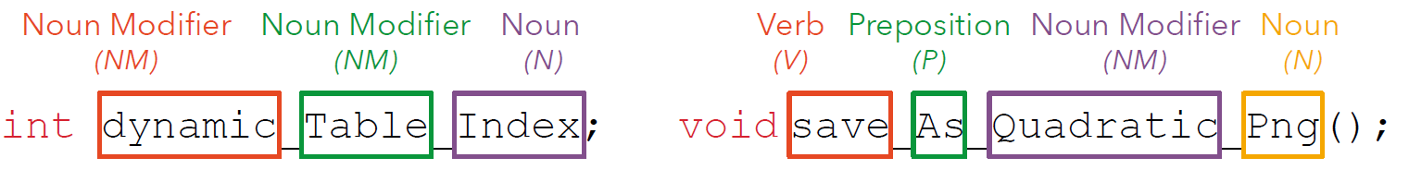
Grammar Patterns
Split identifier into its constituent words, apply a specialized part of speech tagger to the words as if they were a sentence
NM NM N
V P NM N

Slide 10
Name structure catalogue
We created a catalogue of identifier naming structures:
https://github.com/SCANL/identifier_name_structure_catalogue
This a glimpse of the sub-language we have been discussing
These are some of the basic natural language phrasal structures that we, as developers, have created
Notes:
We did a study that generated a taxonomy of these patterns. Let’s take a quick look.

Slide 11
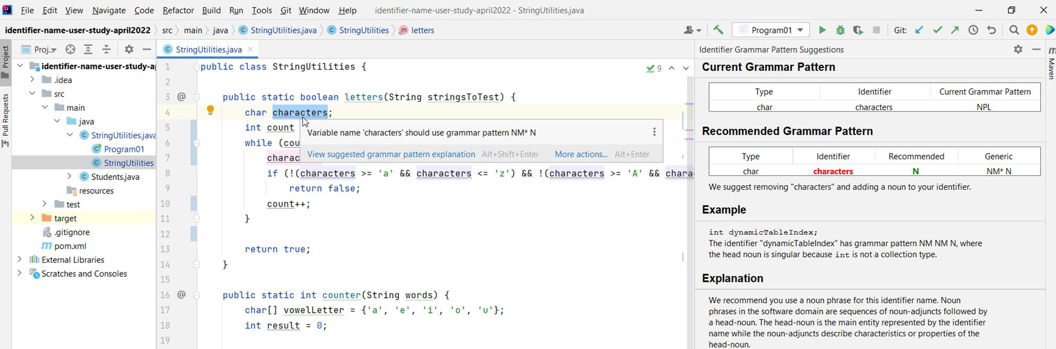
A Tool for Developers
Notes:
Now that you understand what these patterns are, we’ve built them into an IntelliJ tool. This tool analyzes identifiers, gets their grammar pattern, and recommends when the grammatical structure of the identifier can be improved by using a different pattern that is more typically associated with the behavior of the surrounding code. As a simple example, in this window, you can see an identifier called ‘characters’. Our tool is recommending that the developer remove the plural noun and replace it with a singular noun, since the type, which is char, is singular– that is, it’s not a collection type.
On the right you can see that the tool explains its reasoning and gives examples to help a developer make the right decision. Unlike other recommendation approaches, which just recommend an answer, our approach asks developers to think critically about our recommendation so that if they believe our reasoning is bad, they can reject the recommendation based on data. Or if they think it’s good, they’ll be able to explain why it’s good– because we have provided them with an explanation.

Slide 12
Future Work
Goal 1: Fully explore the diversity of grammar patterns
And, thus, gain a formal understanding of the language of software
Goal 2: Create data-driven naming guidelines
A set of measurements that are used to create a naming metric
Requires many, many human subjects trials
Goal 3: Create a framework for optimizing names
Prioritize ease of comprehension for the reader
Prioritize explainability
Approach optimal comprehensibility
Goal 4: Educating developers at all levels

Slide 13
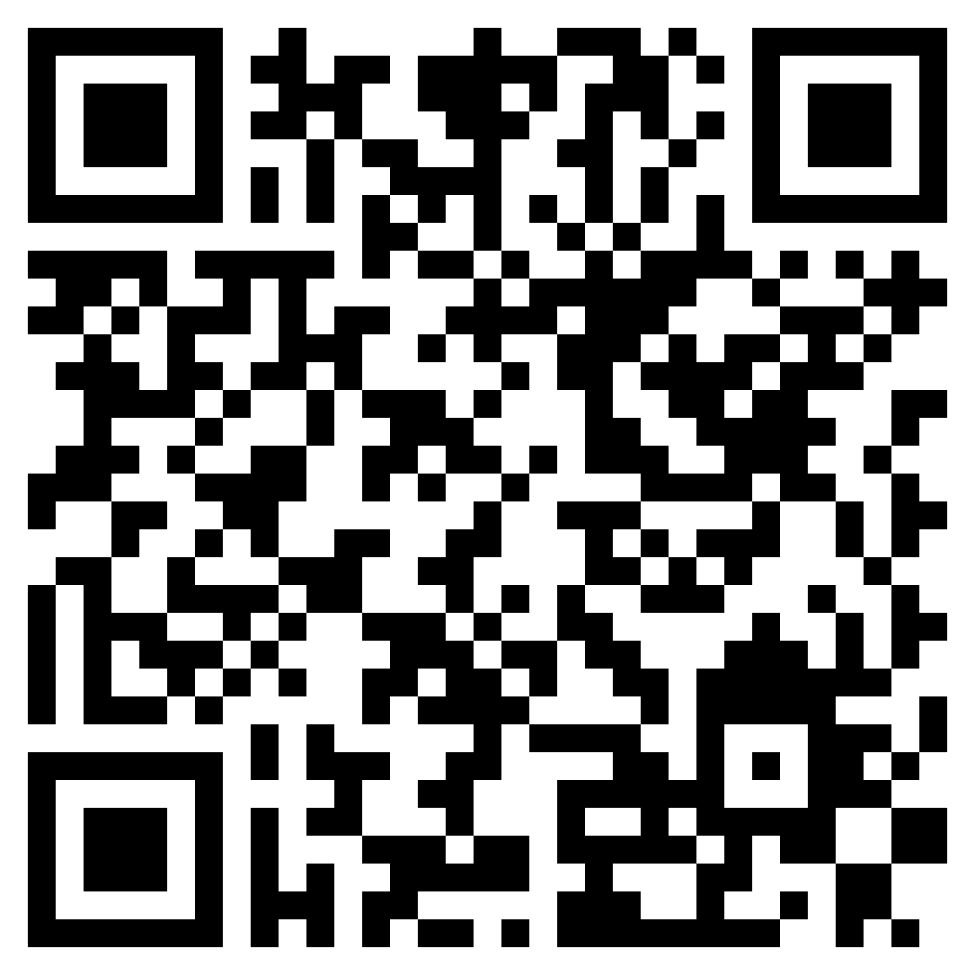
Questions?
You can find more at our webpage!
https://www.scanl.org/
The catalog is on GitHub and is public data
https://github.com/SCANL/identifier_name_structure_catalogue
IntelliJ prototype is also open
https://github.com/SCANL/IDEAL
Contact:
cdnvse@rit.edu

Slide 14
Our work so far
One of our more recent contributions is in the idea of grammar patterns
A way to measure, express, and comprehend identifier meaning and characteristics using part-of-speech tag sequences
Allow us to study high-level identifier naming patterns and semantics
Provide insight into the language of software devs
Notes:
So my lab has been doing a lot of ground work for solving the overall problem of creating a metric. I want to introduce you to one of the results that we have in the form of grammar patterns.
Grammar patterns are a way to describe, at a high level, the grammatical structure of identifiers and how these structures map to program behavior and developer comprehension

Slide 15
Most importantly
We need a formal understanding of how identifier characteristics influence comprehension.
This has to take into account varying levels of experience
Doing so will allow us to provably support comprehension for anyone (even machines) despite experience level.

Slide 16
How does this help?
Grammar patterns highlight the semantics identifiers
We can tie these semantics to a coding context, such as event-driven code, or code that computes type conversions
Grammar patterns allow us to explain
We know what the pattern means, and can explain how it is typically used by developers.
When we recommend a pattern, we recommend it with a reason; this reasoning can be used to approve, or reject, a recommendation
Grammar patterns are a measurable structure
We can measure the effectiveness of different patterns for comprehension tasks
Notes:
In contrast with linters, which are only concerned with lexical structure, or AI which is black box prediction that is not explanable.

Slide 17
Why are they important?
Identifiers must be understood before any other coding activity
Fixing bugs, adding features, cleaning, refactoring, patching
Difficult to measure the influence of identifiers on comprehension
For humans OR for automated tools (e.g., AI)
Many techniques use identifier information
Identifiers are a threat to validity
Can we trust techniques/research that leverage identifiers if we can’t reason about (measure) the quality of identifiers they will be using?
Problem can’t be solved using AI
Developers may just assume that predictions are always correct
Exacerbated because the AI can’t explain itself and we cannot measure identifier quality
Notes:
Can we trust these techniques when the underlying information they are using can vary in quality and we cannot measure that quality easily? If a technique, or a research study, relies on identifier name information, can it be trusted if the identifiers it relies on may vary in quality between systems and we cannot measure or control for this quality?

Slide 18
How does this help?
We need a way to deal with the semantics (i.e., meaning) of the identifier within its coding context
Grammar patterns improve the semantic quality
We can use them to understand both meaning and structure
We can explain why we are recommending a grammar pattern
We can measure comprehension improvements using grammar patterns, which is currently very hard to do without them
They help us understand correctness of the name
Linters only deal with lexical information
Purely AI approaches are not explainable

Slide 19
Identifier Naming
Identifier names
Function, class, function-local, parameter, attribute, global variables
On average, 70% of the characters in code are in identifier names
Identifier naming is a largely unresolved problem
No way to objectively measure quality, very little understanding of how identifiers and their characteristics influence comprehension
“Bad” names slow comprehension, cause developers to introduce bugs or other problems into the code due to misunderstanding
Identifiers have a unique phrasal structure
They don’t follow the same rules as human language
Off-the-shelf NLP techniques underperform on identifiers

