Slide 1
Process-Aware Authenticity Detection
in Supervised Programming Labs
Catching live, in-person proxy-typing that no current attendance
or plagiarism system is built to detect
M.Tech Research Proposal · Rohandeep, M.Tech CSE · IIIT Surat

Slide 2
THE PROBLEM
Labs Verify Presence, Not Authorship
A friend can sit in for 45 minutes and type live at a classmate's terminal, in full view
of an instructor — and no current system is built to catch it.
✅ Verified today
❌ Not verified
Physical identity & presence
ID card · biometric · face match · RFID
Authorship of the code being typed, live,
in that same session
This proposal asks a narrow, previously unasked question: once a student is physically
present and identity-verified, is anyone checking that the hands on the keyboard are theirs?
2

Slide 3
LITERATURE LANDSCAPE
Two Active Research Threads
Thread 1 — Process-Driven Authenticity Detection
Thread 2 — Physical Proxy Attendance Detection
• Targets: take-home, asynchronous cheating
• Signal: keystroke timing, edit sequences
• Adversary: a student alone, unlimited time, disguising an LLM answer
• Key work: Nosi IDE (2026) · keystroke-dishonesty papers (2025) · Crossley et al. (2024) · CodeBench
• Targets: impersonation at check-in
• Signal: face match, RFID, weight sensors, biometrics
• Adversary: someone else physically checks in on your behalf
• Key work: Ege & Özdemir (2026, RFID+weight) · facial-recognition CCTV · NFC/biometric check-in
Neither literature covers a student who is physically present and identity-verified, while someone else does the actual coding live, under supervision.
3

Slide 4
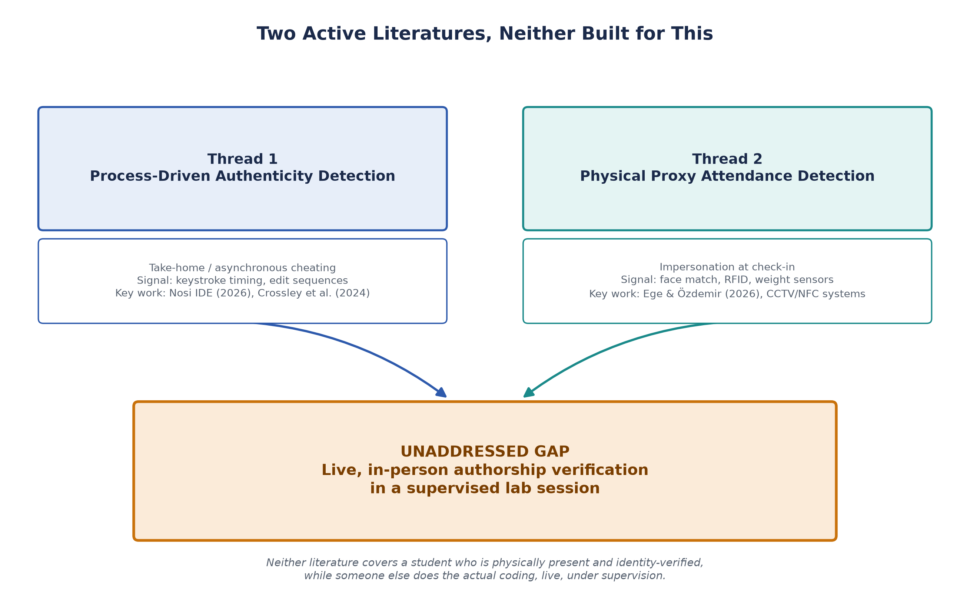
RESEARCH GAP
The Unaddressed Intersection
4
4

Slide 5
LITERATURE SURVEY
What's Confirmed, What's Still Open
CodeBench collected fine-grained data from 2,058 students,
16 CS1 courses
✅ Confirmed
Sequential/clustering analysis of programming trajectories
predicts learning outcomes
✅ Confirmed
AST-evolution / structural-jump detection for pasted code
as a live, single-session anomaly signal
⚠️ Open application
Proxy-attendance research uses IDE process data
❌ Not found — confirms the gap
5

Slide 6
COMPARATIVE ANALYSIS
Where the Proposed Study Sits
Dimension
Process-Driven Work
(Nosi IDE, keystroke papers)
Attendance Systems
(RFID / biometric)
Proposed Study
Adversary model
Solo student, at home,
unlimited time
Someone else checks
in for you
Someone else types for
you, live, in the room
Setting
Take-home / asynchronous
Entry checkpoint only
Supervised, in-session lab
Signal
Keystroke IAT,
edit sequences
Face / RFID / weight
Keystroke IAT + edit
sequence + AST jumps
Ground truth
N=5 proof-of-concept
(Nosi)
Sensor accuracy
benchmarks
Controlled in-lab groups:
genuine/proxy/minimal
6

Slide 7
THE QUESTION
Research Question
Can IDE-level process signals — keystroke timing, edit/execution
sequences, and structural code jumps — distinguish a student's own
authentic in-lab work from proxy-typed or minimally-engaged work, and
do they generalize better or worse than the equivalent signals already
shown to detect take-home LLM-scribing?
This positions the thesis directly against Lueder et al. (2026, Nosi IDE) and the 2024–25 keystroke-dishonesty line of work — extending them into an untested adversary setting rather than re-deriving their framing. Either outcome (the signals transfer, or they don't) is a publishable result.
7

Slide 8
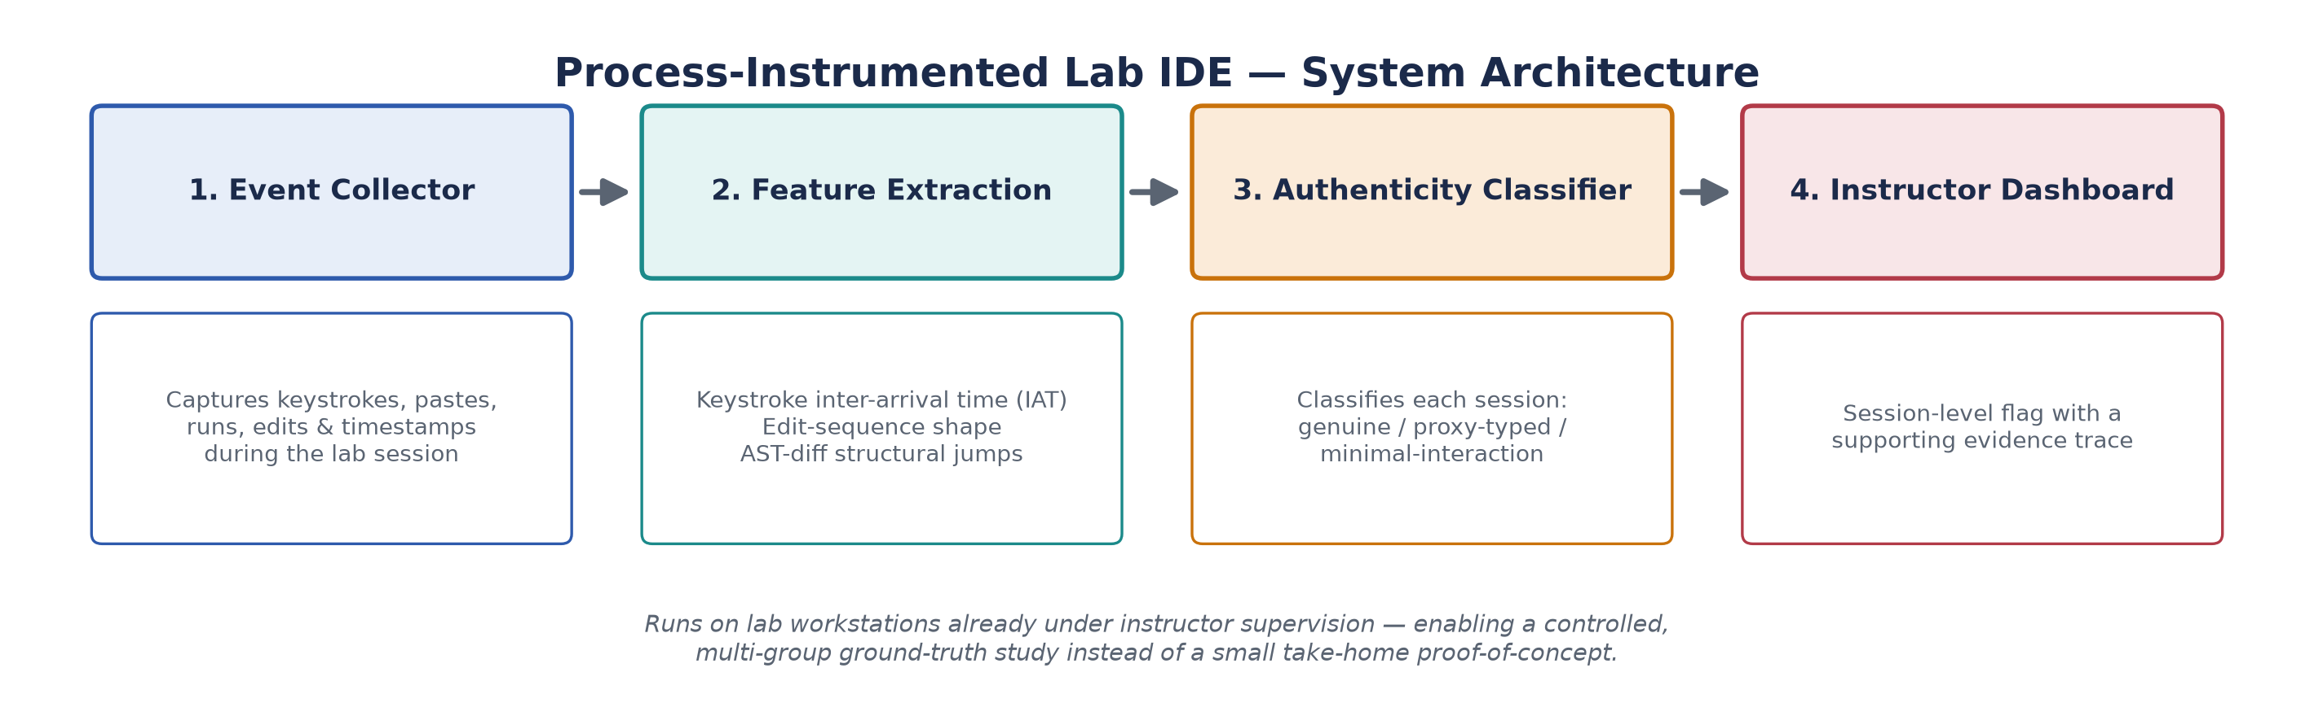
PROPOSED METHODOLOGY
System: A Process-Instrumented Lab IDE
Key design choice: unlike Nosi IDE (encrypted, take-home, N=5), this system runs on lab workstations already under instructor supervision.
8

Slide 9
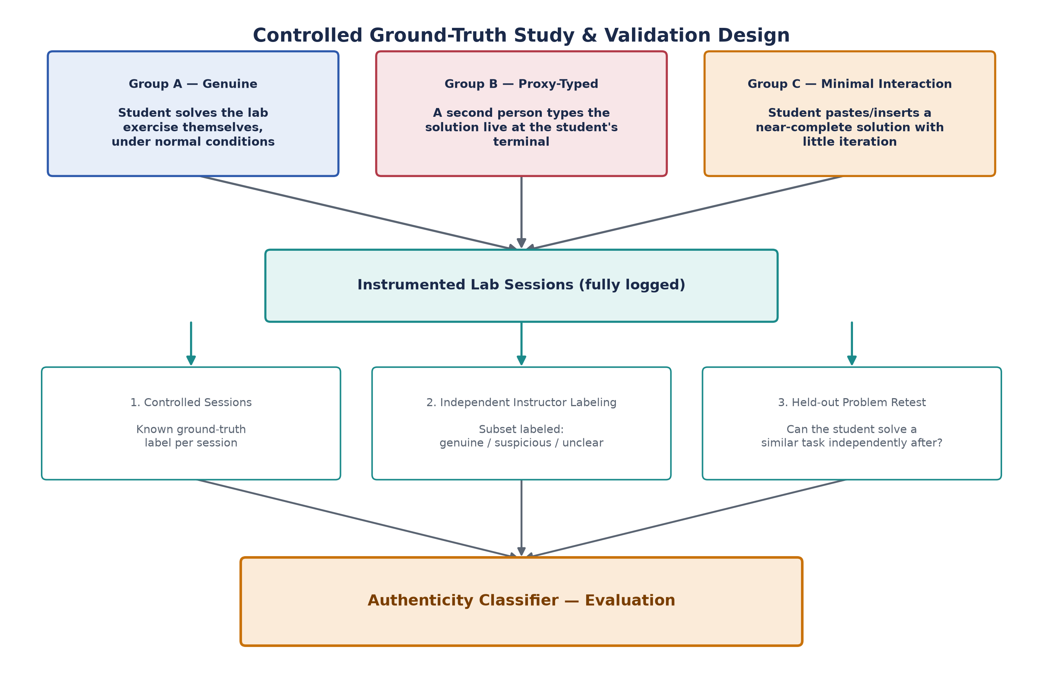
PROPOSED METHODOLOGY
Controlled Ground-Truth Study Design
9

Slide 10
METHODOLOGY
Ethics & Scope Discipline
Ethics Note
Scope Discipline
• Keystroke logs can act as a biometric identifier
• Requires a de-identification plan before any deployment
• IRB / ethics approval required before deployment
• Any published dataset needs the same safeguards discussed in prior keystroke-data surveys
• Original pitch suggested 5 parallel research models across 100–300 students for 8–12 weeks — multiple papers' worth
• This thesis scopes to ONE defensible contribution: the controlled authenticity-classification study
• Engagement modeling & learning-outcome prediction are labeled future work, not promised deliverables
10

Slide 11
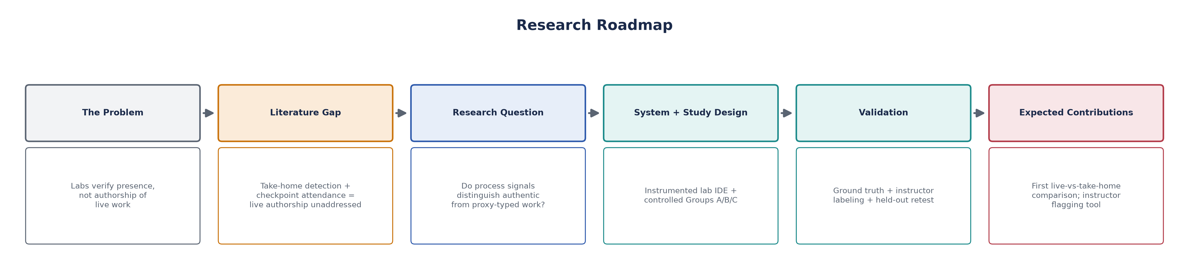
PUTTING IT TOGETHER
Research Roadmap
11

Slide 12
CONTRIBUTIONS
Expected Contributions
1
First controlled comparison of take-home authenticity signals (keystroke IAT) against a live, in-person proxy-typing adversary
2
A ground-truth methodology using in-lab controlled groups instead of small asynchronous proof-of-concept studies
3
An empirical answer to whether existing keystroke/process features transfer across adversary settings — a positive or a null result both add value
4
A scoped, deployable instructor-facing flagging tool for supervised programming labs specifically (distinct from Nosi's take-home use case)
12

Slide 13
Thank You
Questions & Discussion
Rohandeep, M.Tech CSE · IIIT Surat

