Slide 1
Clean India Healthy India
Team Name- GITCODERS
Team Members
1. Samarth Goel
2. Rajat Jain
3. Harshit Agarwal
4. Kanishka Tyagi
Product Name- Clean-o-Bot

Slide 2
Key Concepts
Types of Urban Waste
Idea
Preventing waste
Methods of dealing with IOT
Hazardous waste regulation in the India

Slide 3
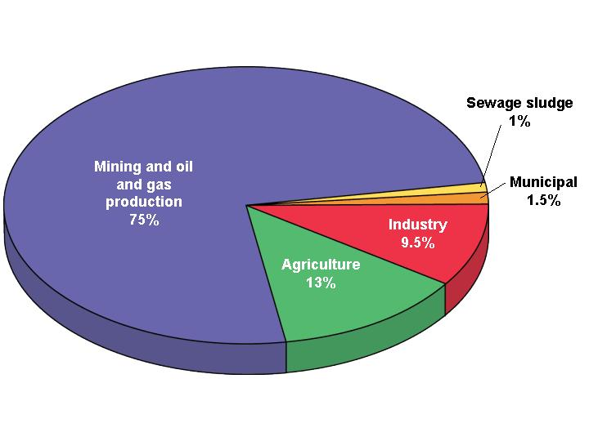
Wasting Resources
India : 11 billion metric tons/year of waste
Mining waste
Agricultural waste
Industrial waste
Municipal solid waste (MSW)
Sewage sludge

Slide 4

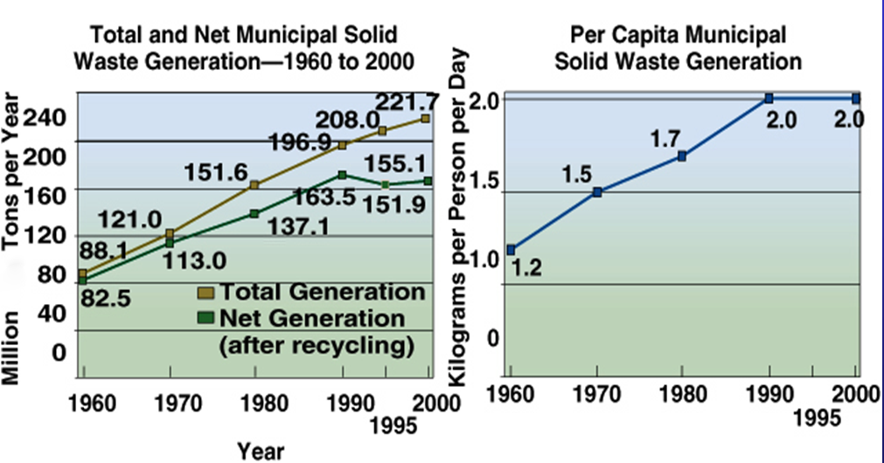
India Solid Waste since 1960

Slide 5
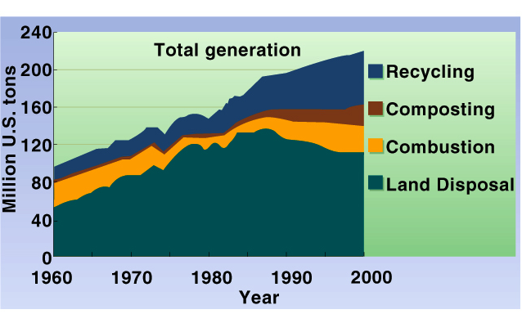
Waste Disposal Methods

Slide 6
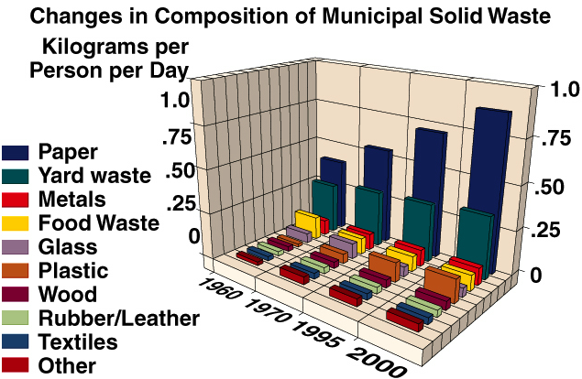
What’s in our trash?

Slide 7
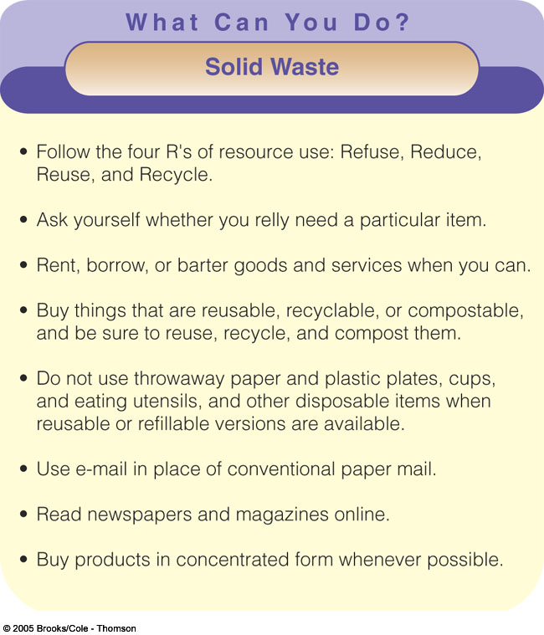

Slide 8
Our Idea
Compactor trucks collect the waste from public waste pits which are equipped with ultrasonic and ldr(Light Dependent resistance) sensors. The sensors tell the department the percentage of refuse in the public waste pit. A machine learning model is employed to schedule the order of visit of the waste compactor truck such that the total distance covered is minimized.
Users can track the waste truck in real time. They also get app notifications reminding them of the arrival of the waste collection truck.

Slide 9
But is it worth it?
People may argue that it is costly to provide these waste bins. So lets reveal the price of Ultrasonic and LDR sensors.
LDR--- Rs 50
Ultrasonic Sensors –Rs 30
Thus these dustbins can also be installed at private places because dustbins are available at a fair price of Rs 200.

Slide 10
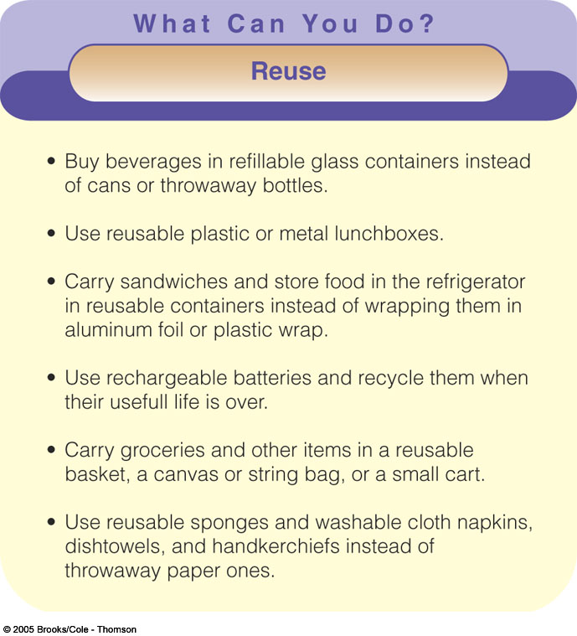

Slide 11
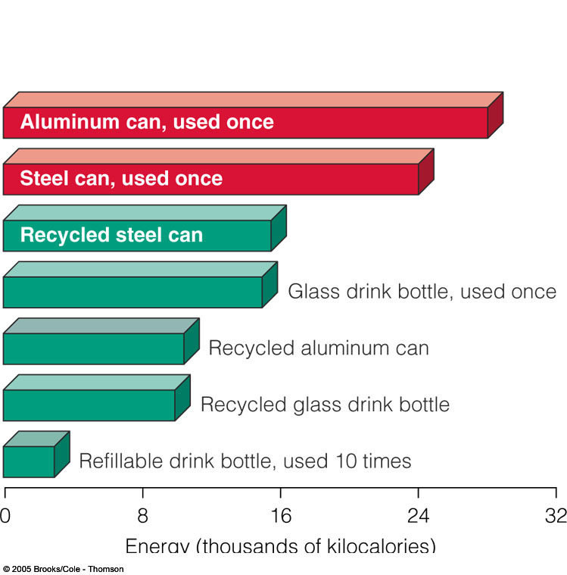
Recycling
Primary (closed-loop)
Secondary (open loop)
Pre-consumer waste
Post-consumer waste

Slide 12
Characteristics of Recyclable Materials
Easily isolated from other waste
Available in large quantities
Valuable

Slide 13
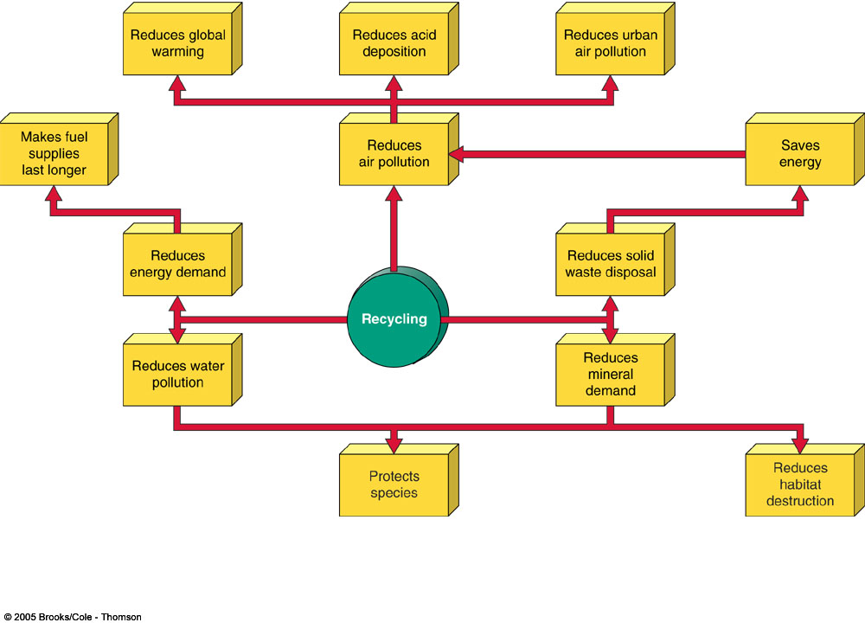
Benefits of Recycling

Slide 14
IT AND IOT
Iot contributes a lot for our idea. Our project can be connected to the Alexa / Google Home to provide real time notifications to the user. Also daily sensors input are checked so as to ensure that each bin have their sensors working . If for some reason a sensor is not working , steps could be taken for sensor replacement.

Slide 15
A Token Of

