Slide 1

Edge AI-Driven Stealth Drone for Autonomous Object Following
Aravindhan K[CH.EN.U4CYS22001]
Mithun R [CH.EN.U4CYS22032]
Dr. Prabu M

Slide 2
Introduction / Background
UAVs are widely used in surveillance, monitoring, and robotics
Traditional drones rely on manual control and human decision-making
Limited scalability and real-time adaptability
Need for autonomous systems with intelligent behavior.
Rise of Edge AI enables real-time processing on local devices
Models like YOLO allow fast object detection
Vision-based tracking works without GPS dependency
Wireless control introduces security risks like spoofing and injection

Slide 3
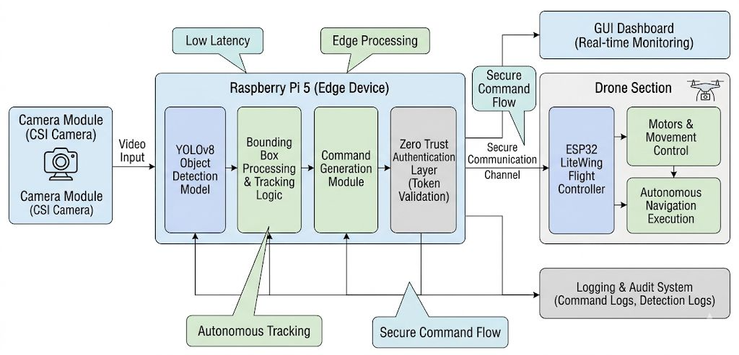
Architecture Diagram

Slide 4
Problem Identification & Statement
High latency due to cloud communication affects real-time tracking
Limited ability to handle dynamic environments like fast motion or occlusion
Lack of intelligent decision-making at the device level
Cloud-dependent architectures reduce reliability in unstable network conditions
Absence of edge intelligence limits responsiveness and adaptability
Weak or no implementation of secure command validation
Need for a system that combines low-latency Edge AI, autonomous control, and Zero Trust security

Slide 5
Our Solution
Feature | Description | Impact
Edge AI Vision Module | Real-time "YOLO-based detection" on "Raspberry Pi" without cloud dependency.. | Enables "low-latency" and reliable real-time tracking.
Autonomous Tracking Logic | Uses "centroid-based tracking" to generate movement commands | Provides "smooth autonomous following" with minimal manual control.
Zero Trust Command Validation | Applies "token-based validation" to verify all commands. | Ensures "secure operation" and prevents unauthorized control.
Secure Communication Pipeline | Uses a "validated communication channel" between edge device and drone. | Ensures "safe command transmission" and reduces spoofing risks

Slide 6
Project Demo

Slide 7
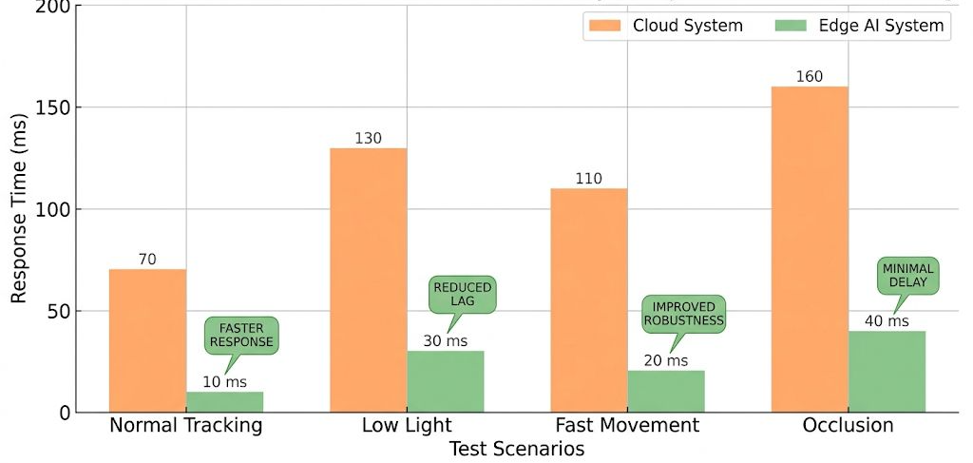
Evaluation

Slide 8
THANK YOU!!!

