Slide 1
Concurrency Utilities in Practice
Using java.util.concurrent
Joe Bowbeer
UIEvolution, Inc.
Tim Peierls
Prior Artisans, LLC

Slide 2
Goals
Review concurrency utilities
Present several applications
Measure and evaluate performance

Slide 3
Speakers
  Joe Bowbeer and Tim Peierls are both members of the JSR 166 Expert Group

Slide 4
Agenda
Concepts TS-1358
Brief Review
Examples — lots of code!
Q & A

Slide 5
Examples
PseudoRandom
MemoFunction
SwingWorker
BoundedBuffer
WebCrawler

Slide 6
Concurrency Utilities
Executors
  Executor
  ExecutorService
  ScheduledExecutorService
  Callable
  Future
  ScheduledFuture
  Delayed
  CompletionService
  ThreadPoolExecutor
  ScheduledThreadPoolExecutor
  AbstractExecutorService
  Executors
  FutureTask
  ExecutorCompletionService
Queues
  BlockingQueue
  ConcurrentLinkedQueue
  LinkedBlockingQueue
  ArrayBlockingQueue
  SynchronousQueue
  PriorityBlockingQueue
  DelayQueue
Concurrent Collections
  ConcurrentMap
  ConcurrentHashMap
  CopyOnWriteArray{List,Set}
Synchronizers
  CountDownLatch
  Semaphore
  Exchanger
  CyclicBarrier
Timing
  TimeUnit
Locks
  Lock
  Condition
  ReadWriteLock
  AbstractQueuedSynchronizer
  LockSupport
  ReentrantLock
  ReentrantReadWriteLock
Atomics
  Atomic[Type]
  Atomic[Type]Array
  Atomic[Type]FieldUpdater
  Atomic{Markable,Stampable}Reference

Slide 7
Caveats
Access modifiers omitted unless relevant
InterruptedException abbreviated as IE
Most interrupt handling omitted for brevity, but very important in real life!
Irrelevant methods, fields, and arguments elided with “…”

Slide 8
Review: Lock
Ensure consistency by exclusion
Lock acquisition/release enforces exclusion
      interface Lock {
      void lock();
      void lockInterruptibly() throws IE;
      boolean tryLock();
      boolean tryLock(long timeout, TimeUnit unit)
      throws IE;
      void unlock();
      …
      }
Notes:
Callable doesn't leave room for arguments, so it is normally implemented as an inner class

Slide 9
Review: Atomic
Ensure consistency by atomic CAS
      class AtomicInteger extends Number
      implements Serializable {
      boolean compareAndSet(int expect, int update) {…}
      boolean weakCompareAndSet(int expect, int update){…}
      int get();
      int getAndSet(int newValue) {…}
      int getAndAdd(int delta) {…}
      int addAndGet(int delta) {…}
      int getAndIncrement() {…}
      int getAndDecrement() {…}
      int incrementAndGet() {…}
      int decrementAndGet() {…}
      }
Notes:
Callable doesn't leave room for arguments, so it is normally implemented as an inner class

Slide 10
Review: CountDownLatch
Coordinate thread activity
Waiting threads are released when count becomes 0
      class CountDownLatch {
      void countDown();
      void await() throws IE;
      void await(long timeout, TimeUnit unit)
      throws IE;
      long getCount();
      …
      }
Notes:
Callable doesn't leave room for arguments, so it is normally implemented as an inner class

Slide 11
Review: Executor
Decouple task submission from execution
Executor executes submitted tasks
      interface Executor {
      void execute(Runnable task);
      }
Executors consists of static factory and utility methods
      class Executors {
      ExecutorService newFixedThreadPool(int nThreads) {…}
      ExecutorService newCachedThreadPool() {…}
      …much more…
      }
ExecutorService extends Executor
  Reviewed later on
Notes:
Callable doesn't leave room for arguments, so it is normally implemented as an inner class

Slide 12
PseudoRandom Example
Overview
PseudoRandom: subset of j.u.Random API
A simple but broken implementation
Reimplement PseudoRandom in different ways
Exercise the implementations
Compare their performance

Slide 13
PseudoRandom Example
PseudoRandom: subset of java.util.Random API
interface PseudoRandom {
int nextInt(int n);
}

Slide 14
PseudoRandom Example
A simple but broken implementation
class NaivePseudoRandom implements PseudoRandom {
public int nextInt(int n) {
int s = seed; seed = computeNext(seed);
return s % n;
}
int computeNext(int s) { return …; }
int seed = …;
…
}

Slide 15
PseudoRandom Example
Fixed using synchronized
class PseudoRandomUsingSynch
implements PseudoRandom {
public synchronized int nextInt(int n) {
int s = seed; seed = computeNext(seed);
return s % n;
}
int computeNext(int s) { return …; }
int seed = …;
}

Slide 16
PseudoRandom Example
Better fix using Lock
class PseudoRandomUsingLock
implements PseudoRandom {
public int nextInt(int n) {
lock.lock();
try {
int s = seed; seed = computeNext(seed);
return s % n;
} finally {
lock.unlock();
}
}
int computeNext(int s) { return …; }
int seed = …;
final Lock lock = new ReentrantLock(true);
}

Slide 17
PseudoRandom Example
Even better fix using AtomicInteger
class PseudoRandomUsingAtomic
implements PseudoRandom {
public int nextInt(int n) {
for (;;) {
int s = seed.get();
int nexts = computeNext(s);
if (seed.compareAndSet(s, nexts))
return s % n;
}
}
int computeNext(int s) { return …; }
final AtomicInteger seed = new AtomicInteger(…);
}

Slide 18
PseudoRandom Example
Exercise the implementations
ShuffleTask repeatedly shuffles a card deck
Coordinate tasks with CountDownLatch
Use Executor to run several ShuffleTasks
Time multiple trials of each implementation
Test methodology disclaimer
Results

Slide 19
PseudoRandom Example
Coordinate tasks with CountDownLatch
final int LOOPS;
final Random rnd = …;
final CountDownLatch startSignal = …;
final CountDownLatch doneSignal = …;
class ShuffleTask implements Runnable {
// Card implements Comparable<Card>
List<Card> deck = …;
public void run() {
startSignal.await();
for (int i = 0; i < LOOPS; ++i)
Collections.shuffle(deck, rnd);
doneSignal.countDown();
} /* IE handling omitted */
};

Slide 20
PseudoRandom Example
Use Executor to run several ShuffleTasks
final Executor exec =
Executors.newFixedThreadPool(NTHREADS);
long trial(final int LOOPS, final PseudoRandom r) {
final Random rnd = PseudoRandomUtils.adapt(r);
… startSignal = new CountDownLatch(1);
… doneSignal = new CountDownLatch(NTHREADS);
class ShuffleTask {…from previous slide…}
for (int j = 0; j < NTHREADS; ++j)
exec.execute(new ShuffleTask());
Thread.sleep(100, TimeUnit.MILLISECONDS);
long start = System.nanoTime();
startSignal.countDown(); // release tasks
doneSignal.await(); // wait ‘til done
return System.nanoTime() – start;
} /* IE handling omitted */

Slide 21
PseudoRandom Example
Time multiple trials of each implementation
interface Factory<Product> {
Product newInstance(Object... args);
String productName();
}
Collection<Factory<PseudoRandom>> impls = …;
int SEED = …; // initial seed value
int TRIALS = …; // #trials per implementation
int LOOPS = …; // #loops per trial
for (Factory<PseudoRandom> impl : impls) {
long nanos = 0;
for (int k = 0; k < TRIALS; ++k) {
nanos += trial(LOOPS, impl.newInstance(SEED));
nanos /= TRIALS * LOOPS;
System.out.println(impl.productName()+” ”+nanos);
}

Slide 22
PseudoRandom Example
Test methodology disclaimer
Results obtained from one machine
Only used one JVM (HotSpot -client)
Many other things could affect results:
  Packing of fields on objects
  Cache locality of generated code
  Thresholds for native compilation
  Background user and system processes
  Other thread interactions
PseudoRandom implementations are not necessarily fair

Slide 23
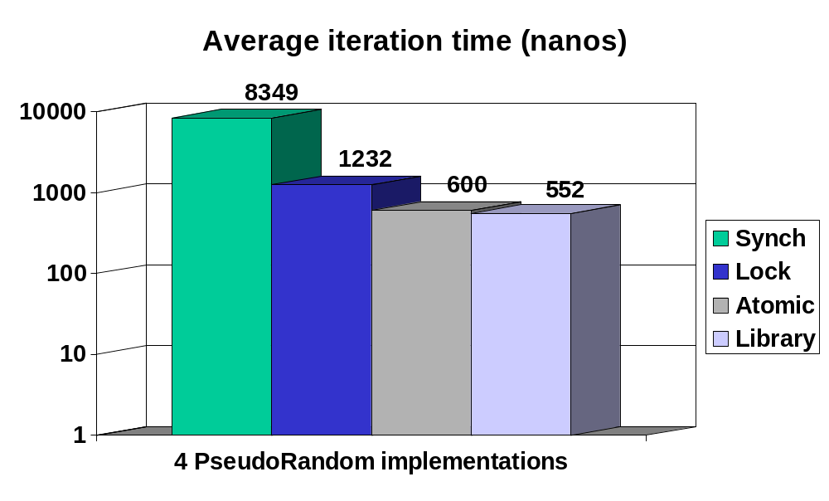
PseudoRandom Example
Results on 3.2 GHz Pentium 4, -client (Windows)

Slide 24
Review: Callables and Futures
Representing asynchronous tasks
Callable is invoked and returns a value
      interface Callable<V> {
      V call() throws Exception;
      }
Future holds result of asynchronous computation
      interface Future<V> {
      V get() throws InterruptedException, ExecutionException;
      V get(long timeout, TimeUnit unit) throws IE, …;
      void cancel(boolean mayInterrupt);
      boolean isCancelled();
      boolean isDone();
      }
FutureTask is a Runnable Future
      class FutureTask<V> implements Future<V>, Runnable {
      FutureTask(Callable<V> c) {…}
      …
      }
Notes:
Callable doesn't leave room for arguments, so it is normally implemented as an inner class

Slide 25
MemoFunction Example
interface Function<A, V> {
V compute<A arg>;
}
public class MemoFunction<A, V> implements Function<A, V> {
final Map<K, Future<V>> map = new ConcurrentHashMap…;
public V compute(final A arg) {
Future<V> f = map.get(arg);
if (f == null) {
Callable<V> c = new Callable<V>() {
public V call() {
return function.compute(arg);
}
};
FutureTask<V> task = new FutureTask<V>(c);
f = map.putIfAbsent(arg, task);
if (f == null) {
f = task;
task.run();
}
}
return f.get();
}
}

Slide 26
Inside MemoFunction
Compute if absent
Future<V> f = map.get(arg);
if (f == null) {
Callable<V> c = new Callable<V>() {
public V call() {
return function.compute(arg);
}
};
FutureTask<V> task = new FutureTask<V>(c);
f = map.putIfAbsent(arg, task);
if (f == null) {
f = task;
task.run();
}
}
return f.get();

Slide 27
SwingWorker Revisited
Perform GUI-related work in a new thread
abstract class SwingWorker<V> {
protected abstract V construct();
protected void finished() { }
public void start();
public V get();
}
SwingWorker<String> sw = new SwingWorker<String>() {
protected String construct() {
Thread.sleep(5000);
return "Done";
}
protected void finished() {
label.setText(get());
}
};
label.setText("Working...");
sw.start();

Slide 28
SwingWorker Reimplemented
abstract class SwingWorker<V> {
FutureTask<V> task =
new FutureTask<V>(new Callable<V>() {
public V call() throws Exception {
return construct();
}
}) {
protected void done() {
EventQueue.invokeLater(new Runnable() {
public void run() {
finished();
}
});
};
protected abstract V construct() throws Exception;
protected void finished { }
public void start() {
new Thread(task).run();
}
public V get() throws InterruptedException, ExecutionException {
return task.get();
}
}

Slide 29
Inside SwingWorker
Task calls construct, then invokes finished
FutureTask<V> task =
new FutureTask<V>(new Callable<V>() {
public V call() throws Exception {
return construct();
}
}) {
protected void done() {
EventQueue.invokeLater(new Runnable() {
public void run() {
finished();
}
});
};

Slide 30
Inside SwingWorker
Implements Future and Runnable
abstract class SwingWorker<V> implements Future<V>, Runnable {
...
public void run() {
task.run();
}
public V get() throws InterruptedException, ExecutionException {
return task.get();
}
public V get(long timeout, TimeUnit unit) throws ... {
return task.get(timeout, unit);
}
public boolean cancel(boolean mayInterruptIfRunning) {
return task.cancel(mayInterruptIfRunning);
}
public boolean isCancelled() {
return task.isCancelled();
}
public boolean isDone() {
return task.isDone();
}
}

Slide 31
Inside SwingWorker
Pluggable Executor
static final Executor EXECUTOR = new Executor() {
public void execute(Runnable command) {
new Thread(command).start();
}
};
private Executor executor;
public void setExecutor(Executor e) ...
public Executor getExecutor() ...
public void start() {
executor.execute(this);
}

Slide 32
Outside SwingWorker
More executor options
SwingWorker parallel, serial;
threadPool = Executors.newCachedThreadPool();
threadPool.execute(parallel);
singleThread = Executors.newSingleThreadExecutor();
singleThread.execute(serial);

Slide 33
Review: BlockingQueue
Blocking version of java.util.Queue
BlockingQueue adds methods to deal with
queue readiness
      interface BlockingQueue<E> extends Queue<E> {
      boolean add(E e);
      boolean offer(E e);
      boolean offer(E e, long timeout, TimeUnit unit) throws IE;
      E poll(long timeout, TimeUnit unit) throws IE;
      void put(E e) throws IE;
      E take() throws IE;
      int remainingCapacity();
      int drainTo(Collection<? super E> elements);
      int drainTo(Collection<? super E> elements, int maxElts);
      }
Notes:
Callable doesn't leave room for arguments, so it is normally implemented as an inner class

Slide 34
Review: Condition
Multiple wait sets
Lock is a Condition factory
      interface Lock {
      …
      Condition newCondition();
      }
Condition API like wait/notify/notifyAll
      interface Condition {
      void await() throws IE;
      void await(long timeout, TimeUnit unit) throws IE;
      void awaitUninterruptibly();
      …
      void signal();
      void signalAll();
      }
Notes:
Callable doesn't leave room for arguments, so it is normally implemented as an inner class

Slide 35
BoundedBuffer Example
Overview
BoundedBuffer: subset of BlockingQueue API
Implement BoundedBuffer with Condition
Exercise the implementation
Compare with other implementations
Alternative approach for single producer / single consumer settings using Exchanger

Slide 36
BoundedBuffer Example
BoundedBuffer: subset of BlockingQueue API
interface BoundedBuffer<E> {
void put(E element) throws IE;
E take() throws IE;
}

Slide 37
BoundedBuffer Example
Implement BoundedBuffer with Condition
class BoundedBufferUsingCondition<E>
implements BoundedBuffer<E> {
final Lock lock = new ReentrantLock();
final Condition notFull = lock.newCondition();
final Condition notEmpty = lock.newCondition();
E[] items; int putIndex, takeIndex, size;
public void put(E element) throws IE {
lock.lock();
try {
while (size == items.length) notFull.await();
items[putIndex++] = element; ++size;
if (putIndex == items.length) putIndex = 0;
notEmpty.signal();
} finally {
lock.unlock();
}
} // continued on next slide…

Slide 38
BoundedBuffer Example
Implement BoundedBuffer with Condition, cont’d
// continuing from previous slide…
public E take() throws IE {
lock.lock();
try {
while (size == 0) notEmpty.await();
E element = items[takeIndex++]; --size;
if (takeIndex == items.length) takeIndex = 0;
notFull.signal();
} finally {
lock.unlock();
}
}
}

Slide 39
Review: ConcurrentLinkedQueue
FIFO wait-free Queue implementation
class ConcurrentLinkedQueue<E>
implements Queue<E> {
ConcurrentLinkedQueue() {…}
…
}
Notes:
Callable doesn't leave room for arguments, so it is normally implemented as an inner class

Slide 40
Review: PriorityQueue
Queue: least element is available first
class PriorityQueue<E> implements Queue<E> {
PriorityQueue(int initialCapacity,
Comparator<? super E> comp);
…
}
Notes:
Callable doesn't leave room for arguments, so it is normally implemented as an inner class

Slide 41
Review: PriorityBlockingQueue
BlockingQueue: least element is available first
class PriorityBlockingQueue<E>
implements BlockingQueue<E> {
PriorityBlockingQueue(int initialCapacity,
Comparator<? super E> comp);
…
}
Notes:
Callable doesn't leave room for arguments, so it is normally implemented as an inner class

Slide 42
Review: ConcurrentMap
Atomic put-if-absent
interface ConcurrentMap<K,V> extends Map<K,V> {
V putIfAbsent(K key, V value);
V replace(K key, V value);
boolean replace(K key, V oldValue, V newValue);
boolean remove(K key, V value);
}
Notes:
Callable doesn't leave room for arguments, so it is normally implemented as an inner class

Slide 43
Review: ExecutorService
Executor with termination
interface ExecutorService extends Executor {
void shutdown();
List<Runnable> shutdownNow();
boolean isShutdown();
boolean isTerminated();
boolean awaitTermination(long timeout, TimeUnit unit);
<T> Future<T> submit(Callable<T> task);
Future<?> submit(Runnable task);
<T> Future<T> submit(Runnable task, T result);
<T> T invokeAny(Collection<Callable<T>> tasks) throws IE;
<T> T invokeAny(Collection<Callable<T>> tasks,
long timeout, TimeUnit unit) throws IE;
<T> List<Future<T>> invokeAll(
Collection<Callable<T>> tasks) throws IE;
<T> List<Future<T>> invokeAll(
Collection<Callable<T>> tasks,
long timeout, TimeUnit unit) throws IE;
}
Notes:
Callable doesn't leave room for arguments, so it is normally implemented as an inner class

Slide 44
Review: ScheduledExecutorService
Periodic and one-shot delayed tasks
interface ScheduledExecutorService extends ExecutorService {
<V> ScheduledFuture<V> schedule(Callable<V> c,
long delay, TimeUnit unit);
ScheduledFuture<?> schedule(Runnable r, long delay, TimeUnit unit);
ScheduledFuture<?> scheduleAtFixedRate(Runnable r, long initDelay,
long period, TimeUnit unit);
ScheduledFuture<?> scheduleWithFixedDelay(Runnable r, long initDelay,
long delay, TimeUnit unit);
}
Notes:
Callable doesn't leave room for arguments, so it is normally implemented as an inner class

Slide 45
WebCrawler Example
Overview
Application of producer/consumer pattern
Implemented using thread pool
Problem: Implementation blocks on fetch
Solution: Pool runs each fetch as task
Wrinkle: Need concurrent collections
Wrinkle: Denial of service
Resolution: Schedule periodic fetches
Refinements

Slide 46
WebCrawler Example
Application of producer/consumer pattern
WebCrawler spider = new WebCrawler(searchOrder);
try {
URL start = …; // start crawl here
BlockingQueue<URL> rq = …; // result queue
// Crawler produces, …
Future<?> crawl = spider.crawl(start, rq);
for (;;) {
// … caller consumes
URL found = rq.poll(timeout, unit);
if (found == null || foundEnough(found)) {
crawl.cancel();
break;
}
}
…reuse spider here…
} finally {
spider.shutdown(); // cancels all crawls
}

Slide 47
WebCrawler Example
Implemented using thread pool
class WebCrawler {
WebCrawler(Comparator<URL> comp) {…}
final Comparator<URL> comp;
final ExecutorService pool =
Executors.newCachedThreadPool();
void shutdown() { pool.shutdown(); }
void finalize() { shutdown(); }
Future<?> crawl(URL url, BlockingQueue<URL> rq) {
return pool.submit(new CrawlTask(url, rq));
}
class CrawlTask implements Runnable {
CrawlTask(URL start, BlockingQueue<URL> rq) {…}
public void run() {…more about this later…}
}
List<URL> fetchLinks(URL url)
throws IOException {…used later…}
}

Slide 48
WebCrawler Example
Problem: Implementation blocks on fetch
class CrawlTask implements Runnable {
public void run() {
add(start); // start and rq are final fields
for (URL url = start; url != null; url = pq.poll())
try {
for (URL link : fetchLinks(url)) put(link);
if (!rq.offer(url, timeout, unit))
return;
} catch (IOException e) { /* skip */ }
}
void put(URL url) {
if (!seen.contains(url)) {
seen.add(url);
pq.put(url);
}
}
final Set<URL> seen = new HashSet<URL>();
final Queue<URL> pq = new PriorityQueue<URL>(…, comp);
}

Slide 49
WebCrawler Example
Solution: Pool runs each fetch as task
public void run() {
add(start);
for (URL url = start; isDone(url); url = poll())
pool.execute(new Runnable() {
public void run() {
try {
for (URL link : fetchLinks(url)) put(link);
if (!rq.offer(url, timeout, unit))
{ done = true; return; }
} catch (IOException e) { /* skip */ }
}
});
}
boolean isDone(URL url) { return !done && url != null; }
volatile boolean done = false;
…continued on next slide…

Slide 50
WebCrawler Example
Wrinkle: Need concurrent collections
final BlockingQueue<URL> pq =
new PriorityBlockingQueue<URL>(…, comp);
final ConcurrentMap<URL, Boolean> seen =
new ConcurrentHashMap<URL, Boolean>();
void put(URL url) {
if (seen.putIfAbsent(url, true) == null)
pq.put(url);
}
URL poll() {
url = pq.poll(timeout, unit);
}

Slide 51
WebCrawler Example
Wrinkle: Denial of service
class HostTask implements Runnable {
final String host;
final Queue<URL> hq =
new ConcurrentLinkedQueue<URL>();
public void run() { // called periodically
URL url = hq.poll();
if (url != null) pq.put(url);
}
void put(URL url) {
hq.put(URL);
}
}
final ConcurrentMap<String,HostTask> hosts =
new ConcurrentHashMap<String,HostTask>();

Slide 52
WebCrawler Example
Resolution: Schedule periodic fetches
final ScheduledExecutorService sched =
Executors.newScheduledThreadPool(1);
// void Webcrawler.shutdown(){…; sched.shutdown();}
void put(URL url) {
if (seen.putIfAbsent(url, true) != null) return;
HostTask newTask = new HostTask();
HostTask existing =
hosts.putIfAbsent(url.getHost(), newTask);
if (existing == null) {
existing = newTask;
sched.scheduleWithFixedDelay(
newTask, 0, 1, TimeUnit.SECONDS);
}
existing.put(url);
}

Slide 53
Summary
Don’t use low level constructs when more appropriate high level ones exist, e.g.,
  Use Queues, BlockingQueues, or Exchangers in producer/consumer designs.
  Use Executors instead of
    new Thread(runnable).start()
Measuring performance of concurrent programs is hard, but must be done
  Try simple examples first, but remember that they won’t necessarily scale
  Be skeptical; instrument as much as possible to confirm that your program is really working

Slide 54
For More Information
API docs for java.util.concurrent
  In Tiger download or on Sun website
Doug Lea's concurrency-interest mailing list
Concurrent Programming in Java
TS 1358
  Concurrency Utilities in JDK 1.5 (Tiger)

Slide 55
Q&A
More JSR 166 EG members:
Brian Goetz, David Holmes, Doug Lea (spec lead),

Slide 56
Supplemental Material

Slide 57
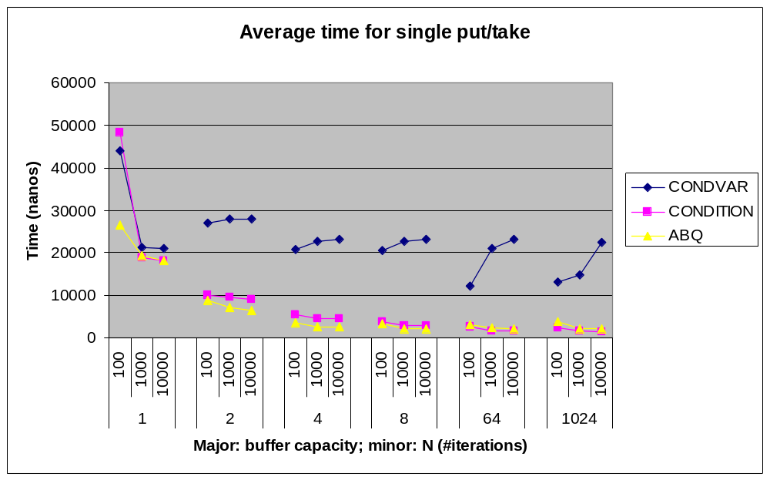
BoundedBuffer Example
Comparing three implementations

Slide 58
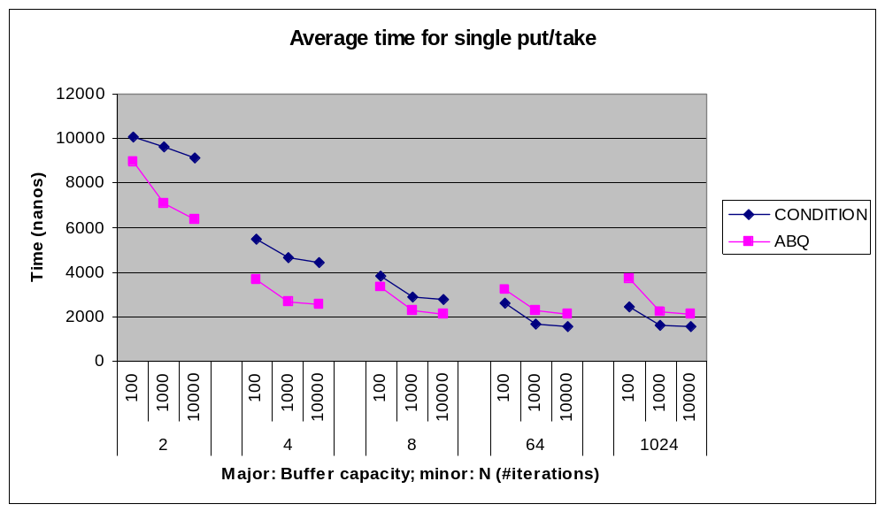
BoundedBuffer Example
Compare hand-rolled to library implementation

Slide 59
BoundedBuffer Example
ArrayBlockingQueue faster than hand-rolled!
May not be significant
  Crude testing methodology (e.g., no warmup)
  Different results obtained using –server
If it is significant, a possible explanation:
  HotSpot not caching final fields across code blocks
  Library implementations have been tuned
Moral: Don’t reinvent the wheel!

Slide 60
Review: Exchanger
Atomic exchange between threads
class Exchanger<T> {
T exchange(T x) throws IE;
T exchange(T x, long timeout, TimeUnit unit) throws IE;
}

Slide 61
BoundedBuffer Example
Alternative for 1 producer / 1 consumer settings
final DataBuffer ebuf = …, fbuf = …;
final Exchanger<DataBuffer> exch = new Exchanger();
exec.execute(new Runnable() { // producer
DataBuffer buf = ebuf;
public void run() {
while (buf != null) {
putIntoBuffer(buf);
if (buf.isFull()) buf = exch.exchange(buf);
}
} /* IE handling omitted */
});
exec.execute(new Runnable() { // consumer
DataBuffer buf = fbuf;
public void run() {
while (buf != null) {
takeFromBuffer(buf);
if (buf.isEmpty()) buf = exch.exchange(buf);
}
} /* IE handling omitted */
});

Slide 62
WebCrawler Example
Refinements
Tune thread pools
Remove HostTasks after poll failure
  Need ScheduledFuture to cancel tasks
Better approach using asynchronous I/O:
  Reduces context switching overhead
  Could use java.nio.channels.Selector wrapped as a CompletionService<List<URL>>
    Fetch requests return immediately
    Separate task polls completion service for next ready list of links

Slide 63
Concurrency Utilities in Practice
Using java.util.concurrent
Joe Bowbeer
UIEvolution, Inc.
Tim Peierls
Prior Artisans, LLC

