Slide 1

WMS Time Series With Mapbuilder
Michael Adair
Natural Resources Canada

Slide 2

Agenda
Introduction to Mapbuilder
Demos

Slide 3
Introduction
Mapbuilder is an Open Source JavaScript framework for implementing web clients in a structured and modular manner
Leverages Open Geospatial Consortium (OGC) specifications for web mapping: Context, WMS, …
Retrieves XML documents (and images) dynamically at run-time using HTTP (AJAX)
Renders XML documents to HTML using the browser’s built-in XSLT processor
Object-oriented architecture using the Model-View-Controller (MVC) design pattern

Slide 4
Features
Client is a web browser
AJAX + browser XSLT + DHTML + DOM
Highly interactive and responsive clients – no “reload” buttons!
Minimal server side requirements
Modular Object-Oriented design - Highly extensible and configurable
Open source (GPL)
Supports OGC standards
Coordinate transformations in JavaScript
Multilingual support

Slide 5
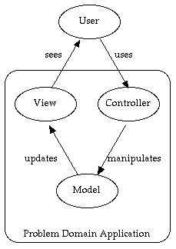
MVC design pattern
The MVC pattern forces one to think of an application in terms of three object types:
Model
maintains the state and data of the application - the XML document
View
A rendering of the XML document
Controller
The user interface presented to the user to manipulate the application

Slide 6
How the Time Series works
OGC WMS and Context documents support the Dimension element:
    <Dimension name="time" units="ISO8601“>
    2004-04/2005-04/P1M, 2005-06-15,2005-06-15
    </Dimension>
Mapbuilder generates a sequence of GetMap requests with timestamps - stacked and looped
WMS request means that zooming, layer overlays, etc. are supported

Slide 7




How it works (2)
http://server/wms?request=GetMap&time=2004-07&...
http://server/wms?request=GetMap&time=2004-06&...
http://server/wms?request=GetMap&time=2004-05&...
http://server/wms?request=GetMap&time=2004-04&...

Slide 8
Demos
Simple
    http://localhost:8080/mapbuilder/demo/simple
Time series
    http://localhost:8080/mapbuilder/demo/timeSeries
    http://geoservices.cgdi.ca/mapbuilder/demo/timeSeries/
At the Demo Fest this afternoon

Slide 9
Thank you!
Home Page
http://mapbuilder.sourceforge.net
Mailing lists
Developer: mapbuilder-devel@lists.sourceforge.net
User: mapbuilder-user@lists.sourceforge.net
Mike Adair
mike.adair@ccrs.nrcan.gc.ca

