Slide 1
.NET Entity Objects
http://neo.codehaus.org
VisualStudio Tool Guide

Slide 2
VisualStudio Tool Guide
What does it do?
The Neo VisualStudio tool is a custom code generator that works much like the one that creates a typed dataset from and xsd file. Whenever the user/developer saves the schema file, it automatically creates all base classes, factories, etc. into one large file that is usually hidden ‘under’ the schema file. It also creates individual files for all new entity object classes.
Building the tool
The VisualStudio tool is part of the Tools solution and builds with it.
Note that all the files in the build output directory, normally VsTool\bin\Debug, are required for the tool to work. If you decide to copy it to another location before installing it make sure that you copy all the files in this directory.
Installing the tool
1) Copy the batch script and the regedit script from VsTool\Resources into the directory where you want to keep the installed binary; this is usually VsTool\bin\Debug.
2) Close all VisualStudio instances, open a VisualStudio Command Prompt from the VisualStudio start menu and navigate to the directory to which you copied the scripts in step 1.
3) Now run the setup batch script. If this fails you might have to look into the script and tweak the commands. Not that this is a hugely complicated beast but, be warned, it does add an entry to your registry.

Slide 3
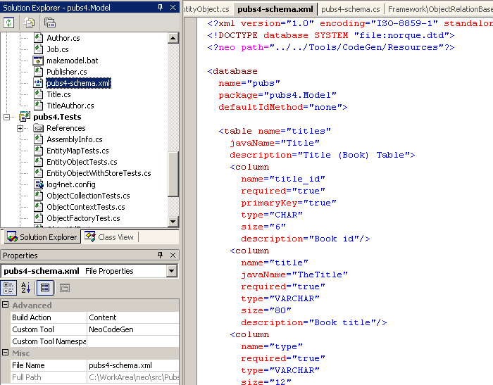
VisualStudio Tool Guide
Using the tool in VisualStudio
Select your schema file and open the properties window.
2) In the advanced section select ‘Content’ as Build Action and enter ‘NeoCodeGen’ as the name of the custom tool.
3) Modify and save the schema file. Alternatively, you can right click on the file and choose ‘Run custom tool’ from the context menu. That’s it!
4) If you receive and error message stating that the templates could not be found you have to add/modify the neo processing directive in the schema file such that the ‘path’ attribute points to a location where the NeoClass.vtl and NeoSupport.vtl files can be found. Note: You may need to restart VisualStudio for it to pick up the change.

Slide 4
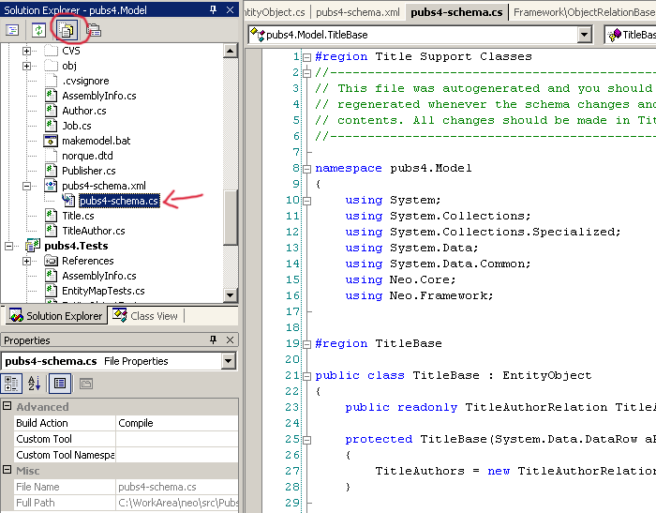
VisualStudio Tool Guide
Where are my files?
The user class files, Author.cs for example, are created into the same directory that the schema is in. (Provided the file does not yet exist.)
All the support files, which the command line tool creates as _Author.cs for example, are written into one large file that is hidden under the schema file. You don’t need to worry about it at all but if you want to see the file and its contents you must activate the ‘Show all files’ option, circled in the screen shot, and expand the schema xml branch. Note: If you are using ReSharper and have more than 50 Entities it can take a long time to add the highlighting to that file.

