Slide 1
.NET Entity Objects
http://neo.codehaus.org
Design Goals
Copyright © 2002-2004 Erik Dörnenburg – Last updated: May 2004

Slide 2
What is Neo?
Neo is a framework for .NET developers who want to write enterprise applications with an object-based domain model. It is well suited for domain-driven design and agile development.

Slide 3
Vision and Design Goals
Business entities are represented by objects
One Entity Object class per database table
One Entity Object per database row
Transparent access to derived properties
Transparent access to related entities
Strongly typed API
Automatic generation of database schema and class templates from a single XML file
Separation of generated and custom code
Full integration with ADO.NET framework

Slide 4
Attributes
Entity object has properties for db columns; attributes in ER-Modelling terms.
public class Author {
public string FirstName {
get { … }
set { … }
}
Usage:
Console.WriteLine(anAuthor.FirstName);
anAuthor.FirstName = "Neal";

Slide 5
Derived Attributes
Custom code adds new (derived) attributes.
public class Author {
public string FullName {
get { return FirstName + " " + LastName; }
set { … }
}
Usage: (indistinguishable from db properties)
Console.WriteLine(anAuthor.FullName);
anAuthor.FullName = "Neal Stephenson";

Slide 6
To-One Relations
Entity object has properties for related objects.
public class Title {
public Publisher Publisher {
get { … }
set { … }
}
Usage: (simple object assignments)
thePublisher = aTitle.Publisher;
Console.WriteLine(thePublisher.Name);
aTitle.Publisher = anotherPublisher;

Slide 7
To-Many Relations
Object has (typed) collection for related objects.
public class Publisher {
public TitleRelation Titles { get { … }; }
public class TitleRelation : IList {
public Title this[int index] { … }
public void Add(Title aTitle) { … }
public int Count { … }
Usage: (identical to .NET collection pattern)
if(thePublisher.Titles.Count > 0)
aTitle = thePublisher.Titles[0];
thePublisher.Titles.Add(anotherTitle);
Objects are loaded on first access (Lazy-Loading)

Slide 8
CRUD – The rest
Factories create and find objects. Objects delete themselves
public class AuthorFactory {
public Author CreateObject()
public AuthorList FindAllObjects()
public AuthorList FindMatchingObjects( … )
public AuthorList Find( … )
public class Author {
public Delete()
Usage:
myFactory = new AuthorFactory( … );
newAuthor = myFactory.Create();
resultSet = myFactory.FindAllObjects();

Slide 9
Primary Keys
Primary keys can be generated; either auto-incremented integers or globally unique ids.
Neo also supports "meaningful" primary keys and generates different Create methods
title = titleFactory.CreateObject("TC7777");
Neo understands correlation tables and generates special Create methods
ta = taFactory.CreateObject(title, author);
Other primary key generation strategies can be implemented outside the framework.

Slide 10
Query Templates
Factories can create a query template that has the same properties as the corresponding entity object, including to-one relationships.
template = authorFactory.GetQueryTemplate();
template.FirstName = "Neal"
template = titleFactory.GetQueryTemplate();
template.Publisher = aPublisher;
Factories can find all objects matching the template
titles = factory.FindMatchingObjects(template);

Slide 11
Qualifiers (Creation)
Qualifiers define criteria for selections. They are normally constructed using formats:
q = Qualifier.Format("name = {0}", input);
Formats can use inlined values and comprise multiple clauses:
q = Qualifier.Format("name = 'Neal'");
q = … ("name = {0} and locked = false", input);
Formats provide a shortcut for simple matches:
q = new Qualifier.Format("Name", input);
Formats can include property paths:
q = new Qualifier.Format("Publisher.Name", n);

Slide 12
Qualifiers (Usage)
Factories use qualifiers:
AuthorFactory f = new AuthorFactory( … );
AuthorList list = f.Find("Name = {0}", input);
So do collections and relations:
sublist = list.Find("Advance < 5000");
sublist = publisher.Titles.Find( … );
Qualifiers can also evaluate whether an object matches their criteria:
if(q.EvaluateWithObject(anAuthor))
doSomething(anAuthor);

Slide 13
Delete modes
SetNull deletes behave as expected
aTitle = thePublisher.Titles[0];
thePublisher.Delete()
if(aTitle.Publisher == null)
Console.WriteLine("It just works!");
Cascading deletes are supported and the last line in the following example will cause an exception to be thrown
aTitle = theAuthor.Titles[0];
theAuthor.Delete()
Console.WriteLine(aTitle.PublicationDate);

Slide 14
Code Separation
All generated db properties are implemented in an intermediary class, AuthorBase for example. This should not be modified.
public class AuthorBase : EntityObject {
public string FirstName { … }
public string LastName { … }
Initially, a subclass is generated but the developer is expected to modify it and the class is not re-generated when the schema changes.
public class Author : AuthorBase {
public string FullName { … }

Slide 15
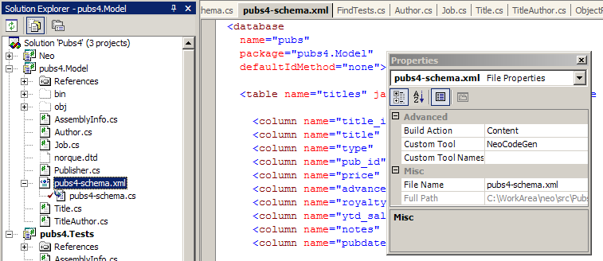
Code Generation
Code is generated automatically in VS.NET using a custom tool. The source file containing base classes, factories etc. is hidden "behind" the XML schema definition.
Command line tool available for scripted builds.

Slide 16
Design Goals (review)
Business entities are represented by objects
One Entity Object class per database table
One Entity Object per database row
Transparent access to derived properties
Transparent access to related entities
Strongly typed API
Automatic generation of database schema and class templates from a single XML file
Separation of generated and custom code
Full integration with ADO.NET framework
✓
✓
✓
✓
✓
✓
✓
✓

