Slide 1
XDoclet 2
Aslak Hellesøy
Senior Developer
ThoughtWorks

Slide 2
Agenda
Introduction
Why a rewrite?
Demonstration
Architecture
Extending XDoclet2
JSR 175 implications

Slide 3
About ThoughtWorks
We are a software delivery consultancy
We solve complex problems with Agile methods
We are a home to many Open Source activists
We are hiring!

Slide 4


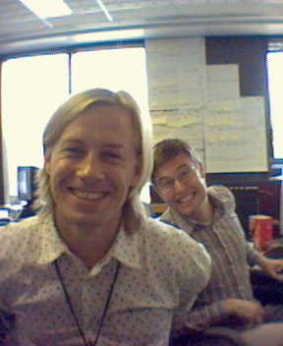





About me

Slide 5
What is a code generator?
A program that writes code
A code generator is a “workaround” for a problem
  That is too hard to code manually
    Because the architecture is bad
    Because the developers are bad and can’t be trusted
    Because we don’t have time
In my ideal world, software is written by humans

Slide 6
Pros and Cons of code generation
Pros
  It helps us cope with bad specs (like EJB)
  It reduces redundancy (DRY)
  Can give a flying start
  It’s consistent
Cons
  It’s an extra build step that can slow down
  Hard to refactor
  Can be hard to read and understand

Slide 7
What is XDoclet/XDoclet2?
Attribute based code generator (@tags)
Extensible
Support for EJB, JBoss, WebLogic, Hibernate, Struts, JDO…
Popular, XXXX downloads
It keeps the code in one place
Generates much of the boilerplate code

Slide 8
Why a rewrite of XDoclet?
XDoclet 1.2 problems
  No tests!
  Code is hard to understand
  Too much to maintain (parser, template engine, plugins)
  Too tightly coupled with Ant
  Falls over on large codebases (time, memory)
What’s new in XDoclet 2?
  TDD, own test framework for plugins
  Advanced @tag validation
  Easy to get started with for developers
  The codebase of the core is very small (pico, qdox, velocity…)
  Fast and scalable for large codebases

Slide 9
XDoclet 2 architecture
Core (Built on several mature libraries_
  Generama code generation framework
    PicoContainer for plugin mechanism
    Velocity for templates
    Jelly for templates
  QDox for metadata
Plugins
  Hibernate
  Portlet
  WebWork

Slide 10
Generama
Small framework that introduces abstractions for
  Template engines (Velocity, Jelly, ….)
  Pluggable Metadata (QDox, JDBC, UML, …)
  Plugins+Templates
Used by XDoclet2 and Middlegen3. Can be used by others too.
Template Engine
Metadata
Generama
Output
Plugin+Template

Slide 11
XDoclet2 core
It’s really just Generama using QDox as a metadata provider!
The XDoclet2 plugins will have to deal with this metadata!
Template Engine
QDox
Generama
Plugin+Template

Slide 12
QDox
Extremely fast Java parser 100-500 classes/sec!
  JavaClass
    getName()
    JavaMethod[] getMethods()
    DocletTag[] getTags()
  JavaMethod
    DocletTag[] getTags()
    Parameter[] getParameters()
  DocletTag[]
    String getParameter(String name)
Accessed by Velocity/Jelly templates

Slide 13
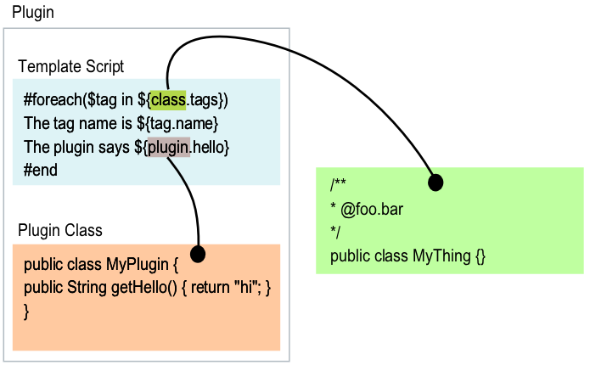
A simple plugin
(Via QDox API)

Slide 14
Velocity and Jelly
Template engines from Jakarta
Mix static content with dynamic content
Own template “language”
  Loops
  Branching logic
  Hooks back to Java objects

Slide 15
Plugin Development
Test framework
  Compares expected output with actual output
    ASTUnit/APIUnit (for generation of Java)
    XMLUnit (for generation of XML)
    Plain string comparison (for generation of other files)
TDD
  Write a test (expected result)
  Make it compile (the simplest way)
  Fix it (the simplest way)
  Refactor redundancies
Results
  Reliable code
  Easy for community to fix and contribute

Slide 16
Advanced Tag Validation
Completely unknown tags
  @blargh
Illegal parameter names
  @hibernate.class blargh=“foo”
Illegal parameter values
  @hibernate.class optimistic-lock=“blargh” (enums)
Missing parameters
  @hibernate.class (without table=“SOMETHING”)
Bad tag location
  @hibernate.property tag on class

Slide 17
Declarative Tag Definition in Java Interfaces
@my.cheese name=“gamle ole” very-good=“true”
Is declared as follows:
/** @qtags.level class */
public interface MyCheeseTag extends DocletTag {
/** @qtags.required */
String getName();
Boolean isVeryGood()
}

Slide 18
Plugin = Java class + template
public class CheesePlugin extends VelocityPlugin {
public CheesePlugin(…) {
setFileregex("\\.java");
setFilereplace(“Description.txt");
setMultioutput(true);
}
// can be set from ant (or gui)
public void setShop(String shop) {…}
// can be accessed from template
public String getShop() {…}
}

Slide 19
Plugin = Java class + template
#set(${myCheeseTag} = ${class.getTagByName(“my.cheese”)})
Cheese name: ${myCheeseTag.getNamedParameter(“name”)}

Slide 20
Plugin wizards and development tools
Translate old XDoclet 1.2 tags to new format
Set up a default file structure and build scripts
Automatically generate tag documentation
Automatically generate plugin documentation
Base classes for TDD of plugins

Slide 21
JSR 175 Implications
Annotations go into the class files
Can be retrieved at runtime with reflection
Lesser need for XML descriptors
Code generation still has a future
  Not generation of XML ☺
  But code!

Slide 22
J2EE complexity
Various approaches to simplify it
  GUI tools (BEA, IBM, Oracle)
    Hard for big teams
    Hard to TDD
  Code generation
  POJOs, Dependency Injection, + AOP
    Simple Java classes
    Depend on services
    Dependency Injection container
    Easy to test in isolation
    AOP for persistence, txn, remoting, security…

Slide 23
J2EE alternative
Not standard
But simple
  Good product -> de facto standard ☺
  Committee standard -> product ☹
Developer friendly!
  Not in a Visual Basic way ;-)
+ AOP frameworks (AspectJ, AspectWerkz, Nanning)
+ Reusable Aspects

Slide 24

Dependency Injection
Not Dependency Injection
Dependency Injection
new
new
Testing becomes easy
Maintenance becomes easy
Configuration becomes easy
Reuse becomes easy

Slide 25
Links
http://xdoclet.codehaus.org/
http://qdox.codehaus.org/
http://sf.net/projects/xdoclet-plugins/
http://jakarta.apache.org/velocity/
http://jakarta.apache.org/commons/jelly/

