Slide 1
Base Conversion Algorithm

Slide 2
Convert from Base 10 to Another
Take your base 10 number and mod it with the new base to get the right-most digit
1234

Slide 3
Convert from Base 10 to Another
Take your base 10 number and mod it with the new base to get the right-most digit
1234

Slide 4
Convert from Base 10 to Another
Divide the number by the new base (in this case 10) to get the next right-most digit
123

Slide 5
Convert from Base 10 to Another
Divide the number by the new base (in this case 10) to get the next right-most digit
123

Slide 6
Convert from Base 10 to Another
Divide the number by the new base (in this case 10) to get the next right-most digit
12

Slide 7
Convert from Base 10 to Another
Divide the number by the new base (in this case 10) to get the next right-most digit
1

Slide 8
Convert from Base 10 to Another
Repeat until the there are no more numbers to process i.e. we’ve hit zero
0

Slide 9
The Algorithm
int number = 1234
int base = 10
while (number > 0)
{
int remainder = number % base;
// TODO: Something with remainder
number /= base;
}
remainder will get used as an
index into an array of sprite
images that represent the
digits 0-9 inclusive

Slide 10
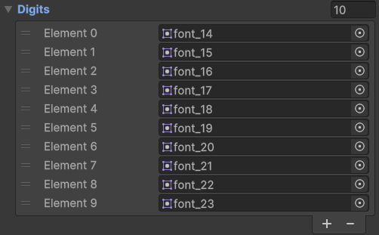
Implementation
An array of SpriteRenderer components that represent the in-game digits.
Least significant is Length-1 i.e. the right-most digit
An array of Sprites that hold the digits 0-9

Slide 11
Implementation
Each time the score changes:
Reset the visual indicators to the 0th sprite (0 digit sprite)
Perform the algorithm and set the values from the least significant number
to the most:
Number: 1234
Index: 5

Slide 12
Implementation
Each time the score changes:
Reset the visual indicators to the 0th sprite (0 digit sprite)
Perform the algorithm and set the values from the least significant number
to the most:
Number: 1234
Index: 5

Slide 13
Implementation
Each time the score changes:
Reset the visual indicators to the 0th sprite (0 digit sprite)
Perform the algorithm and set the values from the least significant number
to the most:
Number: 123
Index: 4

Slide 14
Implementation
Each time the score changes:
Reset the visual indicators to the 0th sprite (0 digit sprite)
Perform the algorithm and set the values from the least significant number
to the most:
Number: 12
Index: 3

Slide 15
Implementation
Each time the score changes:
Reset the visual indicators to the 0th sprite (0 digit sprite)
Perform the algorithm and set the values from the least significant number
to the most:
Number: 1
Index: 2

Slide 16
Implementation
Each time the score changes:
Reset the visual indicators to the 0th sprite (0 digit sprite)
Perform the algorithm and set the values from the least significant number
to the most:
Number: 0
Index: 2
Done!

Slide 18
Attribute X&Y Co-Ordinates

Slide 19
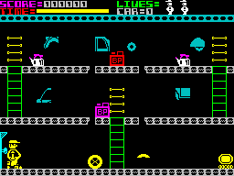

Slide 20
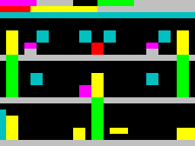
0th element in array
x = 31, y = 23
index = 23 * 32 + 31
index = 767
Index into the array would be…
index = y * columns + x
Notes:
Values are stored in a single dimension array 0 to 767 which is 768 colours

Slide 21
But!
The Ink and Paper textures used for the shader are flipped horizontally!!!
We need to change the formula

Slide 23
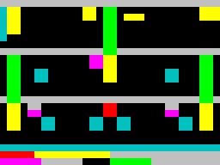

Slide 24
To ensure it’s displayed correctly, i.e. flipped, we have to re-think our formula
0th element in array
x = 31, y = 0
index = 0 * 32 + 31
index = 31
Index into the array would be…
index = (23 – y) * columns + x

