Slide 1
Buildpacks

Slide 2
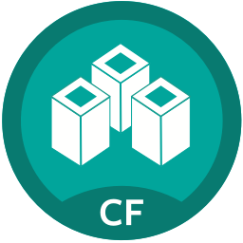
Buildpack Topics
Why Buildpacks?
Using
Developer Configuration
Administering
API
Customizing and Creating

Slide 3
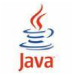
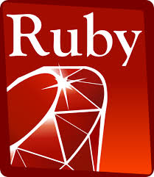




Platform Flexibility
Buildpacks provide an API to allow for the adoption of new languages and runtimes into the platform
  Same basic operational and developer workflows
The diverse landscape of languages and runtimes will continue to evolve

Slide 4

Developer Perspective- The cf push Philosophy
Onsi Fakhouri (Pivotal engineering):
  Here is my source code
  Run it on the cloud for me
  I do not care how
Haiku
Buildpacks are a key part of making this possible

Slide 5
Buildpacks Make Operations Manageable
Controls what frameworks/runtimes are used on the platform
Provides consistent deployments across environments
  Stops deployments from piling up at operation’s doorstep
  Enables a self-service platform
Eases ongoing operations burdens:
  Security vulnerability is identified
  Subsequently fixed with a new buildpack release
  Restage applications

Slide 6
Buildpack Topics
Why Buildpacks?
Using
Developer Configuration
Administering
API
Customizing and Creating

Slide 7

What is a Buildpack?
Enables Cloud Foundry to be language agnostic
  Based on Heroku buildpacks
Three staging scripts and their dependencies
  Run inside of a staging container on Elastic Runtime
Produces a droplet- a compressed archive for running an app instance in a container
Cloud
Controller
staging
cf push
Blobstore
Cells / DEAs

Slide 8

The detect Script
Inspects the pushed application to determine if the buildpack can handle the application
 | Gemfile exists?
 | package.json exists?
 | .php file exists?

Slide 9
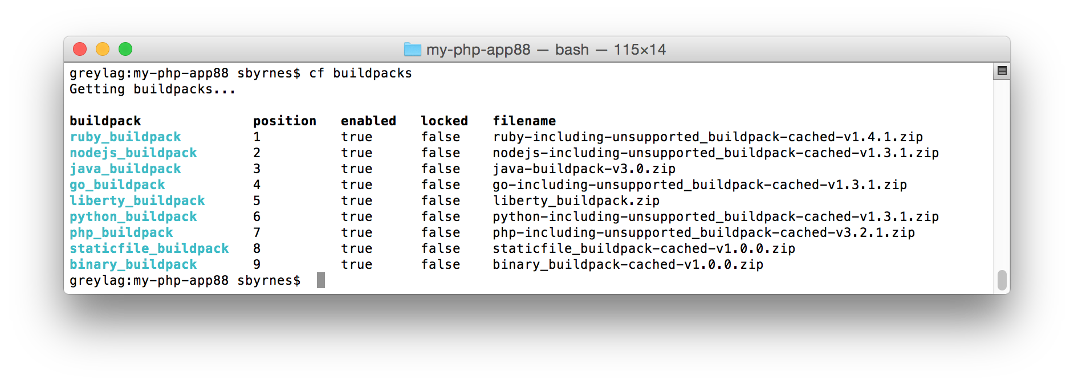
Buildpack Detection
Use cf buildpacks to view the available buildpacks
The position column defines the order in which the detect scripts are run
The first detect script that returns a `0` stops the detection process

Slide 10
Specifying a Buildpack
Use the –b parameter when running cf push to avoid unnecessary buildpack file copying and detection
  Can also specify the buildpack in the application manifest
The buildpack parameter can name an installed buildpack or point to a custom buildpack in a git repository
$ cf push simplephpapp -b "php_buildpack"
Uploading simplephpapp...
Creating container
Downloading buildpacks (php_buildpack)...
Staging...
---
applications:
- name: myapp
buildpack: php_buildpack

Slide 11
Custom Buildpacks
You can specify custom buildpacks located in git repositories
  Custom buildpacks can be disabled by the administrator (Ops Manager > Pivotal Elastic Runtime > Cloud Controller > Disable Custom Buildpacks)
Here a custom fork of the php-buildpack is used…
$ cf push myphpapp -b https://github.com/mygitaccount/php-buildpack
Downloading buildpacks (https://github.com/mygitaccount/php-buildpack)...
Staging...

Slide 12
Buildpack Topics
Why Buildpacks?
Using
Developer Configuration
Administering
API
Customizing and Creating

Slide 13
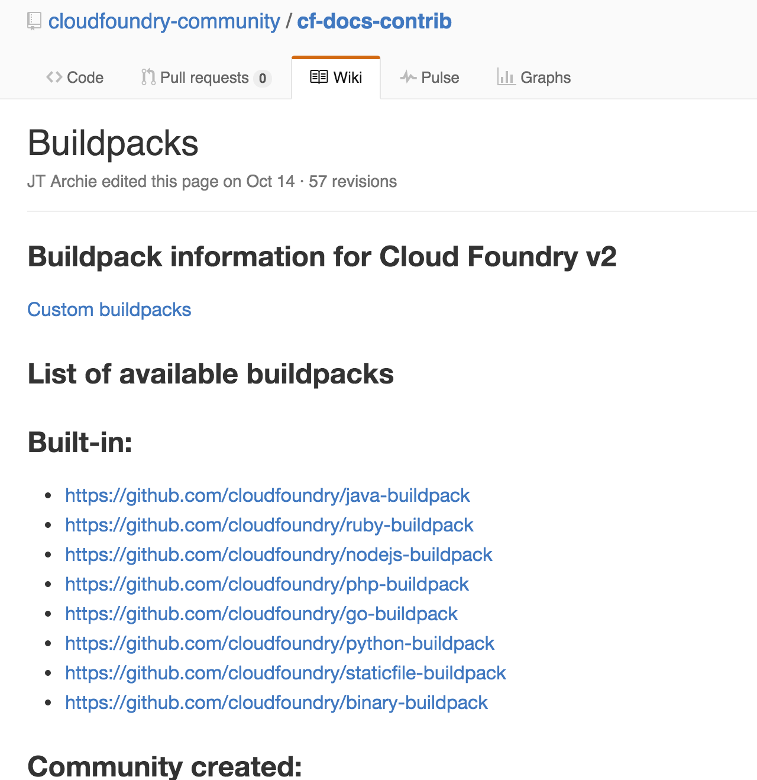
Developer Configuration
Implementations of buildpacks vary
View the github repository for a specific buildpack to view configuration options
https://github.com/cloudfoundry-community/cf-docs-contrib/wiki/Buildpacks

Slide 14
Example Developer Configuration- PHP
Configure PHP applications with a `.bp-config/options.json` file in the application directory
For example, you could enable mysqli extensions
.bp-config/options.json
{
"PHP_EXTENSIONS": [ "mysqli"]
}
https://github.com/cloudfoundry/php-buildpack/blob/master/docs/config.md

Slide 15
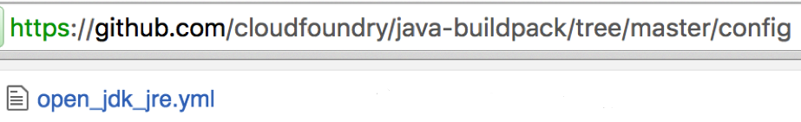
Example Developer Configuration- Java
Java buildpack configuration can be overridden with an environment variable matching the configuration file
  Prefix the environment variable with JBP_CONFIG_ and drop the `.yml`
  The variable value is inline YAML
For example, you could change the default version of Java to 7:
---
applications:
- name: myapp
buildpack: java_buildpack
env:
JBP_CONFIG_OPEN_JDK_JRE: '{jre: { version: 1.7.0_+ }}'
Notes:
You can also set environment variables using an `env` section of the application manifest.

Slide 16
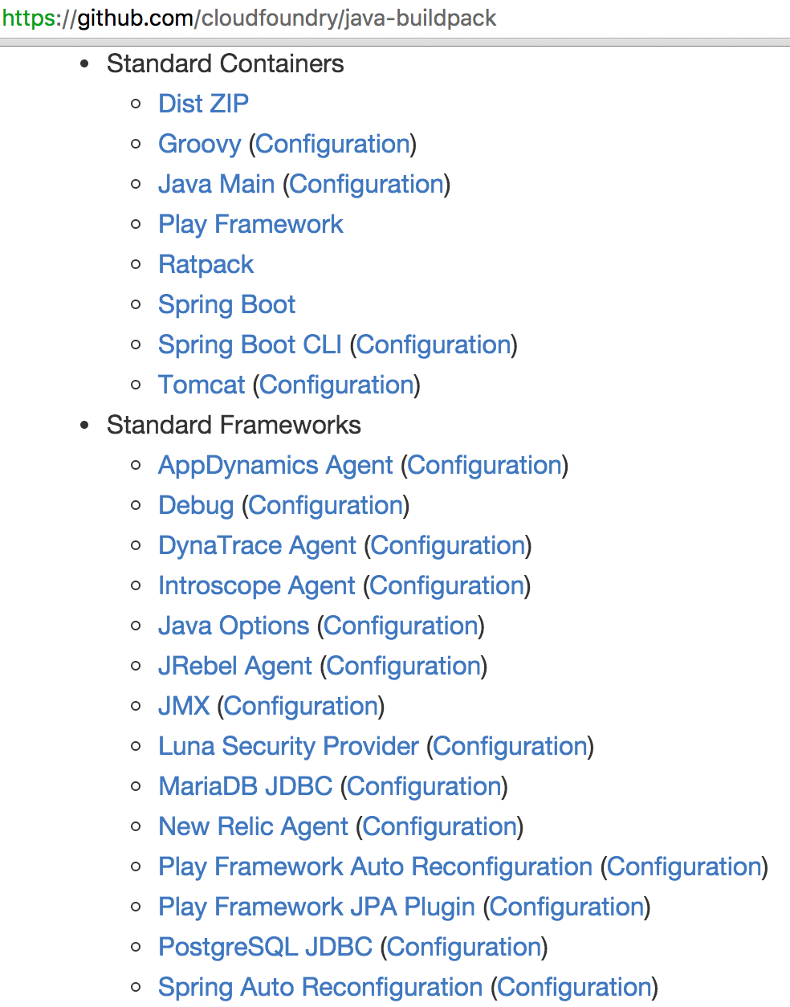
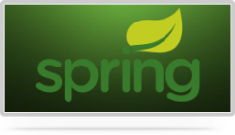


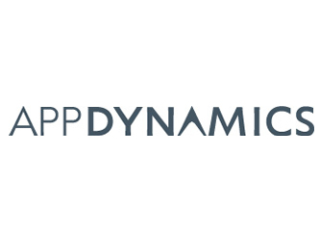

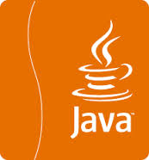


Java Buildpack Configuration
Supports a variety of JVM languages, containers, and frameworks
The buildpack’s GitHub home page has links to configuration information
https://github.com/cloudfoundry/java-buildpack

Slide 17
Buildpack Topics
Why Buildpacks?
Using
Developer Configuration
Administering
API
Customizing and Creating

Slide 18
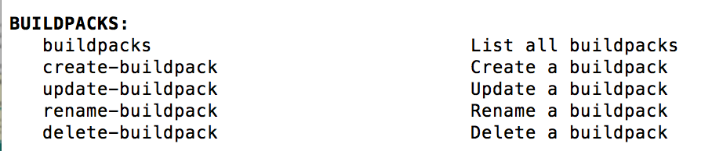
Administering System Buildpacks
cf buildpacks - lists all installed/system buildpacks
cf create-buildpack <name> <path> <position>
  <path> – local directory / zip file / URL / URL to zip file
  <position> – relative order in buildpack list
  --enable / --disable
Administrator permissions required
Notes:
Assuming you have admin permissions, you can use create-buildpack to add a buildpack to the built-in list. The path can be a local zip file, and local folder containing buildpack files, a local zip file containing buildpack files, a URL pointing to buildpack files, or a URL pointing to a zip file containing buildpack files.
You can use the –disable to make the buildpack temporarily disabled, then use –enable later to turn it on.
Administrator permissions are needed to do this, not just Org / space permissions. So this is basically not possible on PWS. Cloud Foundry has a bias towards the operator limiting possible options over the developer having more control.

Slide 19
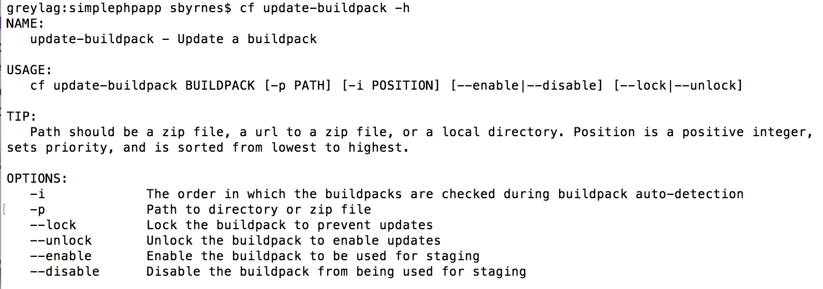
Changing Buildpack Position
Use cf update-buildpack to change a buildpack’s detect position
For example, if node.js apps are mostly pushed, an administrator can move it to position 1 with -i 1

Slide 20
Locking Buildpacks
Use cf update-buildpack --lock to prevent buildpack version updates
  A way to control the production environment

Slide 21
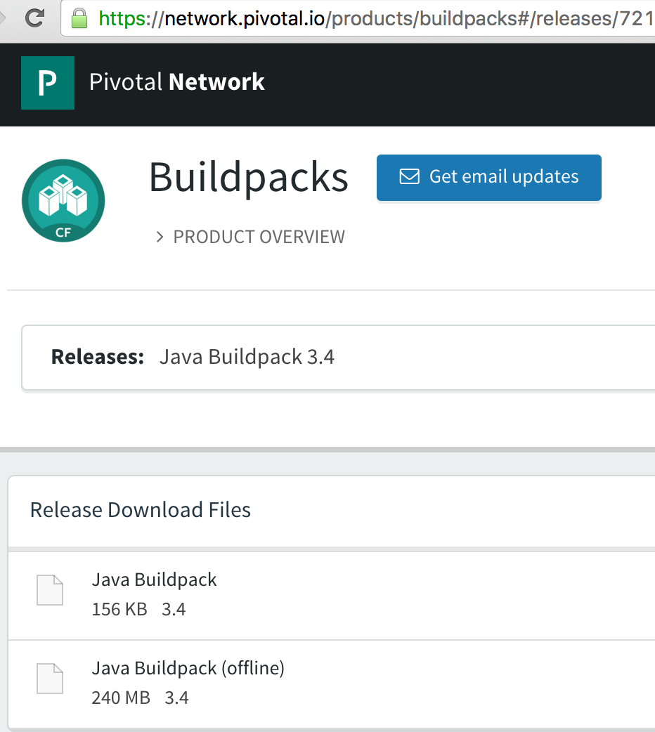
Offline Buildpacks
Builds droplets without internet connection
http://network.pivotal.io contains offline buildpacks

Slide 22
Buildpack Topics
Why Buildpacks?
Using
Developer Configuration
Administering
API
Customizing and Creating

Slide 23
Scripting Languages
Buildpacks are written in a scripting language
  This is why the Java buildpack is not written in Java
Bash- for simple buildpacks, such as Node.js
  Can also call to other scripting languages- the PHP buildpack scripts call Python
Ruby- for more involved buildpacks, such as Java

Slide 24
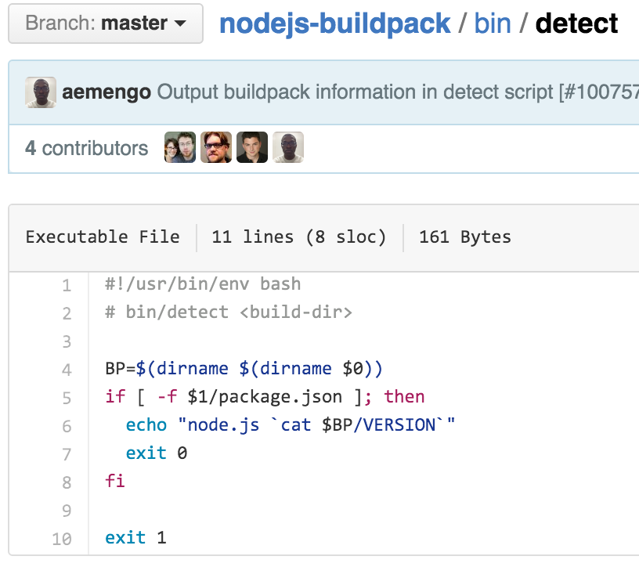
Script 1- bin/detect
The detect script determines if the buildpack applies to the application being pushed
Returns `0` and language information if the buildpack applies
Returns `1` if the buildpack doesn’t apply
The node.js buildpack looks for a pushed file named `package.json`

Slide 25

Script 2- bin/compile
The compile script is run after a detect script was successful
Assembles an application with all of its runtime dependencies
  Downloads, installs and configures dependencies such as a web server and a programming runtime
Produces a droplet
A non-zero return indicates the compile script failed
Application
Framework
Runtime
Web Server
OS container

Slide 26
Example Compile Output- PHP Buildpack
During cf push, you will see staging output
You can also view this information with cf logs
During PHP compile, you can see that the web server (httpd) and the PHP runtime are included
Staging...
-------> Buildpack version 4.3.0
Installing HTTPD
Downloaded [file:///tmp/buildpacks/d5171dc06ed338008c7fdcb4eee474f0/dependencies/https___pivotal-buildpacks.s3.amazonaws.com_concourse-binaries_httpd_httpd-2.4.17-linux-x64.tgz] to [/tmp]
Installing PHP
…
Staging complete

Slide 27
Unsuccessful Buildpack Compilation
When specifying a buildpack, the detect script is not run, but the compile script must successfully run
Here is what happens when you push a PHP application and specify the go buildpack…
$ cf push myphpapp -b "go_buildpack”
Downloading buildpacks (go_buildpack)...
Staging...
! Godeps are required. For instructions:
! https://devcenter.heroku.com/articles/go-support
Failed to compile droplet
Staging failed: Exited with status 223
FAILED
BuildpackCompileFailed

Slide 28
Script 3- bin/release
Simple script that provides the application’s start command to the Cloud Controller database
  For example, start a web server or execute a script
The script writes YAML-formatted metadata to STDOUT
On Cloud Foundry only the web: value is used- it specifies the start command for the app
---
addons: []
default_process_types:
web: <start command>
Notes:
The YAML format of the bin/release script output was defined by Heroku. Cloud Foundry uses a subset of it.
An example of a start command is from the node.js buildpack release script: web: npm start

Slide 29
Staging Container Lifecycle- Before Detect
During cf push or cf restage, a staging container is created on a Cell
Environment variables related to the app are included (e.g. by using cf set-env, specifying in the manifest, or by binding services)
<app_directory> is created by Cloud Foundry- sometimes called the build directory
The files from the pushed application are placed in <app_directory>
System buildpacks are added (if no buildpack was specified)
Staging Container
<app_directory>/pushedfiles
buildpacks
environment variables

Slide 30
Staging Container Lifecycle- Detect
A buildpack’s bin/detect script is executed
  If the –b flag is used to specify a buildpack, the detect script is not run
Cloud Foundry passes the <app_directory> as an argument to the script
The script uses that argument to help determine if the application matches
If so, the script returns successful (0)
Staging Container
<app_directory>/pushedfiles
buildpacks
environment variables
bin/detect app_directory

Slide 31
Staging Container Lifecycle- Compile
Cloud Foundry passes <app_directory> as an argument to the script
The compile script adds any dependencies to <app_directory>
  The script can use environment variables- e.g. if New Relic is a bound service, add the agent to <app_directory>
The contents of <app_directory> are packaged as a droplet tarball
Cloud Foundry creates a <cache_directory> and passes it as the second argument to the script
  The buildpack can cache staging files used for the life of the application- speeds subsequent stages
Staging Container
<app_directory>/pushedfiles
/dependencies
<cache_directory>
environment variables
bin/compile app_directory cache_directory
Notes:
How (and if) the buildpack uses the cache_directory is up to the buildpack. It can be used for caching large download files. Once a file is placed there, Cloud Foundry will make that file available on subsequent executions of cf push or cf restage. Buildpack caches are per application concepts, so the files will last for the life of the application. The cache is created with the first cf push, and starts out empty.

Slide 32
Summary: Buildpack API
/bin/detect app_directory
  Inspects the application to determine buildpack applicability
/bin/compile app_directory cache_directory
  Download and install runtime, web server, packages, libraries
  The final app_directory is packed as a droplet
/bin/release app_directory
  Contains the application’s start command- passed to the Cloud Controller database
The buildpack API is open-ended. If you can script it, you can do it.
Notes:
The app_directory and cache_directory arguments passed by Cloud Foundry to the scripts refer to locations in the staging container.

Slide 33
Buildpack Topics
Why Buildpacks?
Using
Developer Configuration
Administering
API
Customizing and Creating

Slide 34
Configuration, Customization, Extension
Most buildpacks support configuration
  For example, the staticfile, PHP and Java buildpacks
  This is recommended because it does not involve forking
You can customize a buildpack, which involves forking
Some buildpacks support extension, which is a form of customization where the core buildpack is not altered
  Examples include Java and PHP
For more information on configuring, customizing or extending a particular buildpack, check its GitHub repository.

Slide 35


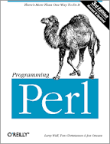




Custom Buildpacks
The Cloud Foundry community provides buildpacks for other languages
Or write your own
  Usually by forking / adapting an existing buildpack
https://github.com/cloudfoundry-community/cf-docs-
contrib/wiki/Buildpacks
Liberty
Notes:
See https://github.com/cloudfoundry-community/cf-docs-contrib/wiki/Buildpacks for current list of community contributed build packs.

Slide 36
Review- Buildpack Topics
Why Buildpacks?
Using
Developer Configuration
Administering
API
Customizing and Creating
Lab- Explore, configure and update a buildpack

