Slide 1
Domains and Routes

Slide 2
Topics
Domains and Routes
Blue-green Deployment using Routes

Slide 3
Domains
Each Cloud Foundry installation has a default app domain
  PWS uses cfapps.io
  Can use custom domains: mycompany.com
  App domains can include a subdomain: apps.mycompany.com
Hosts
  Each application can have a unique host
    Its URL is therefore host.app-domain
    Example: an app named myapp: http://myapp.cfapps.io

Slide 4
Domains and Subdomains- Behind the Scenes
A CNAME wildcard entry (*) is added to DNS for the app domain
That DNS entry points to a load balancer (or Cloud Foundry's HA Proxy), which points to Cloud Foundry's router
The router uses the host to map to application instance(s)
*.cfapps.io
Load Balancer
Router
app1.cfapps.io
app1.cfapps.io
app1.cfapps.io
app1.cfapps.io
...
app1.cfapps.io
myapp.cfapps.io
city.cfapps.io

Slide 5
Routes (1 of 2)
A URL to an application is called a route
  Notice that host + domain = route
An application can be assigned one or more routes
myapp.cfapps.io and cities.cfapps.io can both point to the exact same application
Routes do not have to include the application name
Router
myapp.cfapps.io
cities.cfapps.io
myapp

Slide 6
Routes (2 of 2)
A route can only be used in a single space
  Example: if myapp.cfapps.io is in use in a space, an application in another space can not use it
  This is why you often see unique identifiers on PWS hosted applications (e.g. myapp_654.cfapps.io)

Slide 7
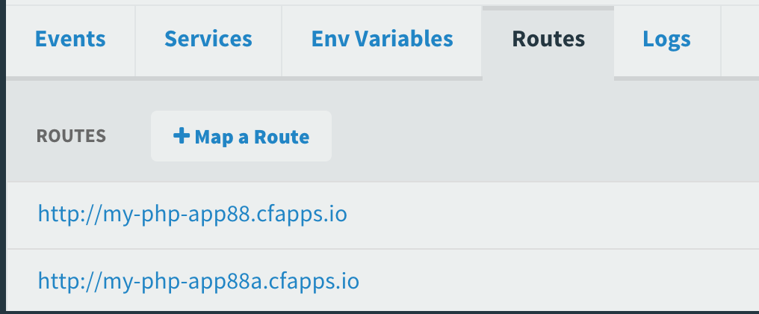
Routes in Apps Manager
View, add and modify routes for an application using the Routes tab in Apps Manager
  Here http://my-php-app88.cfapps.io and
  http://my-php-app88a.cfapps.io both point
  to the same application

Slide 8
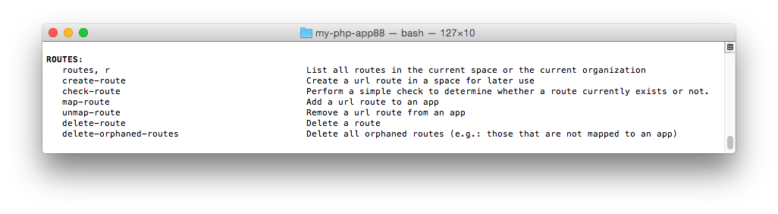
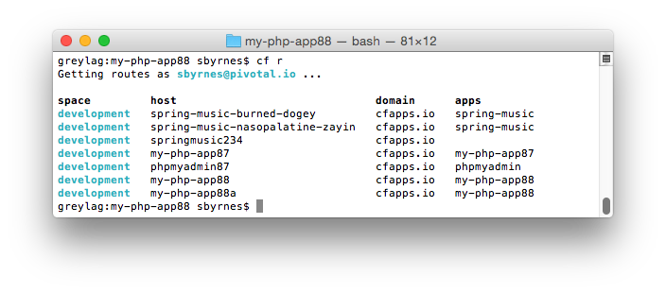
Routes and the cf CLI
cf help shows the route-related commands:

Slide 9
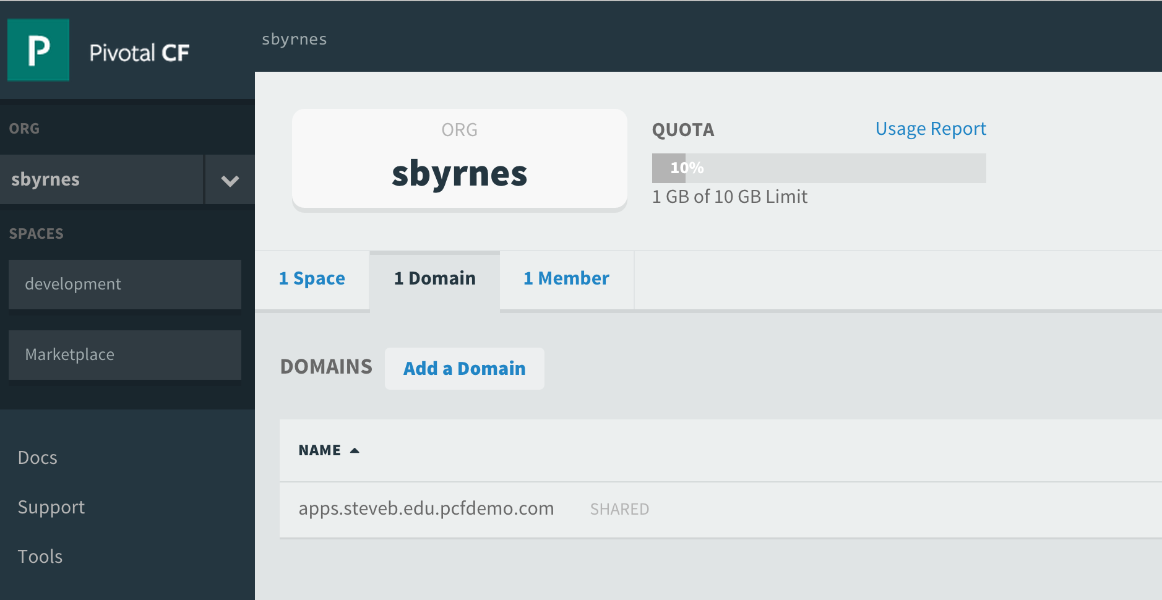
Domains in Apps Manager
Domains are usually defined during installation time
You can add domains using the cf CLI or Apps Manager
This allows the same application to be accessed from multiple domains (cfapps.io, mycompany.com, etc.)
You must also set a DNS entry for your added domain, pointing traffic from your added domain to the domain specified during installation

Slide 10
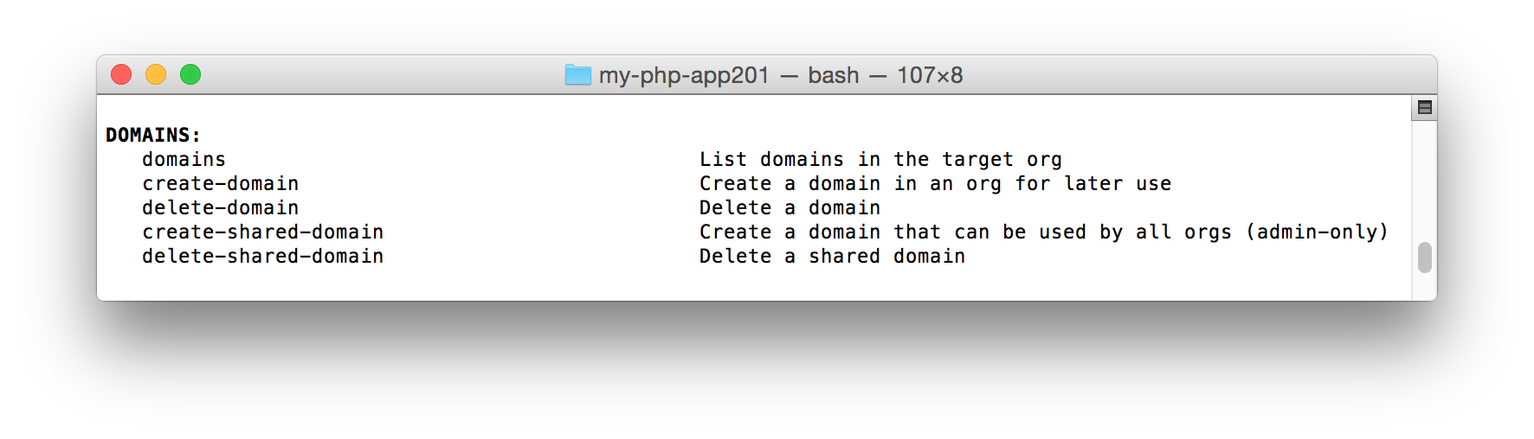
Domains and the cf CLI
Use cf create-domain to create a domain for use inside of an organization
Use cf create-shared-domain to create a domain for the entire Cloud Foundry installation (must be logged in as the administrator)

Slide 11
Topics
Domains and Routes
Blue-green Deployment using Routes

Slide 12
Blue-Green Deployments
Blue-green deployment is an approach to upgrading applications with minimal downtime
It also enables easy rollback to the old version if the new version experiences problems
It works by keeping both versions online, and switching from the old version to the new version
live
traffic
app 1.0
app 1.0
live
traffic
app 1.1
app 1.1
before
after

Slide 13
Blue-Green Deployment using Routes
Main idea: you always want myapp.cfapps.io to be good
Use routes to achieve this
Because you are in a single space, multiple applications can use the same route
myapp.cfapps.io
myapp.cfapps.io
app1.0
app1.0
app1.0
myappdev.cfapps.io
myapp.cfapps.io
myapp.cfapps.io
app1.1
app1.1
app1.1
before
(working on version 1.1)
during
(version 1.1 is ready)
after
(done with version 1.0)

Slide 14
Slowly Turning on Traffic using Instances
Start with four instances of blue, one instance of green
  80 percent of traffic will use version 1.0
Decrease blue instance, increase green instances as confidence builds
myapp.cfapps.io
app1.0
app1_0
app1_0
app1_0
app1.1
myapp.cfapps.io
myapp.cfapps.io
app1_1
app1_1
app1.1
app1_1
app1_1

Slide 15
Topics
Domains and Routes
Blue-green Deployment using Routes

Slide 16
Lab
Perform a simple blue-green deployment using routes

