Slide 1
Logging and Metrics in Cloud Foundry
Using the Loggregator Logging System

Slide 2
Topics
Logging System Overview
Application Logs and Metrics
Platform Logs and Metrics

Slide 3
Loggregator - The Voice of the System
Provides logging and metrics for the Elastic Runtime
A modern approach to logging that emphasizes:
  Support for ephemeral, container-based applications
  Productivity by streaming logs and metrics to operators and developers (no log shipping)
  Accessibility and visibility into your applications and the platform
  Seamless integration with modern log management services (e.g. Splunk, LogStash)

Slide 4
How can Loggregator help me?
Debugging applications
Application insights
Monitoring system and application health
Exporting metrics into visualization tools
Notes:
Examples of monitoring system and application health:
App/platform latency
Platform memory statistics (allocated bytes, duration of last garbage collection)
Platform authentication failures

Slide 5
Topics
Logging System Overview
Application Logs and Metrics
Platform Logs and Metrics

Slide 6
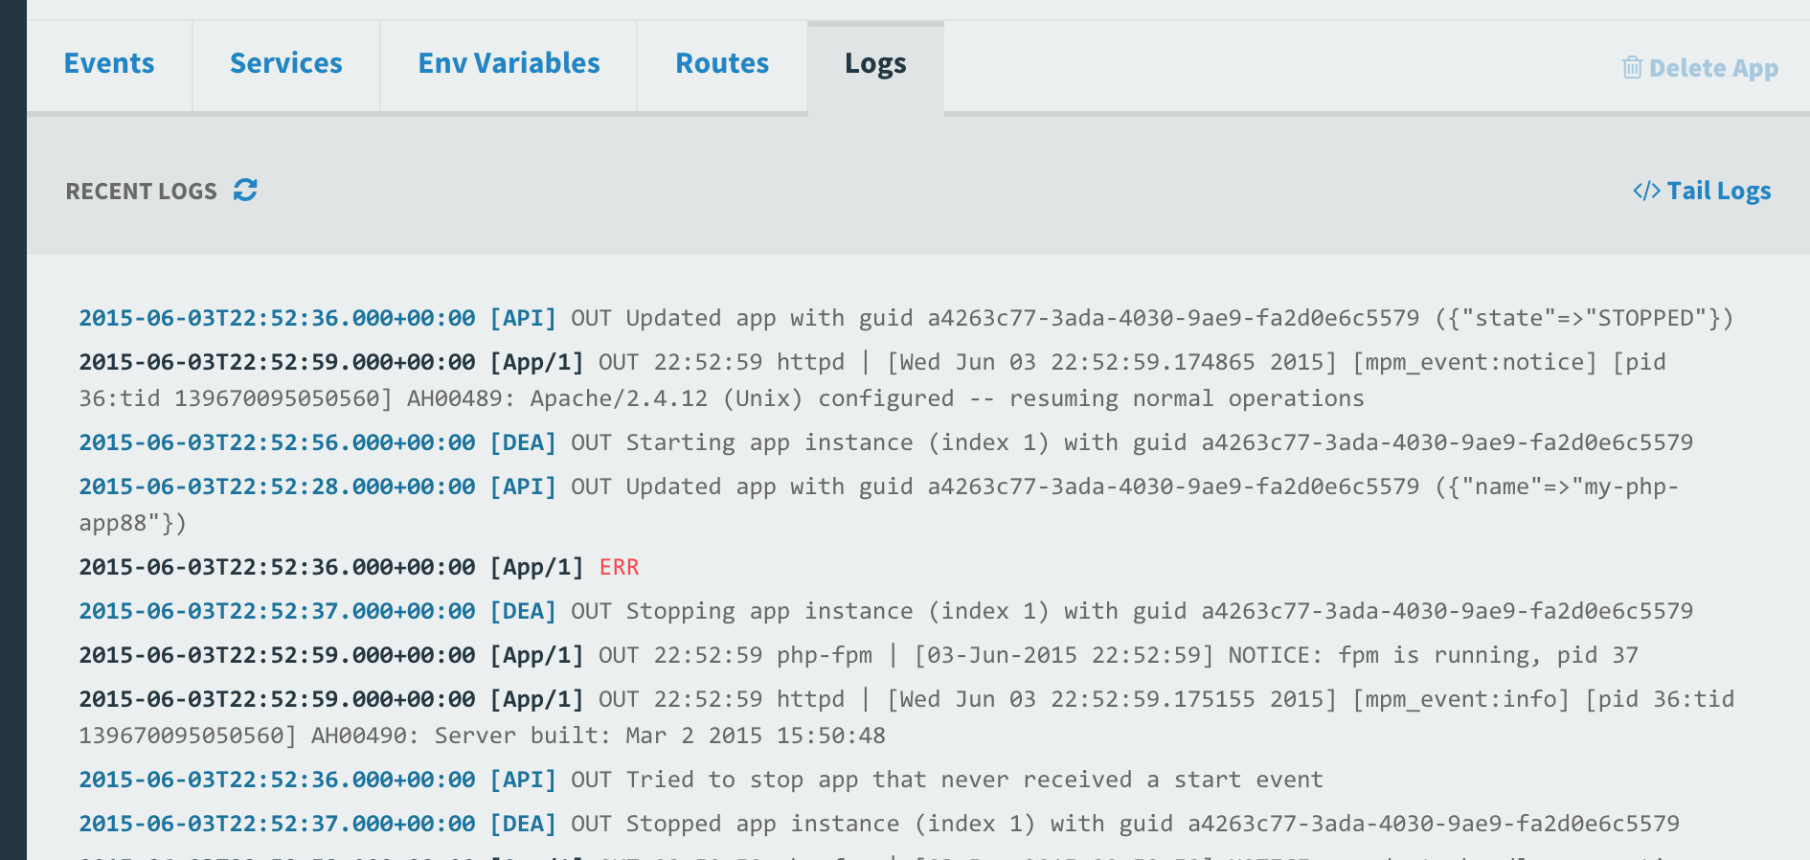
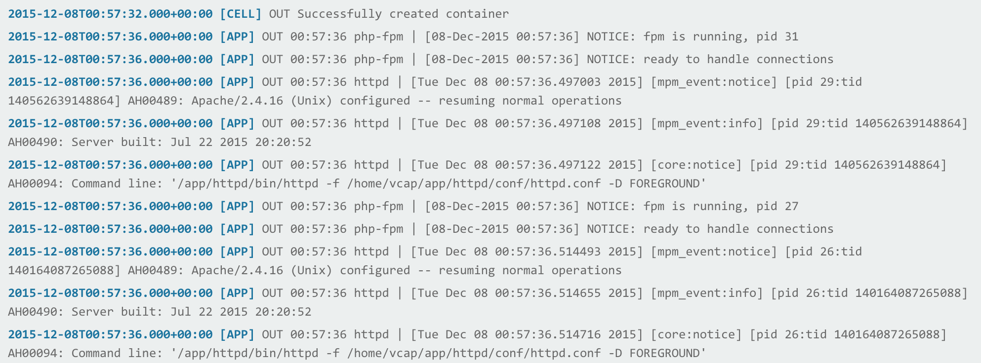
Viewing the Logs for your App using Apps Manager
In Apps Manager, select your app, then select Logs

Slide 7
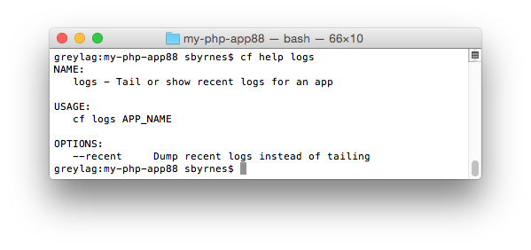
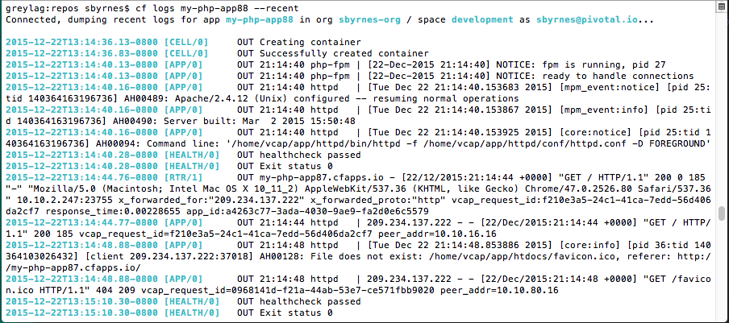
Viewing Recent Logs For an App using the cf CLI
Use cf logs <app_name> --recent

Slide 8
cf logs- Behind the Scenes
Cloud Foundry
Elastic Runtime
Router
Loggregator
Traffic Controller
cf logs MyApp
A component of the Loggregator system called the Traffic Controller receives and responds to requests for logs and metrics
Note: Loggregator typically sends logging traffic out over port 4443- your company’s inbound firewall must open this port in order to read logs using cf logs
  This port is configured in Ops Manager > Pivotal Elastic Runtime > Settings > IPs and Ports > Loggregator port
Notes:
Apps Manager can display logs without opening port 4443 because the path is from the Loggregator to the Apps Manager web app. That web app sends data to the browser over port 80 or 443.

Slide 9
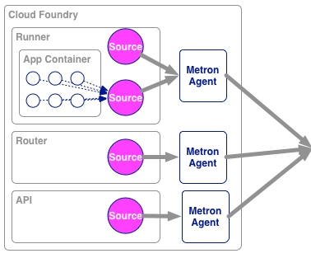
cf logs MyApp- Deeper Behind the Scenes
Sources of logging and metrics data send data to Metron Agents, which reside on Cloud Foundry components
The Metron Agents send the data to Doppler Servers
When the request for logs is made, the Traffic Controller gets the data from the Doppler Servers
Cell
cf logs MyApp
Traffic
Controller(s)
Doppler
Server(s)
Cloud Controller

Slide 10
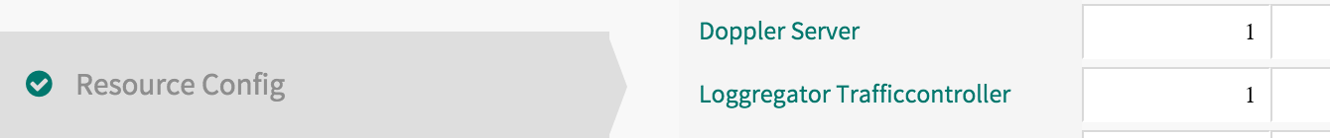
Scaling Logging and Metrics Data Handling
Doppler Servers and Traffic Controllers are components of the Loggregator system installed with Pivotal Elastic Runtime
The components may become lossy if the logging and metric data is too high (e.g. large number of Cells or apps)
  The system favors stability over logging everything
Scale these components using the Resource Config tab of Pivotal Elastic Runtime
You can also increase the Syslog Drain Buffer size on the System Logging tab (default is 100 messages)
Traffic
Controller(s)
Doppler
Server(s)

Slide 11
Syslog Drains
Syslog drains allow data related to an application to be sent to third-party log managers
The data from the Doppler Servers is sent to the Syslog drain
  The Traffic Controller is not used
Syslog
Drains
Cell
Nozzles
Traffic
Controller(s)
Datadog
Doppler
Server(s)
Open
TSDB
Firehose
Cloud Controller

Slide 12





Syslog Drains- Third-Party Log Managers
Recommended approach for application logging
  Can store far more logging information than Cloud Foundry
  Allow for persistence, storage, searching, analyzing, metrics
Variety of third-party log managers supported:
Notes:
The point is to use a tool specialized in log management rather than expecting CF to provide these features. There are lots of good choices.

Slide 13
Firehose and Nozzles
Traffic Controllers have a Firehose endpoint
The Firehose streams all the event data coming from an Elastic Runtime deployment
  Includes application logs, HTTP events and container metrics
  Includes metrics from all Elastic Runtime components
  Does not include Elastic Runtime component logs
Operators can deploy nozzles to the Firehose endpoint, which listen for a subset of data from the Firehose
Cell
Nozzles
Traffic
Controller(s)
Datadog
Doppler
Server(s)
Open
TSDB
Firehose
Cloud Controller

Slide 14
Topics
Loggregator System Overview
Application Logs and Metrics
Platform Logs and Metrics

Slide 15
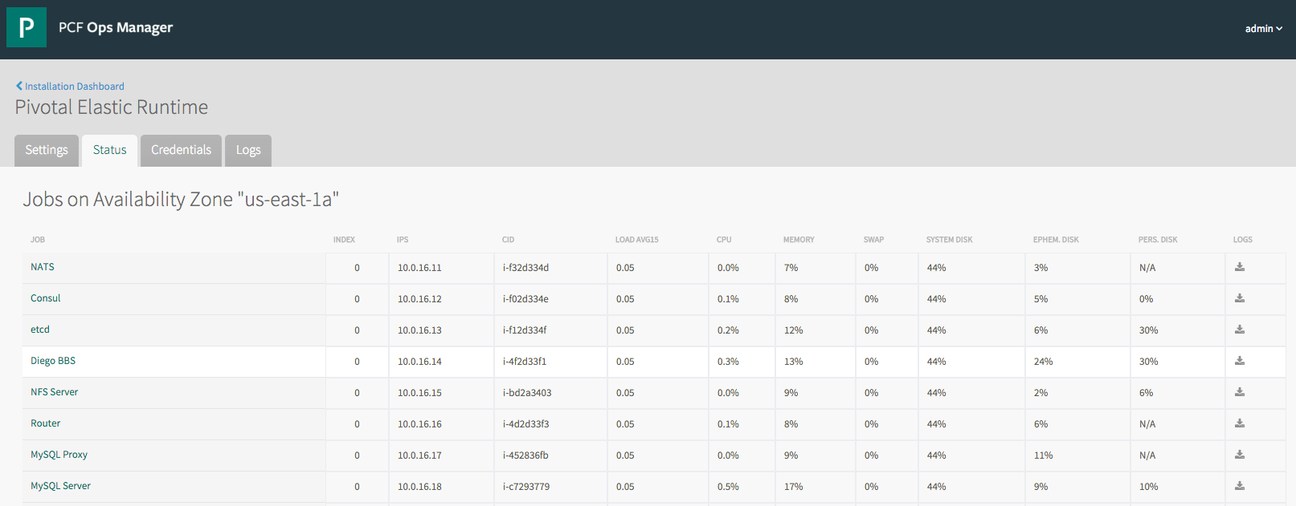
Download Platform Logs
Request the logs for a specific job

Slide 16
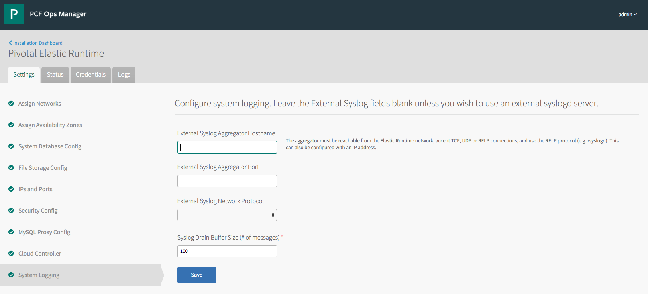
Platform syslog
Elastic Runtime can send system logs to an external syslog server
Configure this in the System Logging tab

Slide 17
Lab
Configuring Third-Party Log Management Tools with Cloud Foundry

