Slide 1
Application Performance Monitoring (APM) Integration

Slide 2


Application Performance
Monitoring (APM)
APM is for real-time monitoring of applications
Used to find and fix performance problems
  An agent in the application container monitors down to the line of code
  Can include client-side performance
Examples:
  New Relic
  AppDynamics
Notes:
AppDynamics works even though it is not present in the marketplace. The javabuildpack can add the agent.

Slide 3

Example- Pivotal Web Services and New Relic
PWS offers a simple interface to New Relic
  Available as a marketplace service
  Tracks different instances of an application
How to use:
  Create a New Relic service instance in a space
  Bind to the desired application(s)
  Re-stage or push the application
    PHP and Java buildpacks includes New Relic agent
    For others, include the agent with the application
  APM available as a link from within PWS

Slide 4
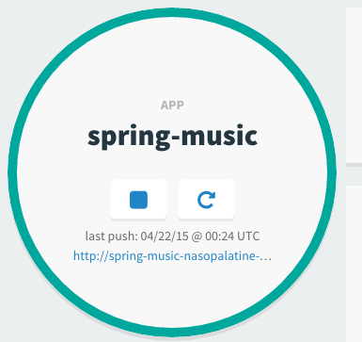
Pushing, Staging, Restarting
When you turn on APM for an existing application, the PHP and Java buildpacks add the agent when creating the droplet
This means that restarting the application will not turn on APM
  cf push uploads files and
  creates a droplet, optionally
  starts the app
  cf restage creates a droplet
  cf restart creates new app
  instances from the existing
  droplet- will not create a new
  droplet
X
restart uses the existing droplet

Slide 5
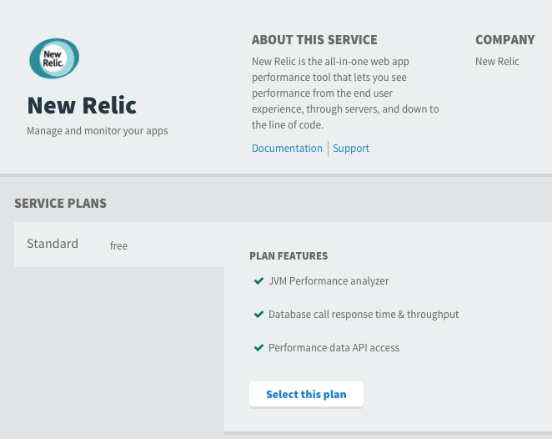
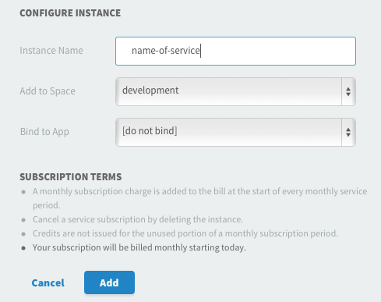
Creating the New Relic Service Instance
Apps Manager
cf CLI
>$ cf create-service newrelic standard apm

Slide 6
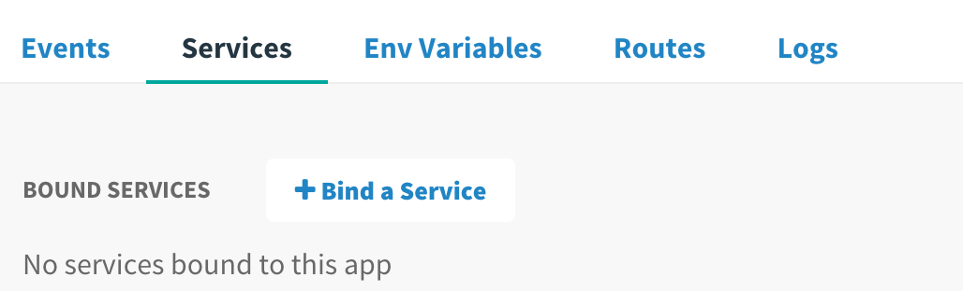
Bind Service Instance to an Application
Bind in Apps Manager when creating the service instance or from the Services tab for the application
Use the cf CLI
>$ cf bind-service your-app apm

Slide 7

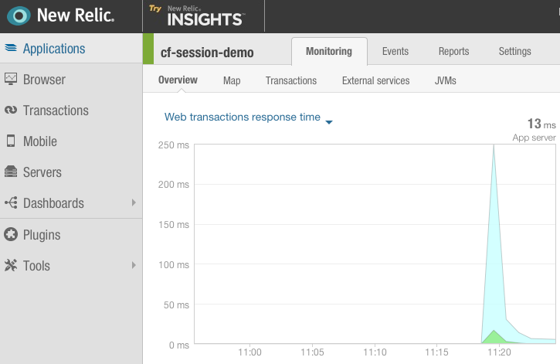
Access Data for the Service Instance via the Manage Link in Apps Manager

Slide 8
Lab
Configuring APM with Cloud Foundry

