Slide 1
Application Security Groups

Slide 2
Topics
Application Security Group overview
Application Security Group cf CLI commands

Slide 3
Application Security Groups- Default
Application Security Groups enable application containers to be locked down to only necessary outbound connections
By default, outbound traffic from application containers is not locked down
default: “all open”
app can make any request
- any destination
- any protocol
app instance
router

Slide 4
Application Security Groups- Locked Down
Can set rules to enable access to only certain IP addresses and/or protocols
  Acts as a virtual firewall
  Especially useful for highly regulated industries (financial services, government, healthcare, etc.)
The application containers are locked down by operators and the security rules are viewable by developers
locked down
app instance
app can not make any
external requests (only respond)
router

Slide 5
Application Security Group Rules
Enable specific egress (outgoing) traffic
  Whitelist (allow) only
  No support for deny
Rules specify:
  Protocol: TCP, UDP, ICMP
  Open port/port range
  Destination IP address or CIDR block
Rules are specified in a JSON file

Slide 6
Example JSON File
Only the protocols, IP address and ports listed are allowed
  TCP to ip-foo:3306
  TCP in IP range some-ip to another-ip on port 55882
[
{ "protocol":"tcp",
"destination":"<ip-foo>",
"ports":"3306" },
{ "protocol":"tcp",
"destination":"<some-ip>-<another-ip>",
"ports":"55882" }
]

Slide 7
Application Security Group Scope
Can be deployment wide (any space) or space-specific
Can apply to staging (push) or runtime
  Staging may allow more outbound traffic for things like downloading external files/artifacts

Slide 8
Topics
Application Security Group overview
Application Security Group cf CLI commands

Slide 9
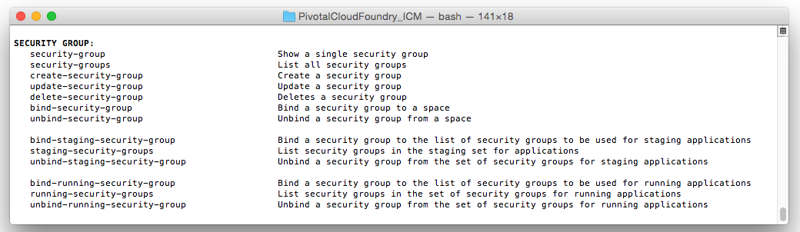
Application Security Group CLI Commands

Slide 10
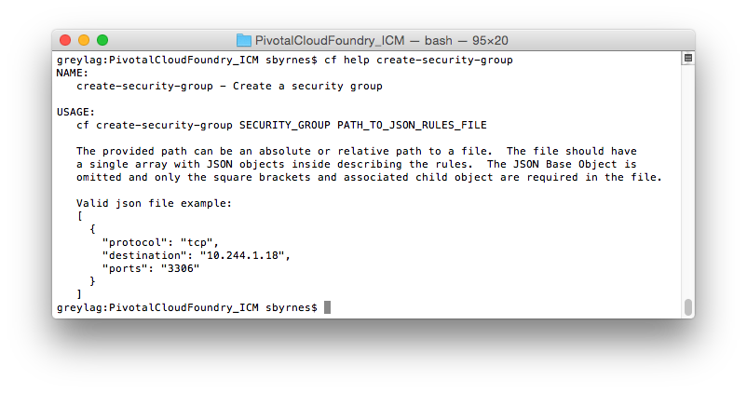
Creating an Application Security Group

Slide 11
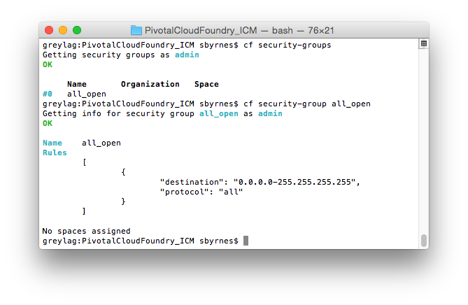
Default Installation- No Container Lockdown

Slide 12
Binding an Application Security Group
Deployment-wide
  bind-staging-security-group
  bind-running-security-group
Space-specific
  bind-security-group
You can bind multiple Application Security Groups
  Any rule that allows the outbound traffic sets the request to allow

Slide 13
Topics
Application Security Group overview
Application Security Group cf CLI commands

Slide 14
Lab
Create and apply Application Security Groups

