Slide 1
Organizations, Spaces, Users and Roles

Slide 2
Topics
Organizations and Spaces
Users and Roles

Slide 3
Organizations
Top-most administrative unit
Any Cloud Foundry installation can have multiple organizations defined in any way
  A logical way to organize users and resources
  Typically a company, department, application suite or large project
Designed to support many users working collaboratively
CF
Installation
Organization
Organization
Organization

Slide 4
Organizations in PWS
For Pivotal Web Services (PWS)
  There is at least one organization per PWS account
  Many PWS accounts share a single Cloud Foundry installation
PWS CF
Installation
Organization
Organization
Organization

Slide 5
Spaces
Organizations contain multiple spaces
  Default PWS space: development
  Spaces also can be defined in any way
  A logical way to organize users and resources
  For example, staging and production
Organization
Space
Space
Space

Slide 6
Spaces: Applications, Services and Users
Applications and services are scoped to a space
Provides a set of users access for:
  Application development
  Functionality and/or performance testing
  Quality assurance
  Deployment to production
  Maintenance
space: development
apps: myApp1, myApp2
services: MySQL
users: developerA, developerB

Slide 7
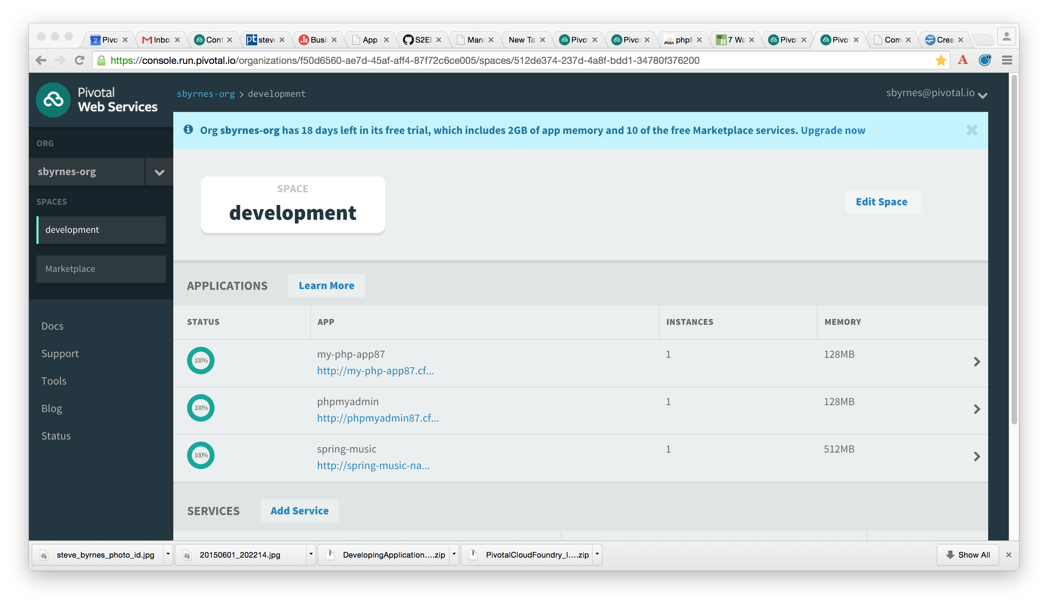
Organizations and Spaces in Apps Manager
When you log into PWS using a browser, you are using Apps Manager
  https://console.run.pivotal.io
You can view/modify organizations and spaces in Apps Manager
Organization
Space
Space
Space

Slide 8
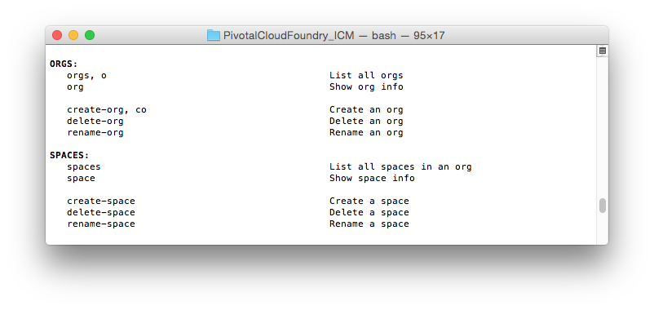
Organizations and Spaces with the cf CLI
You can use the cf CLI to work with organizations and spaces
From cf help...
Organization
Space
Space
Space

Slide 9
Topics
Organizations and Spaces
Users and Roles

Slide 10

Users and Roles
Users are members of an organization
  Usually they are operators or developers (not application end users)
  Users are sent an email invite and asked to create an account
Users have specific organization and space roles
  Organization roles grant permissions in an organization
  Space roles grant permissions in a particular space
  A combination defines the user's overall permissions

Slide 11
Organization Roles
Organization Manager
  Can do things like invite/manage users and roles, manage spaces, view application usage
Organization Auditor
  View-only access to all org and space info, settings, reports
Billing Manager
  Sets org spending limits, and works with invoices and payments
  Only relevant for Cloud Foundry environments deployed with a billing engine

Slide 12
Space Roles
Space Manager
  Can invite/manage users, enable features for a given space
  Can manage applications and services in a space
Space Developer
  Can create, delete, manage applications and services, full access to all usage reports and logs
Space Auditor
  View-only access to all space information, settings, reports, logs

Slide 13
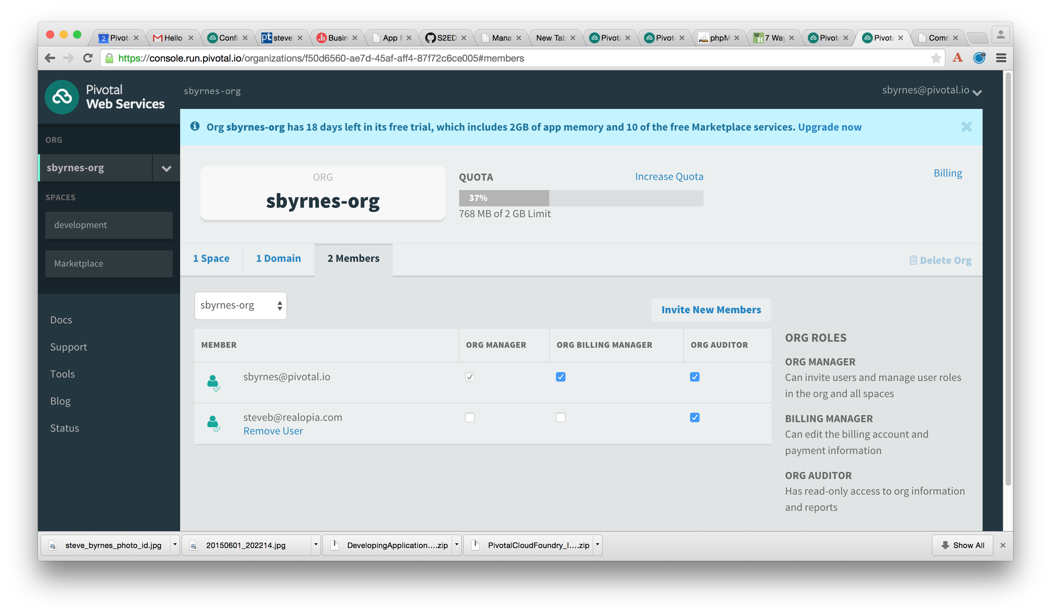
Users and Roles with Apps Manager
Invite members and assign roles with Apps Manager

Slide 14
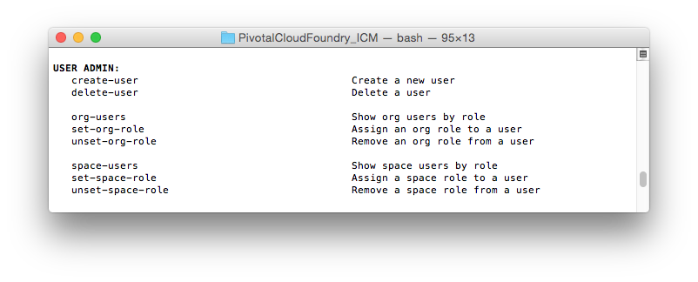
Users and Roles with the CLI
You can use the cf CLI to work with users and roles
From cf help...

Slide 15
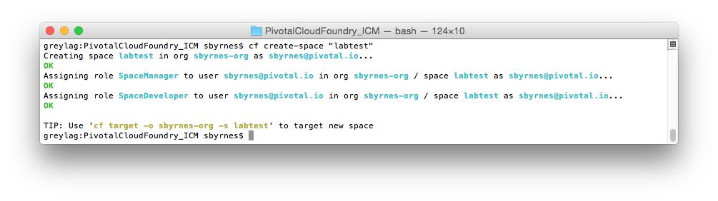
Roles when Creating a Space
Creating a space adds new roles for the organization manager in the new space
  SpaceManager
  SpaceDeveloper

Slide 16

The Administrator User
Special Administrator user / role defined
  Defined for the Cloud Foundry installation
  Separate from users defined at organization / space
Several cf commands restricted to Administrator only
  Setting organization and space quotas
  Defining security groups
  Administering services
  Adding, modifying and removing user accounts
Use without the right role, the cf CLI returns:
Server error, status code: 403, error code: 10003, message: You are not
authorized to perform the requested action

Slide 17
Topics
Organizations and Spaces
Users and Roles

Slide 18
Lab
Manage organizations and spaces
Manage users and roles

