Slide 1
Security and Single Sign-On (SSO)
For the platform and hosted applications

Slide 2
Topics
UAA Overview
Cloud Foundry Platform Users
Pivotal SSO Service
Service Plans
This module shows how OAuth 2.0 is implemented in Cloud Foundry, securing
the platform and allowing you to secure your cloud-native applications

Slide 3
User Authentication and Authorization (UAA) Server- Overview (1 of 2)
Multi-tenant component of the Elastic Runtime
Secures Elastic Runtime components, applications and APIs (e.g. Apps Manager and Cloud Controller API)
  Can also secure access to other applications/APIs using the Pivotal Single Sign-On (SSO) Service
Open source component based on industry standards such as SAML, OAuth 2.0 and OpenID Connect
Notes:
Essentially all Elastic Runtime components use UAA token-based authentication and authorization. This is true whether or not the component has an API. For example, Apps Manager sessions are secured with by the UAA.
Calls to the Cloud Controller API must include a valid token from the UAA.
The UAA is an open source component that can be used independently from the Elastic Runtime.

Slide 4
User Authentication and Authorization (UAA) Server- Overview (2 of 2)
Authenticates users
  Can store user credentials internally or using an external identity provider (Ping Identity, CA SSO, Azure ADFS, Okta ...)
Acts as an authorization server
  Issues tokens to client applications on behalf of users
  Enables the convenience and security of single sign-on (SSO) for platform applications (e.g. Apps Manager) and other applications (using the Pivotal SSO Service)

Slide 5
Topics
UAA Overview
Cloud Foundry Platform Users
Pivotal SSO Service
Service Plans

Slide 6
Cloud Foundry Platform Users
Cloud Foundry platform users are developers and operators using platform applications like Apps Manager or the cf CLI
There are three ways to store platform user credentials:
  Internal store- user information is stored in the UAA database
  LDAP- user information is stored in an LDAP server
    Configured on the Elastic Runtime’s LDAP Config tab
  Enterprise Identity Provider- user information is stored in an external service like CA SSO or ADFS
    Configured on the Elastic Runtime’s SSO Config tab
    This is the recommended approach for external platform users- it is more secure than LDAP
Note: Populate the LDAP Config tab or the SSO Config tab, but not both

Slide 7
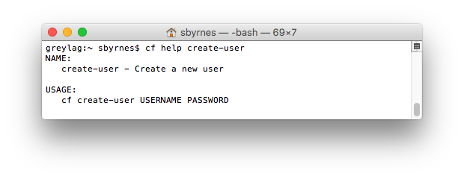
1) Using the Internal Store for Platform Users
The internal store uses the UAA database
Users can be added using Apps Manager
They can also be added with the cf CLI

Slide 8
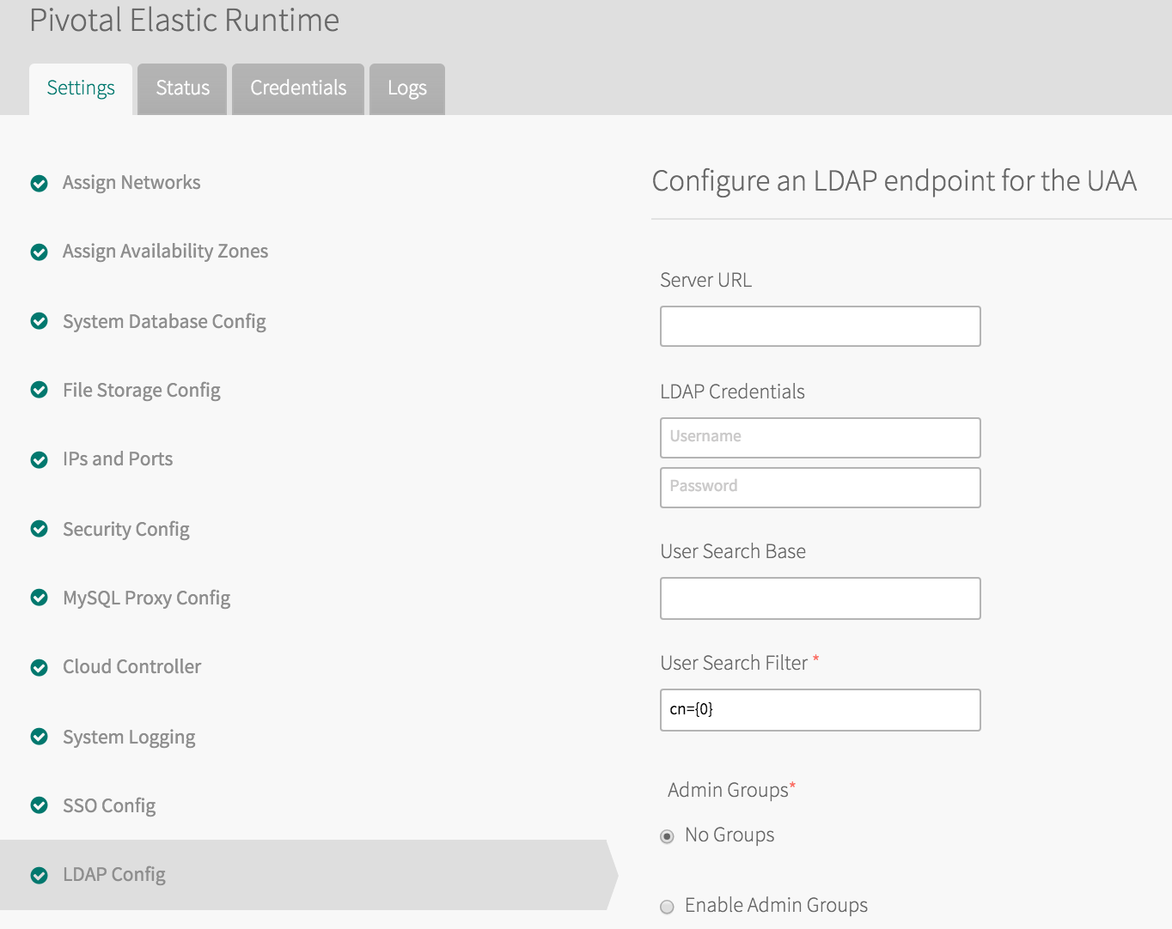
2) Using LDAP for Platform Users
The Elastic Runtime's LDAP Config tab configures the LDAP integration with the UAA
Notes:
In LDAP-enabled Cloud Foundry installations, only admins add users to the deployment.
Disable manual adding of users by setting the ENABLE_NON_ADMIN_USER_MANAGEMENT
environment variable to false in the apps_manager app in the apps_manager space of
the System organization. For all users imported via LDAP you need to define the org/space
mappings via the Cloud Controller API.

Slide 9

Security Assertion Markup Language (SAML)
XML-based, open-standard for exchanging authentication and authorization data between security domains
In Cloud Foundry, used to exchange user data between an external identity provider and the UAA
The UAA acts as the service provider
Identity Provider (IdP)
SAML
Service
Provider
(e.g. UAA)

Slide 10
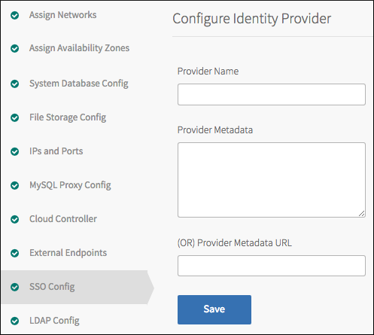
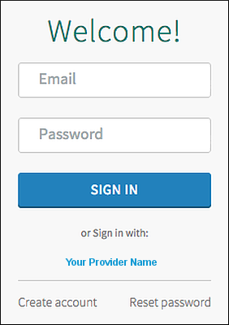
3) Configuring the UAA as a SAML Service Provider
Use the Elastic Runtime SSO Config tab to configure the UAA as a SAML service provider
Platform users will have the option to click on the “Your Provider Name” link on the login page
Your identity provider must also be configured to recognize Cloud Foundry as a service provider
https://docs.pivotal.io/pivotalcf/opsguide/sso.html
Notes:
The internal user store and a SAML service provider can both be used. This is why the login component has the option to enter internal user store credentials and the “sign in with your provider” capability. Currently, the login component displays both options, even if there are no users in the internal user store.

Slide 11
Topics
UAA Overview
Cloud Foundry Platform Users
Pivotal SSO Service
Service Plans

Slide 12



Pivotal Single Sign-On Service for Applications
Identity
Provider (IdP)
Pivotal SSO
Service
Applications
Provides SSO security and convenience to applications hosted on or external to the Cloud Foundry platform
Uses an internal user store (the UAA database) or an external SAML 2.0 compliant federated identity provider
  Certified with Ping Identity, CA SSO, Azure ADFS, ForgeRock Open AM, VMWare Identity Management, Okta
Implemented as a managed service (available in the marketplace)

Slide 13
The Benefits of SSO
Authorization Server / IdP
Resource
Server
Resource
Server
Client
Client
A main point of SSO is to prevent clients from directly passing user credentials to resource servers
Pass tokens from the authorization server instead
  Centralized identity and security policy management
  Better user experience / avoids multiple logins
  More secure
  Scales well in distributed environments (e.g. microservices)

Slide 14
Platform vs. Application SSO
Platform SSO- Used for securing platform components and applications such as the Cloud Controller or the cf CLI
  Users are Cloud Foundry operators and developers
Application SSO- The Pivotal Single Sign-On Service can be used to add security and SSO capabilities to applications
  The applications can be hosted on or external to the platform

Slide 15
Pivotal Single Sign-on Architecture
Single high availability multi-tenant UAA for securing platform and hosted applications
Each tenant gets its own virtual authorization server
Multiple SAML 2.0 external identity providers are supported
Each application has an associated OAuth client in the UAA
All applications must be OAuth 2.0-aware
Pivotal Cloud Foundry – Elastic Runtime
UAA (Multi-tenant)
Default Tenant- Elastic Runtime
Apps Manager
[PCF Platform App]
SAML SP
Apps Manager
[OAuth Client]
SAML IdP for App Developers
OAuth AuthZ Server
SAML
CF CLI
[OAuth Client]
CF CLI
[Client]
Tenant A (Service Plan)
App A
[PCF Hosted App]
SAML IdP for Employees
SAML
SAML SP
App A
[OAuth Client]
OAuth AuthZ Server
App B
[OAuth Client]
App B
[External App]

Slide 16
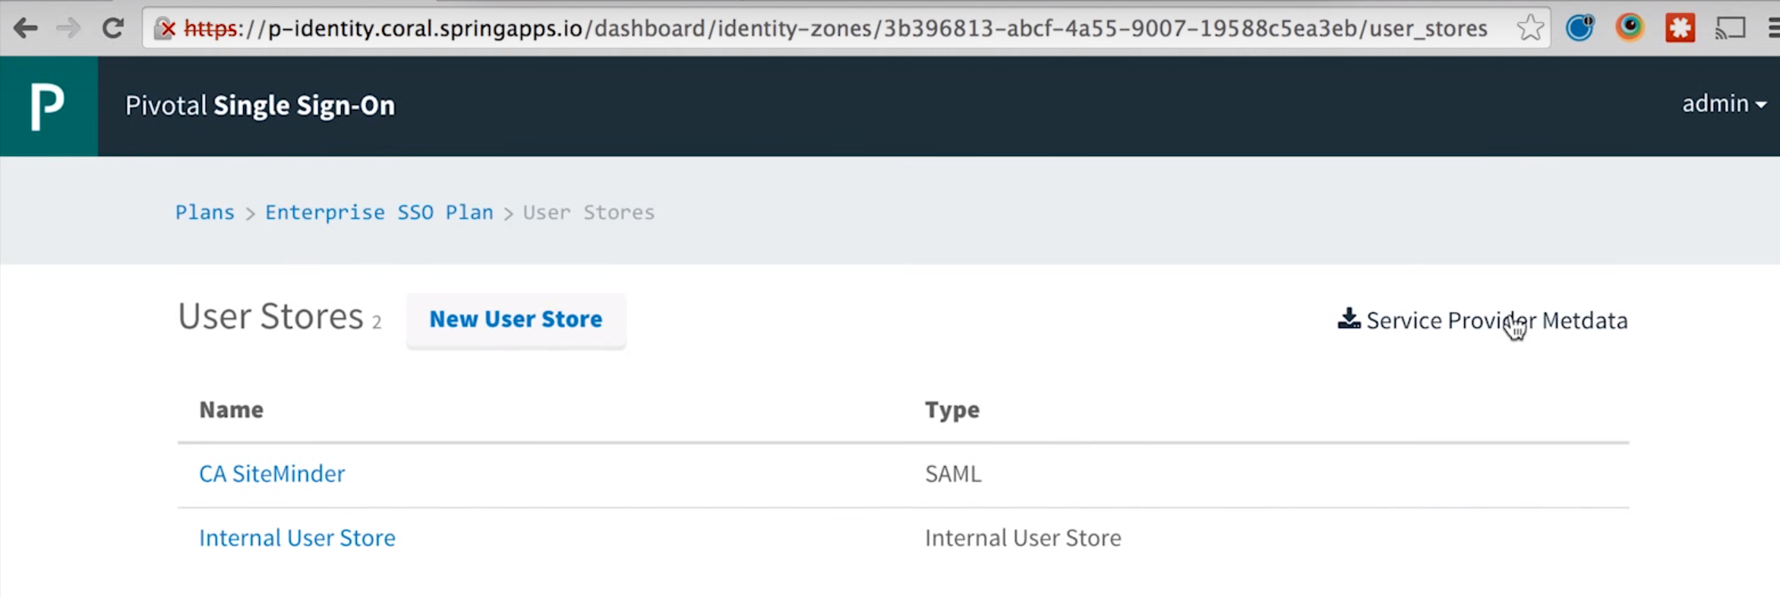
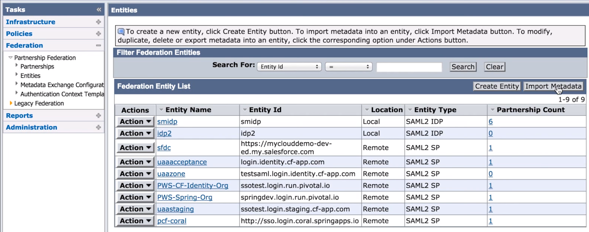
Configuring an External Identity Provider
Metadata is exchanged between the service provider and the identity provider (IdP) to establish trust
  Administrators onboard identity providers using https://p-identity.[system_domain] and the IdP administrative console
  This is analogous to using the Elastic Runtime’s SSO Config tab to configure an external identity provider for platform applications
https://www.youtube.com/watch?v=jttpVGpp6Qc
Notes:
To create users for a UAA tenant using the local store (UAA database), use the UAA CLI (UAAC). https://docs.cloudfoundry.org/adminguide/uaa-user-management.html

Slide 17
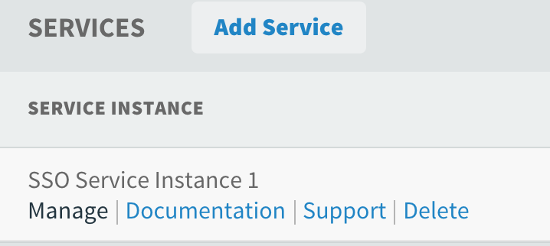
OAuth Clients on the UAA
An OAuth client is created on the UAA for each
application
  When you bind your application to the Pivotal SSO Service…
  … or register your application from the Pivotal Single Sign-On Service dashboard
This is the manual client registration stage of OAuth
  ClientID and ClientSecret are created
UAA (Authorization Server)
Client (OAuth-aware)
Tenant A (Service Plan)
AppA
[PCF Hosted App]
AppA
(OAuth Client on UAA)
ClientID=xyz
ClientID=xyz
AppB

Slide 18
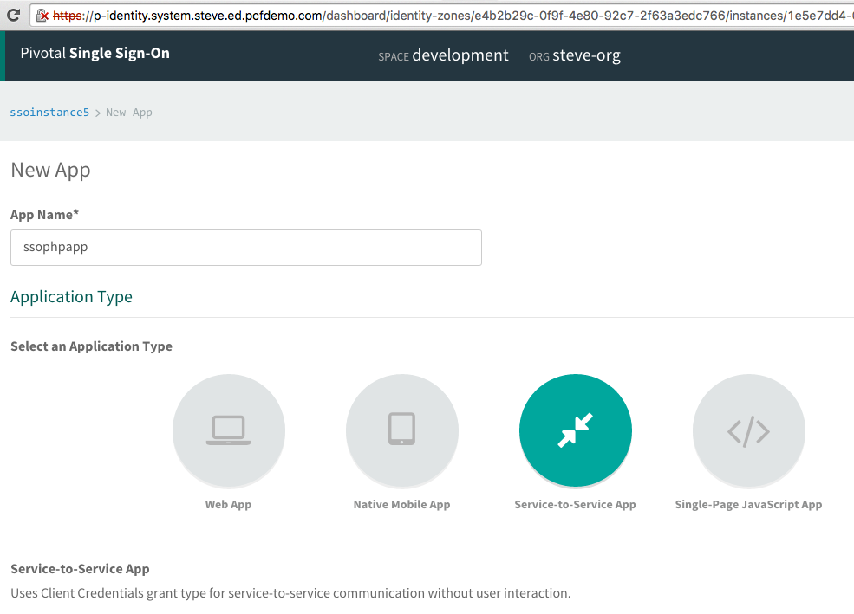
Dashboard
Click on the Manage link for a service instance in a
space to view the dashboard
Shows all of the OAuth clients on the UAA for the service instance
Can register a new OAuth client/app
  The OAuth client app name does not need to match the Cloud Foundry app name

Slide 19
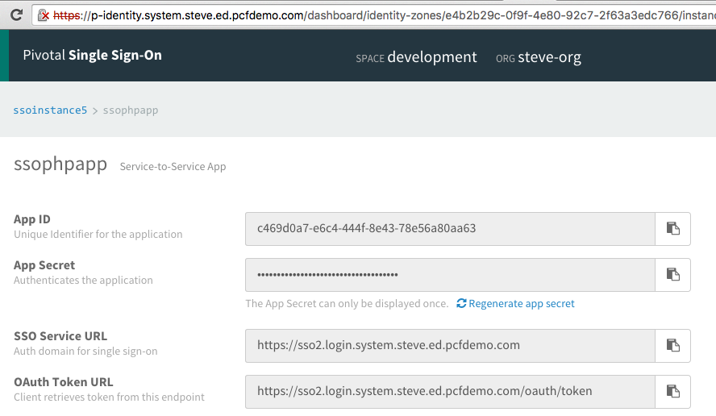
Dashboard
When you register an OAuth client, you receive the ClientID (App ID) and ClientSecret (App Secret)

Slide 20
Cloud Foundry Hosted Applications
If the application being protected is an application hosted on Cloud Foundry:
  Binding or registering the service using the dashboard adds the ClientID and ClientSecret as environment variables to app instances
  Those values are used to authorize the user and obtain tokens
UAA (Authorization Server)
Client (OAuth-aware)
Tenant A (Service Plan)
AppA
(OAuth Client on UAA)
authorization
AppA
redirect
Env variables:
ClientID=x
ClientSecret=y
ClientID=x
ClientSecret=y
token
AppB
Notes:
There is one authorization and token endpoint per UAA tenant. The authorization endpoint is protected using TLS (transport layer security)/SSL.
The authorization code is sent from the authorization server to the client after successful authentication of the resource owner/user. The code is only valid for a particular resource owner/user and for a short period of time. It is used to request tokens.
The ClientID is used to identify which OAuth Client the request applies to.
The authorization endpoint is part of the consent server on the authorization server.
We will see later that the grant_type is also sent with requests to the token endpoint. Extension grant types may define additional endpoints.

Slide 21
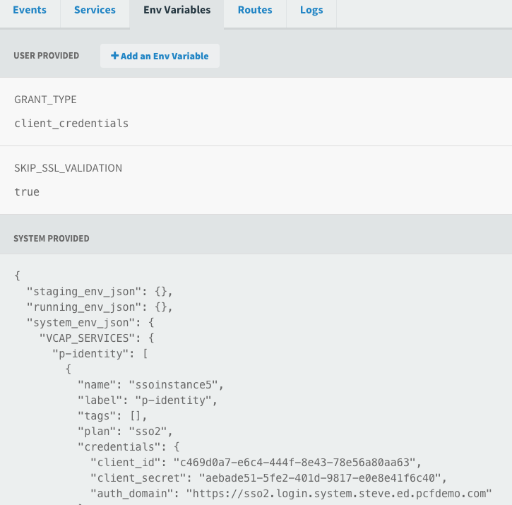
Cloud Foundry Hosted Applications- Environment Variables
  GRANT_TYPE is under user provided environment variables
  The credentials (client_id and client_secret) are system provided and are under the p-identity service

Slide 22
OAuth-Aware Applications
If you are using Java, there are Spring Boot-based sample applications for each of the four flows / grant types
  Uses the SSO Service Connector, which auto configures the application for OAuth
For non-Java applications, your application is responsible for OAuth integration and for validating tokens

Slide 23
Application Types
The type of OAuth client created on the Pivotal Single Sign-On server depends on the application type:
  Web App (grant_type=authorization_code)
  Native Mobile App (grant_type=password)
  Single Page JavaScript App (grant_type=implicit)
  Service-to-Service App (grant_type=client_credentials)
The application type is set in the GRANT_TYPE environment variable for the application needing to be secured
  The grant_type is sent with requests to the token endpoint of the UAA
Each application type represents a different authorization flow
Notes:
Grant type can be thought of as short for “authorization grant type”. Another grant_type is “refresh_token”. This is for cases where a refresh token is sent to the token endpoint rather than an authorization code.

Slide 24
Topics
UAA Overview
Cloud Foundry Platform Users
Pivotal SSO Service
Service Plans

Slide 25
Managed Service
The Pivotal Single Sign-On service is implemented as a managed service
  Available in the marketplace as service plans
Installing the SSO service creates a System > identity-service-space containing an identity-service-broker app
  Can access SSO logs from Apps Manager or the cf CLI
Enable SSO for an application in one of two ways:
  Bind the application to the service instance
  Register the application with the Pivotal Single Sign-On service dashboard
The application must be OAuth 2.0 aware

Slide 26
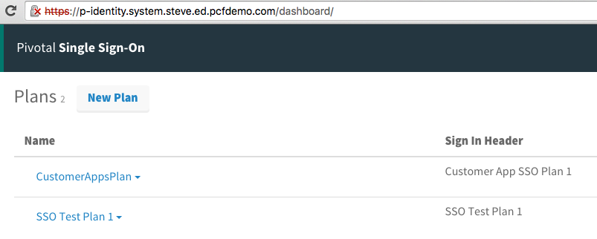
Creating and Viewing Service Plans
Use https://p-identity.[system domain] to create and view service plans (UAA tenants)

Slide 27
Service Plan Visibility
Single Sign-On Service Plan (UAA Tenant)
ORG (Service Plan Visible)
ORG (Service Plan Visible)
Space (Service Instance)
Space (Service Instance)
Space (Service Instance)
Space (Service Instance)
App
App
App
App
App
App
App
App
Enable a service plan for an org with cf enable-service-access

Slide 28
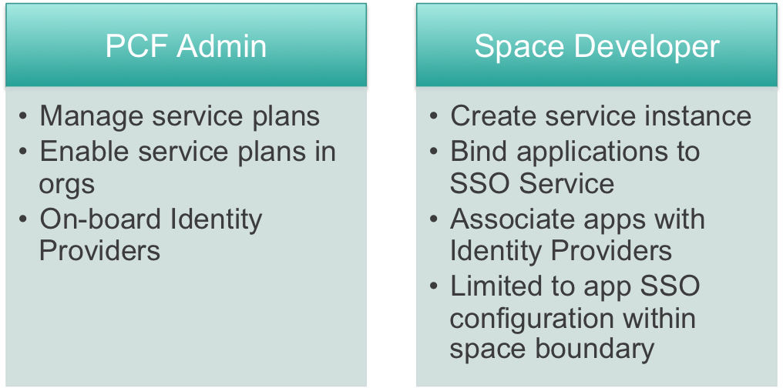
Role-based Access

Slide 29
Topics
UAA Overview
Cloud Foundry Platform Users
Pivotal SSO Service
Service Plans

Slide 30
Lab
- Set up a Single Sign-On Service plan
- Obtain an access token
- Secure an app with access tokens

