Slide 1
OAuth Primer

Slide 2
Topics
OAuth and OpenID Connect Introduction
OAuth Application Types

Slide 3

Why an OAuth Primer?
Securing the Cloud Foundry platform and applications includes OAuth
OAuth demonstrates a modern approach to securing highly distributed cloud-native applications

Slide 4
Authentication vs. Authorization
Authentication- Verifies the credentials of a user
Authorization- Verifies that connection from an authenticated user to a resource is allowed

Slide 5
OAuth 2.0
Open standard framework for delegated resource authorization
  http://oauth.net
  Flexible enough to handle many implementations and authorization flows
Designed for distributed systems
Allows third-party delegated access to secure resources via access tokens, not by sharing user credentials
Authorization Server
request
token
Client
access
token
access
token
Resource
Server
protected
resource
Notes:
OAuth is used for securing applications and APIs. It is used by many Software as a Service (SaaS) companies and by companies including Google, Twitter, LinkedIn, Amazon and EBay.
OAuth introduces an authorization layer in distributed systems. Tokens are used rather than user credentials.
OAuth 2.0 does not actually authenticate users. It would rely on something like a login component to do that. It also does not actually authorize the use of the resource. It would rely on an API to do that, based on the information passed to it related to the access token.

Slide 6

OpenID Connect (OIDC)
Delegated identity protocol built on top of OAuth 2.0
  http://openid.net/connect
Enables the client to use the authorization server to authenticate the user
  Complementary to resource authorization in OAuth 2.0
Provides the client basic profile information about the user
Enables a single set of user credentials to access multiple sites
Standard means of obtaining and verifying identity (ID) tokens
  ID tokens convey identity and authorization information
The UAA issues OAuth 2.0 or OpenID Connect ID tokens

Slide 7
OAuth / OpenID Connect Players
User
Agent
Identity Provider (IdP)
Resource Owner
Client
Authorization Server
Resource
Server
Resource Owner / User- The person or system wanting to access resources (provides credentials)
Client- Application wanting to access resources on the resource server (e.g. an app on a web server)
User Agent- The application used to access the client (e.g. a browser)
Authorization Server / OAuth Provider / OAuth Server / Token Server- Acts as a security intermediary- issues tokens
Identity Provider / User Store- Provides user information to the authorization server (Ping Identity, CA SSO, Azure ADFS, Okta, …)
Resource Server / Resource Provider- Contains the token-protected resources (services, APIs, etc.)
Notes:
The resource owner authorizes client to access the resource server.
The client registers to access the resource server.

Slide 8
OAuth / OpenID Connect- Example Players
browser
Okta
User
Agent
Identity Provider (IdP)
User/Resource Owner
Client
Authorization Server
Resource
Server
Cloud Foundry
developer
UAA
Apps Manager
Cloud Controller API
Note: Depending on the circumstances, some of the players are not used or are
combined
Notes:
In this example, the client is a distributed client. The browser and web application combined make up a client.
From the OAuth 2.0 specification:
A client may be implemented as a distributed set of components, each
with a different client type and security context (e.g., a
distributed client with both a confidential server-based component
and a public browser-based component). If the authorization server
does not provide support for such clients or does not provide
guidance with regard to their registration, the client SHOULD
register each component as a separate client.

Slide 9
Types of Clients
Confidential- can keep client authentication information and tokens secret
  Web application- client running on a web server
    No client credentials or tokens available to the resource owner
Public- client can not be trusted to hold client authentication information- client code is downloaded to the user agent
  Browser- single page JavaScript app
  Mobile app
Client
User
Agent
Note: A client can be distributed, e.g. consisting of a browser and a web app
Each component can have a different client type and security context
Notes:
The resource owner authorizes client to access the resource server.
The client registers to access the resource server.

Slide 10
Authorization Server
Identity Provider (IdP)
Authorization Server
Token
Server
Consent
Server
Token server- Creates and manages authentication codes and tokens
Consent server- Requests consent from an authenticated user for access rights for the client

Slide 11
OAuth Access Tokens and OpenID Connect ID Tokens
OAuth access tokens and OpenID Connect ID tokens are a confirmation of the delegation of access rights
  Avoids the password anti-pattern
Tokens have access rights associated with them
  Secure them with SSL/TLS (transport layer security) communications
  They usually are signed/self validating JSON Web Tokens (JWT)

Slide 12
Types of Tokens
Access token and ID token
  Sent by the client to the resource server to access protected resources
  May be valid for a short period (implementation specific)
  Can be verified by the authorization server or the resource server
Refresh token
  Valid for a longer period
  Used to request a new access or identity token when the current one expires
  The process is transparent for the resource owner
  When a refresh token expires, the client must re-authenticate
  Usually involves a database lookup, so authorization can be revoked

Slide 13
Topics
OAuth and OpenID Connect Introduction
OAuth Application Types

Slide 14
Application Types
There are four application types defined in the OAuth 2.0 spec:
  Web App (grant_type=authorization_code)
  Native Mobile App (grant_type=password)
  Single Page JavaScript App (grant_type=implicit)
  Service-to-Service App (grant_type=client_credentials)
Each application type represents a different authorization flow
Some application types are more secure than others- the spec is flexible
Notes:
Grant type can be thought of as short for “authorization grant type”. Another grant_type is “refresh_token”. This is for cases where a refresh token is sent to the token endpoint rather than an authorization code.

Slide 15
Stages of OAuth Security
Registration
  Client, authorization server and resource server establish trust by exchanging metadata and secrets
  This is usually a one-time, manual setup to enable token exchange
  This is when the ClientID and ClientSecret are created
Authorization
  The client requests permission to access protected resources for a particular user
Token Exchange
  Tokens provided to the resource server when accessing protected resources
Notes:
During registration, a client passes a redirect_uri to the authorization server and receives a ClientID and ClientSecret.

Slide 16
OAuth RESTful Endpoints/Services used with the Application Types
On the authorization server:
  authorization- provides a client with an authorization code
  token- accepts an authorization code or refresh token from the client and returns refresh and access tokens
    Protected using HTTP Basic authentication with ClientID:ClientSecret (base64 encoded)
On your OAuth 2.0-aware application (client):
  redirect- callback entry point on the client- receives the authorization code from the authorization endpoint
    The redirect_uri provided by the client during registration must match the redirect_uri sent during an authorization request
Authorization Server
Client (OAuth-aware)
authorization
app
redirect
ClientID=xyz
token
Notes:
The authorization endpoint is protected using TLS (transport layer security)/SSL.
The authorization code is sent from the authorization server to the client after successful authentication of the resource owner/user. The code is only valid for a particular resource owner/user and for a short period of time. It is used to request tokens.
The ClientID is used to identify which OAuth Client the request applies to.
The authorization endpoint is part of the consent server on the authorization server.
We will see later that the grant_type is also sent with requests to the token endpoint. Extension grant types may define additional endpoints.

Slide 17
Authorization Code Flow (grant_type=authorization_code)
Default and most secure flow- no access token on the browser, no user/password sent to client
Optimized for confidential clients
  The client must securely be able to hold the ClientID, ClientSecret and tokens
Called 3 legged OAuth because the identity of the three main actors is checked (authorization server, resource owner, client)
ClientID
ClientSecret
authcode
Authorization Server
request
token
Client
access
token
access
token
Resource
Server
protected
resource
Notes:
Initial client registration for client/resource provider trust (this can be a manual process)
Client gets a ClientID and ClientSecret from the OAuth provider
These are used as credentials for the /token endpoint (protected by HTTP Basic Authentication)
The client provides the redirect URI to the OAuth provider (this is used later to compare the the URI sent to the /authorization endpoint from the client)
When a resource owner/user wants to access a protected resource (first time):
Client requests an authorization code from /authorization endpoint of the OAuth provider
The OAuth provider authenticates the user’s credentials
The passed in redirect URI must match the one stored during the initial client registration
Client obtains refresh (long term) and access (shorter term) tokens from the
/token endpoint of the OAuth provider
The client sends the ClientID, ClientSecret and authorization code when requesting tokens
When the client has tokens:
Client passes an access token along with requests to the resource provider for protected resources (it is passed as a bearer token in the authorization HTTP header field)
If the access token has expired, the refresh token can be used to get a new one without having the resource owner/user re-enter credentials
Resource provider verifies the access token using the OAuth provider
Returns status code 401 (Unauthorized), 403 (Forbidden)
If 403, client can call the token endpoint with a refresh token or go back to the authorization endpoint

Slide 18
Password Flow (grant_type=password)
Sometime called “native mobile app” or “resource owner password” flow
For cases when the resource owner trusts giving the password to the client (e.g. same company)
  Usually the resource owner only trusts the Authorization Server login component
The client uses the username and password when requesting tokens, but does not store them after that
  Only the access and refresh tokens should be stored by the client
Uses credentials as authorization- no authorization endpoint is used
“I trust you
with my
password”
User/Resource Owner
Client
Authorization Server
Resource
Server

Slide 19
Password Flow (grant_type=password)
Client first registers with the OAuth provider- obtains ClientID and ClientSecret
Client requests (via HTTP POST) tokens from the token endpoint of the OAuth provider
  The client uses base64-encoded value of ClientID:ClientSecret in the Authorization HTTP header
  Credentials are passed as form parameters: username, password and grant_type=password
  Response is JSON containing access and refresh tokens, and expiration
ClientID
ClientSecret
username
password
Authorization Server
Client
access
token
access
token
Resource
Server
protected
resource

Slide 20
Password Flow Example- UAA API
To obtain an access token, use UAA’s /oauth/token endpoint
This token can then be used to make Cloud Controller API calls
curl -k -H 'AUTHORIZATION: Basic Y2Y6'
-d 'username=[username]&
password=[password]&grant_type=password'
https://uaa.[path to system domain]/oauth/token

Slide 21
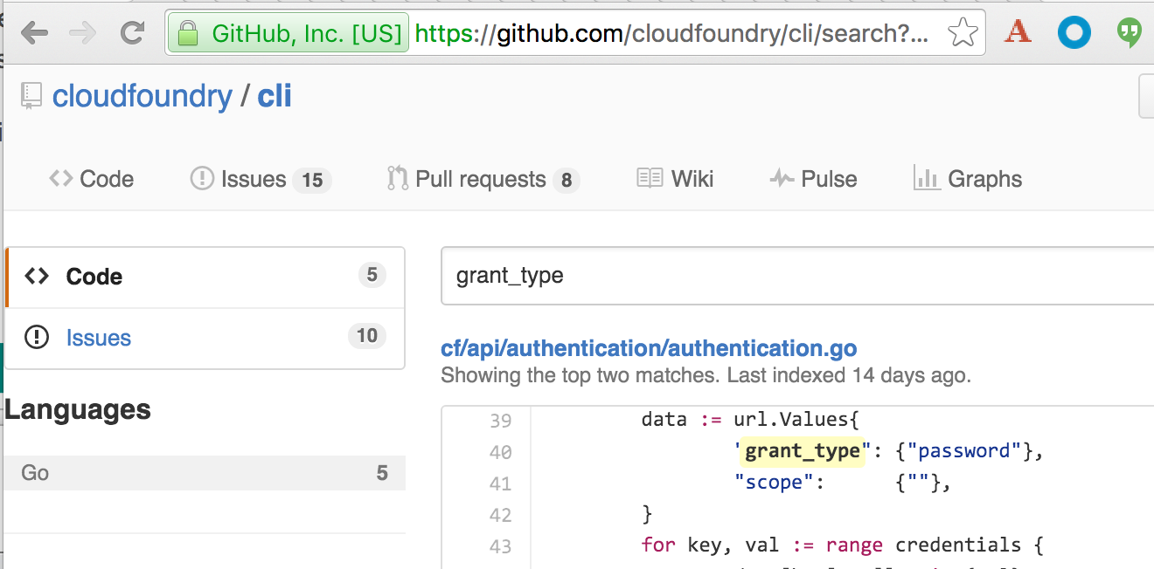
Password Flow Use- cf CLI
The cf CLI is an open source client that makes Cloud Controller API calls
You can search the source code of the cf CLI for grant_type:
The cf CLI uses the password grant type- users provide their password directly to the application rather than using a login component

Slide 22
Single Page JavaScript App Flow (grant_type=implicit)
For cases where the client can’t securely hold the refresh token and ClientSecret (e.g. JavaScript in the browser)
  No refresh tokens or ClientSecrets are used
  Access tokens are issued directly from the authorization endpoint- no authorization code is used
  Only the ClientID and redirect_uri are sent when requesting tokens
  The redirect_uri sent must match the redirect_uri sent when originally registering the client
Simple but less secure- only one call to the authorization endpoint is necessary
Authorization Server
ClientID
redirect_uri
redirect_uri
Client
access
token
Resource
Server
access
token
protected
resource
Notes:
Client registers with OAuth server, passing a redirect_uri and receiving a ClientID
Client requests a token from the authorization endpoint using HTTP Get with a ClientID query parameter and response_type=token
Redirect_uri value passed is compared to registration value
token endpoint not involved
access token is returned as part of URL during redirect (status code 302 (Moved Permanently))
On redirect, browser keeps the parameters, only the base URI is used for redirecting

Slide 23
Service-to-Service App Flow (grant_type=client_credentials)
Also known as 2 legged OAuth
For cases where the client is also the resource owner, or there is no resource owner
  User credentials not necessary- client credentials are used for the authorization grant
Client must register with the OAuth server, and receives a ClientID and a ClientSecret
Client then sends the ClientID and ClientSecret to the token endpoint
Client must securely keep the ClientID, ClientSecret, access token and refresh token
No authorization endpoint or redirect_uri is used
Authorization Server
ClientID
ClientSecret
Client
access
token
Resource
Server
access
token
protected
resource
Notes:
Client requests (via HTTP POST) tokens from the token endpoint of the OAuth provider
The client uses base64-encoded value of ClientID:ClientSecret in the Authorization HTTP header
Form parameters grant_type=client_credentials
Response is JSON containing access and refresh tokens, and expiration

Slide 24
Summary
OAuth is an open standard framework for delegated resource authorization
An authorization server acts as security intermediary, which is especially useful for distributed applications
Tokens are used instead of credentials
There are four application types commonly used, depending on the situation
  Web App (grant_type=authorization_code)
  Native Mobile App (grant_type=password)
  Single Page JavaScript App (grant_type=implicit)
  Service-to-Service App (grant_type=client_credentials)

