Slide 1
Service Brokers
Adding Managed Services

Slide 2
Topics
Managed Services Overview
Service Broker API
Service and Service Broker Implementation
MySQL Service for Pivotal Cloud Foundry

Slide 3
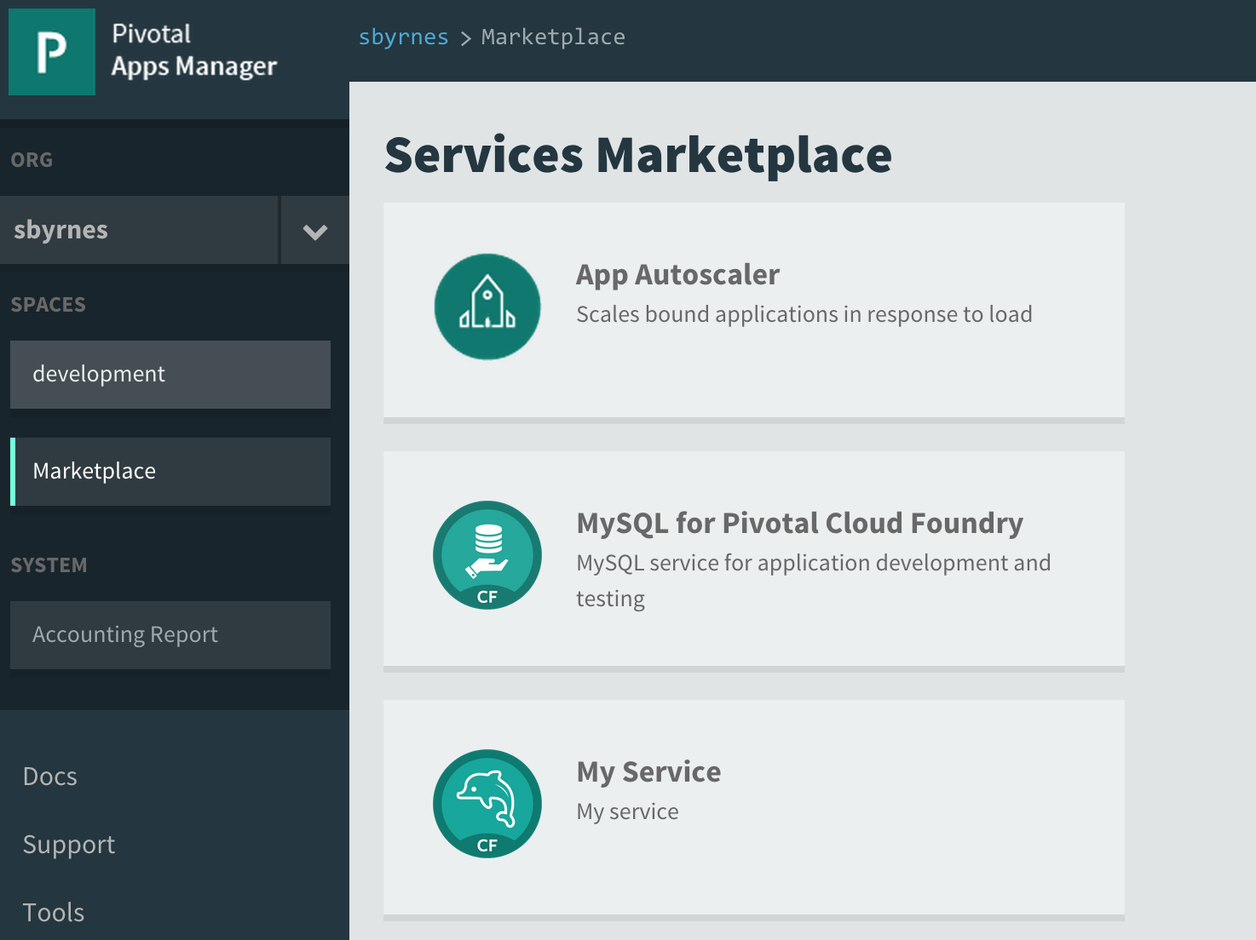
Why Managed Services?
A managed service is a “first class” citizen on the Cloud Foundry platform
  Available in the marketplace
  Has service plans
  Can provision or reserve resources
  Can provision credentials
  Services instances can be created
For operators:
  Can add a custom service to the platform and let the developers provision them
For developers:
  Can provision and use services immediately and without involving operations
  Increases agility

Slide 4
Managed Services
Available as plans in the marketplace
The service may be a Cloud Foundry application
The service may be a BOSH deployment (for example, MySQL)
Includes a service broker, which implements a service broker API
The service broker may be a Cloud Foundry application

Slide 5
Service Broker Overview
Service brokers provide a standardized way to add a managed service to the Cloud Foundry platform
  Service broker API
Create a service broker to add a custom service to the marketplace

Slide 6
The Services Big Picture
Service
Managed
Service
Space
Service
Broker
cf create-service
(provision resources)
Service
Instance
Application
User-Provided
Service
connection info as env variables
cf cups
(pass in connection info)
For managed services, connection info is provisioned when binding the service instance to the application
Notes:
cf cups= cf create-user-provided-service
Once a service instance is created, the developer uses the service instance in much the same way for managed and user-provided services. The connection information is passed to the application as environment variables. For managed services, the developer can also discover the service in the marketplace and immediately provision and use it.

Slide 7
Topics
Managed Services Overview
Service Broker API
Service and Service Broker Implementation
MySQL Service for Pivotal Cloud Foundry

Slide 8
The Cloud Controller vs. Service Broker APIs
Cloud
Controller
API
Service
Broker
API
Cloud
Controller
Service
Broker
cf CLI
Requests from developers or operators related to services start with the cf CLI or other client
The cf CLI actually uses the cloud controller API
The cloud controller calls the service broker API

Slide 9
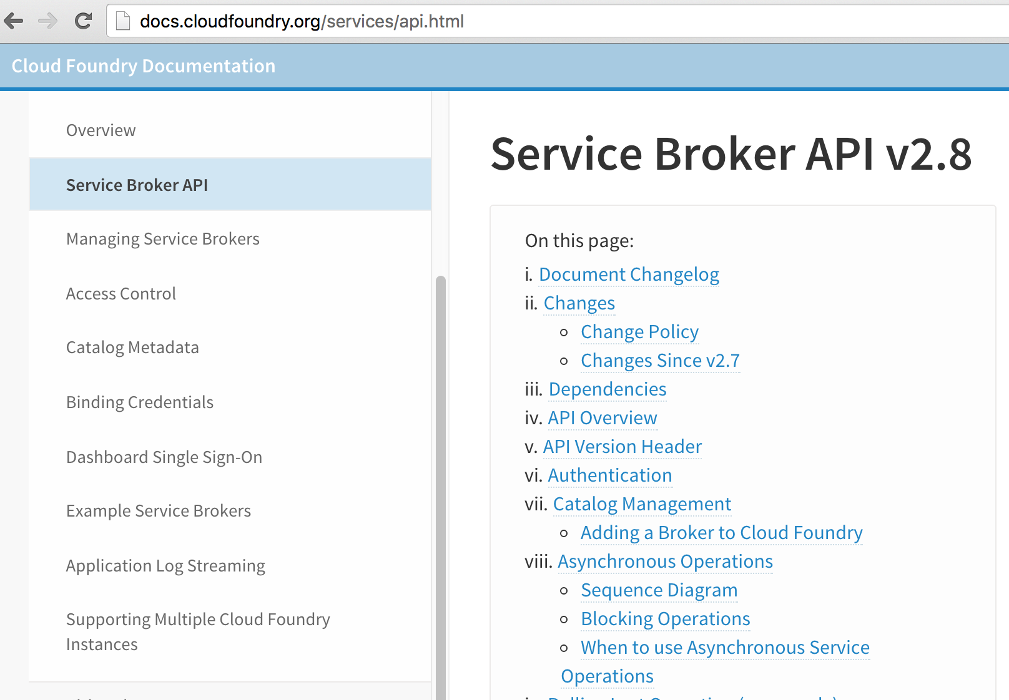
Service Broker API

Slide 10
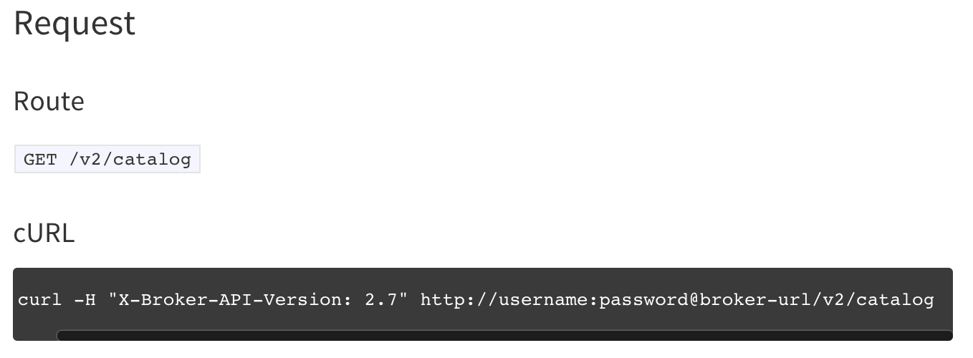
Service Broker API: /catalog
The /catalog endpoint returns JSON with information like the service's name, description and plans
The catalog is visible in the marketplace

Slide 11
Service Broker API: /service_instances
PUT /v2/service_instances/:instance_id
  Create (provision) a new service instance
  For longer operations, use asynchronous provisioning by appending accepts_incomplete=true
  The cloud controller creates and passes a unique :instance_id to the service broker
  The :instance_id is used for future calls, such as the DELETE
DELETE /v2/service_instances/:instance_id
  Delete (deprovision) a service instance
Notes:
For synchronous operations, the service broker must respond to a request within 60 seconds. This may not be enough time to actually fulfill the request. For example, actually provisioning a new MySQL Server takes more than 60 seconds
For asynchronous operations, the client passes the accepts_incomplete=true parameter to the Cloud Controller, which passes it to the service broker. Cloud Foundry then polls a REST endpoint to determine when the operation has completed. Clients such as the cf CLI can then report that the operation is still in progress
http://blog.pivotal.io/pivotal-cloud-foundry/products/a-look-at-cloud-foundrys-service-broker-updates

Slide 12
Creating a Service Instance
The cf create-service command is executed, making the service instance available to the current space
  Calls the service broker’s PUT /v2/service_instances/:instance_id endpoint
CLI
create service
Cloud Controller
/service_instances
Service
Broker
reserve resources
Data
Service
Router
Elastic Runtime

Slide 13
Service Broker API: /service_bindings
PUT /v2/service_instances/:instance_id/service_bindings/:id
  Create a new binding to a service instance
  Results in connection information passed from the service broker to the cloud controller and its database
    The service broker should provision but may also reuse credentials
  The :instance_id is from the /service_instances endpoint
  The :id represents the service binding and is created and passed from the cloud controller
    The cloud controller associates the service instance, service binding and the application
DELETE /v2/service_instances/:instance_id/service_bindings/:id
  Unbind from a service instance
Notes:
Binding is optional for a service (set:bindable:false in the catalog).
Applications should be issued unique service credentials whenever possible, so one application’s access can be revoked without affecting other bound applications .

Slide 14
Binding a Service
The cf bind-service command is executed
  Calls the service broker’s endpoint- PUT /v2/service_instances/:instance_id/service_bindings/:id
  Adds service credentials for the bound application to the cloud controller database
  Those credentials are passed to application instances via environment variables
service
credentials
DB
CLI
create service
Cloud Controller
/service_instances
Service
Broker
reserve resources
Data
Service
Router
bind service
/service_bindings
obtain service credentials
Elastic Runtime

Slide 15
Service Broker API- Update Service
Plan
PATCH /v2/service_instances/:instance_id
  Update a service instance to a different plan
  The /catalog endpoint must include plan_updateable: true

Slide 16
Service Broker API- Summary
GET /v2/catalog
  List services and plans available from this broker
PUT /v2/service_instances/:instance_id
  Create (provision) a new service instance
DELETE /v2/service_instances/:instance_id
  Delete (deprovision) a service instance
PATCH /v2/service_instances/:instance_id
  Update a service instance to a different plan
PUT /v2/service_instances/:instance_id/service_bindings/:id
  Create a new binding to a service instance
DELETE /v2/service_instances/:instance_id/service_bindings/:id
  Unbind from a service instance

Slide 17
Topics
Managed Services Overview
Service Broker API
Service and Service Broker Implementation
MySQL Service for Pivotal Cloud Foundry

Slide 18
Service Broker Implementation
Service broker implementation is up to the service provider/developer
Cloud Foundry only requires that the service provider implement the service broker API
Deploy using cf create-service-broker
  Requires admin privileges
  The service is then available in the marketplace
Notes:
cf create-service-broker causes the cloud controller to fetch and validate the catalog from your service broker, and save the catalog to the cloud Controller database. The basic auth username and password which are provided when adding a broker are encrypted in Cloud Controller database, and used by the Cloud Controller to authenticate with the broker when making all API calls. Your service broker should validate the username and password sent in every request; otherwise, anyone could curl your broker to delete service instances.
Documentation can be found at:
http://docs.cloudfoundry.org/services/managing-service-brokers.html

Slide 19
Developing a Custom Service Broker
Several GitHub projects exist
  Use as starting points for defining a service broker
Download generic project at
  https://github.com/cloudfoundry-community/spring-boot-cf-service-broker
Or rework Mongo DB example project
  https://github.com/spring-cloud-samples/cloudfoundry-service-broker

Slide 20
Service Instance Provisioning Examples
For non-data services, provisioning could just mean getting an account on an existing system
For the MySQL for Pivotal Cloud Foundry service, provisioning results in a database being created on the installed MySQL server
The Cloud Foundry platform is flexible and can support many MySQL provisioning examples
  Creating new MySQL server instances running on its own VM or in a container on a VM
  A database with business schema already there
  A copy of a full database, for example a QA database that is a copy of the production database

Slide 21
Service and Service Broker Deployment Models (1/3)
Service and service broker pushed as applications in an Elastic Runtime space
Service broker endpoints can be added to an existing service
Elastic Runtime
Service Broker
Service
BOSH

Slide 22
Service and Service Broker Deployment Models (2/3)
Entire service (and optionally service broker) packaged and deployed by BOSH alongside Cloud Foundry
This is the MySQL for Pivotal Cloud Foundry model
Elastic Runtime
Service
Service Broker
Service
BOSH

Slide 23
Service and Service Broker Deployment Models (3/3)
Entire service, including service broker, deployed and maintained outside of BOSH and the Elastic Runtime
Elastic Runtime
Service Broker
Service
BOSH
Any combination of the deployment models will also work

Slide 24
Topics
Managed Services Overview
Service Broker API
Service and Service Broker Implementation
MySQL Service for Pivotal Cloud Foundry

Slide 25
Example: MySQL Service
Pivotal Web Services
  The MySQL Server and service broker have already been installed
  MySQL services are available in the marketplace
For custom installations
  Use Ops Manager to install the MySQL for Pivotal Cloud Foundry tile
    The MySQL Server and service broker are installed using BOSH, based on settings in Ops Manager
  MySQL services are then available in the marketplace

Slide 26
MySQL for Pivotal Cloud Foundry Service Provisioning and Binding
MySQL database provisioning (cf create-service)
  The service is pre-provisioned by BOSH when the MySQL tile is installed or updated
  When creating a service instance, a “create database” statement issued on the installed MySQL Server
MySQL binding (cf bind-service)
  MySQL user and password are created for the application
  Credentials are passed to the application instances as environment variables
  The user is granted access to the schema

Slide 27
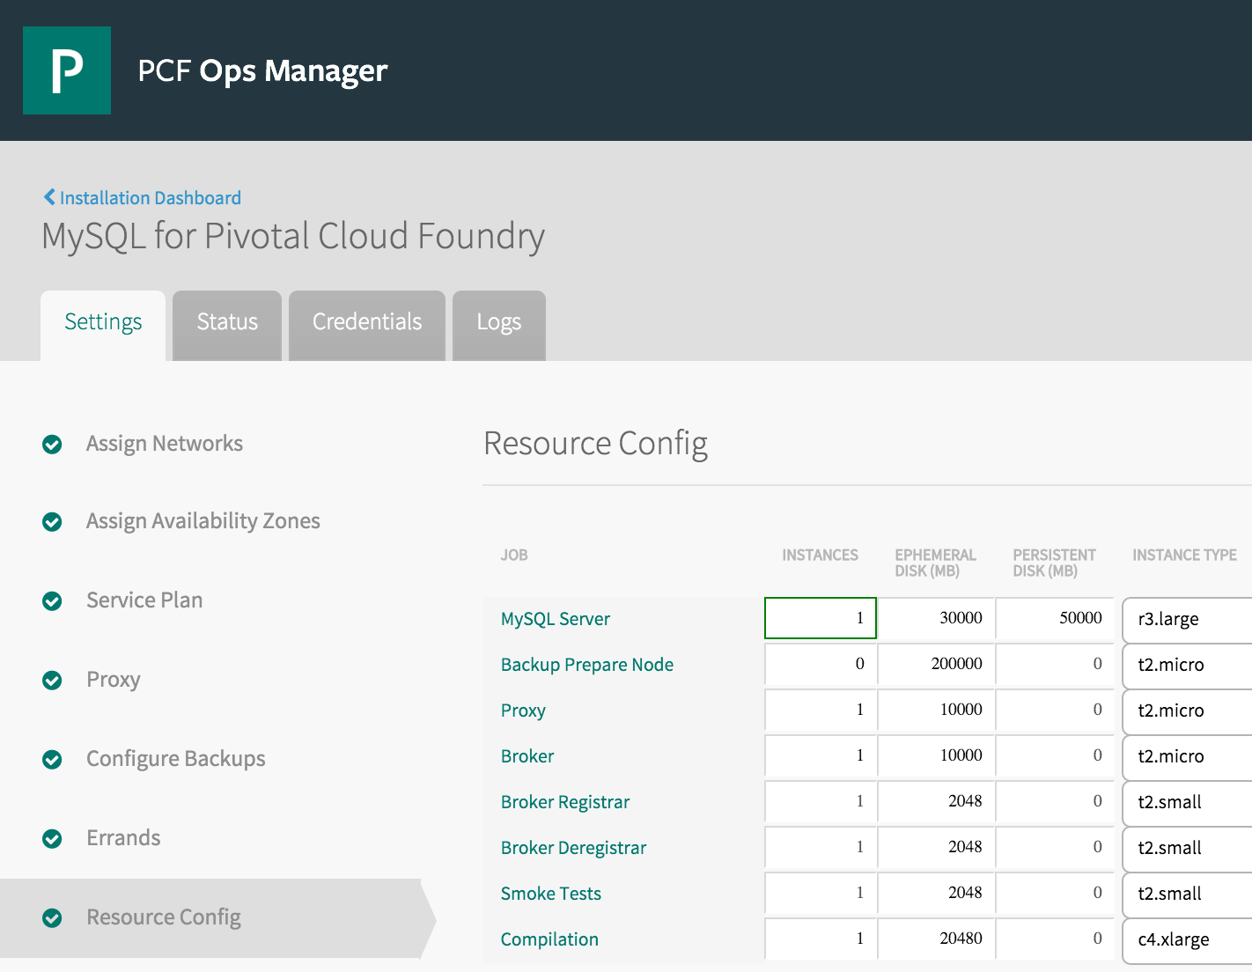
MySQL Server Provisioning
Set the MySQL Server persistent disk size

Slide 28
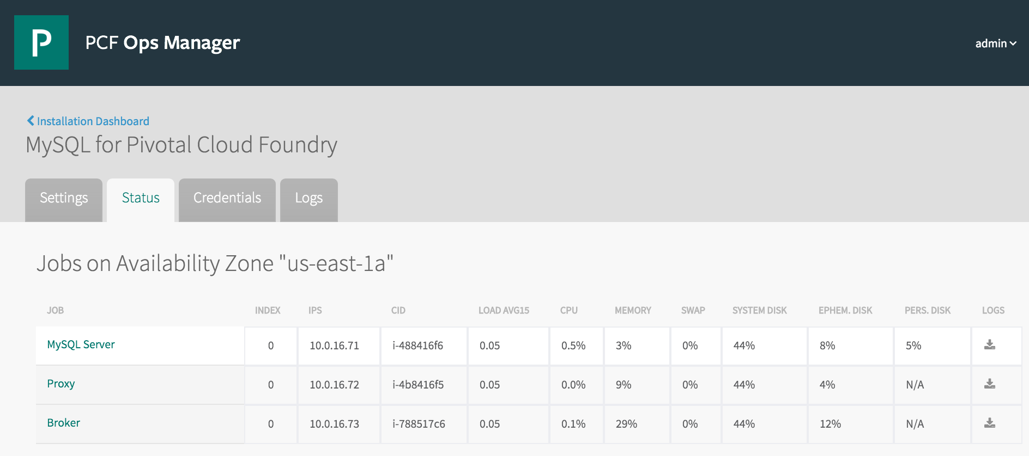
View the Current MySQL Server Disk Usage

Slide 29
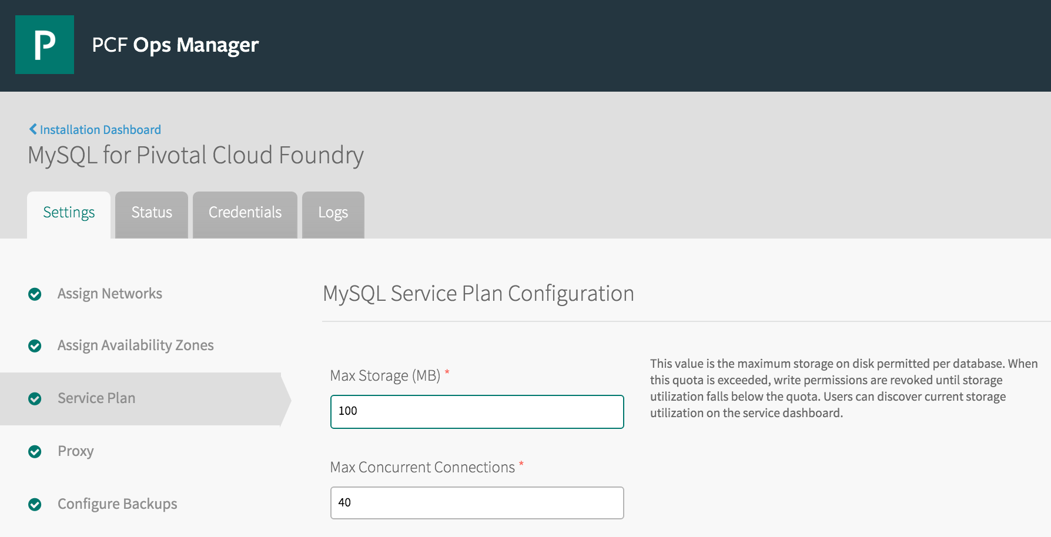
Service Instance Plan Size
Each service instance reserves storage on the MySQL Server

Slide 30
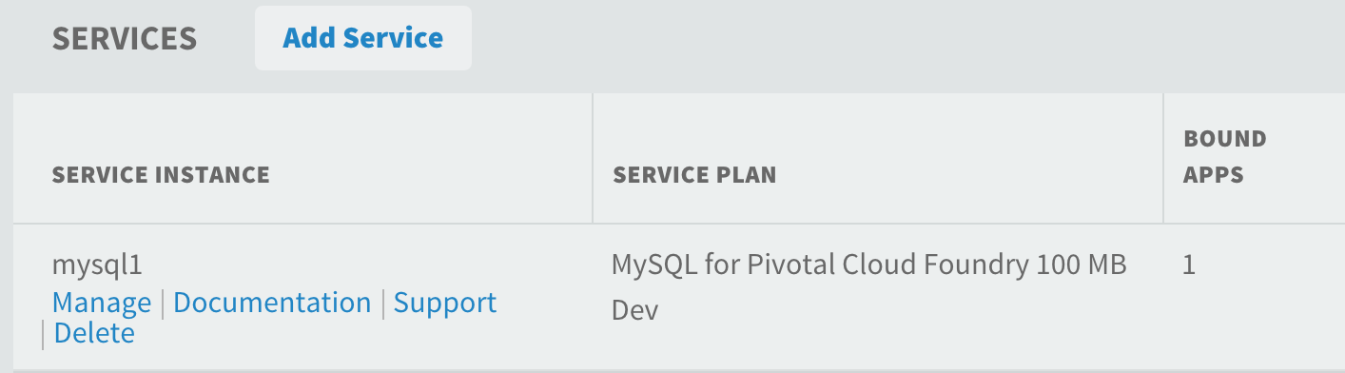
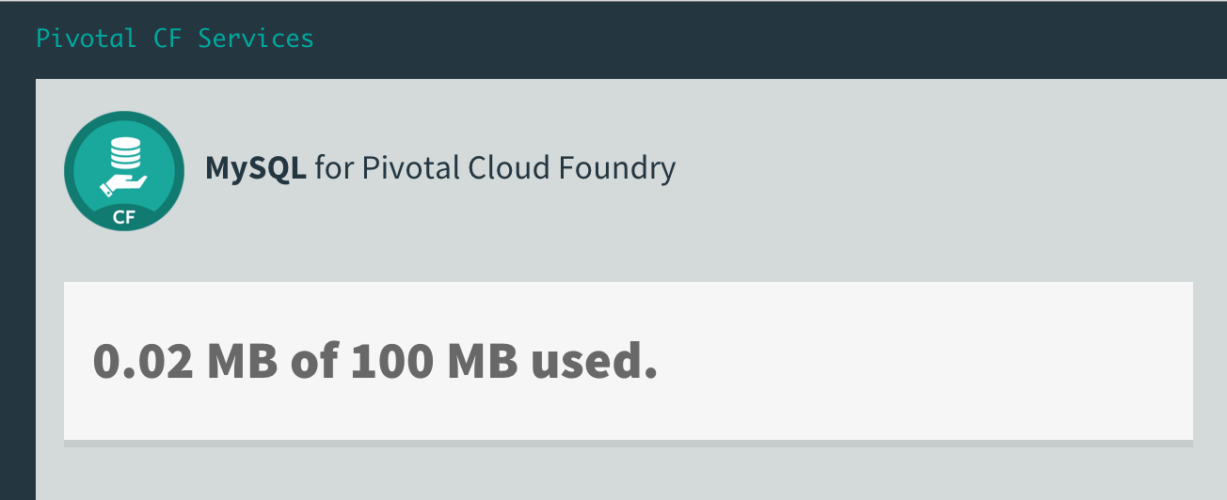
Viewing Current Service Instance Usage
Navigate to the service instance in a space and click the Manage link

Slide 31
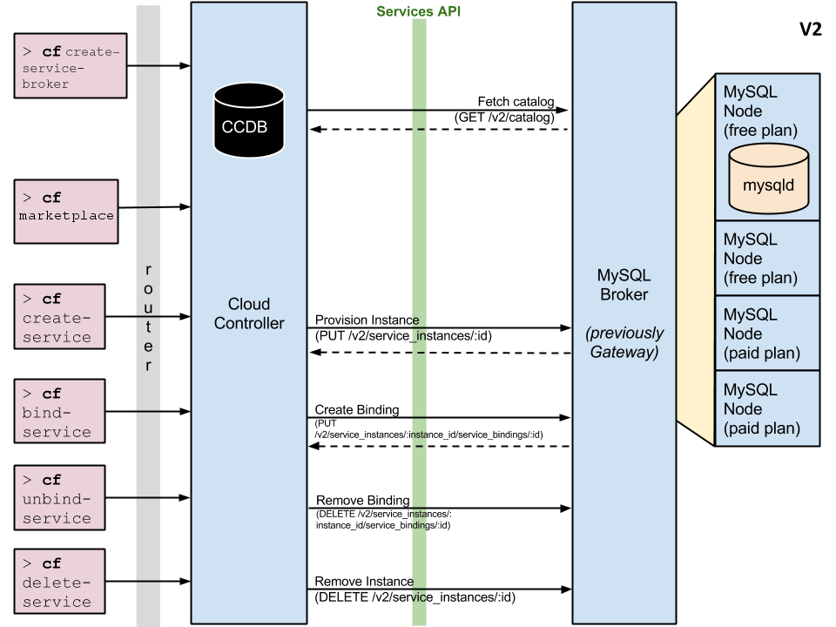
MySQL Service Summary

Slide 32
Lab
Create, register and use a new service broker

