Slide 1
Command Line Interface
Installation, help and logging in

Slide 2
Overview
After completing this lesson, you should be able to:
  Install the cf Command Line Interface (CLI)
  Get help on any cf CLI command
  Log into the Pivotal Web Services (PWS) installation

Slide 3
Topics
Getting Started with the Command Line Interface
Login to Pivotal Web Services (PWS)

Slide 4
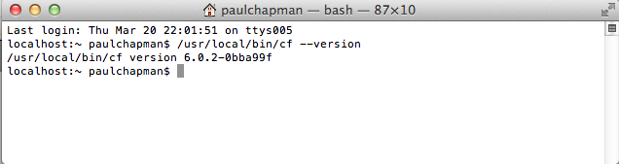
Cloud Foundry –Command Line Interface (cf CLI)
A simple, text-based Cloud Foundry client
Used by operators and developers to access and work with any Cloud Foundry installation
Anything you do with the cf CLI can be scripted/automated

Slide 5

Installing the cf CLI
To install the cf CLI:
  Visit https://console.run.pivotal.io/tools
    or https://github.com/cloudfoundry/cli
  Download and run installer for your platform

Slide 6
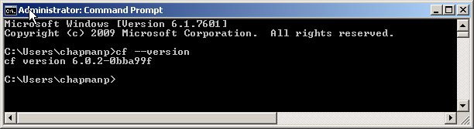
Test the cf CLI Client
The CLI is accessed with cf
  Open a Terminal/Command/Shell window
  At the prompt type: cf --version
  Or use the alias: cf -v

Slide 7
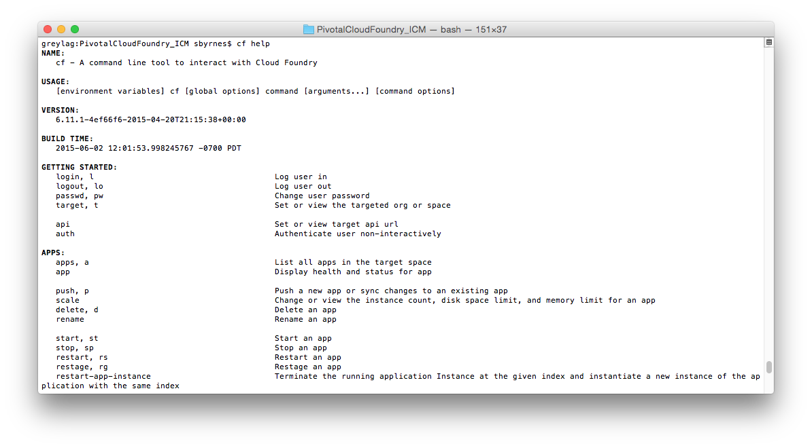
Getting Help- In General
Get help at any time via cf help
See an organized list of commands

Slide 8
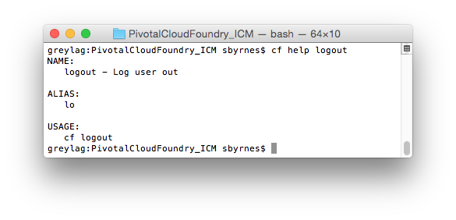
Getting Help- Specific Commands
cf help <command>

Slide 9
Topics
Getting Started with the Command Line Interface
Login to the Elastic Runtime

Slide 10
Pivotal Cloud Foundry @ Solera
The cf CLI needs to point to a Cloud Foundry installation
Development Cloud Foundry Environment: https://apps.system-dev.chdc20-cf.solera.com
You can login using your Active Directory email and password
We will use this installation for the labs

Slide 11
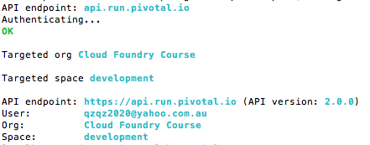
Login to Cloud Foundry
The cf CLI needs to know:
  What Cloud Foundry installation you are using
  What your account details are
Use cf login

Slide 12
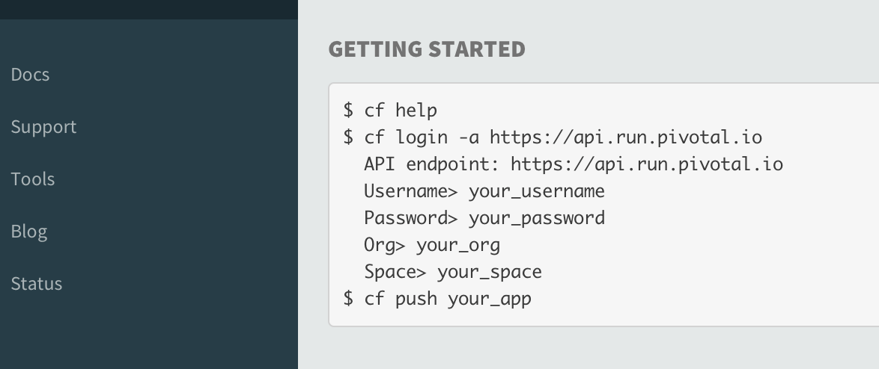
Finding the API Endpoint URL
URL of your Cloud Foundry instance
  On Apps Manager homepage on first login
  Or click Tools
Shows how to run cf login, including the API endpoint

Slide 13
Current Targets
When you first login, you see output shown below
  Notice it shows current organization and space
  At any time, run cf target to get the same information
By default your organization only has one space (development)
Note: On PWS you are set up as your own organization and can add more organizations
API endpoint: https://api.run.pivotal.io (API version: 2.6.0)
User: pchapman@pivotal.io
Org: pivotaledu
Space: development
Notes:
When a new account is created on PWS, the name of the user specified defines their organization too.

Slide 14
Using a Proxy
Your company may require a proxy for internet access
  Look in the Network or Internet settings for your browser
To configure this for cf
  set HTTP_PROXY=...proxyurl... (Windows)
  export HTTP_PROXY=..proxyurl (Unix/MacOS)
localhost:dev$ set HTTP_PROXY=proxy.mycompany.com:8080
localhost:dev$ echo %HTTP_PROXY%
proxy.mycompany.com:8080
localhost:dev$
Windows
dev$ export HTTP_PROXY=proxy.mycompany.com:8080
dev$ echo $HTTP_PROXY
proxy.mycompany.com:8080
dev$
Unix/MacOS

Slide 15
Cloud Controller
When you set a target, you are connecting to a component of Cloud Foundry called the Cloud Controller
The Cloud Controller has a REST API
The commands of the cf CLI make Cloud Controller API calls behind the scenes
Cloud
Controller
API
Cloud Controller
cf CLI
(the Cloud Foundry entry points of a load balancer and router are not shown in diagram)

Slide 16
The .cf Directory
cf creates a .cf directory in your home directory of your computer
  Stores context, logs, crash reports …
  Remembers your CF API endpoint
    Don't need to specify -a option at next login
localhost:dev$ ls -l ~/.cf
total 48
-rw------- 1 paulchapman staff 2491 15 Aug 14:06 config.json
-rw-r--r-- 1 paulchapman staff 11737 29 Nov 2013 crash
drwxr-xr-x 3 paulchapman staff 102 12 Sep 2013 logs
-rw-r--r-- 1 paulchapman staff 26 12 Sep 2013 target
-rw-r--r-- 1 paulchapman staff 2084 29 Nov 2013 tokens.yml

Slide 17
Topics
Getting Started with the Command Line Interface
Login to Pivotal Cloud Foundry via Apps Manager and CLI

Slide 18
Lab
Install the cf CLI and log in to Cloud Foundry

