Slide 1
High Availability

Slide 2
Why is High Availability Important?
Cloud Foundry helps an enterprise prevent application outages and downtime
The cost of outages can be enormous, and many times is not even quantifiable

Slide 3
Topics
Platform Upgrades
Component High Availability
Component Recovery
  VMs
  Processes
Application High Availability
Application Recovery

Slide 4
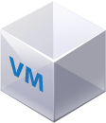
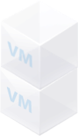
Platform Upgrades
BOSH executes Canary-style deployments to minimize downtime
  Also known as rolling upgrades
A select number of “canary” VMs from the new release are deployed
# of Canaries: 2
v1.0
v1.1
Max in Flight: 2
Notes:
Name derives from “Canary in a coal-mine” - canaries are more sensitive to carbon monoxide build up than humans. Prior to modern ventilation and monitoring, a canary was taken into a mine and if anything happens to it, the miners would evacuate before they too succumbed.
A number of running VMs can be upgraded in a similar way. A small number of VMs are taken down and replaced at a time. All other VMs keep running so there is no downtime but they may experience extra load during the upgrade.
The “canaries” run alongside the originals and if there are any problems, the original VMs are sun up again and the new VMs terminated. If all is well, more VMs are replaced until all VMs have been upgraded. In the content of CF, these VMs would typically be DEAs or Cells, although we haven't covered them yet.

Slide 5
Platform Upgrades
BOSH verifies new VMs have been deployed successfully
Remaining VMs are deployed only if the upgrade of canary VMs succeeded
  Otherwise the upgrade is halted
# of Canaries: 2
v1.0
v1.1
Max in Flight: 2

Slide 6
Platform Upgrades
Success: all VMs upgraded to V1.1
No interruption of service
v1.0
v1.1
Note that Cloud Foundry in general does not patch VMs or app instances, it
recreates or replaces them
Notes:
Change is inevitable and is notoriously hard to manage.
BOSH views everything as VMs to be managed. VMs can be upgraded any time using the Canary Upgrade approach.
Why BOSH:
1. Easier to deploy and upgrade VMs

Slide 7
Example: OS Security Upgrade
Because all VMs use the same OS, Cloud Foundry can use rolling upgrades to replace every OS instance automatically
This is one of the benefits of having an “opinionated” platform- you are in control of the infrastructure
  This would be much more challenging on a haphazard collection of machines
pre-OS upgrade
OS upgraded

Slide 8
Canary-Style Deployment: Implications
Elastic Runtime can be upgraded to new versions with no application downtime
  “Apply changes” does not mean “wait for it to finish”
  You will have limited ability to deploy applications during Elastic Runtime upgrades
Installing or modifying other tiles does not affect the Elastic Runtime
For the ops team- upgrade the system during working hours!
Notes:
Change is inevitable and is notoriously hard to manage.
BOSH views everything as VMs to be managed. VMs can be upgraded any time using the Canary Upgrade approach.
Why BOSH:
1. Easier to deploy and upgrade VMs

Slide 9
Topics
Platform Upgrades
Component High Availability and Recovery
  VMs
  Processes
Application High Availability
Application Recovery

Slide 10
Component High Availability
Some Cloud Foundry components can be scaled to multiple instances for high availability
Increase number of instances on Resources tab of Elastic Runtime
Some components are single instance only
Example Scalable Components
HAProxy
NATS
Cloud Controller
Cloud Controller Worker
Router
UAA
Login
Cell/DEA
  http://docs.pivotal.io/pivotalcf/opsguide/single-component.html
Notes:
The Load Balancer (eg. HAProxy for vSphere) can be externalized (ELB, F5, etc.). Can handle the SSL termination.

Slide 11
Component Recovery – VMs
Each component of Cloud Foundry is a VM deployed and managed by BOSH
BOSH health monitor continuously compares current component state to desired state, including:
  number of instances
  running processes
If current state differs from desired state, the health monitor:
  triggers the VM resurrector, or
  sends alerts
Notes:
Change is inevitable and is notoriously hard to manage.
BOSH views everything as VMs to be managed. VMs can be upgraded any time using the Canary Upgrade approach.
Why BOSH:
1. Easier to deploy and upgrade VMs

Slide 12
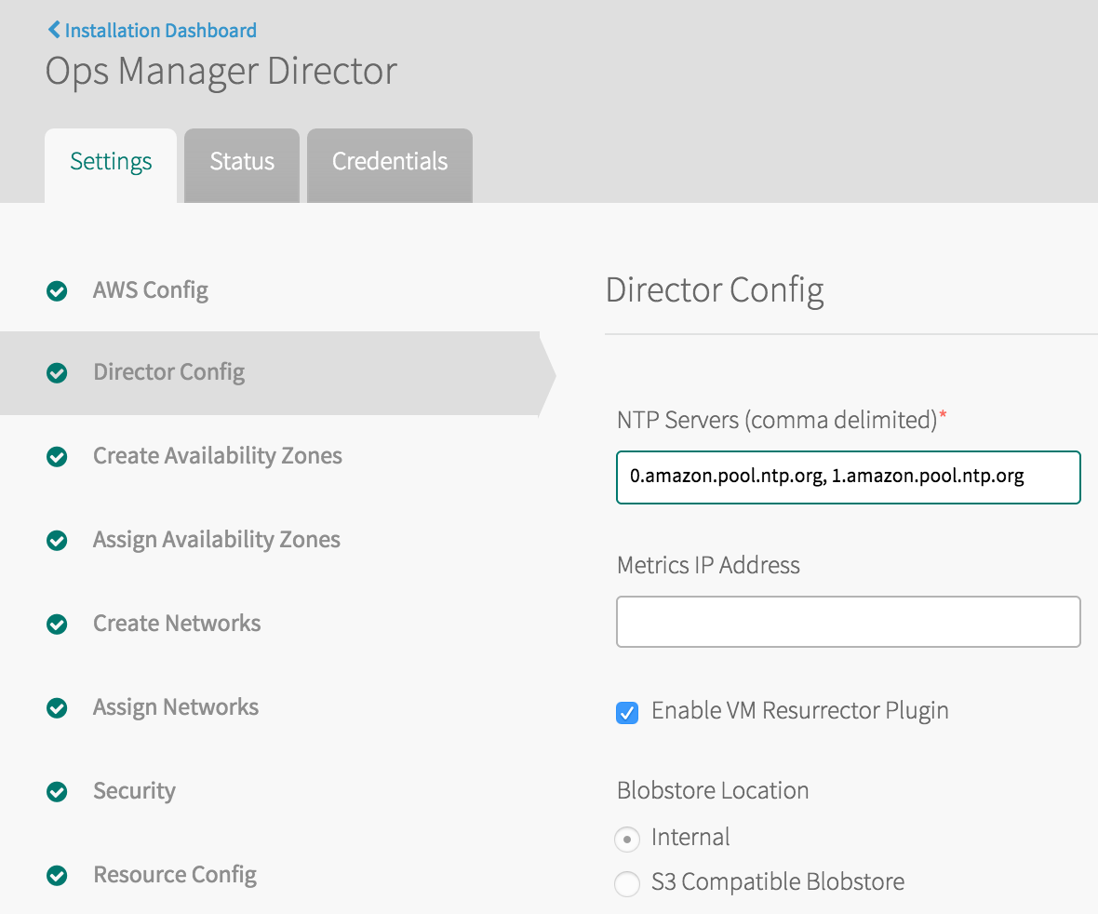
VM Resurrector Plugin
The VM resurrector plugin is a health monitor plugin that recreates VMs when a VM's BOSH agent stops sending heartbeats
It calls the API of the infrastructure to create a VM, then copies necessary files from the BOSH blobstore

Slide 13
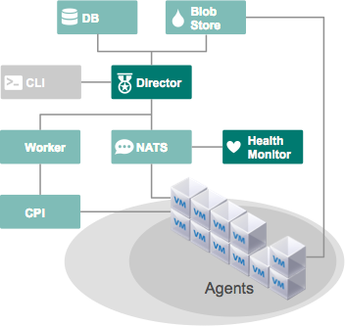

Scenario 1: Component VM Failure
Alert: VM down
desired state
actual state

Slide 14
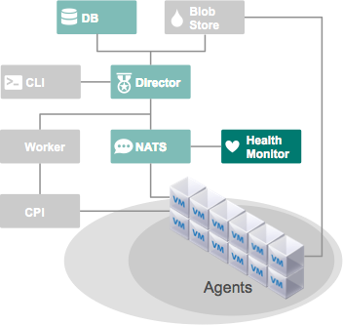
Scenario 1: Component VM Failure
desired state
actual state
failed VM restored

Slide 15
Component Recovery - Processes
Monit utility running on the component VMs automatically restarts failed processes
BOSH release defines which processes to monitor
Notes:
Change is inevitable and is notoriously hard to manage.
BOSH views everything as VMs to be managed. VMs can be upgraded any time using the Canary Upgrade approach.
Why BOSH:
1. Easier to deploy and upgrade VMs

Slide 16
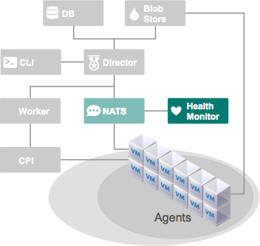

Scenario 2: Component Process Failure
Alert: process failure
component
process fails
Notes:
monit is an open-source process monitoring utility available for several Linux and Unix variants.
BOSH uses monit to start key processes and monit notices when they are sown so that action can be taken if they die or appear frozen. Monit is effectively a component inside the Health Monitor.
In Cloud Foundry terms, processes like the Cloud Controller are managed and made HA by BOSH.

Slide 17
Scenario 2: Component Process Failure
component
process
recovered

Slide 18
Topics
Platform Upgrades
Component High Availability
Component Recovery
  VMs
  Processes
Application High Availability
Application Recovery

Slide 19
Application High Availability
Cloud Foundry will scale application instances across availability zones
Availability zones correspond to independent infrastructure segments
  Different racks, or even different data centers
  Provide physical isolation, redundancy
  Feature of the IaaS layer
  Be aware of latency between zones
ELASTIC RUNTIME
App Execution
App Execution
inst-1
inst-2
inst-3
inst-4
AZ-1
AZ-2

Slide 20
Scenario: Availability Zone Failure
If one zone fails, the application instances in the other zone pick up the load
No outage
cf push my-app -i 4
ELASTIC RUNTIME
X
App Execution
App Execution
inst-1
inst-2
inst-3
inst-4
AZ-1
AZ-2

Slide 21
Topics
Platform Upgrades
Component High Availability
Component Recovery
  VMs
  Processes
Application High Availability
Application Recovery

Slide 22
Application Recovery
The Elastic Runtime monitors
application instance processes,
and detects failures
On failed instances, the
container is destroyed
and a new container is
created
  Droplet is copied from the
  Cloud Controller blobstore
  to the container and started
cf push my-app -i 4
ELASTIC RUNTIME
App Execution
App Execution
inst-1
inst-2
X
inst-3
inst-4
AZ-1
AZ-2
Notes:
Performs same task for the Elastic Runtime that the Heath Monitor performs for BOSH.
This component is removed in DIEGO and replaced by the Converger.

Slide 23
Summary
Canary style deployments minimize impact of upgrades
Components should be scaled when possible
There are four levels of high availability:
  Enable the VM Resurrector to recover failed VMs
  Component processes will be automatically restarted
  Availability zones protect against infrastructure failures
  Application instances will be automatically recreated and restarted
Note: The PWS Ops team uses a 2 minute delay before being notified of system problems- this is because the system usually repairs itself within that time

