Slide 1
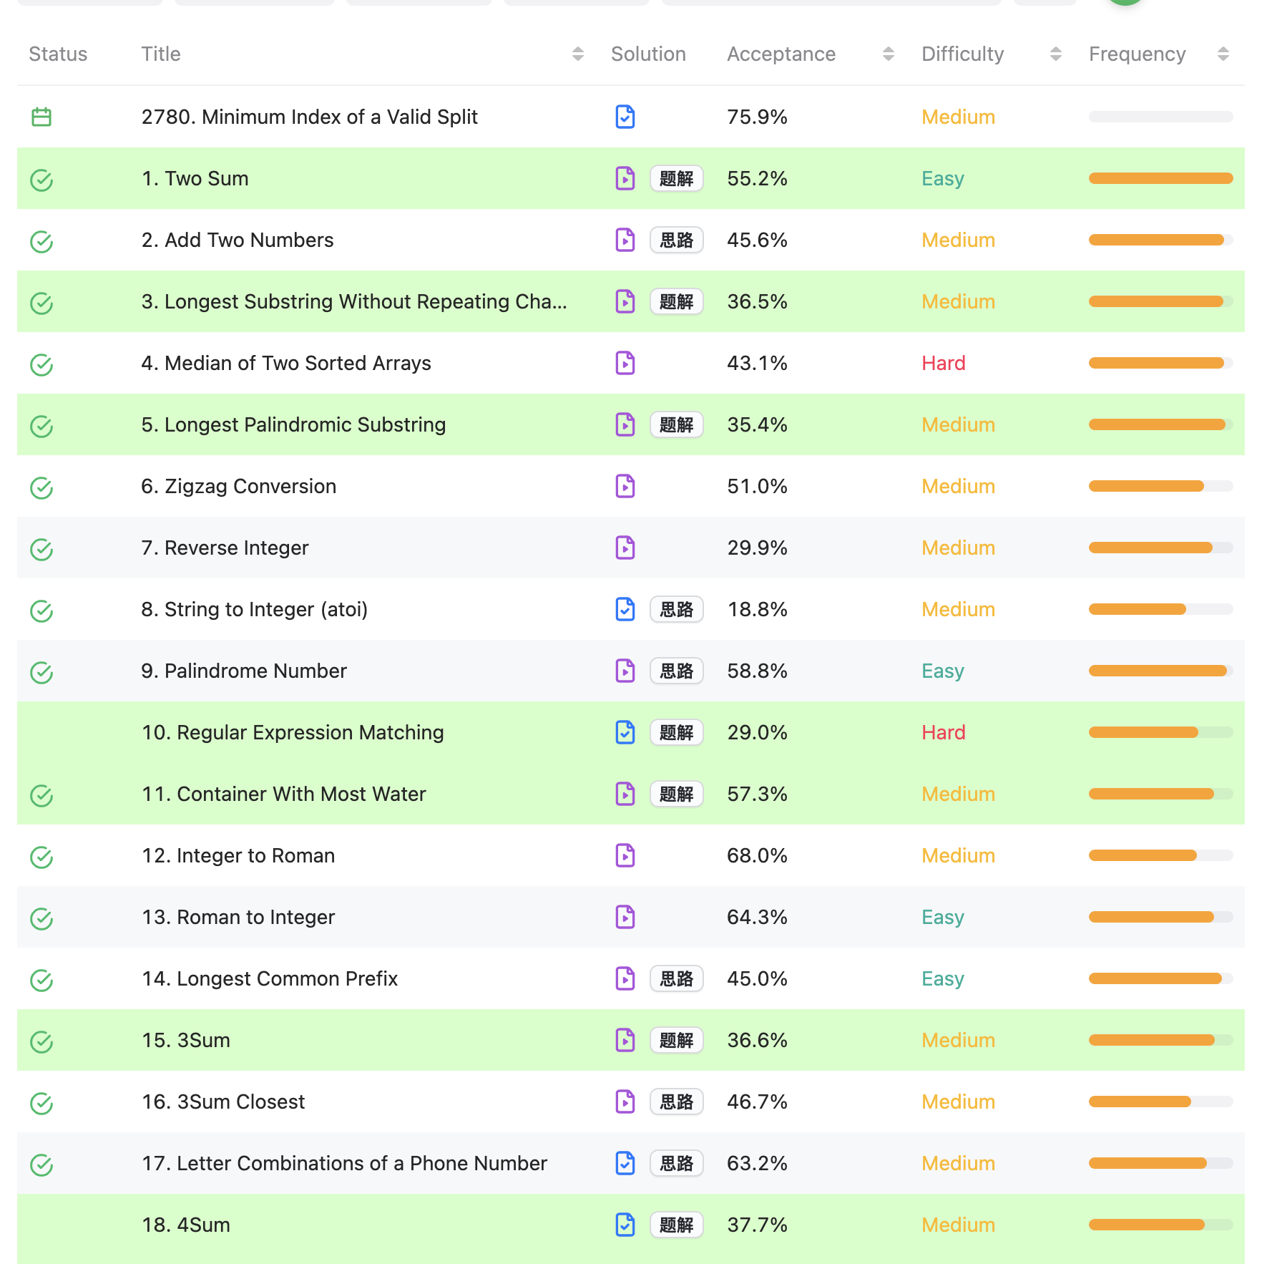
student
Problem
Profile
Module1
Message
Module2

Slide 2
Create Delete
instructor
Problem
Profile
Module1
Message
Module2
Chatbot

Slide 3
Single problem
Problem
Choice
C2
c3
Correct!
submit
Feedback

Slide 4
message

Slide 5
Profile

Slide 6
Chatbot

Slide 7
sign in

Slide 8
Sign up

