Slide 1
Deep Learning To Filter SMS Spam
By
Gaurav Rai (1706019) & Shubham Vasnik (1706083)

Slide 2
Introduction & Idea
The popularity of short message service (SMS) has been growing over the last decade.
For businesses, these text messages are more effective than even emails. This is because while 98% of mobile users read their SMS by the end of the day, about 80% of the emails remain unopened.
The popularity of SMS has also given rise to SMS Spam, which refers to any irrelevant text messages delivered using mobile networks. They are severely annoying to users. Most existing research that has attempted to filter SMS Spam has relied on manually identified features

Slide 3
Implementation Overview
We uses deep learning to classify Spam and Not-Spam text messages. Specifically, Convolutional Neural Network and Long Short-Term Memory models were employed
The proposed models were based on text data only, and self-extracted the feature set.
Dataset used: UCI ML REPO SMS Spam Collection Data
Dataset consists of 747 Spam and 4,825 Not-Spam text messages
A remarkable accuracy of 99.44% was achieved In Paper However we managed to get 98.68% only.

Slide 4
Possible methodology
Traditional Machine Learning Based approach
Deep Learning Based Approach

Slide 5
Problems with Traditional Implementation
We need to identify various features from SMS to be used as input to the machine learning model in order to use supervised approach.
The feature extraction in machine learning based models are manual which required domain knowledge.
The accuracy of the classifiers are highly dependent on these features.
Deep learning eliminates the need of these manual feature extraction by identifying the hidden features from the data.
Deep Learning approach is much faster and thus requires very less time.

Slide 6
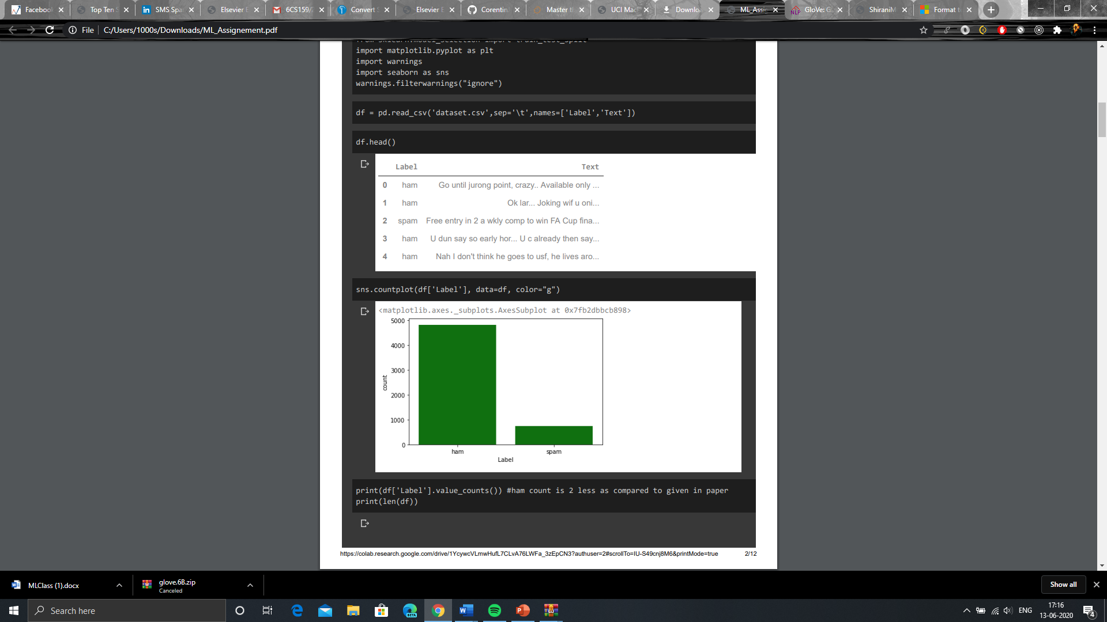
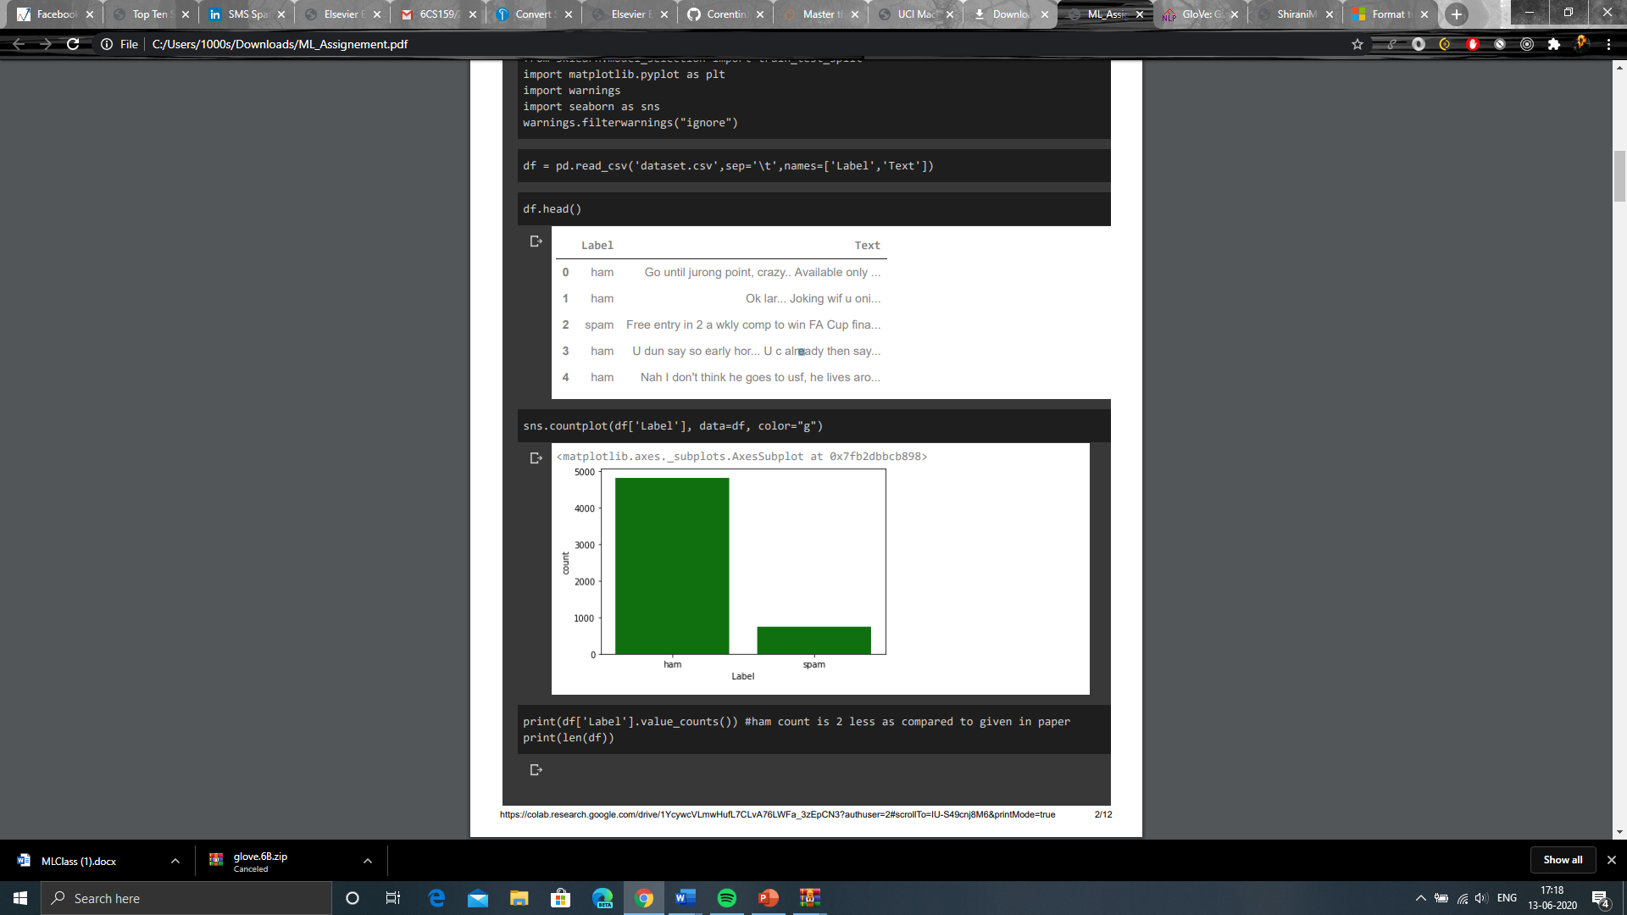
Dataset Exploration & Preprocessing
Dataset used: UCI ML REPO SMS Spam Collection Data
Dataset has a total of 4,825 SMS legitimate messages (86.6%) and a total of 747 (13.4%) spam messages.
Each line is composed by two columns: one with label (ham or spam) and other with the raw text

Slide 7
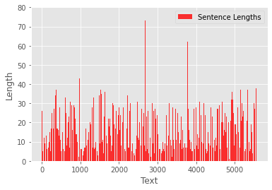
Data Preprocessing…..
‘ham’ and ‘spam’ were replaced by 0 and 1 respectively
We then change the labels 0/1 to categorical values.
All the punctuations are removed and text is converted into sequences of tokens.
Plotting distribution of sentence length showed that more than 95% of the sentences has less than 32 words.
So We converted all sentences to vectors of dimension 32 and post padded the shorter sentences with zeros.

Slide 8
DATA Preprocessing…..
We then embedded each sentence into 25d vector space with the help of pretrained Glove weights.
Those words which were not in Glove were assigned weights randomly.
We tried both Wikipedia crawled & twitter crawled text and found twitter one was giving better accuracy.
So now each sentence was converted to 32*25 matrix.

Slide 9
CNN BASED MODEL
CNN is one of the popular deep learning models which is able to extract the relevant features from the data.
CNN mainly works in three phases:
creation of word matrix,
identifying the hidden features from the text, and
classify them into predefined classes.

Slide 10
1.Creation of word Matrix
Every message M is the sequence of the words: w₁, w₂, w₃, …, w_{n} . From the given dataset, all unique word are bagged together to create a vocabulary (V) set. Each word of the V is assigned a unique integer value. From the pre-trained word vector called Glove, The word vector extracted from the Glove is rep-resented as:
E(m) = e(w₁), e(w₂), e(w₃), … , e(w₃,), where e(w₁), e(w₂), e(w₃), … , e(w_{n}) are the individual word vectors of the words w₁, w₂, w₃, … , w_{n} and are concatenated to create a complete SMS word matrix
2.Context dependent feature extraction
The convolution Layer used captures the contextual dependencies and we have used kernels of different sizes to capture 2-gram,3-gram,4-gram,5-gram features.
The operation converts word matrix into a feature vector.
3.Classification into ham/spam
At Last the Extracted features are flattened and connected with fully connected dense layer to classify into spam/ham with softmax activation.

Slide 11
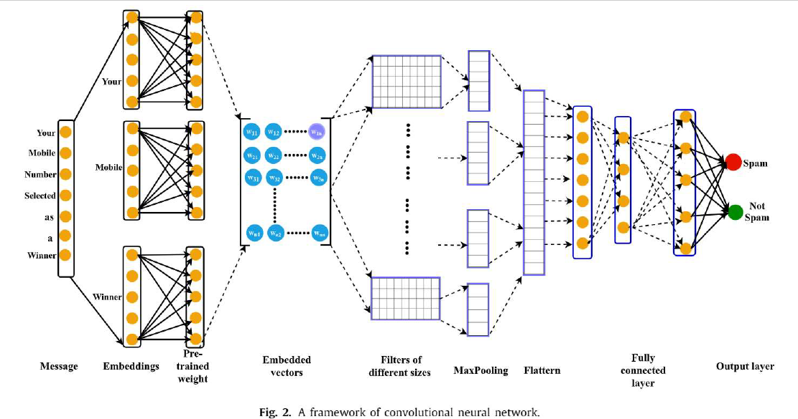
Framework of Convolutional Neural Network

Slide 12
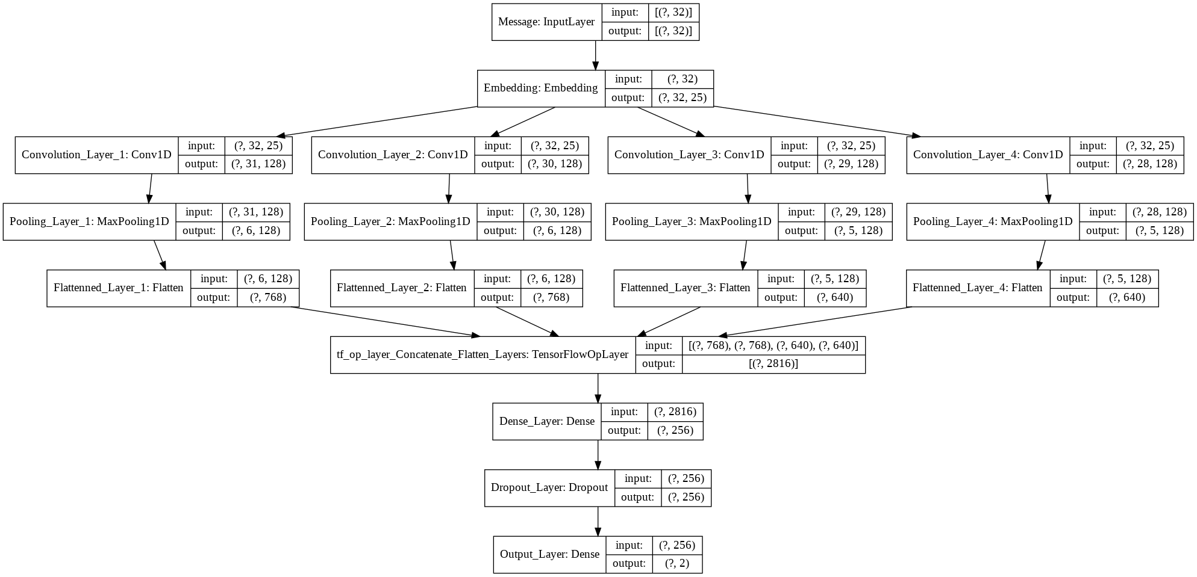
Our CNN Implementation

Slide 13
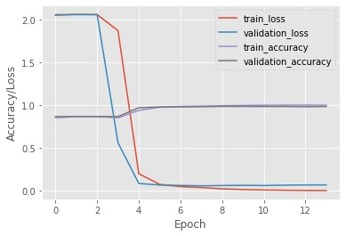
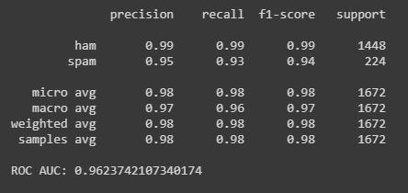
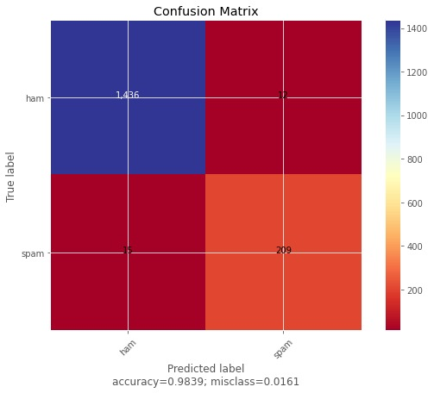
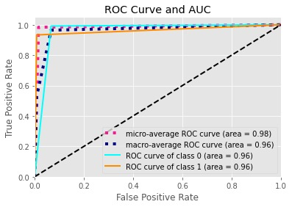
Model Training and Results-cnn

Slide 14
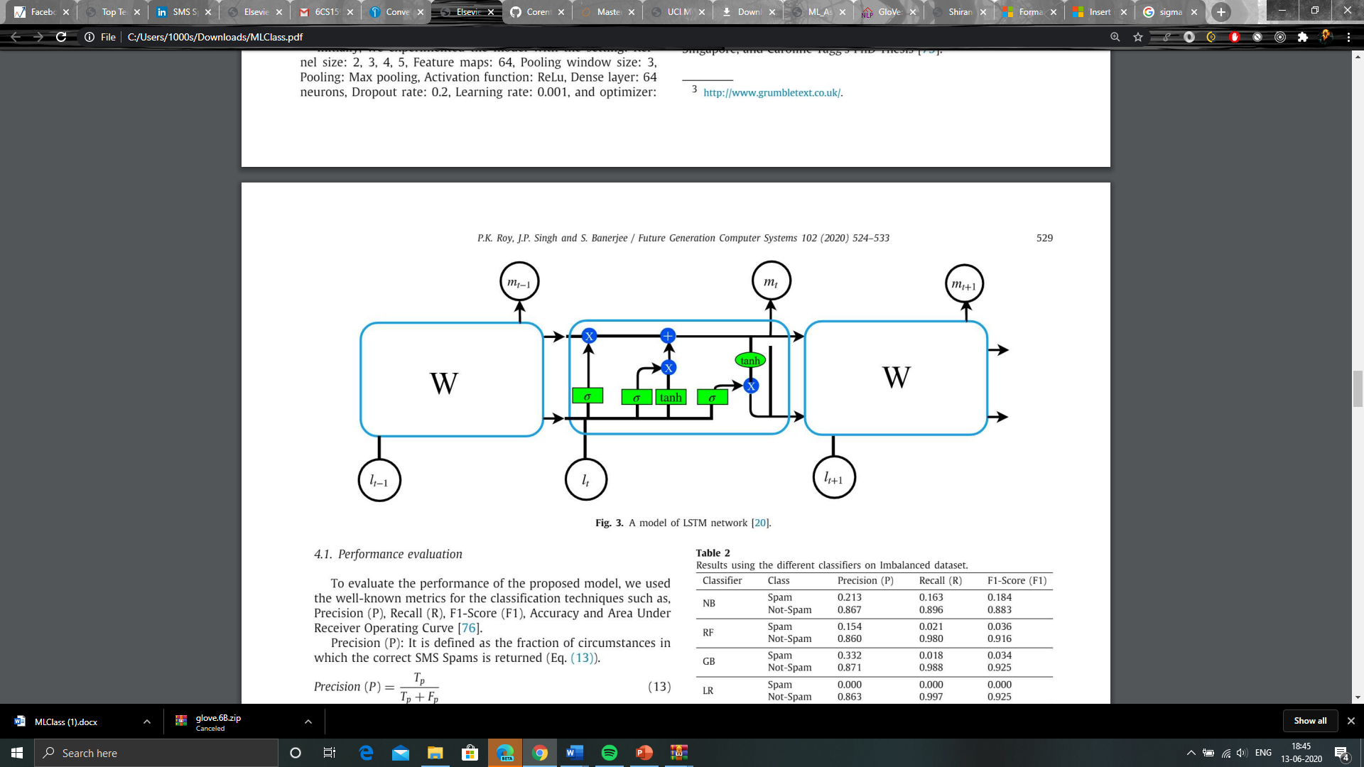
Long Short Term Memory (LSTM) MODEL
CNN can extract hidden features from the text however it is unable to remember the long sequences of text. But LSTM Network can Do SO.
So we tried with both Simple LSTM Model and Bi-LSTM with Attention & found That the attention based Model out performs the simple lstm-model.

Slide 15
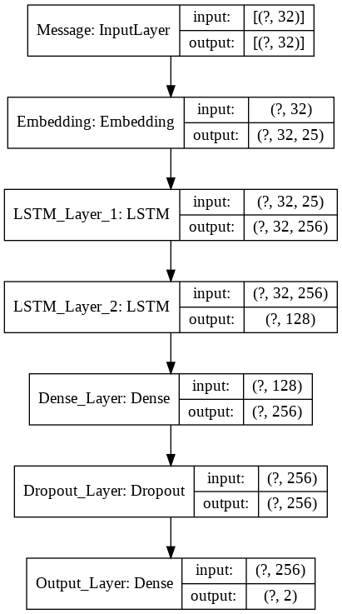
Our Simple LSTM IMplementation

Slide 16

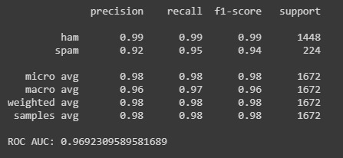
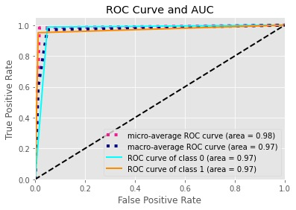
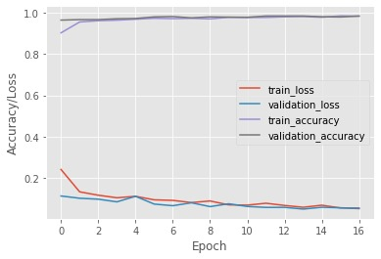
Model Training and Results-LSTM

Slide 17
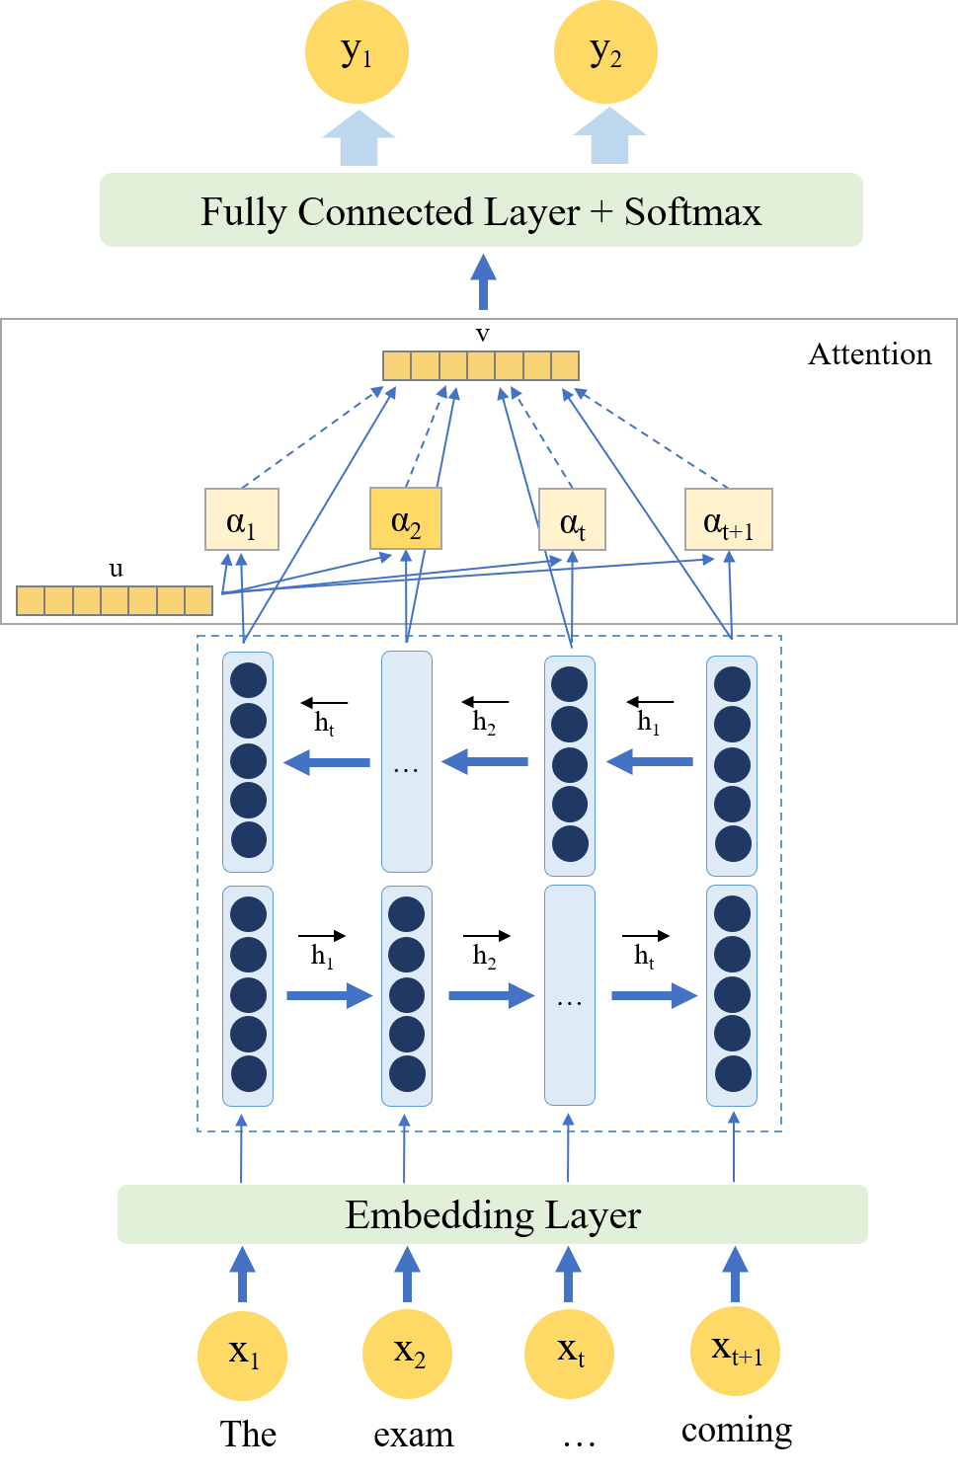
Framework of Attention based bi-LSTM

Slide 18
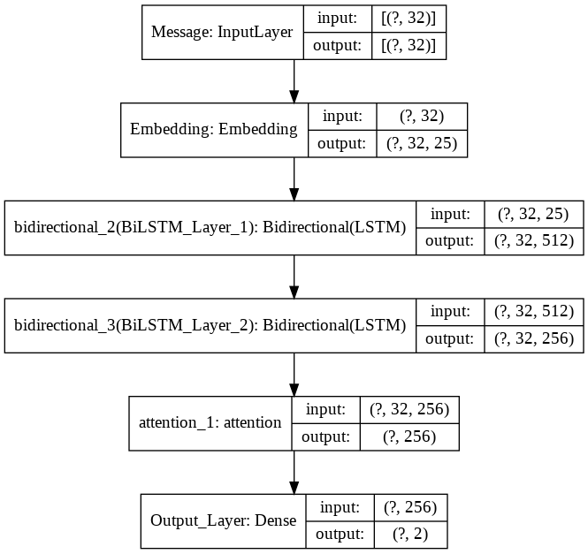
OUR Attention Based Bi-LSTM IMPLEMENTATION

Slide 19

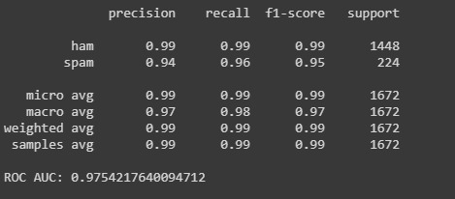
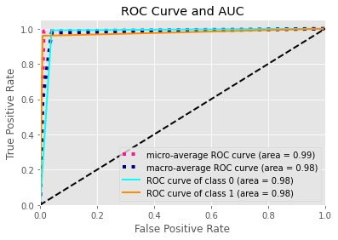
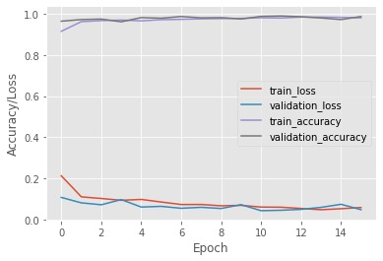
Model Training and Results
Attention+bi-LSTM

Slide 20
Performance Evaluation & METRICS USED
To evaluate the performance of the proposed model, we used the well-known metrics for the classification techniques such as:
Precision (P),
Recall (R),
F1-Score (F1),
Area Under Receiver Operating Curve.

Slide 21
RESULT & comparative Analysis
For the CNN Model, We managed to get close reported score and AUC value but can't reach completely with a AUC value of 96.23 instead of AUC score 96.8 and accuracy of 98.38% instead of 98.63% which is reported in paper.
However out 10 fold Cross validation doesn't performed very well with an accuracy of 97.33% as compared to papers ground breaking 99.44%. Though I believe with increased no of epochs and some other minor tweaking we can get much close to the reported score.
Also, We tried with both Glove's twitter text and Wikipedia crawled text pretrained weights and found that twitter text pretrained weights are giving higher accuracy
For the Simple LSTM model We got accuracy more than mentioned in paper with a value of 98.26% instead of 96.67% which is mentioned in paper
Also we tried another Attention based implementation with BiLSTM network which is not mentioned in paper but found that It fetches better score than the Simple LSTM model with an accuracy of 98.68% and remarkable AUC value of 97.54 instead of what was with simple LSTM i.e. 98.26% accuracy and AUC of 96.92

Slide 22
Conclusion
We were able to successfully implement the model described as in the source paper
We were able to confirm that the deep learning based CNN and LSTM models are better than traditional models
We were able to filter spam SMS with an accuracy of 98.68%.
Since Attention based models are performing significantly well so we can try Self-Attention based language Models like Elmo, Bert etc.

Slide 23
References and papers used
Attention? Attention
Attention-based bidirectional LSTM for Classification Task (ICASSP) Paper
Glove Vectors
Bahdanau Attention AnalyticsVidhya
Deep Learning to Filter SMS Spam [Source Paper]

