Slide 1
Final Project
Suriya Sampathkumar
Generative Adversarial Networks

Slide 2
Landscape Picture Generation
Generative Adversarial Network (GAN) for Landscape Image Generation
3/21/2024 Annual Review

Slide 3


AGENDA
1. Problem Statement
2. Problem Overview
3. Who are the end users?
4. Your solution and its value proposition
5. The wow in your solution
6. Modelling
7. Results
3/21/2024 Annual Review

Slide 4

PROBLEM STATEMENT
The generation of realistic landscape images remains a challenging task in computer vision due to the complexity and variability of natural scenes. Traditional image generation techniques often struggle to produce high-quality, diverse landscape images that capture the richness of natural environments. This presents a limitation in applications such as virtual reality, gaming, and artistic content creation, where realistic landscape imagery is essential.

Slide 5

PROJECT OVERVIEW
This project aims to address the limitations of traditional landscape image generation methods by leveraging Generative Adversarial Networks (GANs). GANs consist of two neural networks, a generator, and a discriminator, trained in an adversarial manner to generate high-fidelity images that closely resemble real landscapes. By using the power of deep learning and adversarial training, we seek to create a novel solution for generating realistic landscape images.

Slide 6
WHO ARE THE END USERS?
The end users of this project include:
Artists and designers seeking high-quality landscape imagery for digital art and multimedia projects.
Game developers looking to enhance the visual realism of virtual environments.
Architects and urban planners visualizing and designing outdoor spaces.
Environmental researchers simulating natural landscapes for data analysis and modeling.

Slide 7

YOUR SOLUTION AND ITS VALUE PROPOSITION
The solution leverages state-of-the-art GAN architectures to generate realistic landscape images with high fidelity and diversity. By training the GAN on a large dataset of landscape images, we enable the model to learn the intricate details and characteristics of natural scenes, thereby producing visually compelling results. The value proposition lies in providing a tool that simplifies the process of generating high-quality landscape imagery, saving time and effort for users across various domains.

Slide 8

THE WOW IN YOUR SOLUTION
The wow in the solution is its ability to generate diverse and photorealistic landscape images that closely mimic real-world scenes. By harnessing the power of deep learning and adversarial training, our GAN model can capture subtle nuances in lighting, texture, and composition, resulting in visually stunning landscapes that are indistinguishable from real photographs. Additionally, our solution offers flexibility and scalability, allowing users to customize and generate landscapes tailored to their specific requirements.
3/21/2024 Annual Review

Slide 9
MODELLING
The model architecture consists of a generator network responsible for generating fake landscape images and a discriminator network trained to distinguish between real and fake images. The generator network utilizes convolutional and transposed convolutional layers to upsample random noise into high-resolution landscape images. The discriminator network, on the other hand, employs convolutional layers followed by fully connected layers to classify images as real or fake. The two networks are trained in an adversarial manner, with the generator aiming to deceive the discriminator into classifying its generated images as real.

Slide 10
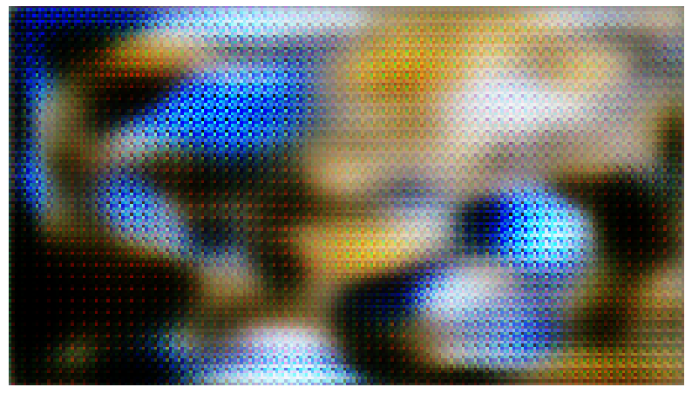
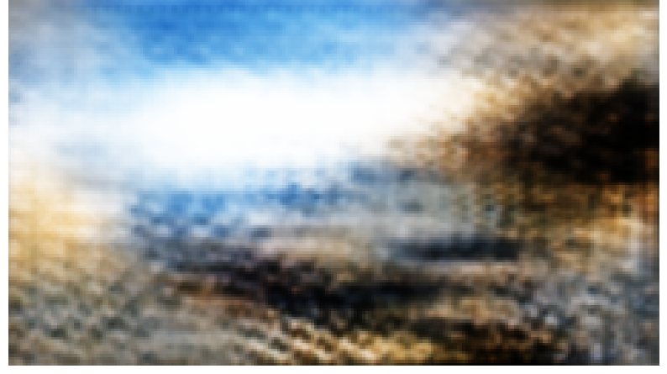
RESULTS
Initial generation
Later generations
Demo link
https://youtu.be/42mqSTZPwbU

