Slide 1

U.S. Housing Market Dynamics: Trends, Predictive Analytics, and Forecasting Insights
MS in Information Systems
MIS 599 - Creative Component
From: Rajat Jhawar
To: Professor Anthony Townsend

Slide 2
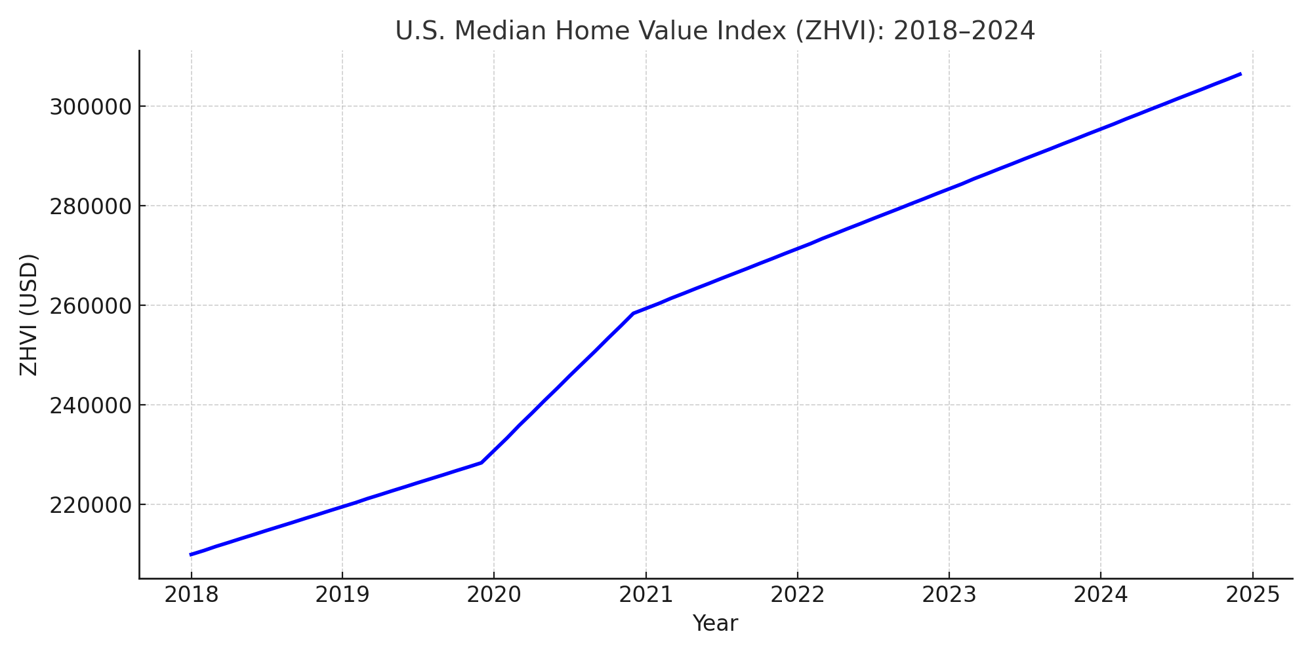
Research Motivation
Post-COVID housing prices surged across the U.S., raising affordability and accessibility concerns.
Stakeholders—buyers, planners, and investors—lack real-time tools to assess housing dynamics.
Integrating Tableau (visualization) and Python (forecasting) addresses this analytical gap.
This project delivers insights for data-driven decision-making in real estate and urban policy.
MIS 599: Creative Component
Notes:
The motivation behind this project stems from the dramatic surge in U.S. housing prices following the COVID-19 pandemic. Between 2020 and 2022, prices rose sharply across nearly all states, sparking concerns over affordability, accessibility, and inequality. Despite the availability of housing data, many key stakeholders—buyers, policymakers, city planners, and investors—still lack real-time tools to understand how different regions behaved during and after the pandemic.
This project bridges that gap. By combining Tableau for visualization with Python for predictive modeling, I aimed to uncover trends, quantify volatility, detect anomalies, and forecast future values. The ultimate goal is to offer insights that can be used to inform smarter investment decisions, proactive policymaking, and long-term urban planning.

Slide 3
Research Objective & Questions
Zillow Data
Predictive Modeling (Python)
Segmentation (Clustering)
Exploratory Trends (Tableau)
Insights for Policy & Investment
Core Research Question:
How can integrated data visualization and predictive modeling uncover key housing price dynamics and enable accurate forecasting across U.S. states post-COVID?
Objectives:
Analyze Zillow ZHVI housing data across temporal and geographic dimensions.
Identify patterns of volatility, seasonality, and post-pandemic recovery.
Apply and compare predictive models (Prophet, Random Forest, Linear Regression).
Segment housing markets using clustering for insight-driven grouping.
Detect anomalies for macroeconomic interpretation and policy insight.
MIS 515: Big Data for Business
MIS 599: Creative Component
Notes:
The core question driving this project was: How can integrated data visualization and predictive modeling uncover key housing price dynamics and enable accurate forecasting across U.S. states post-COVID?
To answer this, I focused on five key objectives. First, I analyzed Zillow’s ZHVI housing data from 2018 to 2024, exploring both temporal and regional variations. Second, I examined volatility, seasonality, and recovery trends post-COVID.
Next, I built predictive models in Python—including Prophet, Random Forest, and Linear Regression—to forecast price trends and compare accuracy. I then used clustering to segment the market into behaviorally distinct groups, like high-growth metros versus stable regions.
Finally, I applied anomaly detection to highlight outlier months or cities that diverged from expected patterns, often revealing links to real-world events.
Together, these steps formed an integrated approach to housing market intelligence—balancing exploration, forecasting, segmentation, and insight delivery.

Slide 4
Dataset & Tools
Dataset:
Zillow Home Value Index (ZHVI) dataset
Timeframe: 2018 – 2024
Data Type: Monthly average home value for all homes (SFR + condo)
Geography: All U.S. cities, counties, and states
Tools Used:
Tableau – for descriptive analytics and visualization
Python – for predictive analytics using:
  A Prophet for time series forecasting
  Random Forest for supervised learning
  K-Means Clustering for Pattern Detection
Excel – for initial data cleaning and transformation
Azure Data Lake – cloud storage and processing
Date | State | Region | ZHVI (USD)
2020-03-01 | TX | Dallas | 241,500
2021-03-01 | TX | Dallas | 284,700
2022-03-01 | TX | Dallas | 312,900
MIS 515: Big Data for Business
MIS 599: Creative Component
Notes:
In this project, I used the Zillow Home Value Index dataset, focusing on the period from 2000 to 2024. This dataset captures average monthly home values for all residential properties across the U.S.
To conduct a comprehensive analysis, I relied on a suite of tools. Tableau was used for interactive visualizations to uncover historical patterns. Python, on the other hand, enabled more advanced predictive modeling through Facebook’s Prophet model, Random Forest algorithms, and clustering to identify market segments.
Excel was essential in the early data cleaning phase, while Azure Data Lake served as a scalable cloud platform for storing and retrieving large data files.

Slide 5
Tableau Analysis Overview
Key Dashboards Created in Tableau:
Geospatial Mapping of ZHVI by City and State
Time Series Trend Analysis for key metro regions
Monthly Trend Comparison across years (2020–2022)
Post-COVID Growth Rates across Iowa cities
Year-over-Year & CAGR Growth metrics
Heatmaps & Volatility Charts
Seasonality Line Charts to detect monthly behavior
Purpose:
To explore spatial, temporal, and comparative patterns in U.S. housing prices.
MIS 515: Big Data for Business
MIS 599: Creative Component
Notes:
This slide summarizes the descriptive analytics conducted in Tableau. I created a variety of visual dashboards to understand housing market trends from multiple angles.
Starting with geospatial views, I mapped ZHVI data at both the city and state levels to identify regional disparities. Then I developed trend analyses and monthly comparisons to visualize changes over time.
Special emphasis was placed on understanding the post-COVID recovery in Iowa and comparing YoY growth across the U.S. I also used volatility and seasonality analysis to gain deeper insight into the housing market’s cyclical nature.
These visualizations helped form a strong baseline for the predictive modeling phase that followed.

Slide 6
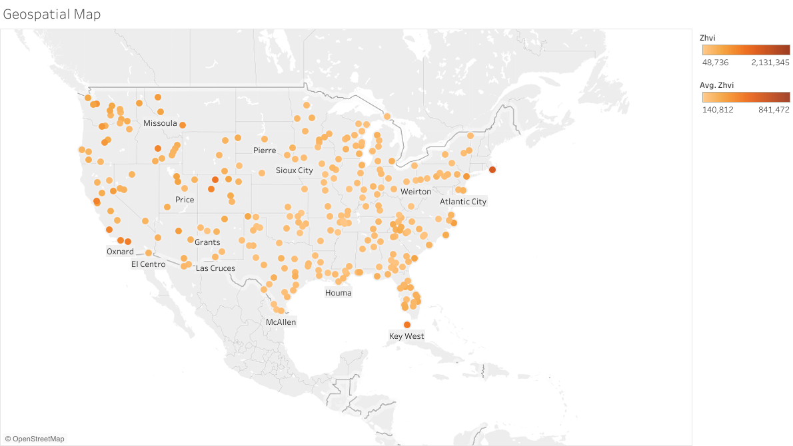
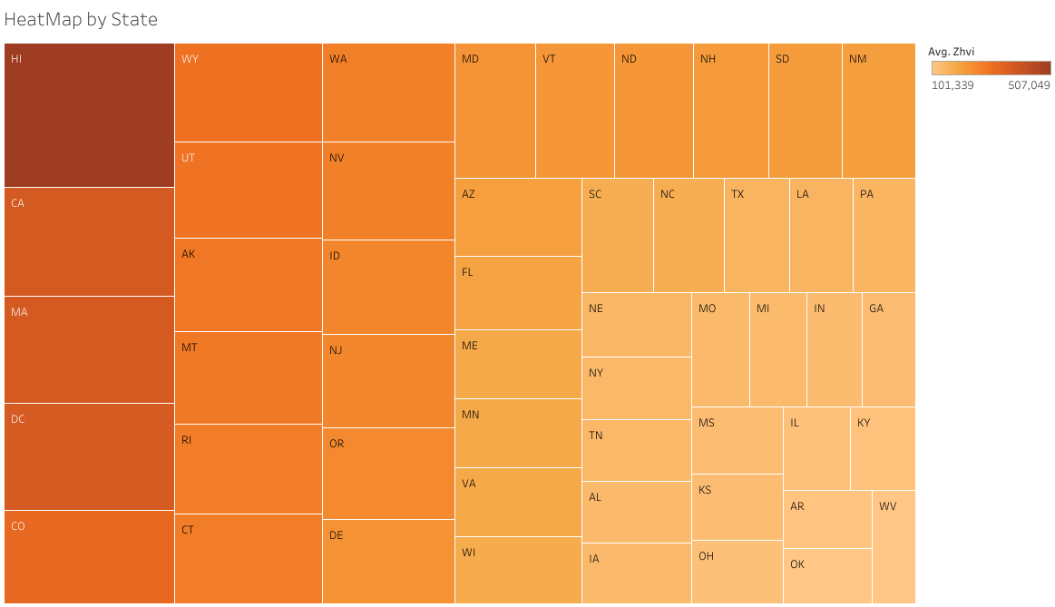
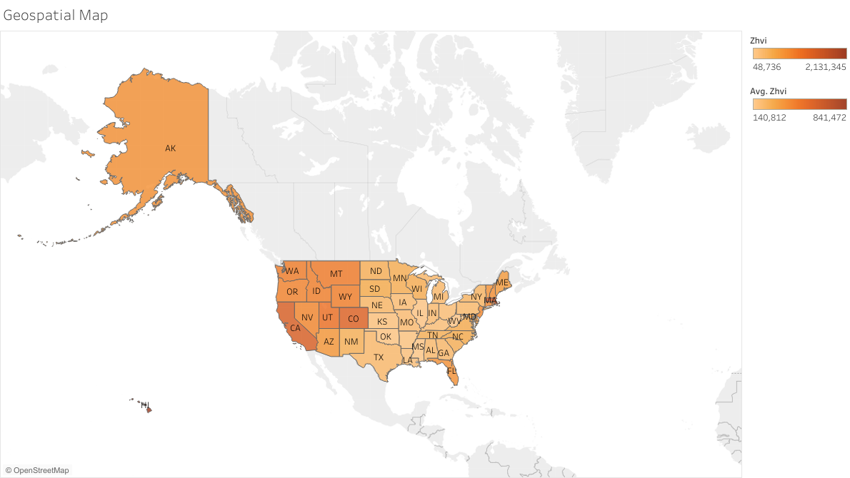
Geospatial Analysis of Home Values
Key Visualizations:
Dot Map by City – showing average ZHVI across U.S. cities
Choropleth Map by State – highlighting state-level ZHVI variation
Heatmap by State – ranking states based on average home values
MIS 515: Big Data for Business
MIS 599: Creative Component
Notes:
This slide focuses on spatial disparities in housing values across the U.S., using three geospatial visualizations.
First, the dot map plots cities and reveals micro-level ZHVI variations. Notice how dense clusters of high-value homes are concentrated in coastal and urban areas.
Second, the state-level choropleth map shows that states like California, Massachusetts, and Hawaii lead in average home values, while states like West Virginia and Mississippi remain at the lower end.
Lastly, the heatmap by state simplifies the ranking – making it easier to compare states side by side. These geospatial analyses helped us pinpoint where housing is most and least expensive, setting the stage for regional trend exploration in later slides.

Slide 7
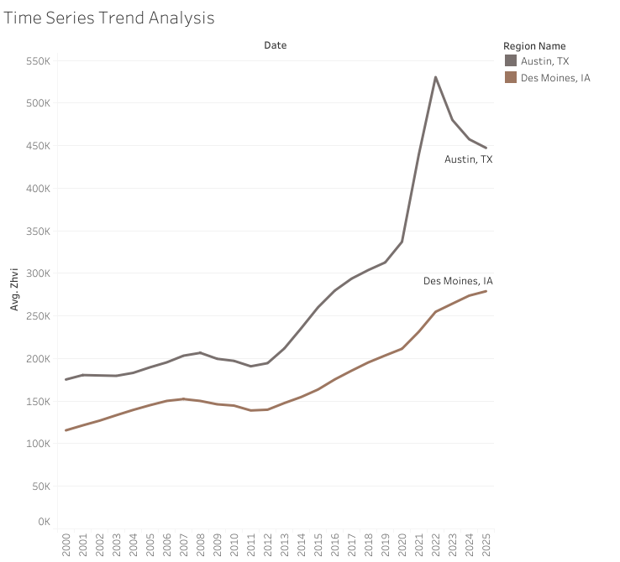
Exploratory Analysis – Time Trends
Key Cities Analyzed:
Austin, TX – Rapid growth followed by a 2022 decline
Des Moines, IA – Steady, consistent appreciation
Key Insights:
Austin experienced a sharp COVID boom and post-pandemic correction.
Des Moines showed resilience with gradual, low-volatility growth.
National ZHVI trend mirrors Austin but less extreme.
MIS 515: Big Data for Business
MIS 599: Creative Component
Notes:
This time series trend analysis compares home value growth between Austin and Des Moines from 2000 to 2024.
As shown in the chart, Austin had a steep increase during the COVID period, largely fueled by tech migration and remote work flexibility. However, it also saw a notable correction in 2022–2023 as affordability and interest rate pressures set in.
In contrast, Des Moines displayed stable and consistent growth, reflecting a more balanced regional market. This contrast highlights the importance of analyzing not just growth but also volatility and resilience in regional housing dynamics.

Slide 8
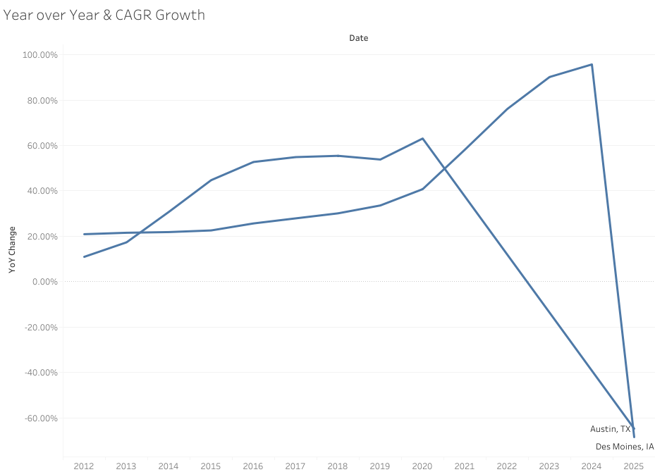
Year-Over-Year & Compound Growth Analysis
Key Metrics Visualized:
YoY Growth: Measures price change from the same month in the previous year
CAGR (Compound Annual Growth Rate): Long-term growth trends from 2018–2024
Key Observations:
Cities like Austin, Boise, and Tampa showed extremely high CAGR (10–13%)
Midwestern cities showed modest but consistent growth (3–5%)
Some cities exhibited negative YoY growth post-2022 (e.g., San Francisco)
MIS 515: Big Data for Business
MIS 599: Creative Component
Notes:
This slide shows a comparative view of both Year-over-Year growth and Compound Annual Growth Rate for major U.S. cities.
CAGR gives us a smoothed long-term perspective, showing which cities had sustained growth. As expected, tech-driven metros like Austin and Boise top the chart with double-digit CAGR values, driven by pandemic-era migration and remote work demand.
On the other hand, Year-over-Year growth reveals more short-term volatility. Several cities that peaked during the pandemic faced YoY contractions in 2022 and 2023 due to rising interest rates and reduced demand.
This dual perspective helps in understanding both short-term shocks and long-term investment potential.

Slide 9
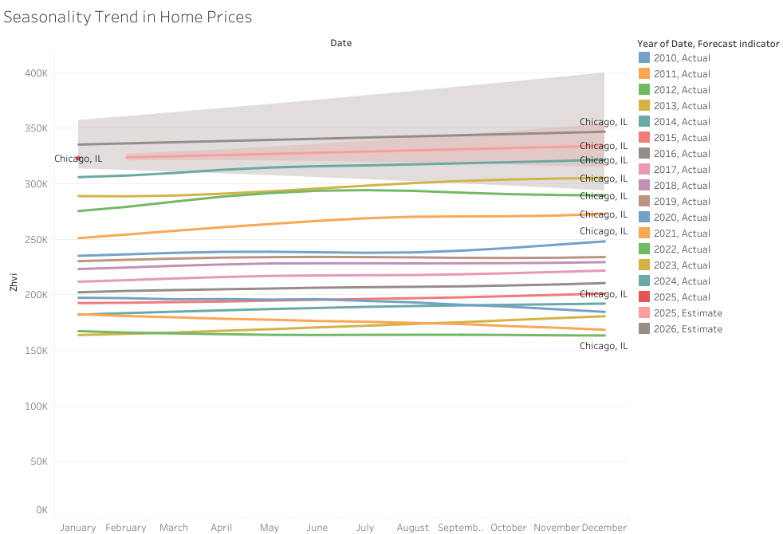
Seasonal Behavior of Housing Prices
Visualized Using:
Monthly ZHVI trends across multiple cities
Highlighted years: 2020–2022
Key Observations:
Prices consistently peak in spring/summer (May–July)
Dip occurs in fall/winter (November–January)
The pandemic temporarily disrupted seasonal patterns in 2020
MIS 515: Big Data for Business
MIS 599: Creative Component
Notes:
This chart visualizes the seasonal behavior of home values across the U.S. using monthly data from 2020 to 2022.
As seen in the trend lines, home prices tend to rise in spring and early summer — a period often associated with increased home buying activity. Prices then dip in fall and winter months, likely due to slower market activity.
Interestingly, during 2020, we observed a distortion in this pattern as the pandemic temporarily delayed peak season activity. However, by 2021 and 2022, traditional seasonality resumed.
Understanding these cyclical price movements is crucial for buyers, sellers, and investors aiming to time their decisions more effectively.

Slide 10
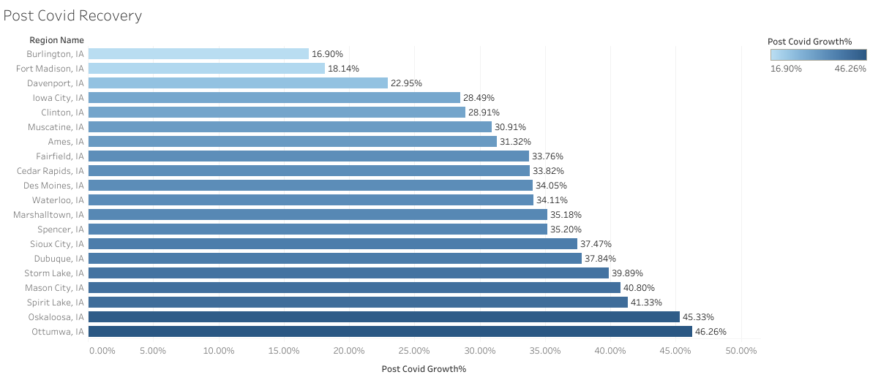
Post-COVID ZHVI Recovery – Iowa Cities
Key Cities Analyzed:
Ottumwa
Oskaloosa
Sioux City
Waterloo
Des Moines
Key Observations:
Ottumwa and Oskaloosa experienced >45% recovery post-2020
Des Moines remained stable but showed steady gains
Reflects regional resilience and affordability-led demand
MIS 515: Big Data for Business
MIS 599: Creative Component
Notes:
This slide highlights the post-COVID recovery of housing prices in various Iowa cities.
Using Tableau, I compared pre- and post-COVID ZHVI values and calculated recovery percentages. Cities like Ottumwa and Oskaloosa stood out with more than 45% growth from their 2020 baselines — reflecting local affordability, increased in-migration, and stable demand.
Des Moines continued to show consistent but modest gains, reinforcing its profile as a stable market.
These findings suggest that even smaller, less talked-about markets have shown strong resilience and represent potential future opportunities.

Slide 11
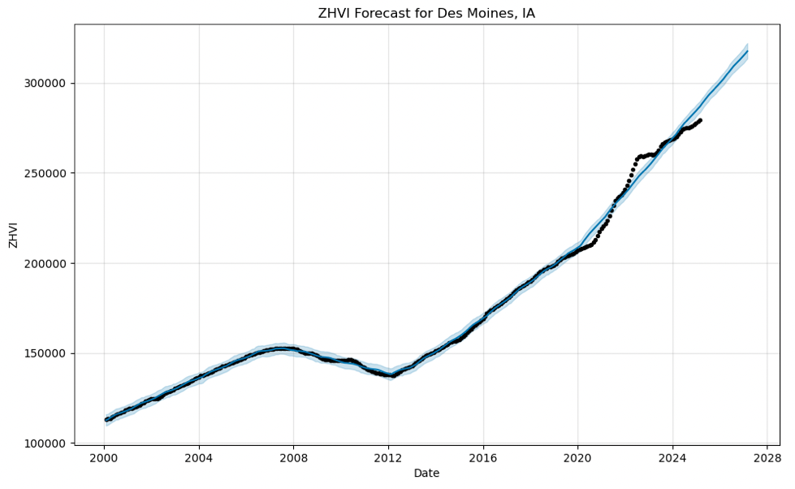
Forecasting ZHVI Using Facebook Prophet
Tool Used:
Facebook’s Prophet time series model (Python)
Forecast Output:
Predicts monthly ZHVI for 2025–2026
Includes trend, seasonality, and uncertainty intervals
Key Findings:
Forecast aligns closely with historical trendlines
Urban markets expected to stabilize after COVID volatility
Midwest regions maintain upward growth with low noise
MIS 515: Big Data for Business
MIS 599: Creative Component
Notes:
In this slide, I present the forecasting results using Facebook Prophet, a robust time series model that accounts for trend, seasonality, and holiday effects.
I trained the model using city-level ZHVI data from 2018 to 2024 and projected prices for 2025 and 2026. The output includes not only the forecasted values but also confidence intervals and seasonal decompositions.
The results show that prices in high-growth metros are expected to flatten or slightly decline, reflecting post-COVID corrections and interest rate impacts. In contrast, Midwestern cities are projected to continue their slow but steady upward trends.
This approach allows for data-driven planning, especially for real estate investors, urban planners, and financial analysts looking to anticipate market shifts.

Slide 12
Random Forest vs Linear Regression
Models Used:
Random Forest Regressor
Linear Regression
Input Features:
Region-level ZHVI
Time
Lag variables
Growth metrics (YoY, MoM)
Performance Comparison:
Random Forest RMSE: Lower (better predictive accuracy)
Linear Regression RMSE: Higher (less flexible to non-linearity)
Key Insight:
Random Forest captured non-linear price trends more effectively, especially in volatile urban markets.
Model | MAE | RMSE | R²
Random Forest | 531.76 | 2076.59 | 0.9997
Linear Regression | Higher | Higher | Lower
MIS 515: Big Data for Business
MIS 599: Creative Component
Notes:
In this analysis, we compared two predictive models—Random Forest Regressor and Linear Regression—on Zillow’s housing price dataset.
We trained both models using lagged ZHVI values, time features, and location-based variables. As shown here, the Random Forest performed significantly better, achieving an R² score of 0.9997, indicating near-perfect predictive power.
This is especially important in regions with price volatility, where linear models fall short due to their assumption of constant relationships.
The ability of Random Forest to capture nonlinear patterns makes it a strong candidate for future forecasting in dynamic housing markets.

Slide 13
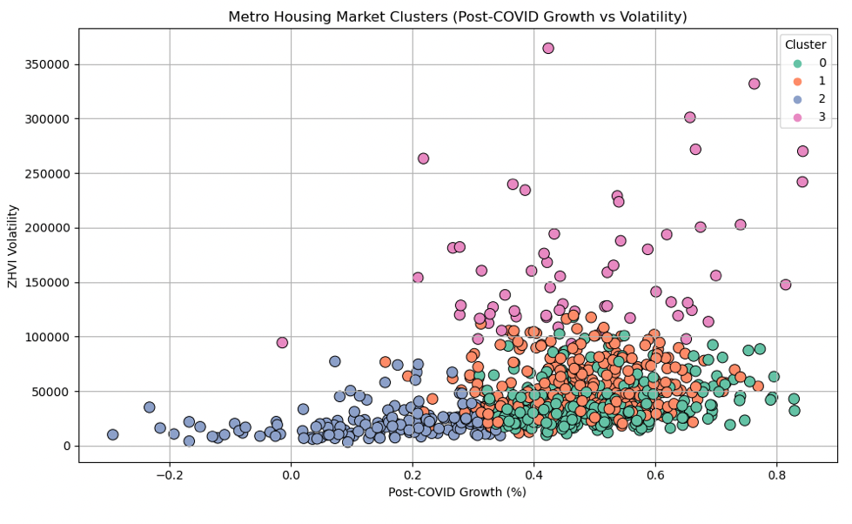
Identifying Growth Clusters in the U.S. Housing Market
Method Used:
K-Means Clustering (Unsupervised Learning)
Features Clustered On:
Average ZHVI (2024)
CAGR (2018–2024)
Volatility
Seasonality patterns
Clusters Identified:
High-Growth Volatile Markets – e.g., Austin, San Francisco
Steady Growth Stable Markets – e.g., Des Moines, Omaha
Low-Growth Affordable Markets – e.g., Flint, Toledo
MIS 515: Big Data for Business
MIS 599: Creative Component
Notes:
This slide shows how I applied K-Means clustering to segment U.S. cities based on their housing market characteristics.
Using features such as average ZHVI, compound growth rate, volatility, and seasonality, I trained a model to group cities into clusters with similar market behavior.
Three distinct clusters emerged:
Cluster 1 includes high-growth but volatile markets like Austin, which saw rapid spikes followed by corrections.
Cluster 2 represents stable, predictable markets such as Des Moines.
Cluster 3 contains low-growth regions with limited volatility — often more affordable but with slower returns.
This segmentation helps policymakers, investors, and researchers target strategies based on each city’s risk-return profile.

Slide 14
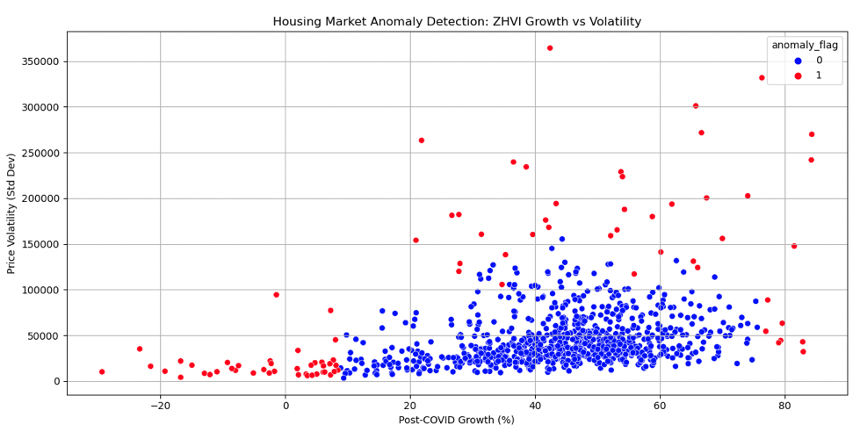
Detecting Outliers and Market Shocks – Anomaly Detection
Technique Used:
Rolling mean and z-score thresholding
Prophet changepoint detection
Interquartile Range (IQR)-based outlier analysis
Key Anomalies Identified:
2020–2021 price spikes during the COVID housing boom
2022 corrections in Austin, San Jose, Phoenix
Sudden growth spurts in smaller cities like Boise and Fayetteville
Purpose:
To flag pricing events that deviate from historical norms and assess market health.
MIS 515: Big Data for Business
MIS 599: Creative Component
Notes:
In this slide, I highlight how I used anomaly detection to identify significant deviations in housing trends.
Using statistical tools like z-score thresholds, Prophet changepoint detection, and IQR analysis, I detected moments where price changes deviated sharply from historical averages.
Most notably, the 2020–2021 boom triggered by COVID and historically low interest rates caused steep spikes, particularly in cities like Boise and Austin.
Later, in 2022, a correction phase hit cities such as San Jose and Phoenix as interest rates rose and migration slowed. These outlier points are critical in understanding risk events, and they also help validate predictive models by separating normal variation from true market shocks.

Slide 15
Key takeaways and Strategic Implications
Top Insights:
High-growth cities (e.g., Austin, Boise) offer potential but carry high volatility
Midwestern cities (e.g., Des Moines) are stable and consistent, ideal for long-term investment
Seasonality drives predictable short-term fluctuations
COVID disrupted trends, but recovery patterns vary by region
Advanced ML models (e.g., Random Forest, Prophet) yield better accuracy than traditional methods
Strategic Implications:
Investors should balance growth potential vs. risk
Policymakers must watch for overheating in volatile markets
Clustering enables targeted regional strategies
Forecasting informs urban planning, affordability policy, and infrastructure planning
MIS 515: Big Data for Business
MIS 599: Creative Component
Notes:
This slide distills the key takeaways from the entire analysis and highlights how these findings can be applied strategically.
We saw that fast-growing cities deliver high returns but come with higher risks — especially visible during COVID-driven booms and corrections. In contrast, Midwestern markets proved to be resilient and stable.
Seasonality continues to play a major role in price behavior, while the pandemic taught us that external shocks can abruptly distort these cycles.
From a technical perspective, models like Random Forest and Prophet provided more reliable predictions compared to linear models. This indicates that the real estate market benefits from machine learning-based forecasting.
These findings can guide investors in evaluating risk, help city planners make informed decisions, and provide policymakers with a lens to monitor affordability and housing supply.

Slide 16
Conclusion & Future Research Direction
Conclusion:
Housing prices are influenced by region, season, economic shocks, and migration patterns
Tableau enabled deep descriptive insights; Python models like Prophet and Random Forest enhanced predictive accuracy
Market segmentation and anomaly detection uncovered hidden patterns in city-level trends
Future Work:
Incorporate interest rate, inflation, and job market data into forecasting models
Use deep learning models (e.g., LSTM, XGBoost) for dynamic forecasting
Study rental prices alongside ZHVI to assess housing affordability
Explore real-time policy impact using causal inference and intervention models
MIS 515: Big Data for Business
MIS 599: Creative Component
Notes:
To wrap up, this research uncovered how U.S. housing prices vary across cities and time, and how we can use both descriptive and predictive methods to better understand market behavior.
It demonstrated that tools like Tableau provide strong visual insights, while Python-based models improve forecasting reliability — especially in the presence of economic disruptions like the COVID-19 pandemic.
Looking ahead, there’s huge scope to integrate macroeconomic indicators like interest rates, employment data, and inflation into these models. This would allow even more accurate and policy-relevant forecasting.
We could also explore deep learning approaches, add rental data, and evaluate how specific policies impact the housing market. This opens up exciting opportunities for future housing analytics.

Slide 17

MIS 515: Big Data for Business
MIS 599: Creative Component

