Slide 1
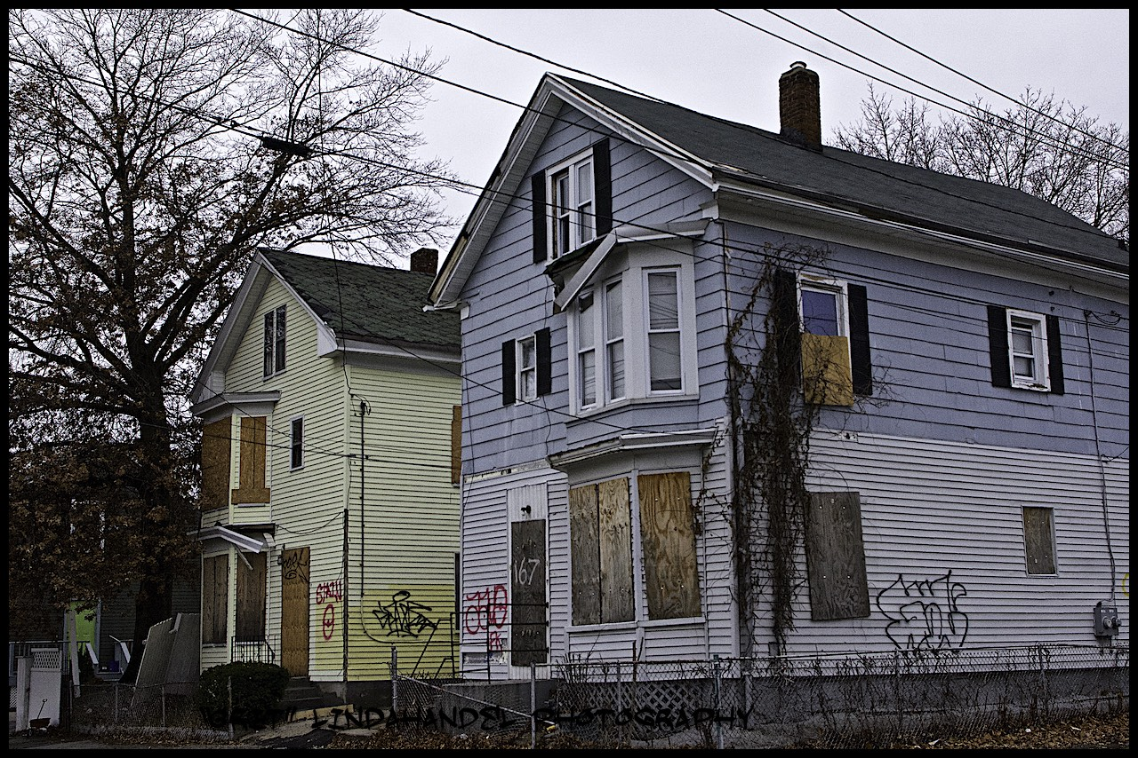
Reclaim_PVD: Mapping Abandoned & Vacated Properties in Providence, RI
By Jonathan Lax
Presentation for Housing & Neighborhood Development Committee
December 22, 2014

Slide 2
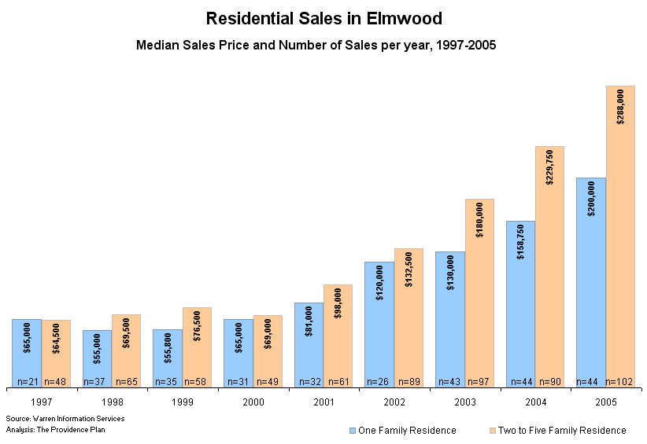
From the late 1990s to 2008, widespread subprime lending and low interest rates fueled an immense housing bubble across the United States. In Elmwood, 2-5 Family homes rose 347% from 1997 – 2005.

Slide 3
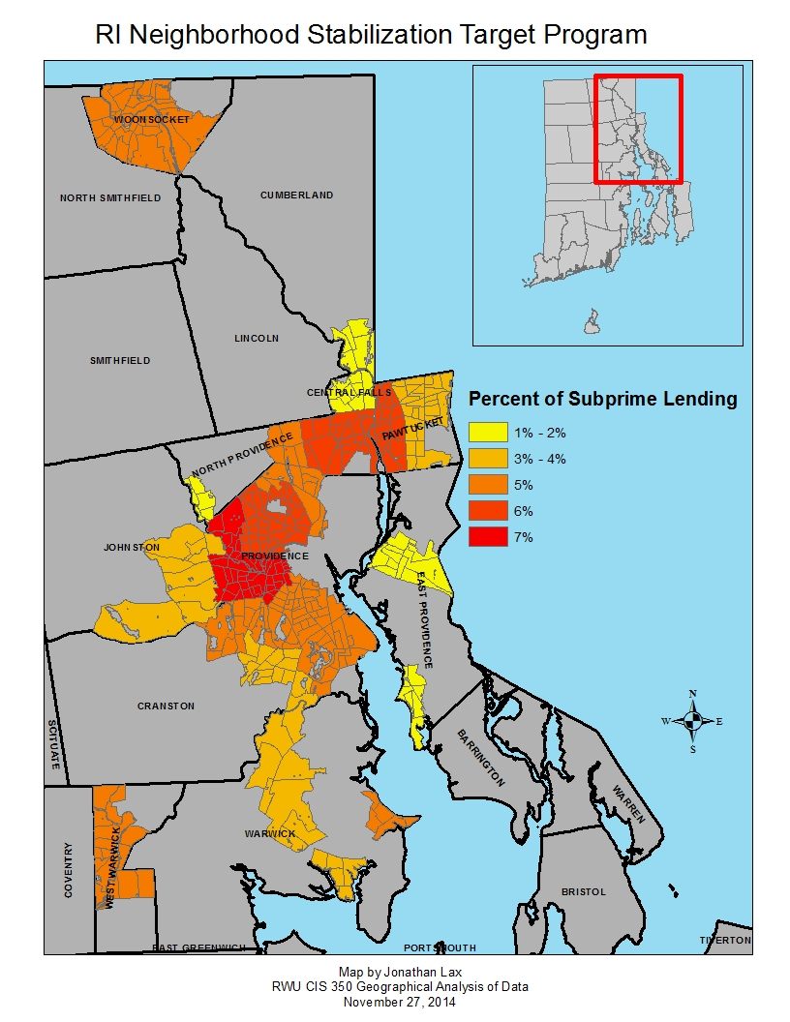
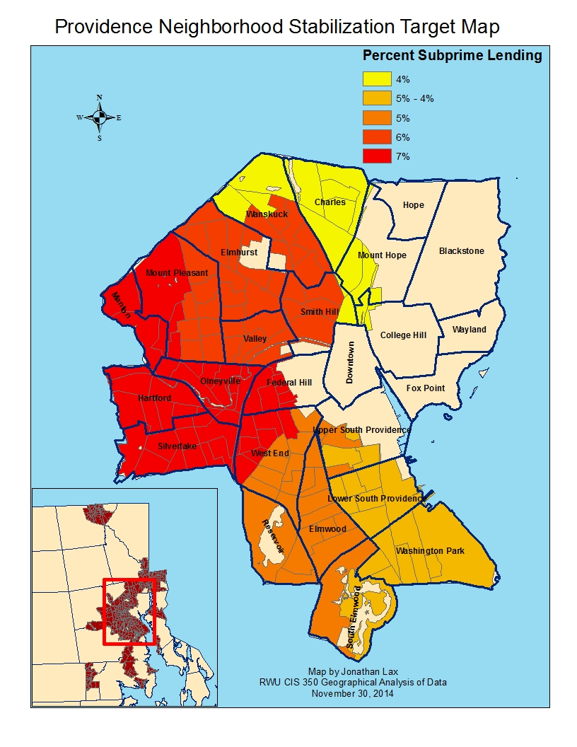
Subprime Lending was highly localized

Slide 4
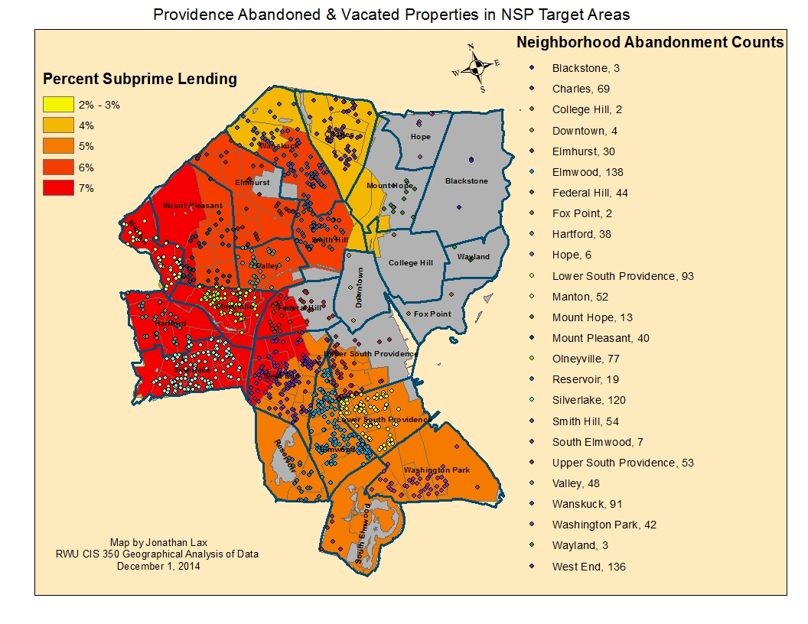
PVD Abandoned / Vacated Properties & Subprime Lending

Slide 5
Sources of Data:
The Four Lists of Abandoned & Vacated Property:
2012 Waste Collection Survey by DPW & DIS – 687 Identified properties
City-owned Vacated Tax Sales - 380
PRA-owned Vacated properties - 72
Abandoned property survey by Elmwood Neighborhood Association- 70

Slide 6
Key Findings of Abandoned & Vacated Properties:
Estimated number of Identified Abandoned & Vacated Properties: 1214
At the 90% confidence level, the actual number is between 1115 to 1327
Estimated total tax assessed value: over $128 million (excluding $32 million PRA owned municipal building)
At the 90% confidence level, the actual amount is between $118 million to $141 million
Estimated total tax due to the City of Providence: over $3.6 million
At the 90% confidence level, the actual amount is between $3.34 million to $3.97 million
The most common class of abandoned property: 2 – 5 Family homes with an estimated number of 400 housing properties

Slide 7
Key Findings of Abandoned Housing:
Estimated total of Abandoned Housing Units: 1615
At the 90% confidence level, the actual number is between 1495 to 1779
Estimated total tax assessed value of Abandoned Housing (for 1479 of the identified housing properties): over $94 million
At the 90% confidence level, the actual amount is between $86 million to $103 million
Estimate total tax bill due to the City of Providence for Abandoned Housing: over $2.7 million
At the 90% confidence level, the actual amount is between $2.5 million to over $3 million

Slide 8
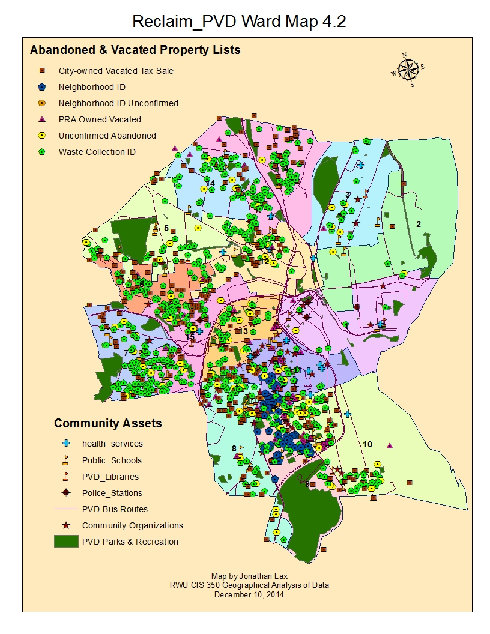
City Of Providence Efforts to Reclaim Abandoned Property:
Under Rhode Island law, municipalities are empowered to take owners of abandoned property to court for maintaining a public nuisance. If the owner of such properties fail to abate the public nuisance, then the court can appoint a receiver to take possession of the property to rehabilitate it back into the community.
Taking advantage of this statute, the City of Providence has recently launched the Providence Receivership program, in which abandoned properties and their owners and interested parties are taken to court with the goal of either abating the public nuisance or having the property placed under receivership for redevelopment.
Mayor-elect Jorge Elorza has proposed expanding the receivership program and using a $5 million bond issue to finance rehabilitation of reclaimed housing.

Slide 9
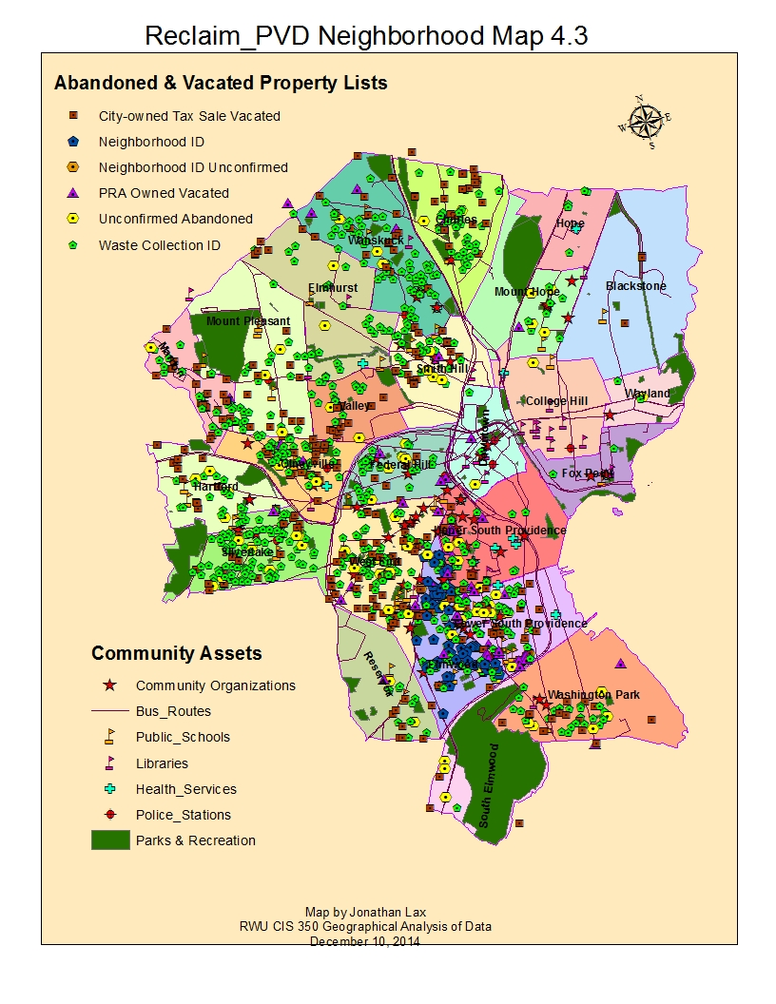
Abandoned Property & Community Assets: Integrated Approach for Neighborhood Revitalization
Abandoned properties must be viewed within the fabric of their locality, not in isolation, and their reclamation must be approached strategically.
Their proximity to key assets of the community – bus routes, schools, parks and recreation areas, and organized groups – should be assessed and mobilized to fully re-integrate those rehabbed housing back into the neighborhood.
This holistic approach will help prevent the reclaimed housing from falling back into the cycle of exploitation that leads to slum conditions.

Slide 10
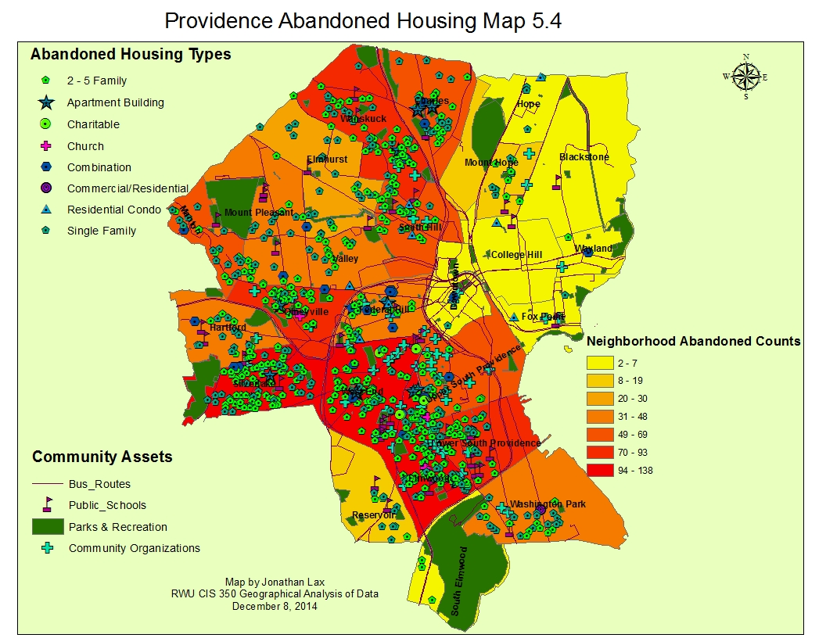
Most Abandoned PVD Homes are Multi-family dwellings in mostly low income minority-majority neighborhoods

Slide 11
Preliminary Conclusions:
A review of the data shows that most abandoned and vacated property in Providence is residential in character, with an estimated number of identified housing properties at 707 and residential vacated lots at 371.
That total of 1078 is nearly 89% of the total identified properties
Multi-unit dwellings make up over 59% of the identified abandoned housing
There appears to be a strong association between areas of elevated subprime lending and abandonment clusters.
Over 64% of the identified abandoned properties are clustered in just 8 of the 25 Providence neighborhoods

Slide 12
Policy Recommendations:
Extend the Abandoned property research immediately, to include 1) investigating ownership, 2) housing code violations and Providence Housing Court data and 3) Hot Spot Analysis
Promote Inter-agency coordination within the City of Providence and inform the public by creating a shared information platform for abandoned properties
Have the City of Providence Law Department initiate large scale receivership cases where appropriate
Integrate abandoned property restoration with other City and State initiatives, such as the Green & Healthy Homes and Full Service Schools
Recruit and Empower the Public

Slide 13
Reclaim_PVD_Abandoned_Property_Community_Asset_Map2
http://bit.ly/1BwiGeW

Slide 14
Acknowledgements:
City of Providence
Brian Hull, Director of Municipal Affairs
Elyse’ Pare, Deputy Tax Assessor
Sean Creegan, Assistant City Solicitor
Jim Silveria, Chief Information Officer
Providence Plan
Ryan Kelly, Urban Information Specialist
Brown University
Bruce Boucek, Social Science Data Librarian
Roger Williams University
Jamie Scurry, Dean of School of Continuing Studies
Professor Jorge Elorza, School of Law
Professor Mark Brickley, Gabelli School of Business
Professor Eric Jacobs, Director of Community Development Program
Elizabeth Debs, Instructor
State of Rhode Island
Raymond Neirinckx, Housing Resource Coordinator, RI Housing Commission

