Slide 1
Cryptography and Network Security CSL 759
Shweta Agrawal

Slide 2
Course Information
4-5 homeworks (20% total)
2 minors (15% each)
A major (30%)
A project (20%)
Attendance required as per institute policy
Scribe / Challenge questions (Extra Credit)
When : Tu-Wed-Fri 6 to 7 pm
Where : Bharti, room 201
Course Webpage : http://www.cse.iitd.ac.in/~shweta/teach.html

Slide 3
Administrative stuff
Teaching Assistants:
Chandrika Bharadwaj chandrika.bhardwaj@gmail.com
Abhay Gupta abhay3390@gmail.com
Nikhil Kumar nikhilkumar4@gmail.com
Utkarsh Ohm utkarshohm@gmail.com
Office Hours : TBA

Slide 4
Policies etc…
Ask questions!
Make the class interactive. We’re all here to learn.
Switch of cellphones, laptops, anything distracting.
Highest ethical standards expected. Any dishonesty/cheating of any kind will result in failing the course.

Slide 5
Course Reading
Will not follow any one book. But Katz-Kindell’s “Introduction to Modern Cryptography” will be handy.
Bellare-Goldwasser’s lecture notes
http://cseweb.ucsd.edu/~mihir/papers/gb.pdf
Lecture notes by Yevgeniy Dodis (http://www.cs.nyu.edu/courses/spring12/CSCI-GA.3210-001/index.html ) and Luca Trevisan (http://theory.stanford.edu/~trevisan/cs276/ )

Slide 6
What is this course about
Theoretical foundations of cryptography
Mathematical modeling of real world attack scenarios
Reductions between crypto primitives and hard number theoretic problems
Using cryptographic building blocks to build more complex real world protocols

Slide 7
What this course is NOT about
Implementing secure systems
Real world attacks / hacking
Analyzing hardness of underlying number theoretic problems such as factoring etc
You can do your projects on these topics if you like!

Slide 8
Course Outline
Foundations : Principles of crypto design, number theory, OWF, OWP, TDP, PRGs, PRFs, MACs
Constructions : symmetric and public key crypto, digital signatures, MPC
Advanced Topics: Zero Knowledge, Functional encryption, fully homomorphic encryption, broadcast encryption etc

Slide 9
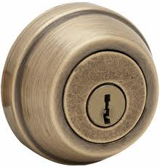

Cryptography
A mathematical science of controlling access to information
Cryptography deals with methods for protecting the privacy and integrity while preserving functionality of computer and communication systems.
What would we like to achieve?

Slide 10
Real World Problems

Slide 11
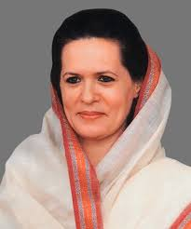
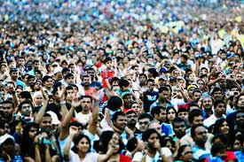
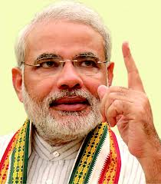
#1 : Secure Elections
Multi-party computation!
VOTE
COUNTING
VOTES
Winner ?
CORRECT : Winner determined correctly
SECURITY : individual vote privacy maintained

Slide 12

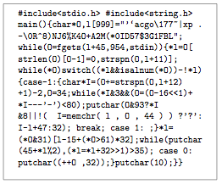
#2 : Protecting your code
I know a better algorithm to factor numbers!
Program
Obfuscation!
O
B
F
U
S
C
A
T
O
R
Obfuscated code
code
Produces correct output
Impossible to reverse engineer

Slide 13
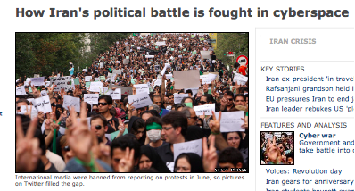
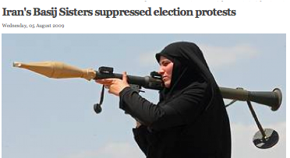
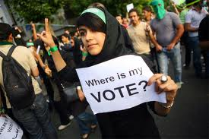
#3 : Activism with safety
Probabilistic algorithm
R, R’ : Random bits
C = Encrypt (“The election was rigged”, R)
Under coercion, reveal R’ s.t. C =(“Really like to cook”, R’)
Deniable Encryption!

Slide 14
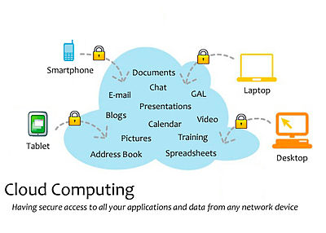
#4: Computing on encrypted data
Users access data and infrastructure on-the-go
Cloud stores data about you, me and many more
I should learn information about myself but no information about you

Slide 15
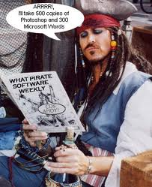
#5: Traitor Tracing
I’ll buy one license
And use it to forge and sell new licenses …
Can we catch him ?

Slide 16
#5: Traitor Tracing
N users in system, One PK, N SKs
Anyone can encrypt, only legitimate user should decrypt
If collusion of traitors create new secret key SK*, can trace at least one guilty traitor.

Slide 17
This course ….
1. How can we build these things from math ? 2. What guarantees can we have ? 3. How do we move from messy real world scenarios to clean mathematical definitions? 4. How do theorems in math say anything about real world attacks?

Slide 18
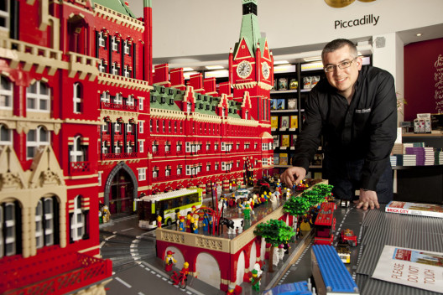
Building Blocks
St. Pancreas International Station - 18 months, 150,000 LEGO bricks
Warren Elsemore

Slide 19

What he started with

Slide 20
Building cryptography
Same idea!
One way functions, trapdoor permutations, Pseudo random generators, PRFs
Symmetric key crypto, public key crypto, Digital signatures ……
Multiparty computation, homomorphic encryption, functional encryption, deniable signatures, obfuscation, traitor tracing …..

Slide 21
Principles of Crypto Design [Katz-Lindell]
Formulate a rigorous and precise definition of security for cryptosystem – security model.
Precisely formulate the mathematical assumption (e.g. factoring) on which the security of the cryptosystem relies.
Construct cryptosystem (algorithms) and provide proof (reduction) that cryptosystem satisfying security model in (1) is as hard to break as mathematical assumption in (2).

Slide 22

1: Security Model
Real world attacks
Crypto
Proofs
Security Model : Mathematical definition that scheme has to satisfy
Scheme achieves security in given model = Scheme secure against attacks captured by that model

Slide 23
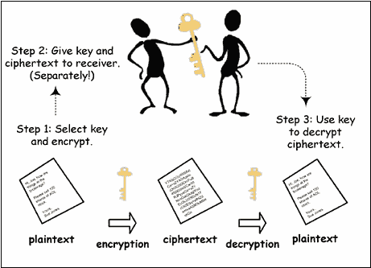
Case Study : Secure encryption
Every pair of users must share a unique secret key
Need key to encrypt and decrypt. Intuitively, only holder of secret key should be able to decrypt

Slide 24
Case Study : Secure encryption
Syntax
We must construct the following algorithms:
Keygen : Algorithm that generates secret key K
Encrypt(K,m) : Algorithm used by Alice to garble message m into “ciphertext” CT
3. Decrypt(K, CT) : Algorithm used by Bob to recover message m from ciphertext CT.

Slide 25
Case Study : Secure encryption
How should security of encryption be defined?
Answer 1 : Upon seeing ciphertext, Eve should not be able to find the secret key.
But our goal is to protect the message!
Consider encrypt algorithm that ignores the secret key and just outputs the message. An attacker cannot learn the key from the ciphertext but learns the entire message!

Slide 26
Case Study : Secure encryption
Answer 2 : Upon seeing ciphertext, Eve should not be able to find the message.
Is it secure intuitively to find 99% of the mesg?
Answer 3 : Upon seeing ciphertext, Eve should not be able to find a single character of the message.
Is it ok to leak some property of the mesg, such as whether m> k?

Slide 27
Case Study : Secure encryption
Answer 4 : Any function that Eve can compute given the ciphertext, she can compute without the ciphertext.
Still need to specify :
Can Eve see ciphertexts of messages of her choice?
Can Eve see decryptions of some ciphertexts?
How much power does she have?

Slide 28
What about security of real world functionalities?

Slide 29

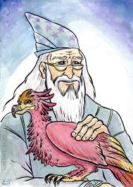
Ideal Security definition
REAL
IDEAL
adversary A
Cryptographic
protocol
Trusted
party

Slide 30
Ideal Security definition
REAL
IDEAL
adversary A
adversary S
Cryptographic
protocol
Trusted
party

Slide 31
Ideal Security definition
REAL
IDEAL
≈
adversary A
adversary S
Cryptographic
protocol
Trusted
party

Slide 32
2: Mathematical Assumption
Trivial assumption : my scheme is secure
Use minimal assumptions
Existence of one way functions
Use well studied assumptions
Examples: factoring, discrete log, shortest vector problem etc…

Slide 33
3: Reduction
Reduction B
Instance x of hard
Problem X
Attacker A
Cryptosystem Π
Break on Π
Solution to x

Slide 34
3: Reduction
Show how to use an adversary for breaking primitive 1 in order to break primitive 2
Important :
Run time: how does T₁ relate to T₂
Probability of success: how does Succ₁ relate to Succ₂
Access to the system 1 vs. 2

Slide 35
Secret Key Encryption Construction
Keygen : Pick a random string r . Set K = r. Give to both Alice and Bob
Encrypt (m, K ) : CT = m r
Decrypt ( CT, K) : m r r =m
Only works for single use of r!
How to generate shared key?
Notes:
Develop proof of security in HW. How long does the key need to be? Card trick ☺

Slide 36
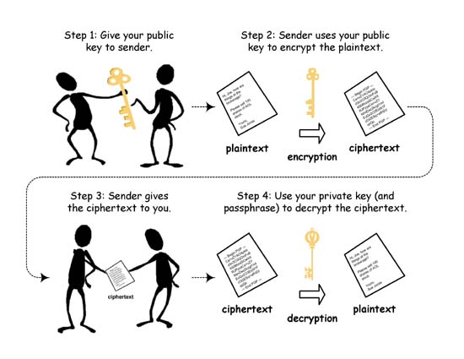
Public Key Cryptography

Slide 37
What we need…
Invertible: It must be possible for Alice to decrypt encrypted messages.
Efﬁcient to compute: It must be reasonable for people to encrypt messages for Alice.
Difﬁcult to invert: Eve should not be able to compute m from the “encryption” f(m).
Easy to invert given some auxiliary information: Alice should restore m using SK.

Slide 38
What we need…
Invertible
Efﬁcient to compute
Difﬁcult to invert
Easy to invert given some auxiliary information
One way functions!

Slide 39
What we need…
Invertible
Efﬁcient to compute
Difﬁcult to invert
Easy to invert given some auxiliary information
One way permutations!

Slide 40
What we need…
Invertible
Efﬁcient to compute
Difﬁcult to invert
Easy to invert given some auxiliary information
Trapdoor permutations!

Slide 41
Up Next …
Discuss some number theory
Introduce conjectured hard problems such as factoring, discrete log.
Build candidate one way functions, one way permutations and trapdoor permutations
Construct proofs of security.

