Slide 1
implementing Service Level Indicators (SLIs) and Service Level Objectives (SLOs) for measuring system reliability:
Step 1: Define Service Level Indicators (SLIs)
Identify Key Metrics: Determine what aspects of reliability are important for your service. Common SLIs include:
Availability: Are users able to access the service?
Latency: How quickly do responses occur?
Throughput: How many requests can be handled in a given time?
Error Rates: How many requests result in errors?
Customer Perspective: Ensure that these metrics reflect the experience of the end user.
Step 2: Establish Service Level Objectives (SLOs)
Set Targets: For each SLI, define a specific target that you want to achieve. For example:
"99.9% of requests should succeed."
"90% of responses should be under 200 milliseconds."
Time Frame: Specify the period over which these metrics will be measured, such as daily, weekly, or rolling 30 days.
Step 3: Implement Monitoring
Choose a Monitoring System: Select a reliable monitoring tool that can track your SLIs and SLOs.
Integrate SLIs into the System: Set up your monitoring system to collect and report the defined SLIs in real-time.
Ensure Trustworthiness: Make sure the monitoring data is accurate and reliable, as this will serve as the basis for your discussions and decisions.
Step 4: Use Data for Decision-Making
Monitor Performance: Regularly check your SLIs against the established SLOs.
Assess Reliability: Determine if the service is meeting the objectives. For example:
If availability is at 95%, but your SLO is 99.9%, investigate the reasons for the shortfall.
Step 5: Error Budgets
Calculate the Error Budget: This is the difference between your SLO and actual performance. For example, if your SLO is 99.9% and you achieved 98%, you have a 1.9% error budget.
Manage Changes:
If you're under your error budget, consider increasing release frequency or adding new features.
If you exhaust your error budget (i.e., performance drops below your SLO), focus on improving reliability before making further changes.
Step 6: Continuous Improvement
Review and Adjust: Regularly evaluate the SLIs and SLOs to ensure they remain relevant and achievable.
Foster a Culture of Reliability: Encourage teams to use data in discussions about performance, leading to informed decision-making and continuous improvement efforts.
Step 7: Communicate and Collaborate
Establish Common Language: Use SLIs and SLOs to create a shared understanding among stakeholders, developers, and management about system performance.
Facilitate Conversations: Focus discussions on objective data rather than subjective opinions to foster transparency and trust within the team.
By following these steps, you can effectively implement SLIs and SLOs in your organization, leading to improved reliability and better alignment with customer expectations.

Slide 2
Service Level Objectives (SLOs):
Define clear reliability goals based on user and business needs.
Monitor system performance against these goals.
Ensure that unmet SLOs trigger proactive improvement measures.
Error Budgets:
Quantify acceptable unreliability as the difference between 100% reliability and the SLO.
Use error budgets to determine when changes are necessary if reliability goals are exceeded.
For example, a 99.9% uptime SLO allows for approximately 43 minutes of downtime per month.
Making Tomorrow Better:
Allocate time for SRE teams to focus on project work aimed at improving system reliability.
Balance operational work with initiatives that enhance system performance.
Prevent overload from operational toil by emphasizing continuous improvement.
Shared Responsibility:
Encourage collaboration between SRE and development teams.
SRE teams should not act as gatekeepers; instead, they should partner in maintaining reliability.
Share operational responsibilities to foster better teamwork and reduce bottlenecks.
Regulating Workload:
Implement mechanisms for SRE teams to manage their workloads effectively.
Leadership support is crucial for prioritizing reliability efforts and addressing workload issues.
Allow SRE teams to push back when their workload becomes unmanageable.

Slide 3
Common Monitoring Mistakes
Underestimating Monitoring Needs
Relying solely on cloud metrics (AWS, Azure, Google Cloud) is a mistake.
Assuming market leadership negates the need for robust monitoring.
Time Constraints
Developers often prioritize coding and release over monitoring.
This can lead to serious issues when systems fail.
Importance of Monitoring
What is Monitoring?
Systematic collection and analysis of data to track progress and guide decisions.
Benefits of Monitoring
Analyzing long-term trends.
Alerting on threshold breaches.
Building dashboards for visualization.
Conducting troubleshooting (ad hoc analysis).
Key Monitoring Areas
What to Monitor
System Level: CPU, memory, disk usage.
Application Level: Process checks, error rates.
Network Monitoring: Traffic patterns, API performance.
Security Monitoring: Ensuring data integrity and protection.
Monitoring Types
White Box Monitoring
Focuses on internal metrics of applications.
Tools: Prometheus, Dynatrace, etc.
Black Box Monitoring
Monitors external performance from a user's perspective.
Tools: General system metrics (HTTP status, response times).
Implementation Steps
Setting Up Monitoring
Define what to monitor and how.
Determine data collection methods and storage.
Analyze data for insights and set up alerts.
Key Metrics: Golden Signals
Golden Signals to Monitor
Latency: Time to service requests.
Traffic: Number of requests per second.
Errors: Rate of failed requests.
Saturation: Resource utilization levels.

Slide 4
1. Need for Observability vs. Monitoring
Early detection of bugs is key to maintaining reliability and customer satisfaction.
Effective observability and monitoring can prevent issues from escalating.
Observability and monitoring are often confused but have distinct differences.
Both are crucial for identifying and fixing bugs before they impact users.
2. What is Monitoring?
Monitoring tracks the performance of applications and infrastructure.
Example: In an e-commerce app, if users face latency while searching for products, monitoring tools can alert developers about the slow search service.
Tools like Prometheus and Grafana are commonly used for monitoring key metrics.
3. Key Metrics to Monitor: The Four Golden Signals
Latency: Time taken for a request to be processed. Lower latency improves user experience.
Traffic: Number of requests over time. Important during peak times, like flash sales.
Error Rate: Percentage of failed requests. High rates indicate issues in the system.
Saturation: Resource utilization levels (CPU, memory). High saturation can degrade performance.
4. Monitoring Best Practices
Start monitoring early and focus on key metrics.
Use clear, actionable alerts to prevent alert fatigue.
5. What is Observability?
Observability allows deeper insight into application health through logs, metrics, and traces.
It helps identify the root cause of issues, rather than just notifying about them.
6. Three Pillars of Observability
Logs: Provide a chronological record of events, helping identify what went wrong.
Metrics: Offer quantitative data about system performance (e.g., response times).
Traces: Track requests through services, highlighting where delays occur.
7. Observability Best Practices
Control log volume to manage costs.
Ensure sufficient context is available for troubleshooting.
8. Key Differences Between Monitoring and Observability
Monitoring alerts teams to problems; observability provides the context to understand and fix those problems.
Analogy: Monitoring is like receiving an alert about a patient's high heart rate; observability is gathering additional data to diagnose the underlying issue.
Conclusion
Both monitoring and observability are essential for maintaining application reliability.
Monitoring identifies issues; observability helps understand and resolve them effectively.

Slide 5
Acceptance of Failure: Google views accepting failure as a normal aspect of DevOps. Site Reliability Engineers (SREs) anticipate incidents and outages, even with precautions in place.
Monitoring and Response: Before incidents occur, SREs build robust monitoring and observability systems, and establish documented processes for incident management. This preparation allows teams to focus on resolving issues effectively during an incident.
Blameless Postmortems: After an incident, SREs conduct blameless postmortems or retrospectives to analyze what happened without placing blame on individuals. This approach encourages collective learning and prevents recurrence of the same issues.
Purpose of Postmortems: The main goals of a postmortem include:
Understanding all root causes, recognizing that multiple factors often contribute to outages.
Implementing actions to prevent future occurrences and reduce stress on teams.
Avoiding unnecessary complexity in systems, as quick fixes can lead to a tangled web of dependencies.
Learning from failures to foster a culture of improvement and resilience.
Cultural Impact: A blameless approach enhances team effectiveness and psychological safety, allowing engineers to focus on preventing problems rather than fearing blame for failures.

Slide 6
Understanding Psychological Safety: Psychological safety is the belief that team members won’t be punished for voicing ideas, concerns, or mistakes. Low psychological safety can stifle communication, innovation, and learning, leading to a fear of speaking up.
Consequences of Low Psychological Safety: When team members don’t feel safe to express concerns, they miss opportunities for learning and improvement. This can lead to poor team dynamics and hinder overall performance.
Building Psychological Safety: Leaders can cultivate this environment by:
Framing challenges as learning opportunities rather than execution failures.
Encouraging open communication and acknowledging their own mistakes.
Modeling curiosity by asking questions.
Impact on Software Delivery: Environments with high psychological safety encourage collaboration, welcome new ideas, and treat failures as learning opportunities. This ultimately enhances lead times, deployment frequency, and recovery times.
Importance of Blamelessness: Blameless postmortems are essential for learning from incidents. They focus on systems and processes rather than assigning blame to individuals. This helps reduce fear and encourages more open discussions about failures.
Reasons for Blaming:
Hindsight Bias: The tendency to believe one could have predicted an outcome after it has happened, leading to misplaced blame.
Discomfort Discharge: The instinct to blame as a way to alleviate discomfort, which ultimately hinders learning.
Shifting Focus from People to Systems: Organizations should investigate the underlying processes that led to incidents rather than blaming individuals. This approach fosters an environment of trust and encourages risk-taking, essential for innovation.
Real-World Application: Examples, such as the experience of a Dutch retailer with Google’s SRE training, illustrate how shifting from a blaming culture to one of psychological safety can transform team dynamics and enhance operational effectiveness.

Slide 7
Breaking Down Silos: Traditionally, software development and operations have operated in silos, leading to issues with system reliability. To avoid a "break-fix" mentality, collaboration between business, development, and operations teams is essential.
Cost of Maintenance: A significant portion of software costs is incurred after launch (40-90%). Since developers typically focus on building rather than maintaining, SRE practices are vital for bridging the gap between development and operations.
Error Budgets: An error budget defines how much downtime or unreliability a service can tolerate. It allows teams to balance innovation (new features) with reliability. As long as the service remains within its error budget, developers can continue to push updates.
Service-Level Objectives (SLOs): SLOs are agreed-upon targets for system reliability that provide clear expectations for performance. They help teams gauge the reliability of their services and determine when it's safe to introduce new features without compromising user experience.
Service-Level Indicators (SLIs): SLIs are quantifiable measures that reflect the service's reliability at any given moment, expressed as a percentage of good events over total valid events. This data informs the SLOs, which should be just below 100% (e.g., 99.9%).
Customer Expectations: Meeting SLOs ensures customer satisfaction, as anything below the agreed-upon target may lead to unhappy customers. SLOs act as a threshold between acceptable and unacceptable service performance.
Service-Level Agreements (SLAs): SLAs are formal commitments to customers regarding service health and what the business will do if it fails to meet SLOs, such as providing refunds.

Slide 8
1. Unified Vision
Team Vision: Aligns with the company's overall vision and includes core values, purpose, mission, strategy, and goals.
Core Values: Guide behaviors and build trust, psychological safety, and commitment among team members.
Purpose: Clarifies why the team exists; research shows teams with a clear purpose have higher satisfaction and fewer conflicts.
Mission: Defines a clear goal for the team to achieve (e.g., Google's mission to organize the world’s information).
Strategy: Outlines how to achieve the mission, considering external and internal factors and aligning resources effectively.
Goals: Utilize frameworks like OKRs (Objectives and Key Results) to set ambitious targets, encouraging innovation and collaboration.
2. Collaboration and Communication
Effective Communication: Critical for distributed SRE teams to overcome challenges and foster problem-solving.
Service-Oriented Meetings: Regular meetings to review service states, ensuring all stakeholders are informed and engaged. Attendance and a clear agenda are essential.
Team Composition: Roles such as tech leads, managers, and project managers should prioritize excellent communication skills to facilitate collaboration across time zones.
Cross-Functional Collaboration: Best achieved early in the design phase to allow SREs to influence architecture and software behavior.
3. Knowledge Sharing
Cross-Training: Encourages SREs to learn multiple job functions, increasing flexibility, job satisfaction, and productivity.
Employee Networks: Google’s g2g (Google to Google) network allows employees to teach and learn from each other, enhancing skill development.
Job Shadowing: Provides insights into different roles, fosters understanding, and creates a safe environment for asking questions.
Postmortems: Help teams learn from mistakes and enhance collaboration and knowledge sharing. Tools like Google Docs facilitate real-time collaboration and input collection.

Slide 9
1. Gradual Change vs. Moonshot Thinking
Moonshot Thinking: Emphasizes large-scale, innovative changes that may yield significant breakthroughs but come with high risks of failure.
Gradual Change: Advocated by SREs, this approach involves smaller, incremental changes that minimize user disruption and reduce the overall risk of failure.
2. Key Practices of SRE for Gradual Change
Continuous Integration (CI):
Involves regularly building, integrating, and testing code within a development environment.
Aims to improve code quality and catch critical issues early.
Continuous Delivery (CD):
Focuses on ensuring code can be deployed to production frequently, allowing teams to release updates as needed while maintaining quality.
Involves automation in testing and deployment processes.
Benefits of CI/CD:
Reduces integration issues and human error.
Enhances code quality and recovery speed after failures.
Saves time and costs through automation.
Shortens time to market and increases visibility into project progress.
3. Canarying
Definition: A deployment strategy that tests changes on a small, controlled subset of users before a full rollout.
Metaphor: Similar to using canaries in coal mines to detect danger; in this case, the canary represents a small portion of the service that can be monitored for issues resulting from the change.
Requirements for Effective Canarying:
Representative Subset: The canary group should reflect the broader user population.
Minimal Differences: The only significant difference between the canary and control groups should be the new change being tested.
Manageable Scale: The canary group should be small enough to avoid compromising the overall service quality.
Simplicity: The deployment process should be straightforward to facilitate easy monitoring and rollback if necessary.

Slide 10
Emphasizing gradual change through practices like CI/CD and canarying not only reduces the cost of failure but also fosters a more innovative culture within teams. By creating an environment where changes can be tested safely, teams are encouraged to think creatively and explore bold ideas. Here's a summary of how design thinking and prototyping fit into this framework:
Design Thinking in SRE Culture
Design thinking combines creativity with a structured approach to problem-solving, consisting of five key phases:
Empathize: Understand the needs and environments of your users through observation and engagement. This phase is crucial for setting aside assumptions and gaining real insights.
Define: Clearly articulate the problem from the user's perspective. This helps focus the team's efforts on solving real user issues.
Ideate: Generate a wide range of ideas and potential solutions. This phase encourages expansive thinking and creativity without immediate constraints.
Prototype: Transform ideas into tangible representations. Prototyping is experimental and allows teams to explore solutions without committing fully, making it easier to identify the best options.
Test: Evaluate prototypes in real-world settings with users. This feedback is essential for refining solutions before full-scale implementation.
The Importance of Prototyping
A prototype-driven culture allows teams to test more ideas rapidly, leading to quicker failures and, consequently, more opportunities for success. Without prototyping, teams may become risk-averse, limiting innovation.
Types of Prototyping:
Physical Prototyping: Using models made from building blocks or other materials.
Paper and Drawing: Sketching ideas to visualize concepts.
Clickable Prototypes: Using software to simulate a solution.
Role Play: Engaging testers in interactive scenarios.
Video Prototypes: Recording interactions to analyze user behavior.
Real-World Applications
Successful prototyping can lead to innovative solutions and improvements in complex processes. For example, a leading online retailer in the Netherlands used paper cups to represent and visualize their production steps, highlighting areas for improvement.
Conclusion
Cultivating a culture of design thinking and prototyping encourages teams to experiment and innovate. Leaders in organizations must actively support and promote these practices to fully realize their benefits.

Slide 11
The emphasis on reducing toil through automation is central to the Site Reliability Engineering (SRE) philosophy at Google. Here's a concise breakdown of the key points:
Understanding Toil
Toil is defined as work that is:
Manual and repetitive
Automatable
Tactical and without enduring value
Scalable linearly with service growth
Toil is distinct from necessary administrative tasks and can hinder an SRE team's effectiveness.
Problems Caused by Toil
Career Stagnation: Excessive toil limits opportunities for professional growth.
Low Morale: High levels of toil can lead to burnout and dissatisfaction among team members.
Confusion: Engaging too much in toil can blur the lines between SRE and traditional operations roles.
Slowed Progress: Teams overwhelmed with toil struggle to deliver new features quickly.
Precedence Setting: Taking on too much toil can encourage developers to shift operational responsibilities to SREs.
Attrition: Talented engineers may leave if they feel burdened by excessive toil.
Breach of Faith: New hires expecting project work may feel misled if they encounter high levels of toil.
The Role of Automation
To combat toil, SREs prioritize automation. Key benefits include:
Consistency: Reduces human error by ensuring uniformity in processes.
Scalability: Automated systems can be extended and centralized, making it easier to fix issues.
Speed: Machines can act faster than humans, which is crucial for managing large production systems.
Cost Reduction: Early detection and resolution of issues are generally less expensive.
Time Savings: Once a task is automated, it can be executed easily by anyone without ongoing training.
Balancing Toil and Project Work
Toil should be limited to a maximum of 50% of an SRE’s time. This allows SREs to focus on:
Projects that enhance reliability and performance.
Initiatives aimed at reducing future toil.

Slide 12
Implementing automation to reduce toil can lead to resistance from team members, and it's crucial to understand the psychological aspects behind these reactions. Here’s a summary of the key points regarding change management and addressing resistance in the context of Site Reliability Engineering (SRE):
Understanding Resistance to Change
Categories of Reactions:
Navigators: Champions of change who can lead and support others. Celebrate and utilize their influence.
Critics: Passionate individuals with valid concerns. Engage with them to turn their fears into support.
Victims: Those who feel personally affected by change. Listen to their concerns and empathize to help them move forward.
Bystanders: Individuals who are unaware of the changes. Communicate clearly with them to gauge their feelings and awareness.
Emotional Responses to Change:
Change can elicit a range of emotions, from anxiety to excitement. Understanding that these reactions are natural is important for effective leadership.
Biological responses in the brain, such as feelings of exclusion or anxiety about deception, can influence how people react to changes.
Addressing Emotional Responses
Involvement: Include team members in the change process to mitigate feelings of exclusion.
Set Realistic Expectations: Clearly communicate the reasons behind the changes to reduce anxiety.
Co-Creation: Encourage collaboration and problem-solving to empower team members.
Simplify Messaging: Focus on key concepts to reduce overwhelm and ensure clear communication.
Build New Habits: Allow time for team members to adapt to new processes.
Supporting Teams Through Change
Connect on Three Levels:
Head: Rational explanation of the change's purpose and strategic importance.
Heart: Address personal impacts and benefits, making individuals feel involved.
Feet: Provide necessary resources, training, and support for successful adaptation.
Change Curve Awareness: Recognize that individuals may move back and forth through various stages of acceptance and that it's normal for people to need time to adjust.
Handling Resistance
Fear of Loss: Understand that resistance often stems from fears about losing security, control, or relationships.
Checklist for Successful Change:
Ensure leaders model desired behaviors.
Clarify the reasons behind the change.
Foster genuine care for the change's success.
Provide knowledge and resources for success.
Implement reinforcement and recognition programs.
Case Study Example
A leading commercial bank in Spain faced resistance when trying to automate processes. The engineering teams perceived automation as a threat to their jobs due to a lack of communication and support during the SRE implementation. This highlights the importance of clear communication and support to alleviate fears and promote acceptance.

Slide 13
The final pillar of DevOps philosophy emphasizes the importance of measuring everything to gain clear insights into service performance. At Google, three primary goals for measurement are identified:
Objective Status Understanding: IT teams can assess the current service status using metrics like SLIs (Service Level Indicators) and SLOs (Service Level Objectives).
Data Analysis for Improvement: Teams can analyze collected data to determine necessary actions for service enhancement.
Collaboration for Better Decisions: Measurement fosters collaboration between IT and business teams, facilitating informed decision-making across the organization.
Effective measurement leads to data-driven businesses and improved operational decisions. Key practices include:
Measuring Reliability: It’s vital to choose SLIs that reflect user experience, focusing on metrics that clearly indicate user happiness rather than technical performance.
Measuring Toil: Toil refers to repetitive, low-value work. Teams can identify, quantify, and track toil to reduce it, improving efficiency and morale.
Monitoring: Effective monitoring involves alerting based on user-visible symptoms rather than underlying causes. Google suggests focusing on the "four golden signals": latency, traffic, errors, and saturation.
Overall, measurement and monitoring are crucial for maintaining service health and enabling development teams to prioritize critical business tasks. The upcoming discussion will explore cultural aspects like goal setting and data-driven decision-making that support effective measurement practices.

Slide 14
1. Goal Setting
a. Data-Driven Process
Develop a structured approach to setting goals using data as the foundation. This involves identifying specific metrics that are relevant to the team's objectives and organizational priorities.
b. Key Performance Indicators (KPIs)
Utilize KPIs to measure success and track progress. Google employs OKRs (Objectives and Key Results) as a framework for defining and communicating goals.
c. Setting Ambitious OKRs
Encourage teams to think big when formulating OKRs. The optimal achievement level for these goals is typically between 60% to 70%, promoting ambition while recognizing that not every goal will be fully met.
d. Public Grading of OKRs
Make OKR progress visible across the organization. This transparency helps foster accountability and motivates teams to stay aligned with their objectives.
e. Regular Check-Ins
Implement frequent check-ins throughout the quarter. These meetings help teams discuss progress, adjust goals as necessary, and maintain momentum towards achieving their objectives.
2. Transparency
a. Embracing Transparency
Cultivate a culture that values openness. As noted by former Google SVP Laszlo Bock, demonstrating trust in employees encourages better judgment and engagement.
b. Sharing Tools
Provide access to tools that facilitate collaboration and information sharing. For example, Google’s issue tracker, Buganizer, allows development and operations teams to monitor issues and track resolution progress transparently.
c. Communication and Feedback Loops
Establish clear communication channels that allow for regular feedback. This creates a cycle of production, measurement, and improvement, where teams continuously learn from outcomes.
d. Systemic Transparency
Beyond tool sharing, ensure that the organization’s systems promote information sharing. This helps everyone stay informed about processes and changes, fostering a culture of collective responsibility.

Slide 15
3. Data-Driven Decision-Making
a. Removing Unconscious Biases
Acknowledge and address unconscious biases that can impact decision-making. This includes biases like affinity bias (favoring those similar to oneself) and confirmation bias (favoring information that supports pre-existing beliefs).
b. Strategies to Mitigate Bias
Question First Impressions: Encourage team members to reflect critically on their initial judgments before making decisions, particularly regarding promotions or hiring.
Justify Decisions: Promote accountability by requiring individuals to explain the rationale behind their decisions. Documenting these justifications can serve as a reference for future choices.
Collective Decision-Making: Foster an environment where decisions are made collaboratively. Encourage team discussions to verify understanding and challenge biases collectively.
c. Encouraging Openness to Call Out Bias
Create a safe space for team members to voice concerns about potential biases influencing decisions. This practice helps maintain a healthy workplace culture and encourages accountability among team members.
d. Empowering Objectivity
Ultimately, by removing biases and fostering an open environment, teams can make more objective, data-driven decisions. This leads to better outcomes and a more inclusive culture, which enhances creativity, morale, and overall engagement.
Conclusion
By focusing on these three areas—goal setting, transparency, and data-driven decision-making—organizations can create a robust culture that supports effective measurement in SRE. This culture not only improves service reliability but also enhances team performance and job satisfaction. The next steps involve applying these principles in practical scenarios, such as team structure and collaboration with external services like Google Cloud.

Slide 16
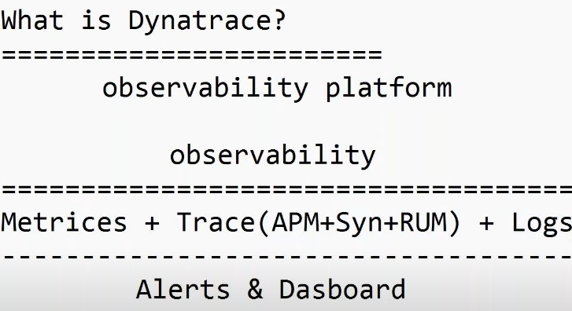

Slide 17
Here’s a step-by-step breakdown of the key points from the presentation:
1. Introduction of Speakers
Garrett Pollard (Senior Specialist in Cloud Operations) introduces himself and his colleague Kevin Lewin (Specialist Solutions Architect for Observability).
They will be presenting on Observability with AI Ops on AWS.
2. What is Observability?
Observability is defined as not just monitoring failures but preventing them in the future.
It helps businesses make real-time decisions by using real-time data.
This improves application availability, reliability, and latency and reduces downtime (which costs money).
AWS focuses on helping customers:
Understand application and infrastructure health.
Improve collaboration.
Reduce operational costs.
Enhance customer satisfaction and experience.
3. Maturity Levels in Observability
Observability isn’t one-size-fits-all; it evolves as businesses mature.
Level 0: Basic monitoring with dashboards and logs.
Higher Levels: More proactive observability where automatic actions are taken, and systems are optimized for greater resilience.
4. Traditional Monitoring Workload
Traditional monitoring involves:
Ingesting metrics from applications and infrastructure.
Creating dashboards and alarms.
Manual efforts to visualize business-critical KPIs.
5. AI Ops for Monitoring with AWS
AI Ops (artificial intelligence for operations) simplifies the process and reduces manual efforts.
DevOps Guru uses machine learning to provide insights and automated actions to address issues in real-time.
Customers can get out-of-the-box insights and automated operational actions with AWS Systems Manager Incident Manager.
DevOps Guru reduces noise, focusing only on critical issues and helping to quickly resolve problems.
6. Why Use DevOps Guru?
DevOps Guru is a fully managed service that:
Requires no training of machine learning models or hardware setup.
Automatically monitors application data and adapts as new resources are added.
Helps improve Mean Time to Recovery (MTTR) by focusing on high-severity issues.
7. CloudWatch and Anomaly Detection
Some resources may not be covered by DevOps Guru, or customers may need more customization. CloudWatch fills these gaps.
Anomaly Detection in CloudWatch uses machine learning models to set dynamic thresholds based on expected values.
Custom metrics can also be monitored using anomaly detection.
CloudWatch alarms are triggered when a metric is outside the expected value range, helping to identify issues early.

Slide 18
8. X-Ray Insights for Performance
X-Ray provides distributed tracing, which helps detect bottlenecks in applications.
By instrumenting an application, X-Ray correlates performance data across various sources, giving insights on performance issues.
This helps optimize application-level performance.
9. End-to-End Observability in AWS
AWS offers a unified observability experience:
It integrates with over 120 AWS services and can monitor on-premises, hybrid, and multi-cloud environments.
AWS collects data from various sources, including IOT sensors, applications, and infrastructure.
10. How Data is Collected and Processed
AWS collects data from different sources, such as:
AWS resources (e.g., EC2, RDS).
Custom metrics, including third-party services.
Processing data: Enrich the collected data to make it actionable for observability purposes. This allows for better insights, dashboarding, alarming, and correlation.
11. Managed Open Source Observability Services
AWS offers managed services for open-source tools like Grafana and Prometheus, reducing the complexity of managing these tools at scale.
These services help customers focus on observability without worrying about managing infrastructure.
12. AWS Observability Benefits
Improved user experience through better application performance and reliability.
Helps with monitoring SLOs (Service Level Objectives) and SLAs (Service Level Agreements).
Reduces downtime, optimizes costs, and improves end-user experiences.
13. End-to-End Observability
AWS supports a comprehensive observability framework for every part of your system, whether cloud-based, on-premises, or hybrid.
This includes monitoring infrastructure, containers, applications, and networks.
14. Resources and Next Steps
AWS offers various resources to help implement these observability tools:
DevOps Guru, CloudWatch anomaly detection, and X-Ray Insights.
Self-paced workshops and other resources to help you get started with observability.
Conclusion:
AWS provides an integrated approach to observability with tools like DevOps Guru, CloudWatch, and X-Ray Insights. These solutions help customers monitor their infrastructure, analyze performance, and reduce downtime—all while simplifying management through AI-powered automation and machine learning. The aim is to improve application health, optimize user experience, and ensure business continuity.

Slide 19
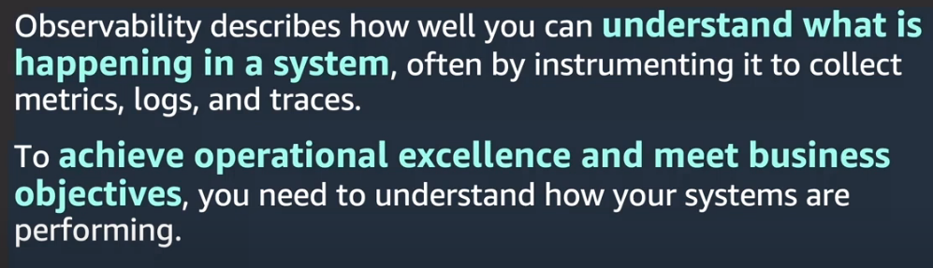
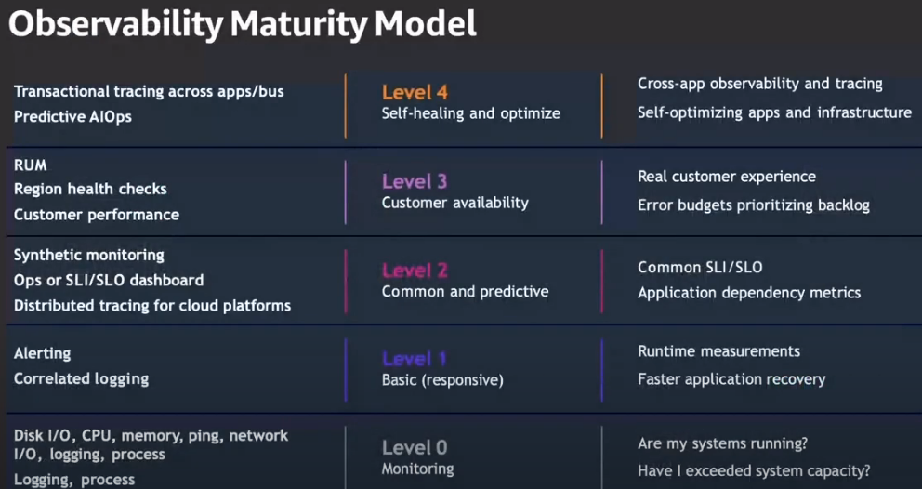
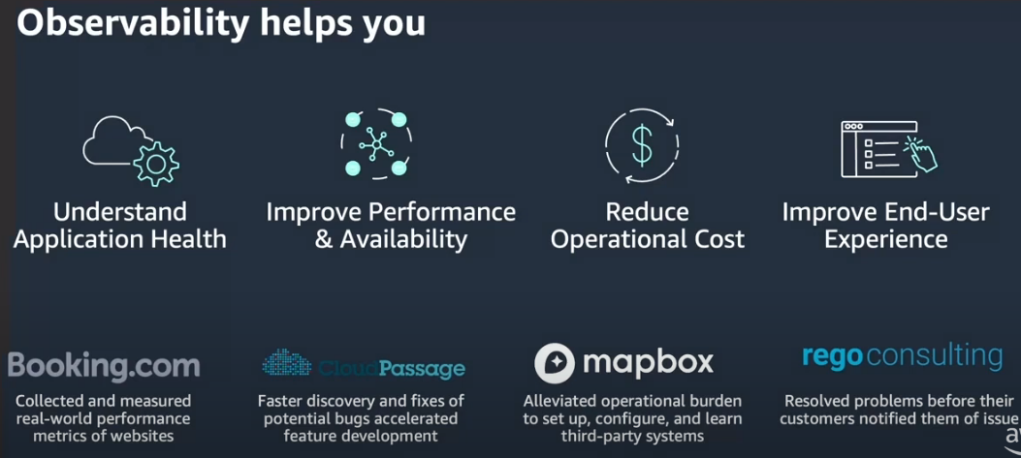

Slide 20
