Slide 1
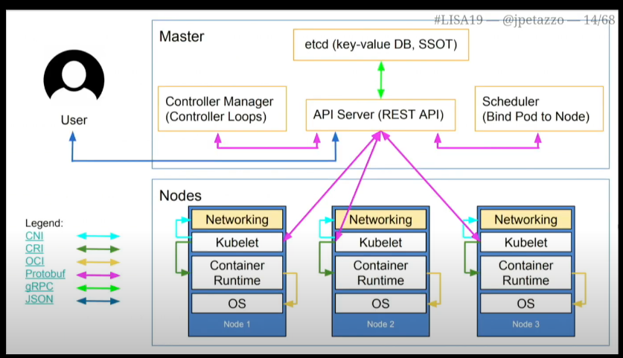

Slide 2
Flowchart Layout
User Interaction
(Start)
User issues command (e.g., kubectl run)
API Server
Receives command
Creates manifest
Writes manifest to etcd
etcd
Stores desired state of objects
Controller Manager
Detects changes in etcd
Triggers deployment controller
Creates ReplicaSet
ReplicaSet Controller
Maintains desired number of replicas
Creates Pods (in pending state)
Scheduler
Detects pending Pods
Assigns Pods to Nodes
Kubelet (on Nodes)
Communicates with API Server
Pulls images
Starts containers
Status Reporting
Kubelet reports Pod status to API Server
Loop
Controllers adjust state as necessary
(End)

Slide 3
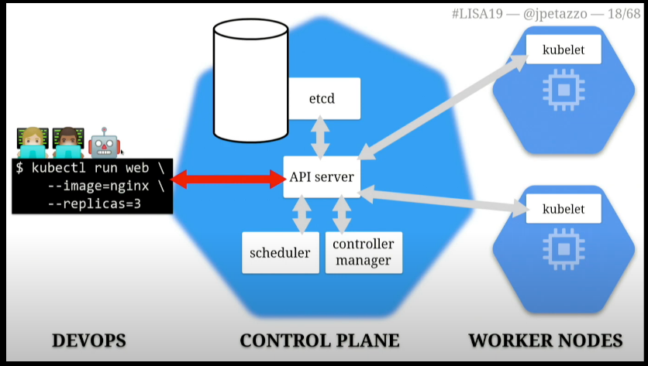
Flowchart Steps
Start with a "User Interaction" box leading to an "API Server" box.
Draw arrows from the API Server to etcd and to the Controller Manager.
From the Controller Manager, connect to the ReplicaSet Controller.
Show the flow from the ReplicaSet Controller to the Scheduler.
Connect the Scheduler to Kubelet (on Nodes).
Finally, show the Kubelet reporting back to the API Server and looping back to the Controller Manager.

Slide 4
Step-by-Step Flow for Kubernetes Anatomy
User Interaction
Action: User issues a command (e.g., kubectl run nginx --replicas=3).
Purpose: To create a new deployment.
API Server
Receive Command: The API Server accepts the command.
Create Manifest: Generates a manifest that describes the desired state (e.g., 3 replicas of an nginx container).
Write to etcd: Stores the manifest in etcd.
etcd
Storage: Acts as the key-value store, holding the current desired state of the cluster.
Controller Manager
Detect Changes: Monitors etcd for changes to the desired state.
Trigger Deployment Controller: If a new deployment is detected, the controller manager activates the deployment controller.
Create ReplicaSet: The deployment controller creates a ReplicaSet object based on the deployment specifications.
ReplicaSet Controller
Maintain Replicas: Responsible for ensuring the correct number of pod replicas (3 in this case).
Create Pods: Creates Pod objects in etcd, setting their status to "Pending."
Scheduler
Detect Pending Pods: The scheduler identifies Pods that are in the "Pending" state.
Assign Nodes: Evaluates available nodes and assigns Pods to them based on resource availability and other scheduling policies.
Kubelet (on Nodes)
Communicate with API Server: Each node’s kubelet continuously polls the API Server for work.
Receive Pod Assignments: Gets instructions for which Pods to run.
Pull Container Images: Fetches necessary container images from a container registry.
Start Containers: Initializes the containers specified in the Pods.
Status Reporting
Kubelet Reports Status: The kubelet continuously reports the status of each Pod (e.g., running, healthy) back to the API Server.
Monitoring and Adjustment
Controller Loops: The controllers keep monitoring the state of the cluster.
Adjust as Necessary: If the actual state diverges from the desired state, the controllers take action to reconcile the two.

Slide 5
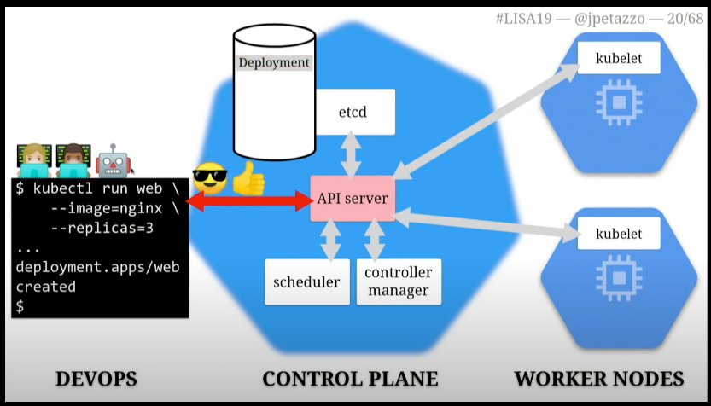
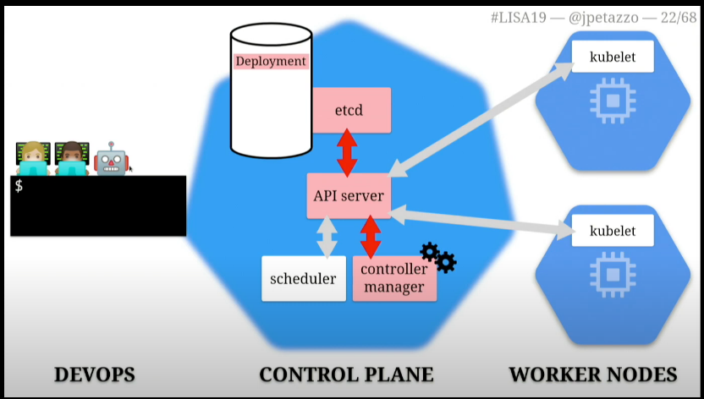
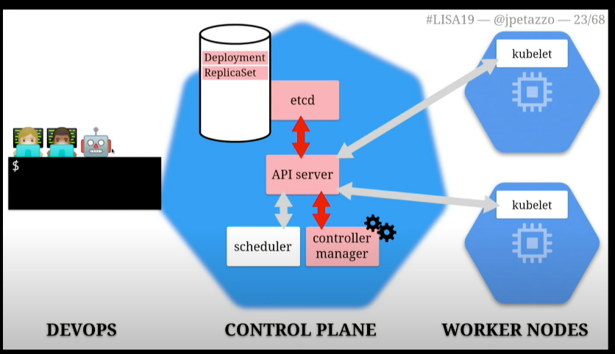
User Interaction
Action: User issues a command (e.g., kubectl run nginx --replicas=3).
Purpose: To create a new deployment
Controller Manager
Detect Changes: Monitors etcd for changes to the desired state.
Trigger Deployment Controller: If a new deployment is detected, the controller manager activates the deployment controller.
Create ReplicaSet: The deployment controller creates a ReplicaSet object based on the deployment specifications.

Slide 6
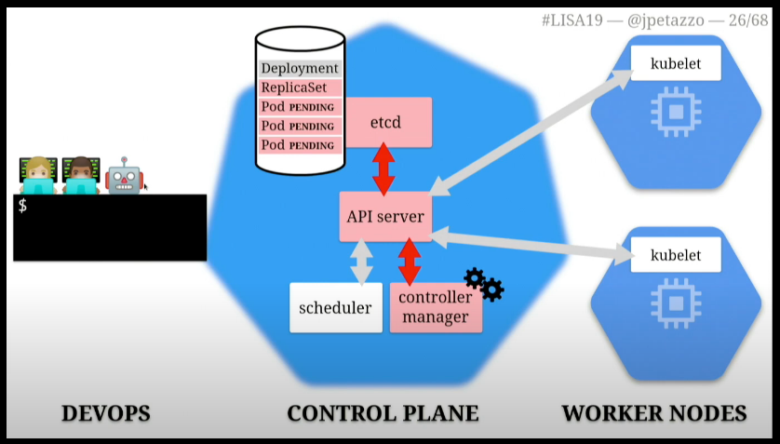
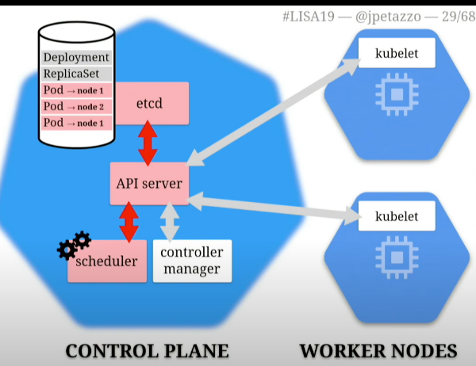
ReplicaSet Controller
Maintain Replicas: Responsible for ensuring the correct number of pod replicas (3 in this case).
Create Pods: Creates Pod objects in etcd, setting their status to "Pending."
Scheduler
Detect Pending Pods: The scheduler identifies Pods that are in the "Pending" state.
Assign Nodes: Evaluates available nodes and assigns Pods to them based on resource availability and other scheduling policies.

Slide 7
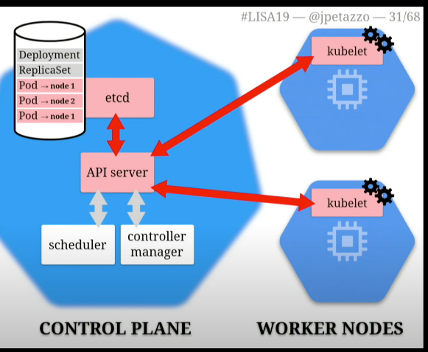
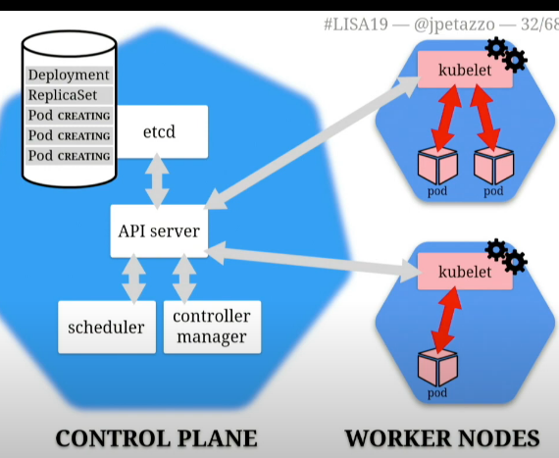
Kubelet (on Nodes)
Communicate with API Server: Each node’s kubelet continuously polls the API Server for work.
Receive Pod Assignments: Gets instructions for which Pods to run.
Pull Container Images: Fetches necessary container images from a container registry.
Start Containers: Initializes the containers specified in the Pods.
Status Reporting
Kubelet Reports Status: The kubelet continuously reports the status of each Pod (e.g., running, healthy) back to the API Server.
Monitoring and Adjustment
Controller Loops: The controllers keep monitoring the state of the cluster.
Adjust as Necessary: If the actual state diverges from the desired state, the controllers take action to reconcile the two.

