Slide 1

Integrated Project–II | Progress Review –2
IoT-Based Smart Sewer Safety and Monitoring System
Department of Computer Science & Engineering
CHITKARA UNIVERSITY, HIMACHAL PRADESH
Submitted To: Ms. Shiwani Sharma | Submitted By:
 | 1.Harpreet Singh (2411981229)
 | 2.Ishpreet Singh (2411981250)
 | 3.Krish Jindal (2411981287)
 | 4.Krish Koundal (2411981288)

Slide 2
Agenda
Project Overview
Requirements & Data Collection
Design Phase
Development Kickoff
SDG Goals Mapping
Multidisciplinary Approach
Novelty Factor
Challenges & Risks

Slide 3
Project Overview
Problem statement:
Sewer blockage causes flooding.
Harmful gases like Methane (CH₄) and Hydrogen Sulfide (H₂S) are dangerous
Workers face life-threatening risks.
Objective: To develop an IoT-based smart system that monitors sewer drains by detecting water level rise and harmful gases, and sends real-time alerts to
improve safety and prevent sewer overflow.
Scope:
Real-time monitoring of sewer water level and harmful gases.
Use of sensors and NodeMCU for data collection and processing.
Sending alerts through mobile application and email notifications.
Stakeholders:
Municipal Authorities: Monitor sewer conditions and manage drainage work.
Sanitation Workers: Benefit from improved safety.

Slide 4
Project Overview
Timeline:
Week 1 – Problem Research & Planning
Studied sewer monitoring problems
Identified need for gas and water level detection
Week 2 – System Design
Designed system architecture
Selected components (NodeMCU, gas sensor, water level sensor)
Week 3 – Hardware Setup & Sensor Testing
Connected sensors with NodeMCU
Tested distance/water level measurement
Week 4 – Software Development (In Progress)
Writing Arduino code for automation
Integrating mobile app and email alert system

Slide 5
Requirement Gathering & Data Collection
Sources of Data:
Observations:
Observation of drainage systems helped identify issues such as
water blockage, sewer overflow, and hazardous environments.
Existing Datasets & Literature Review:
Research papers, articles, and technical resources on IoT monitoring systems, gas sensors, and smart city technologies were studied to understand existing solutions.

Slide 6
Requirement Gathering & Data Collection
Key Functional Requirements
Continuously monitor water level in sewer drains.
Detect harmful gases inside the sewer.
Sensors send real-time data to the NodeMCU.
System triggers alerts when danger levels are detected.
Send notifications via mobile app and email.
Enable real-time monitoring via an IoT platform

Slide 7
Requirement Gathering & Data Collection
Key Non-Functional Requirements
Reliability: Accurate and consistent sensor readings.
Scalability: Can be expanded to monitor multiple sewer locations.
Low Cost: Uses affordable components for practical deployment.
Energy Efficiency: Low power consumption for continuous
operation.
Durability: Hardware should withstand moisture and toxic gases.
Real-Time Performance: Alerts generated immediately during
dangerous conditions.

Slide 8
Requirement Gathering & Data Collection
Challenges in Data Collection
Limited Access: Sewer areas are difficult and dangerous to access.
Safety Risks: Toxic gases and contaminated water make manual observation unsafe.
Lack of Data: Reliable datasets on sewer gas levels and overflow are limited.
Environmental Changes: Water level and gas concentration can
change quickly.
Sensor Calibration: Sensors need proper calibration for accurate readings.

Slide 9
Requirement Gathering & Data Collection
Current Status of the Project
The problem of sewer overflow and toxic gas hazards has been studied.
System design and architecture for the IoT monitoring system
prepared.
Hardware components selected: NodeMCU, MQ-2 Gas Sensor, Water Level Sensor.
Software tools identified: Arduino IDE and Blynk platform.
Planning completed for sensor integration, data transmission, and alerts.

Slide 10
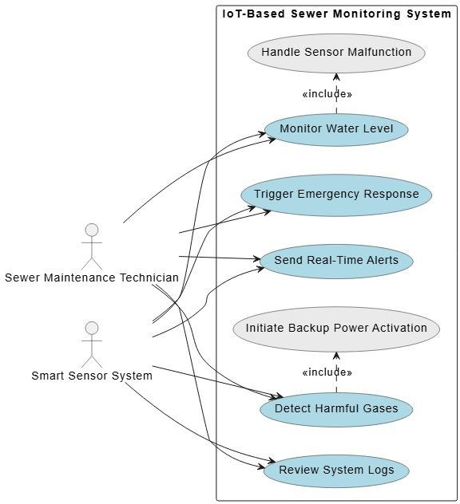
Design Phase
Use Case Diagram

Slide 11
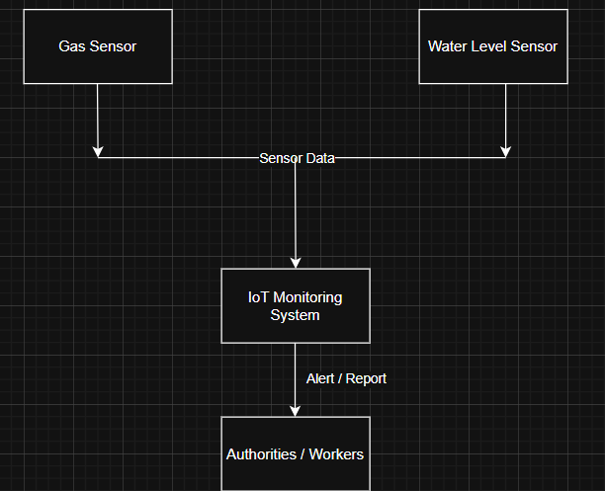
Design Phase
Data Flow Diagrams (DFDs)
– Level 0: Overall system view (Context Diagram)

Slide 12
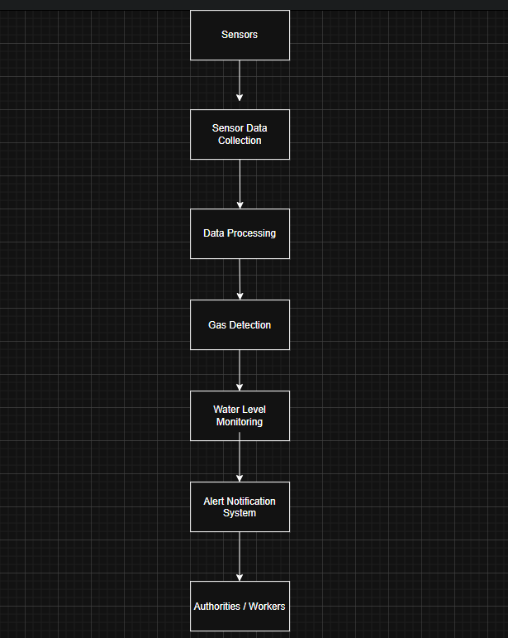
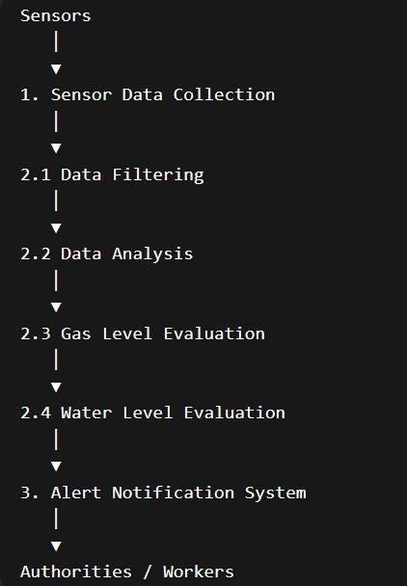
Design Phase
– DFD Level-1 & Level-2: Internal Data Flow
Level 1: Major system processes Level 2: Detailed data processing flow

Slide 13
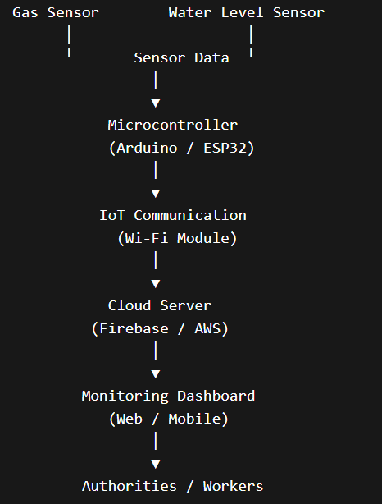
Design Phase
Architecture & Tech Stack
System Architecture (IoT Sewer Monitoring System)
Working Flow
Sensors detect gas leakage and water level in sewer.
Microcontroller collects and
processes sensor data.
Data is sent to the cloud server using IoT communication.
Dashboard displays real-time
monitoring information.
If danger is detected, alert notification is sent to workers.

Slide 14
Development Kickoff
Initial Codebase Setup
Prepare the development environment for the IoT monitoring system.
Install Arduino IDE to write and upload code.
Configure NodeMCU ESP8266 board settings in Arduino IDE.
Install required libraries for sensors and IoT connectivity.
Write code to read data from MQ-2 gas sensor and water level sensor.
Enable Wi-Fi connectivity for data transmission.
Integrate with Blynk for real-time monitoring and alerts.

Slide 15
SDG Goals Mapping
Clean Water and Sanitation (SDG 6)
Promotes proper monitoring of sewer systems.
Helps prevent sewer overflow and water contamination.
Supports improved urban sanitation management.
2. Good Health and Well-Being (SDG 3)
Detects harmful gases in sewer systems.
Reduces health risks for sanitation workers.
Prevents exposure to toxic gases and hazardous environments.
3. Sustainable Cities and Communities (SDG 11)
Supports smart city infrastructure through IoT technology.
Helps manage urban drainage systems efficiently.
Reduces flooding and environmental pollution.

Slide 16
SDG Goals Mapping
Industry, Innovation and Infrastructure (SDG 9)
Uses IoT technology for smart infrastructure monitoring.
Encourages innovation in public safety and urban management.
Potential Impact
Worker Safety: Detects toxic gases and reduces risk for sanitation workers.
Overflow Prevention: Early detection of rising water levels.
Real-Time Monitoring: Continuous monitoring using IoT technology.
Better Sanitation: Improves cleanliness and safety of drainage systems.
Smart City Support: Helps develop automated urban infrastructure.
Overall Impact:
Reduces accidents, improves public health, and makes sewer management
safer and more efficient.

Slide 17
SDG Goals Mapping
Contribution to Sustainability and Social Good
Protects Human Life: Detects harmful gases and unsafe sewer
conditions.
Improves Public Health: Reduces pollution and health risks.
Sustainable Infrastructure: Enables continuous IoT-based sewer
monitoring.
Smart City Development: Encourages use of smart technologies in urban management.
Environmental Protection: Prevents sewer overflow and protects water sources.

Slide 18
Multidisciplinary Approach
Fields Involved
Engineering: Hardware development using sensors and microcontrollers.
Computer Science / IoT: Programming, data communication, and
system integration.
Data Science: Analysis of sensor data and system performance.
AI / Machine Learning (Future Scope): Predict sewer overflow and
gas hazards.
Social Sciences: Improve sanitation worker safety and community well-being.
Business / Urban Management: Efficient sewer infrastructure management.

Slide 19
Multidisciplinary Approach
Team Collaboration
Task Distribution: Members handle hardware, coding, research,
and documentation.
Communication: Regular discussions to track progress and share ideas.
Problem Solving: Teamwork in fixing sensor, coding, and integration issues.
Knowledge Sharing: Members share technical knowledge and
research.
Project Coordination: Work together to complete hardware, software, and presentation on time.

Slide 20
Multidisciplinary Approach
Interdisciplinary Innovation
Combines multiple fields to create a smart sewer monitoring
solution.
Engineering & IoT: Sensors and microcontrollers monitor water level and gas.
Computer Science: Programming enables data processing and real-time alerts.
Data Science: Sensor data can be analyzed for better monitoring.
Environmental Science: Helps reduce pollution and improve sanitation.
Social Impact: Enhances safety of sanitation workers and urban
infrastructure.

Slide 21
Novelty Factor
What Makes This Project Unique?
Combines water level monitoring and gas detection in a single system.
Provides real-time alerts through mobile application and email.
Designed as a low-cost IoT solution for urban sewer safety.
Comparison with Existing Solutions
Traditional systems rely on manual inspection.
Existing monitoring often detects only water overflow.
Our system detects both hazardous gases and water level rise simultaneously.
Innovation in Approach
Integration of IoT technology with environmental sensors.
Automated alert system for early hazard detection.
Scalable design suitable for smart city infrastructure.

Slide 22
Challenges and Risks
Key Challenges Faced So Far
Accurate measurement of water level in sewer conditions.
Proper calibration of gas sensors for reliable detection.
Integrating sensors with NodeMCU and ensuring stable connections.
Maintaining reliable WiFi connectivity for real-time alerts.
Identified Risks & Mitigation Strategies
Risk | Mitigation Strategy
Incorrect sensor readings | Regular calibration and testing
Network/WiFi failure | Store data locally and retry alerts
Harsh sewer environment | Use protective casing for sensors
Power supply interruption | Use stable power source or backup battery

Slide 23
Next Steps
Finalizing Design Phase
Complete system architecture and hardware connections.
Confirm selection of sensors and NodeMCU configuration.
Define threshold values for water level and gas detection.
Early Development & Testing
Develop and upload the software code to NodeMCU.
Integrate mobile application and email alert system.
Perform initial testing of sensors and alert functionality.
Verify system performance under different conditions.

Slide 24
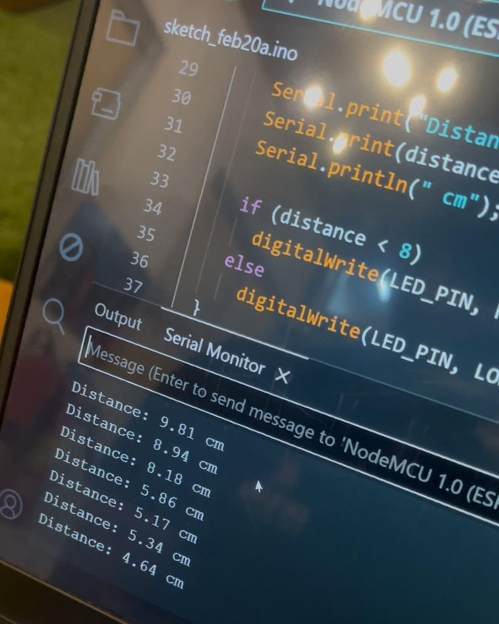
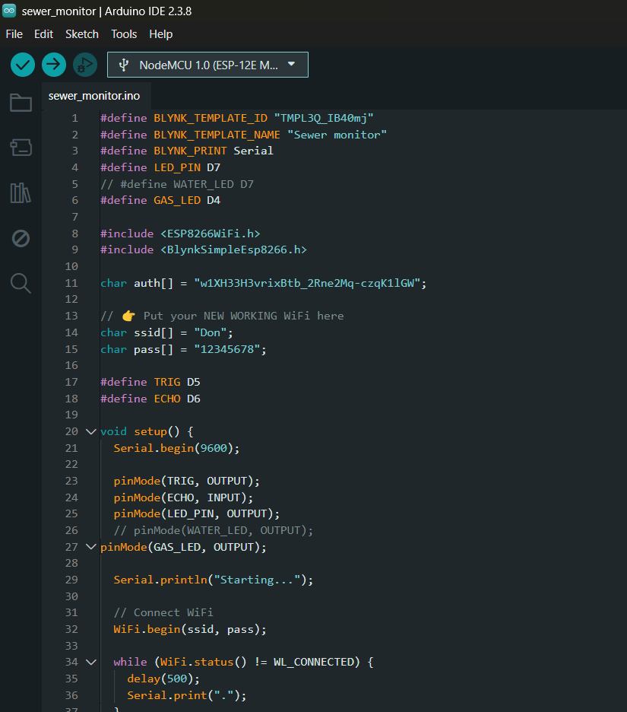
Project Implementation – Testing & Configuration
Figure 1: Serial Monitor Output Showing
Real-Time Distance Measurement
Figure 2: Blynk and WiFi Configuration in
NodeMCU Program

Slide 25
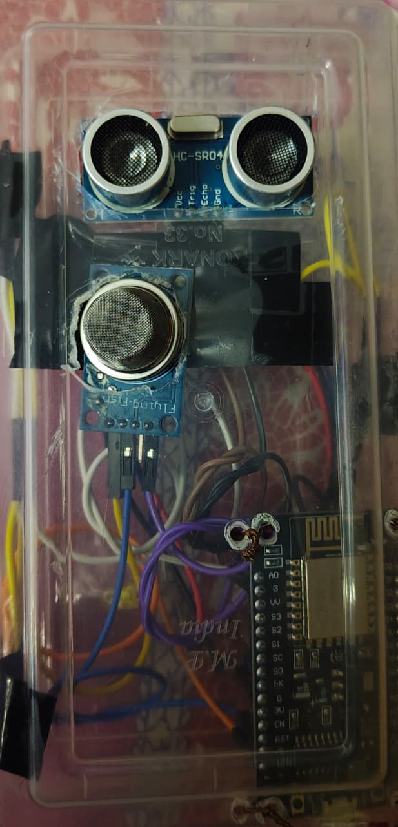
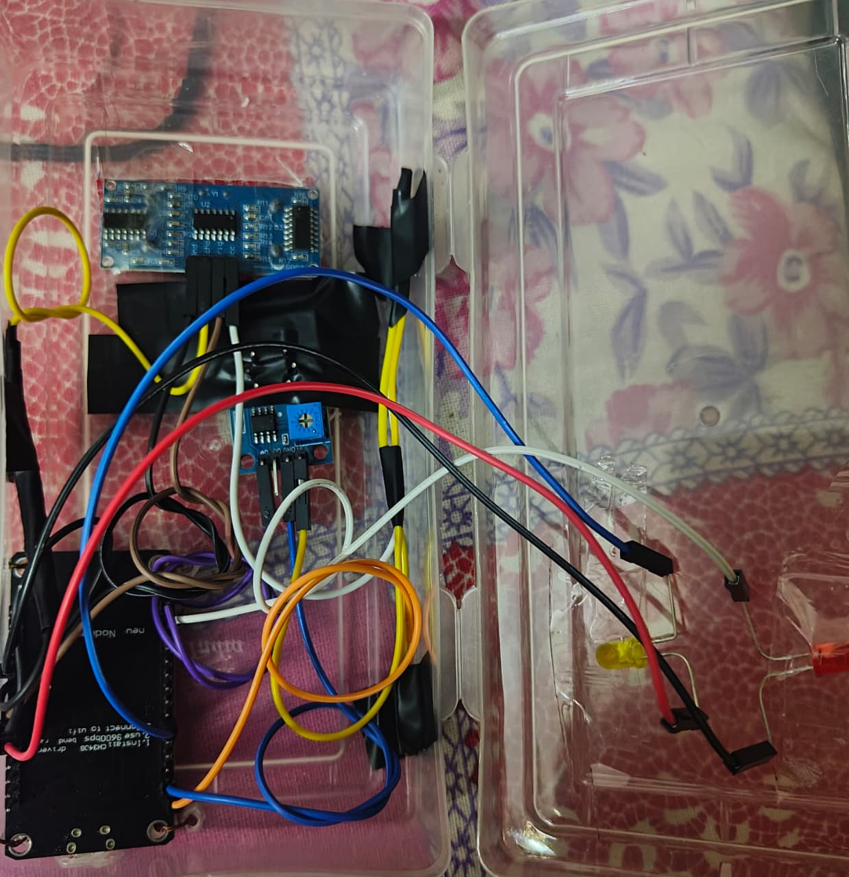
Hardware Implementation – Sensor & Circuit Setup
Figure 3: Ultrasonic and Gas Sensor Module
Figure 4: Internal Circuit Connections Using NodeMCU

Slide 26
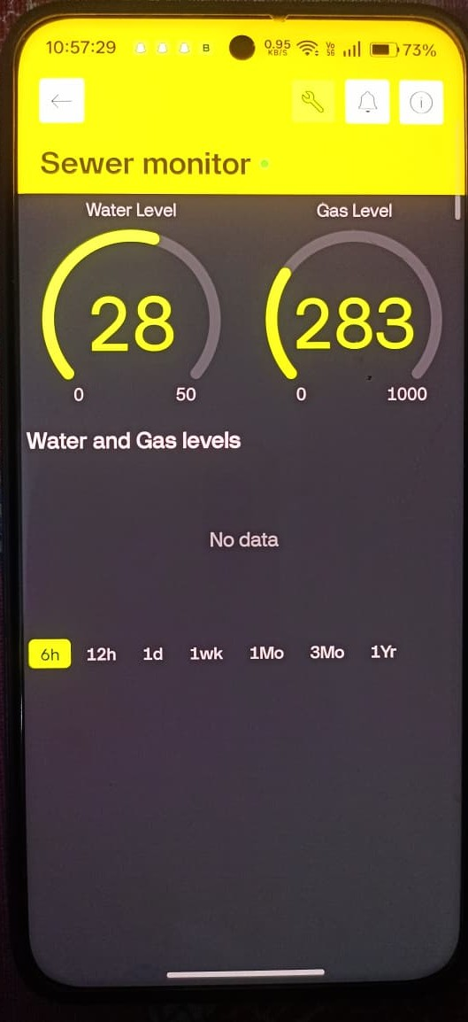
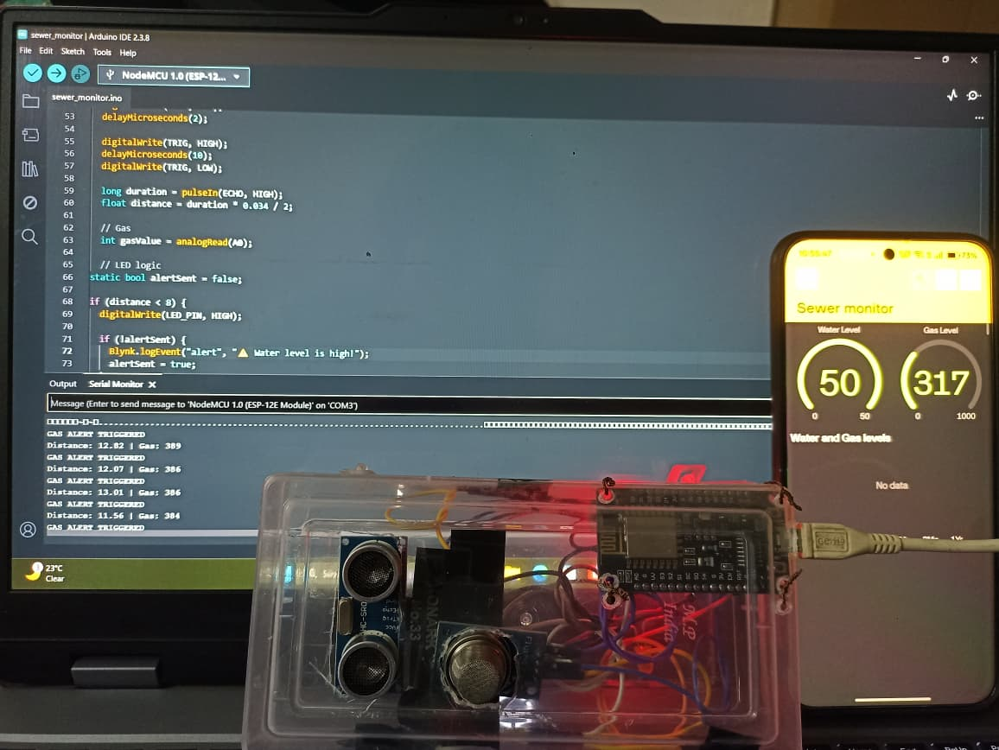
Final Output – Real-Time Monitoring System
Figure 5: Mobile App Showing Real-Time Water and Gas Levels
Figure 6: Complete System Integration and Testing

