Slide 1
Chemical Structure Searching with Lucene.Net and Indigo
Josh van Eikeren
2015 .NET Fringe Conference

Slide 2
Quick Note
A copy of this presentation and all demo code is available on GitHub:
https://github.com/jvaneikeren/ChemicalStructureSearchingDemo

Slide 3
About Me
Currently CTO/Co-Founder of Avea Solutions
Create practice management solutions for the mental health industry
Startup located in Portland, OR
I work/live remotely in Bend, OR
Previously CTO/Co-Founder of IntelliChem (1998 - 2004) and Blue Reference (2005 – 2012)
Built information management solutions for the pharmaceutical industry
Created an Electronic Laboratory Notebook that replaced paper notebooks
Recorded chemical procedures (“recipes”) as structured data
Value proposition based on information sharing
Searching was critically important
Text
Chemistry objects (chemical structures and reactions)

Slide 4
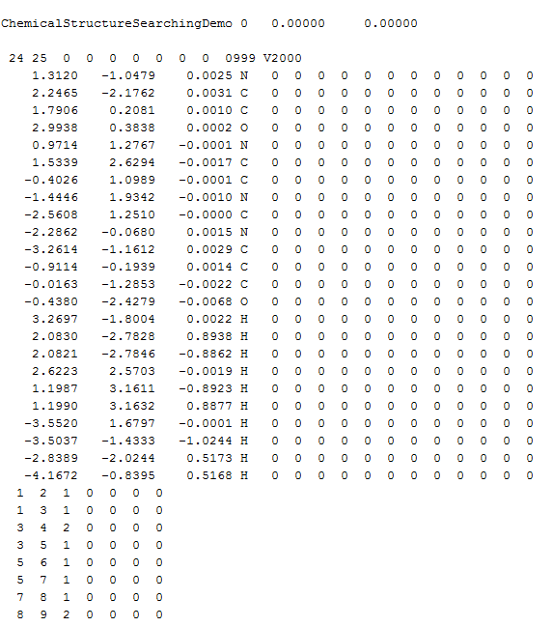
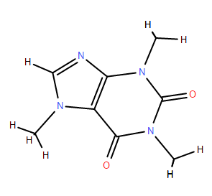
What is a chemical structure?
Representation of the atoms and bonds that comprise a molecule
Coordinates table (visual layout of atoms)
Connection table (atom/bond connections)
Visually represented as a two-dimensional diagram:
Typically stored in an open-standard ascii file format called a Molfile (*.mol):

Slide 5
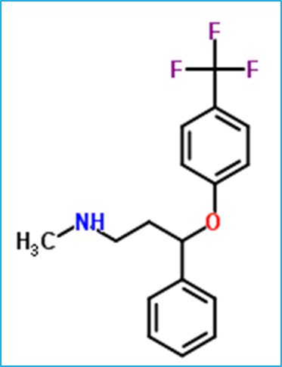
Chemical structure searching importance
Chemical compounds have can have many different names
Example: Prozac
IUPAC name: N-methyl-3-phenyl-3-[4-(trifluoromethyl)phenoxy]propan-1-amine
Trade names: Fluoxetine, Deprex
CAS number: 54910-89-3
Index identifiers: 39914106
Chemspider lists over 50 text synonyms for Prozac http://www.chemspider.com/Chemical-Structure.3269.html
Searching by text is not an effective way of locating chemical compound-based relevant information
Chemical compounds, however, have only one chemical structure
Example: Prozac

Slide 6
Historical structure searching solutions
No open source solutions
Proprietary solutions
Oracle data cartridge (MDL, Accelrys)
Molfiles stored in SQL tables
Database plug-in (“data cartridge”) performed searching
Mediocre performance
Unix server implementation (Daylight)
Better performance
Separate server cluster (required regular data export)
All very expensive
Example: $100k+ per processor per year
Made product solution pricing difficult; cost had to be passed on to the customer

Slide 7
Modern structure searching solution
Chemical structure searching can be implemented easily in .NET using open source libraries
Less than 400 lines of code
Lucene.Net
Embedded document search platform
Superior search performance through use of an inverted index
http://lucenenet.apache.org/
NuGet package: Lucene.Net
Indigo
Cheminformatics library
Provides chemical structure manipulation, depiction, and analysis capabilities
.NET assemblies that wrap C libraries
http://scitouch.net/opensource/indigo/
NuGet package: Indigo.Net

Slide 8
Searching approach
Leverage Lucene to perform indexing and searching
But…Lucene is a document search engine that primarily searches text
So…must convert the properties of chemical structures into text-based representations which can then be indexed and searched using Lucene => Indigo

Slide 9
Transforming chemical structures to text for indexing and searching
Text
Chemical structures
Break text down into tokens
Example:
Text: “The quick brown fox jumps over the lazy dog”
Tokens: the, quick, brown, fox, jumps, over, lazy, dog
Index tokens
Search index by breaking down query into similar tokens
Example
Search text: “brown fox”
Query: brown OR fox
Break chemical structure down into features
Fingerprint: collection of identified features
Fixed list of 467 possible features
Fixed length byte array
Byte array index always refers to the same feature
Structure either has the feature or it doesn’t
All that matters is the collection of index positions where features have been identified
Index integer fingerprint feature indices as strings
Search index by breaking down query into comparable fingerprint feature index strings

Slide 10
Search types
Exact
Matches chemical structures with the same composition
Can’t just compare Molfiles, as structures may be drawn differently
Instead, generate a unique for each Molfile that is unique based on the connection table
Similarity
Matches chemical structures that contain similar fingerprint features
Looking for some overlap between query structure fingerprint features and chemical structure fingerprint features
Substructure
Matches chemical structures that contain a specific substructure
Looking for complete overlap between query structure fingerprint features and chemical structure fingerprint features
Must perform an additional analysis to verify actual substructure containment

Slide 11
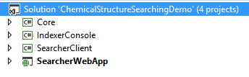
Searching implementation demo
ChemicalStructureSearchingDemo: Visual Studio 2013 Solution
Core: Library containing the business logic for indexing and searching chemical structures
IndexerConsole: An example console application that indexes a directory of Molfiles
SearcherClient: A WinForms application that can search an index of chemical structures
SearcherWebApp: An ASP.NET MVC web application that can search an index of chemical structures

Slide 12
Core object model
ChemicalStructure.cs
Encapsulates the contents of a chemical structure (i.e., Molfile)
Uses Indigo to generate a unique key, fingerprints, and images for the chemical structure
ChemicalStructureIndexer.cs
Uses Lucene.Net to create a Lucene index of chemical structures
ChemicalStructureSearcher.cs
Uses Lucene.Net to search a Lucene index of chemical structures
ChemicalStructureSearchResult.cs
Encapsulates a search match
Includes the score for the search match as well as the associated chemical structure

Slide 13
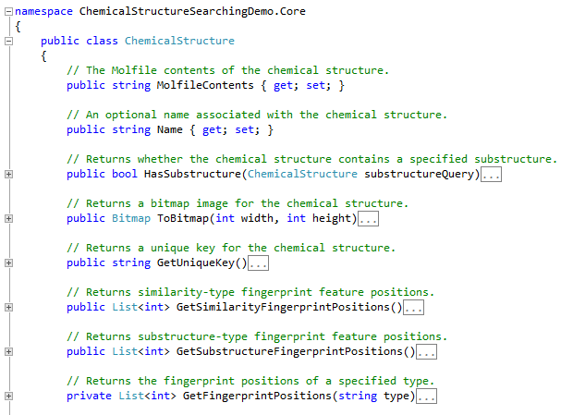
ChemicalStructure.cs

Slide 14
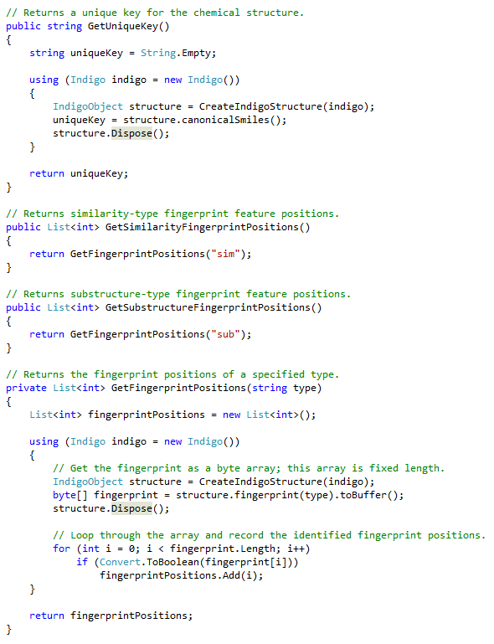
Fingerprint generation
Indigo is used to generate a unique key
Canonical smiles string
Indigo is used to generate two different fingerprint types
Similarity
Substructure
Fingerprints
Returned as a fixed-length byte array
Each index position corresponds to the same feature across all structures
Every structure either has a feature or it doesn’t; hence a byte value of 1 or 0 for the feature
Can be condensed into a list of integers comprising the identified feature index positions

Slide 15
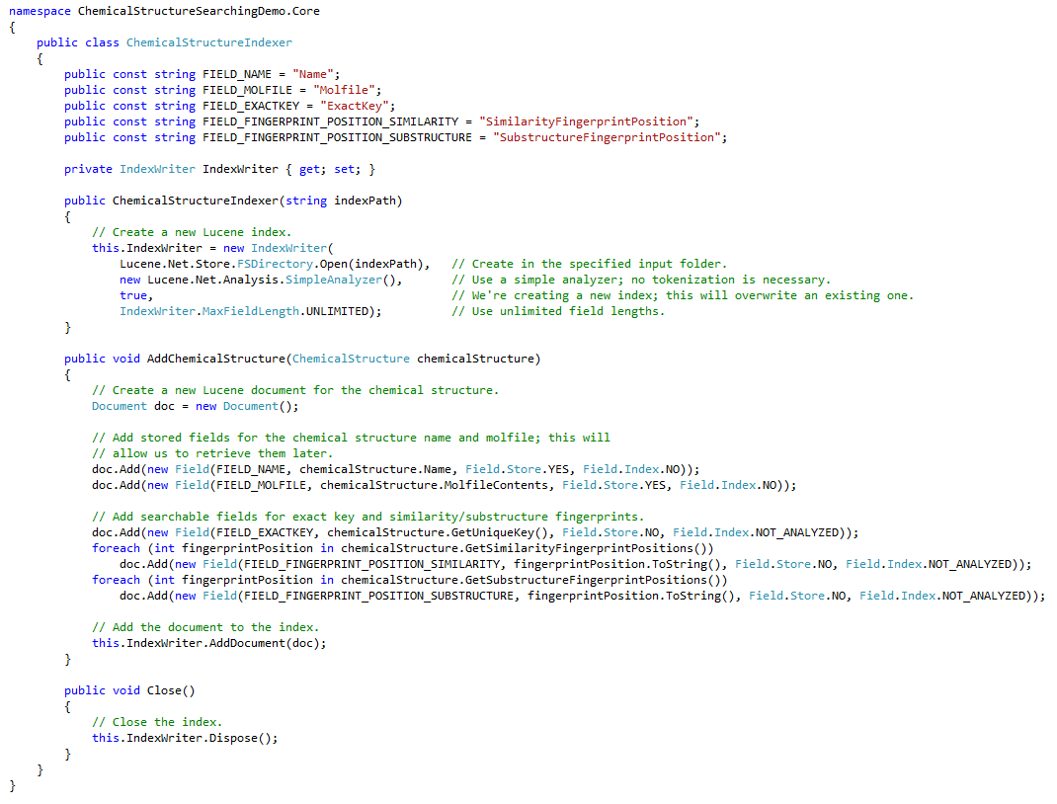
ChemicalStructureIndexer.cs
Creates a new Lucene index
Indexes added chemical structures
Adds Name and MolfileContents as retrievable fields
Adds unique key, similarity feature positions, and substructure feature positions as searchable fields
Key: All fingerprint elements have been converted into a collection of searchable strings

Slide 16
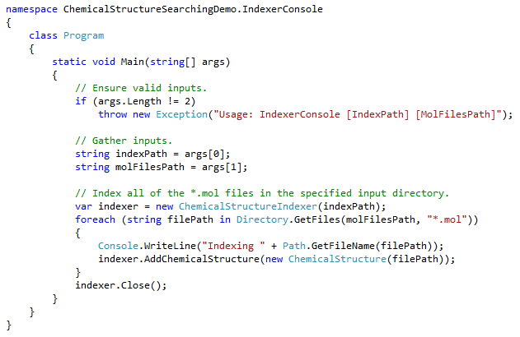
Indexing example: IndexerConsole.exe

Slide 17
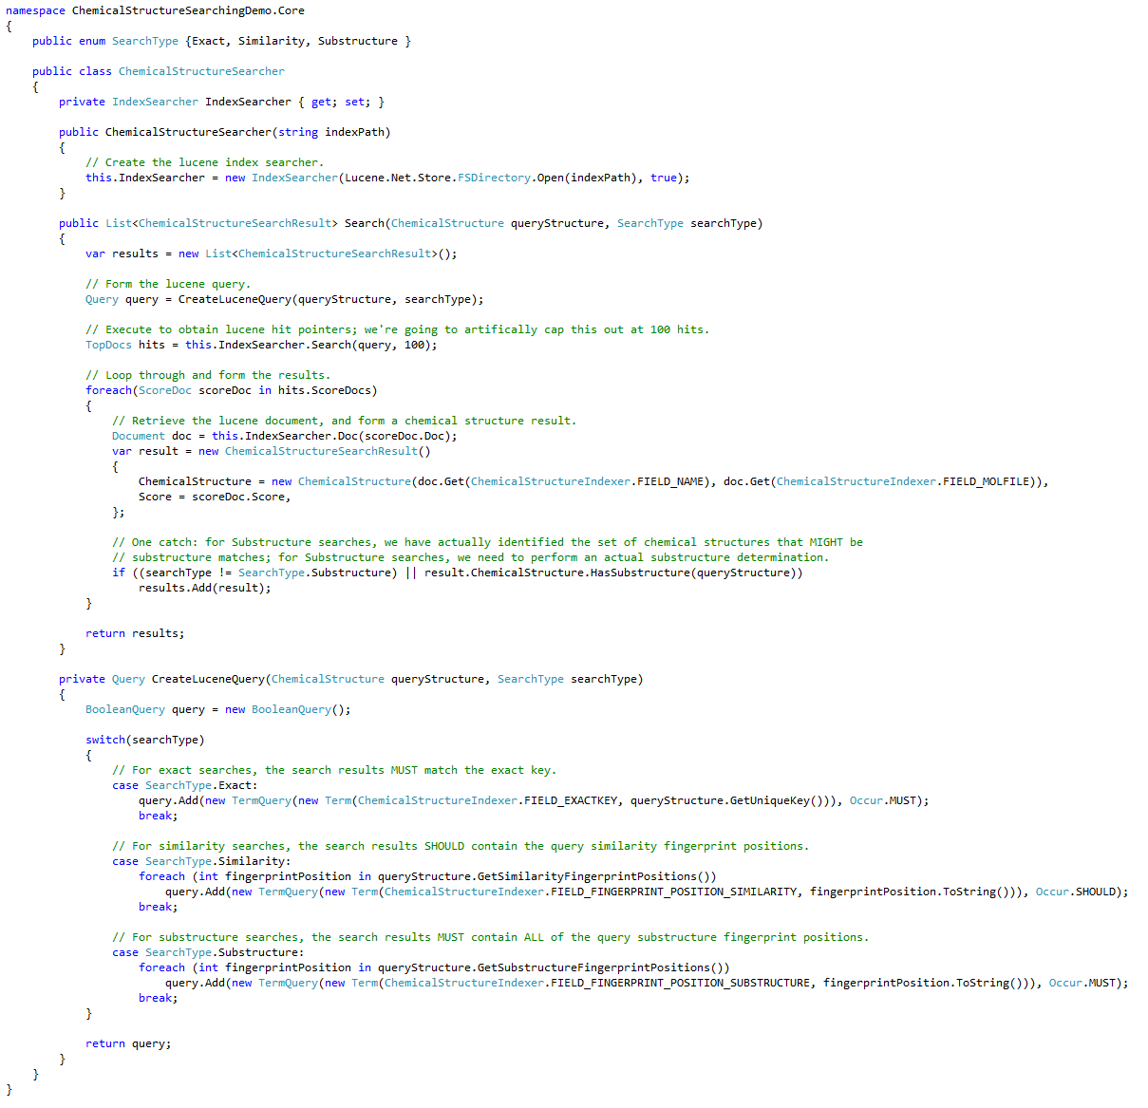
ChemicalStructureSearcher.cs
Searches the Lucene index
Takes a query structure and search type as arguments
Builds a Lucene query as such:
For the Exact search type, we search for an exact match on the query structure’s unique key
For the Similarity search type, we search for matches between the query structure’s similarity fingerprint positions; the more matches, the higher the score
For the Substructure search type, we search for an exact match on the query structure’s substructure fingerprint positions
These hits, however, only represent possible matches
A secondary analysis must then be performed to determine if the match actually indeed does contain the query substructure
Extracts name and Molfile contents to return as ChemicalStructureSearchResult objects

Slide 18
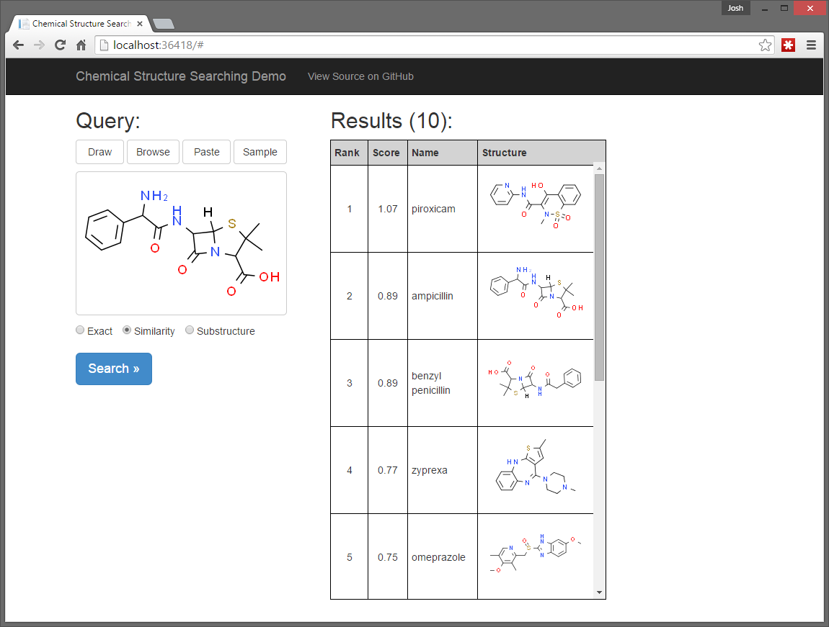
Searching Demo: SearcherWebApp

Slide 19
Summary
Chemical structure searching is no longer requires expensive/proprietary solutions
Chemical structure searching can be implemented easily using open-source technologies
Lucene.Net and Indigo
Superior performance compared to database-based implementations
A copy of this presentation and all demo code is available on GitHub:
https://github.com/jvaneikeren/ChemicalStructureSearchingDemo
Questions?

