Slide 1
Secure File Transfer Application
Asymmetric Encryption with SSL Certificates

Slide 2
Group Details
Group Number: 6
Group Members
Ajay Dayma 17114006
Bhavye Jain 17114020
Kaustubh Trivedi 17114044
Shiva Reddy 17114045
Sai Krishna Abhiram 17114054
Ritik Kumar 17114063
Saurabh Singh 17114068

Slide 3
The Problem Statement
An organization needs an application which can help their employees to transfer files between them securely on the same network. Develop an application using socket programming to send files between two machines and secure the data transfer using a strong encryption algorithm. Capture these packets using a sniffing tool like Wireshark and show that data transfer is secure

Slide 4
Assumptions
The required system is built to operate inside the network of an organization.
Since the clients belong to the same organization, they need not communicate to decide a cypher between them.
The certificates for secure communication are digitally generated by a master authentication server inside the organization. This server has the root certificate and key pair.
All the clients agree to encrypt data using asymmetric public-private key encryption.
The public ports of other nodes are already known within the network.
Every device entering our network already has the organization’s root certificate pre-installed on their devices, which would be used for key chain validation.
Auth server is online and it’s accessible to the user in the network.

Slide 5
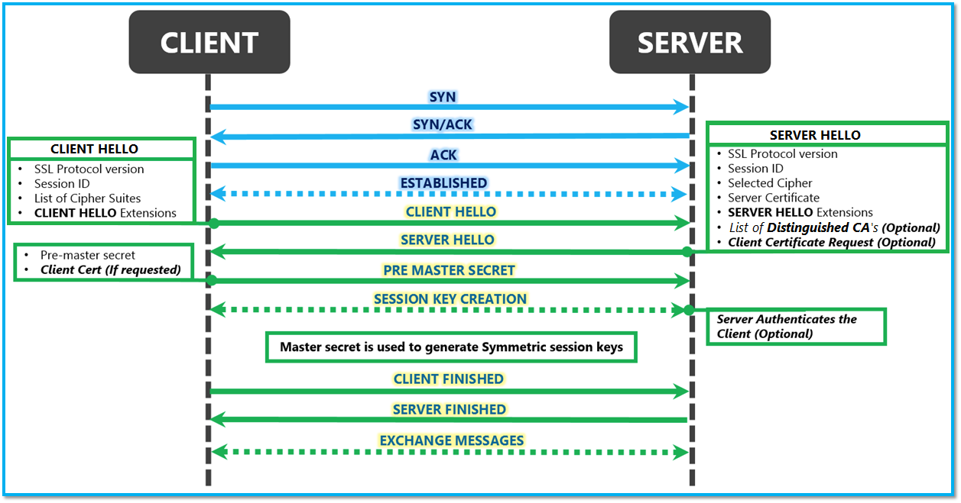
Security on the internet - TLS/SSL

Slide 6
Security in our application
Both the sender and receiver have a certificate issued by the authentication server. First, a TCP handshake is done between the two parties while creating a socket.
Further steps-
Client 1 Certificate Send: The client that wants to initiate a file transfer sends a request for a secure connection with the server. It sends it’s signed certificate to the other client.
Client 2 Certificate Auth and Send: The receiver receives the transfer request, and verifies the authenticity of the certificate sent by client 1 using the auth server’s trust anchor certificate .The secure connection is then established.

Slide 7
Working of the System

Slide 8
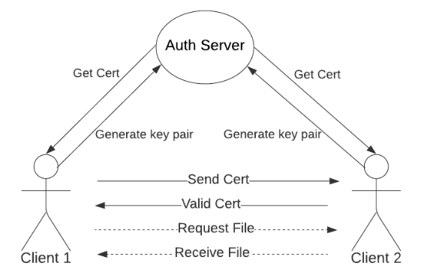
Architecture

Slide 9
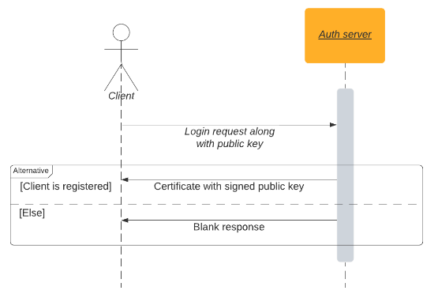
Client Auth Server

Slide 10
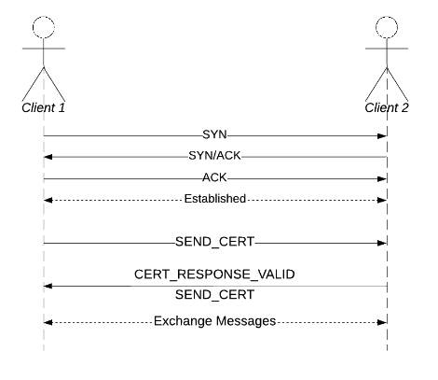
Client to client communication

Slide 11
Code Components [Modularization]
auth.py - The master authentication server for the organization. Functions as the trust anchor for the system and signs certificates of the clients.
SHA256 hashing to encrypt the certificate
X.509 format for the certificate
client.py - The front end script for each individual client.
Gets the user logged in safely and gets the user’s key certified.
Initiates a connection to another client for file transfer

Slide 12
Code Components [Modularization]
peer.py - File to store the state of a client
Stored data like received public key for a particular connection.
Also responsible for sending and receiving data from connected peer.
Data sent is in the form of a struct: !4sL<payload_length>s
connection.py - Helper script containing procedures for requesting files and to handle incoming connections and messages
encrypt.py - A helper script to handle and generate keys and certificates

Slide 13
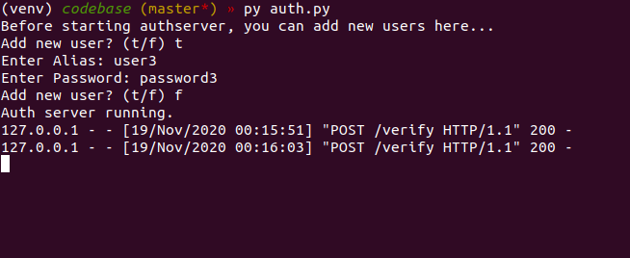
Working Demonstration

Slide 14
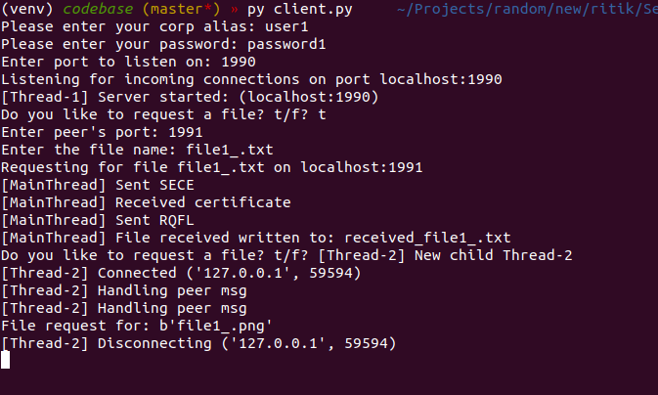
Working Demonstration

Slide 15
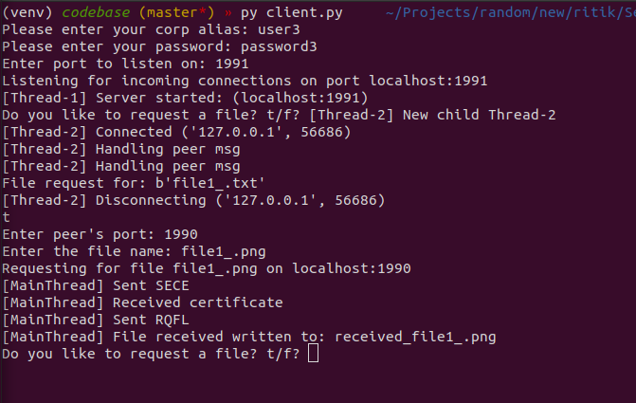
Working Demonstration

Slide 16
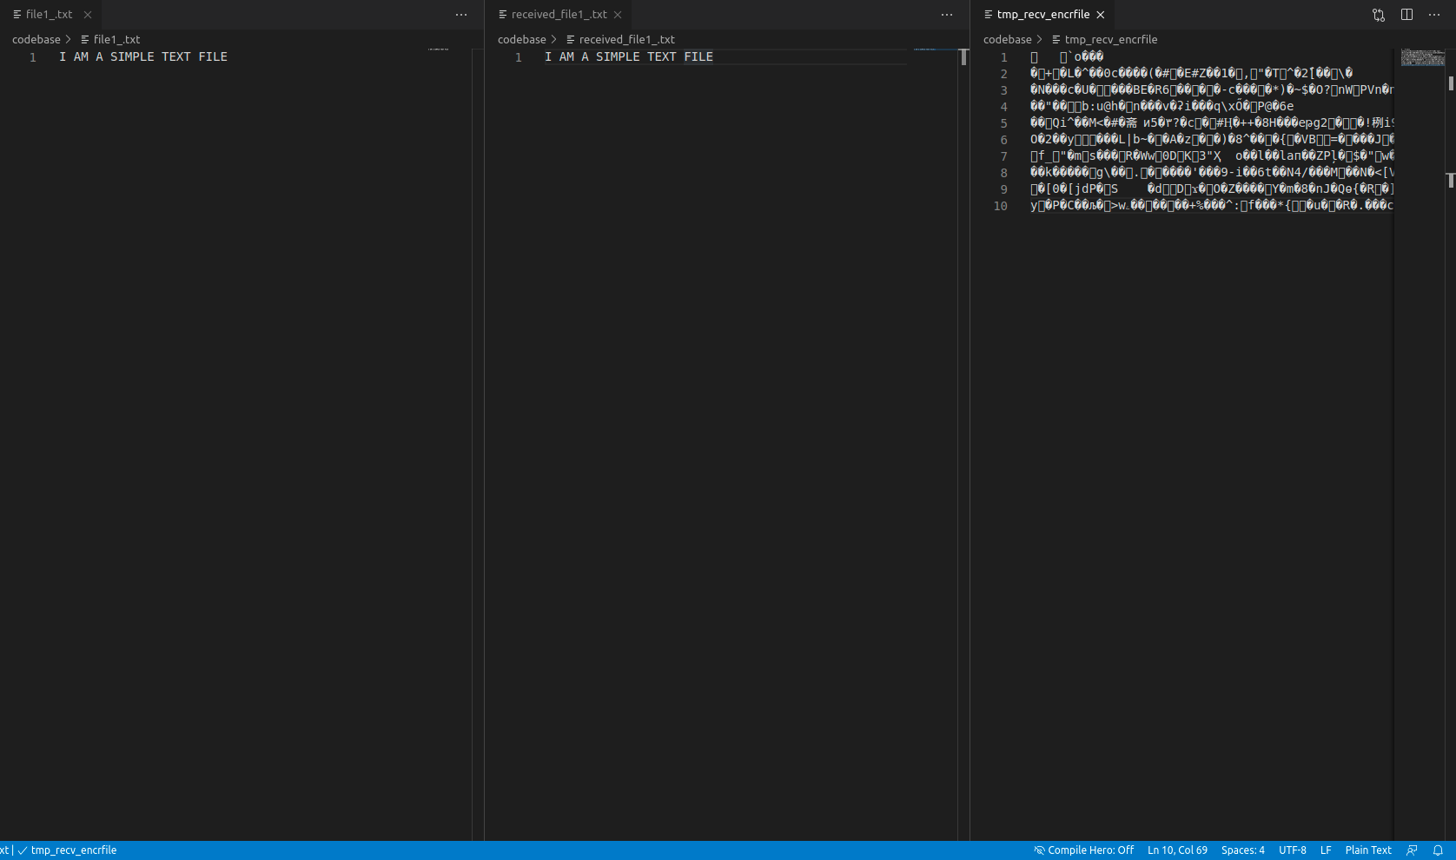
Working Demonstration

Slide 17
Wireshark Captures

Slide 18
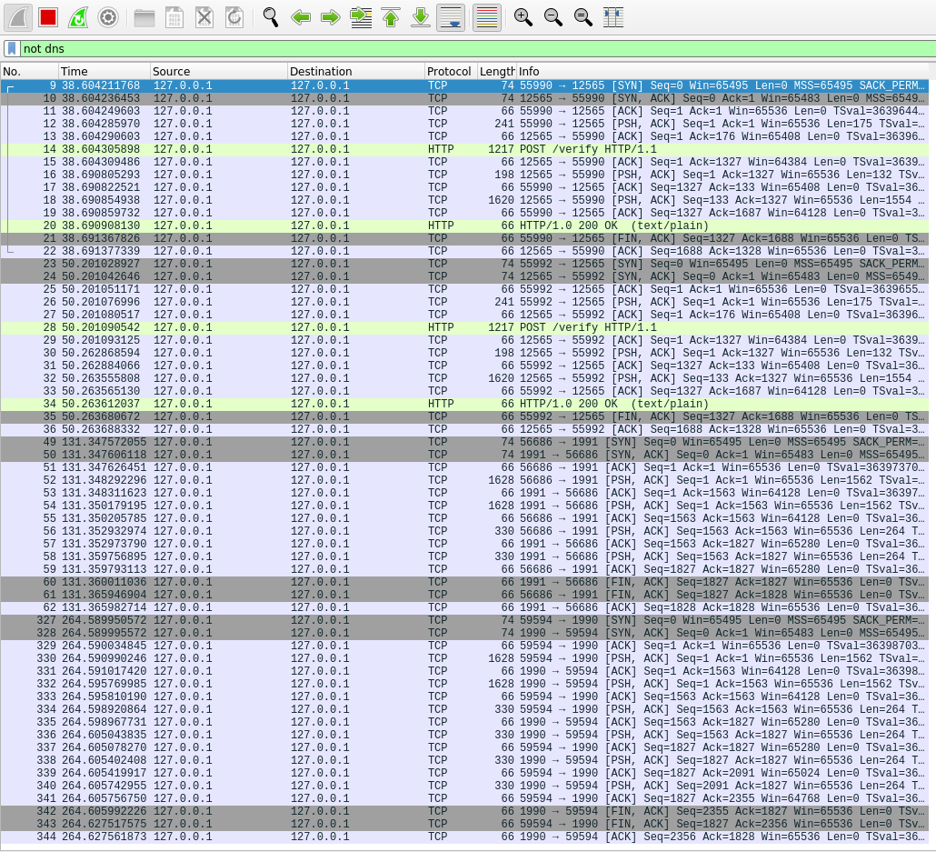
DATA EXCHANGES

Slide 19
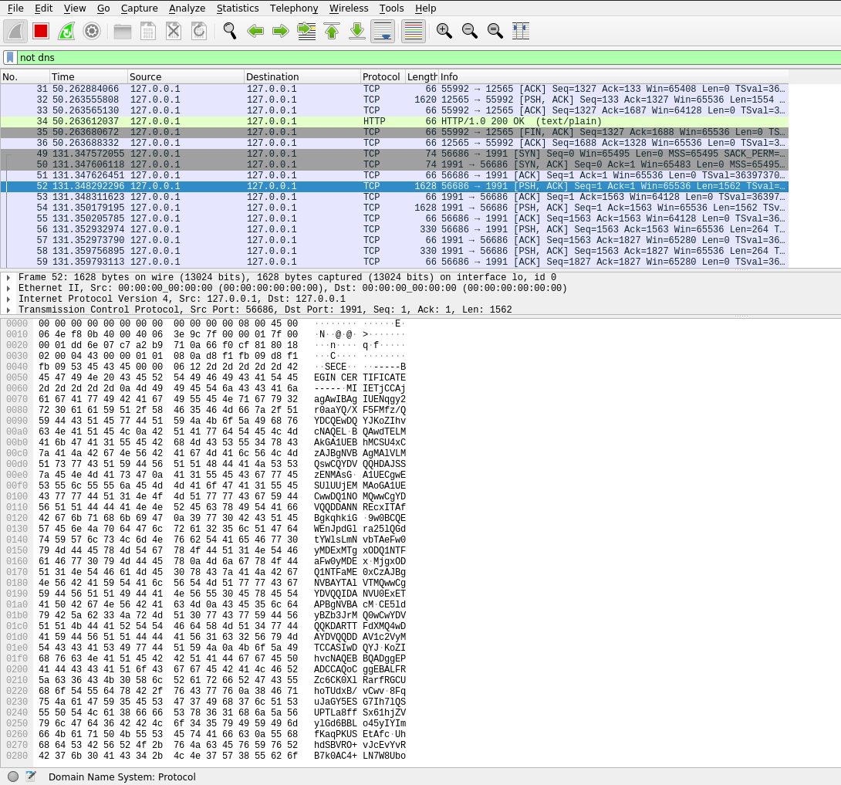
Unencrypted certificate

Slide 20
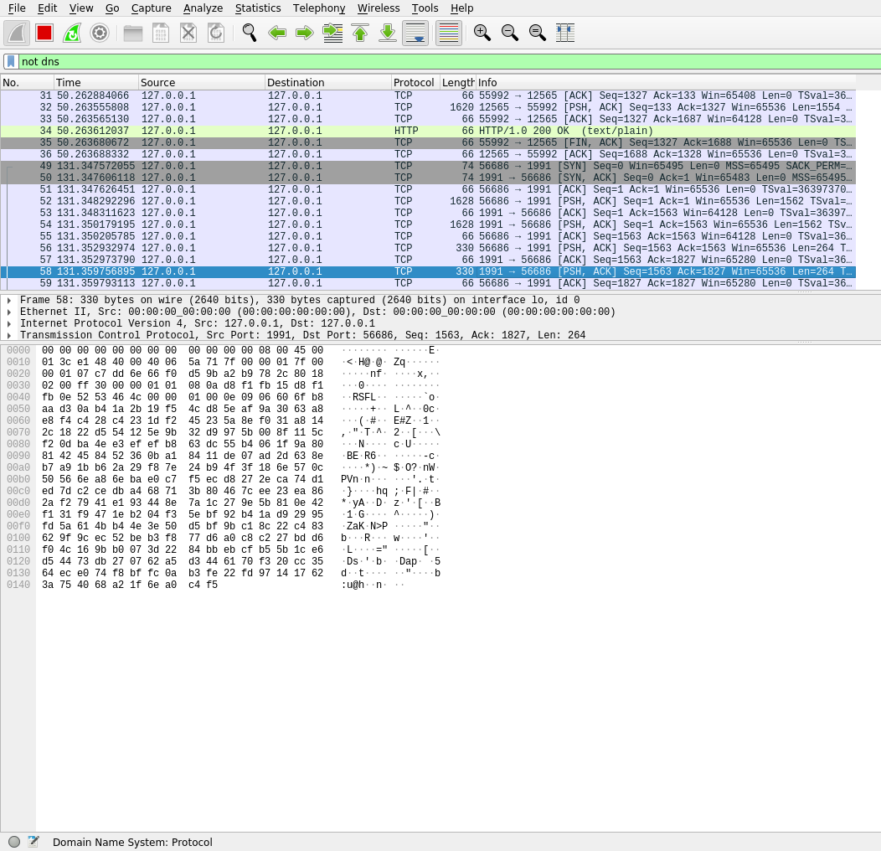
Encrypted data

Slide 21
Contributions
Ritik Kumar - Contributed to the actual coding the implementation together with looking at the available libraries to handle encryption and key management. Contributed to the terminal based demonstration for the project.
Kaustubh Trivedi - Contributed in the actual code, specifically connections.py and peer.py, where I handled the encryption and sending of data as bytes chunks from file. Contributed to make the tool interactive and demonstrate its POC.
Bhavye Jain - Created the overall design of the system encompassing the various entities, their roles and interactions. Evaluated the various options of signing certificates and decided on the hierarchy suitable for the project.
Saurabh Singh - Worked on securing file transfer using Sockets and developing an architecture that works similar to SSL/TLS security on the internet to ensure that communication is encrypted.
Ajay Dayma - Worked on security issues of File transfer and how we can improve the existing solution. Explored different ways of securing communication, specifically JWT.
Sai Krishna Abhiram - Packet Capture and Analysis using Wireshark
Shiva Reddy - Worked on what assumptions to take for our System. Explored different ways of securing communication, specifically Symmetric Cryptography.

Slide 22
Thank You

