Slide 1

CARITAS UNIVERSITY, ENUGU
DEPARTMENT OF COMPUTER SCIENCE
MediAI
Design and Implementation of a Web-Based
AI-Assisted Telehealth Platform
Daniel Isaac Echo · CS/DE/2022/1300
Final Year Project · B.Sc. Computer Science · July 2026
Supervised by Mr Ejike Ugwu

Slide 2
OVERVIEW
What We'll Cover
A guided walkthrough from the problem MediAI solves to how it was built, secured, tested, and evaluated.
01
The Problem & The Fix
04
Platform Capabilities
Why healthcare-seeking is fragmented — and how MediAI closes the gap
The features patients, doctors & admins use
02
Aim & Objectives
05
Security, Testing & Evaluation
What MediAI set out to achieve
How correctness and safety were verified
03
System Architecture
06
Conclusion & Recommendations
The layered design and technology stack
What was achieved, and what comes next
MediAI
02

Slide 3




INTRODUCTION
A Fragmented Path to Care
Symptom-checking, doctor discovery, booking, and consultation exist today as disconnected, manual steps — several still depending on physical presence or phone calls.
No Preliminary Guidance
No Verified Directory
Manual, Unscheduled Booking
No Central Record
Patients have no low-cost way to gauge a symptom's urgency before contacting a doctor
No single, trustworthy, searchable listing of credentialed doctors to consult
Consultations arranged by phone call or physical queue, with no status tracking
No secure, unified place for medical documents or consultation notes
MediAI
03

Slide 4









THE SOLUTION
One Platform, Four Fixes
MediAI closes the gap by consolidating symptom triage, doctor discovery, booking, consultation, and record-keeping into a single authenticated, role-based system.
THE PROBLEM
MEDIAI'S FIX
No preliminary guidance on symptom urgency before contacting a doctor
AI-assisted assessment: follow-up questions, severity grading & a persistent disclaimer
No single, trustworthy, searchable directory of doctors
Verified doctor directory, searchable by specialisation, availability & rating
Booking and consultation handled by phone call or improvised video calls
Structured booking with a signed, time-windowed Jitsi video-consultation room
No secure, central place for documents or consultation notes
Cloud-based document storage and consultation notes, scoped to the treating doctor
MediAI
04

Slide 5







PURPOSE
Aim & Objectives
Role-separated JWT authentication for patients, doctors & administrators
AI-assisted symptom assessment with severity grading & disclaimer
THE AIM
To design and implement a web-based telehealth platform that gives patients AI-assisted symptom assessment, verified doctor booking, video consultation, secure records, and communication — all within one role-based system.
Doctor discovery, profiles & administrator-led verification
Appointment booking with signed, time-windowed video consultation
Secure document storage plus real-time messaging & notifications
Automatic emergency-request assignment to an on-duty doctor
MediAI
05

Slide 6



SYSTEM DESIGN
A Layered, Modular Architecture
Presentation, business logic, and persistence are separated into distinct layers, so a change in one — like swapping a storage provider — never ripples into the others.
Presentation Layer
React 19 single-page app · TanStack Query · Zustand · Tailwind CSS
Business Logic Layer
Django REST Framework · Serializers · Role-based Permission Classes
Persistence Layer
PostgreSQL, accessed exclusively through the Django ORM
A JSON Web Token (JWT) authentication scheme cuts across all three layers, verifying every request's identity without server-side session state.
KEY THIRD-PARTY INTEGRATIONS
Cloudinary
Jitsi Meet
Django Channels
Gemini AI
Secure document storage
Signed video consultation
Real-time chat & alerts
Symptom assessment engine
MediAI
06

Slide 7


CAPABILITIES
What MediAI Delivers
AI Symptom Assessment
Verified Doctor Directory
Secure Video Consultation
Follow-up questions, severity grading, and a persistent medical disclaimer
Search and book approved doctors by specialisation, availability & rating
Signed, time-windowed Jitsi Meet rooms generated per appointment
Medical Document Storage
Real-Time Messaging
Emergency Routing
Records held securely via Cloudinary signed, time-limited URLs
WebSocket-based chat and notifications between patient and doctor
Automatic assignment to an available emergency-duty doctor
MediAI
07

Slide 8
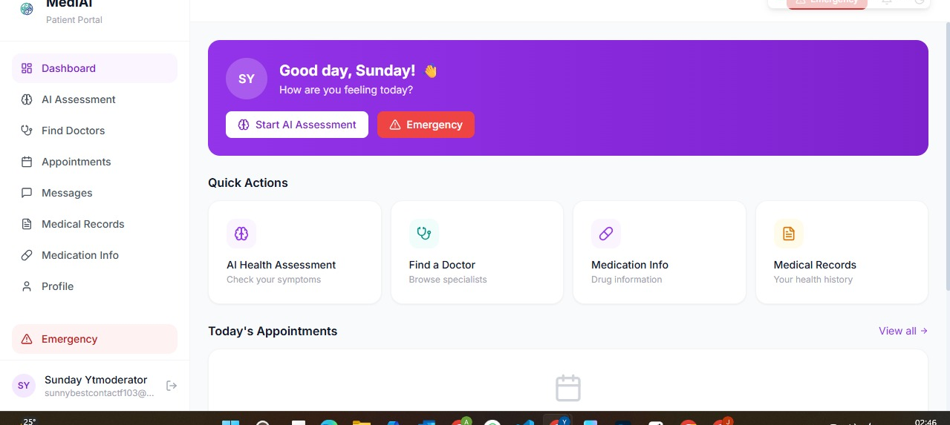
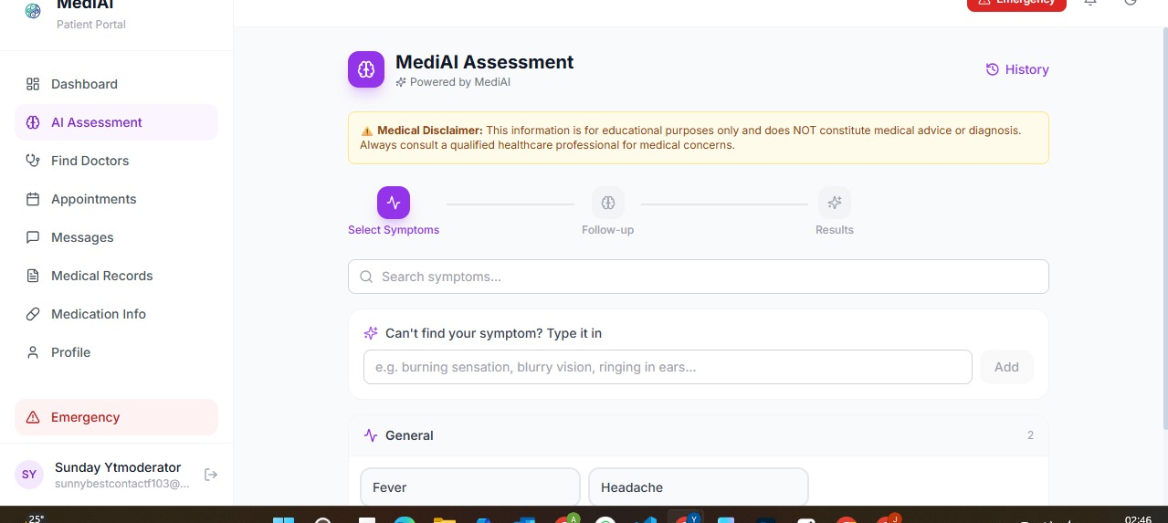
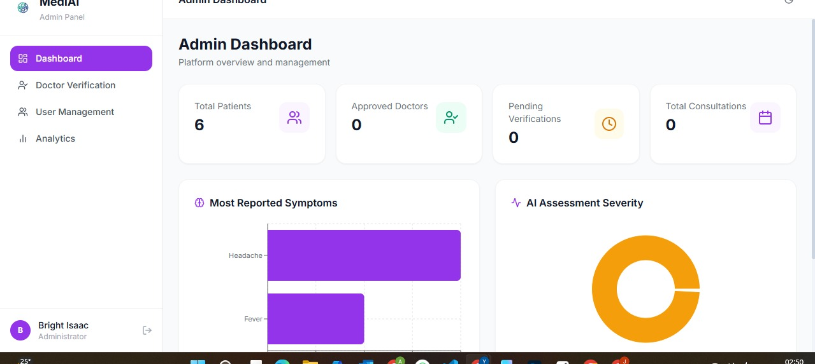



DEMONSTRATION
MediAI in Action
Screenshots captured from the deployed application.
Patient Dashboard
AI Symptom Assessment
Administrator Analytics
3 Role-Based Views
Real-Time by Default
Disclaimer Everywhere
Distinct, purpose-built dashboards for patients, doctors & admins
Chat, alerts & appointment status update live over WebSocket
Every AI result carries a persistent, non-suppressible medical notice
MediAI
08

Slide 9


QUALITY & ASSURANCE
Built and Verified with Rigor
SECURITY, IN LAYERS
Authentication
7 / 7
Salted password hashing, plus short-lived JWT access & refresh tokens
Stated objectives achieved and traced to implementation & test evidence
Authorization
Role-based permission classes, with querysets scoped to the owning user
TESTING CARRIED OUT INCREMENTALLY
Transport & Platform
CORS allow-list, HSTS, secure headers, and request throttling on sensitive routes
Unit
Integration
System
User Acceptance
MediAI
09

Slide 10
CLOSING
Conclusion & Path Forward
CONCLUSION
KEY RECOMMENDATIONS
MediAI substantially addresses the fragmentation of remote healthcare, achieving all seven stated objectives. It stands as a credible academic prototype — unifying AI-assisted triage, verified booking, video consultation, and secure records in one authenticated platform, though not yet a production-ready clinical system.
1
Integrate a genuine payment gateway (Paystack, Flutterwave, or Stripe) with webhook confirmation
2
Implement refresh-token blacklisting and move JWT storage to HttpOnly, secure cookies
3
Close object-level authorization gaps and introduce an automated test suite with CI
4
Commission an independent medical and security review before any clinical deployment
MediAI
10

Slide 11
Thank You
Questions & Discussion
Daniel Isaac Echo · CS/DE/2022/1300
Design and Implementation of a Web-Based AI-Assisted Telehealth Platform (MediAI)
Department of Computer Science, Caritas University, Amorji-Nike, Enugu

