Slide 1

Introduction to GoogLeNet
GoogleNet is a powerful convolutional neural network (CNN) architecture developed by Google. It is known for its innovative Inception modules, which allow efficient feature extraction and model training.
By Sri Bharath Sharma P Shriyans Arkal Yudhajit Jana

Slide 2
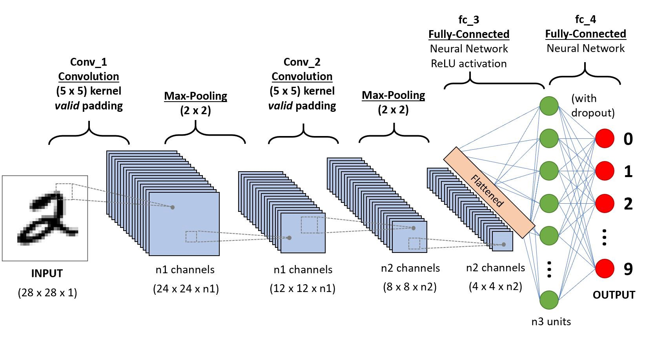
Overview of Convolutional Neural Networks
1
Image Processing
2
Hierarchical Learning
3
Specialized Architecture
CNNs excel at tasks like image classification, object detection, and segmentation by automatically learning features from raw pixel data.
CNNs learn low-level features like edges, then progressively combine them into more complex, higher-level concepts.
The specialized CNN architecture with convolutional, pooling, and fully connected layers makes them highly effective for visual tasks.

Slide 3
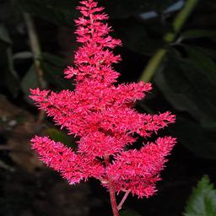
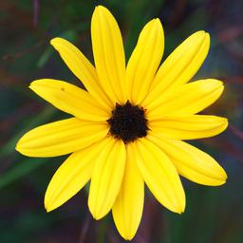

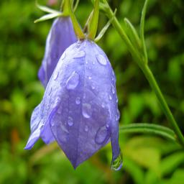
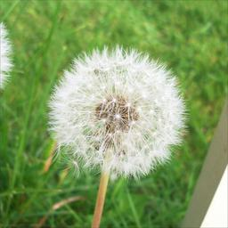
DATASET
This dataset contains images of 16 different flowers species.
Here's the list of flowers in the dataset:
- astilbe
- bellflower
- black_eyed_susan
- calendula
- california_poppy
- carnation
- common_daisy
- coreopsis
- daffodil
- dandelion
- iris
- magnolia
- rose
- sunflower
- tulip
- water_lily

Slide 4
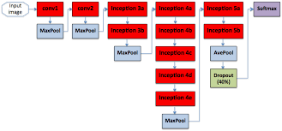
Architecture of GoogleNet
Depth
Efficient Design
GoogleNet has a very deep architecture with 22 layers, allowing it to learn rich, hierarchical features.
GoogleNet's design is highly optimized for computational efficiency, making it fast and resource-friendly.
Inception Modules
The key innovation is the Inception module, which processes inputs at multiple scales in parallel.

Slide 5
Inception Modules
Parallel Convolutions
1
The Inception module applies convolutions of different sizes in parallel to capture features at multiple scales.
2
Feature Aggregation
The outputs of these parallel convolutions are then concatenated, allowing the network to learn rich, multi-scale representations.
Computational Efficiency
3
Inception modules use 1x1 convolutions to reduce the number of parameters and computations, making the model efficient.

Slide 6
Auxiliary Classifiers in Inception Model
What are auxiliary classifiers?
Additional branch classifiers added to intermediate layers
Provide supervision signals during training
Not used during inference (evaluation or prediction)
Purpose:
Facilitate gradient propagation in very deep networks
Help overcome the vanishing gradient problem
Enable effective training of extremely deep architectures
Implementation
Branched off from intermediate feature maps
Consist of auxiliary layers (pooling, convolutions, fully connected)
Outputs class predictions (with softmax activation)
Benefits:
Improved convergence and stability during training
Act as regularizers, reducing overfitting
Enable training of extremely deep architectures (22 layers in GoogLeNet)

Slide 7

Advantages of GoogleNet
1
High Accuracy
2
Efficient
GoogleNet achieves state-of-the-art performance on many image recognition and classification tasks.
Its optimized architecture makes GoogleNet computationally efficient, allowing for fast inference on devices.
3
Scalable
4
Robust
The modular Inception design allows GoogleNet to be easily scaled up or down for different applications.
GoogleNet's depth and multi-scale feature learning make it more robust to variations in the input data.

Slide 8
Applications of GoogleNet
Image Classification
Object Detection
GoogleNet excels at classifying images into predefined categories with high accuracy.
Its ability to learn multi-scale features makes GoogleNet well-suited for detecting and localizing objects in images.
Medical Imaging
Autonomous Driving
GoogleNet has been successfully applied to medical image analysis tasks like tumor detection and disease diagnosis.
The model's efficiency and accuracy make it a popular choice for computer vision in self-driving car systems.

Slide 9
Comparison to other CNN models
VGGNet
ResNet
AlexNet
GoogleNet is more efficient and accurate than the deeper but more computationally expensive VGGNet.
ResNet's residual connections allow for even deeper architectures, but GoogleNet is more parameter-efficient.
GoogleNet significantly outperforms the earlier AlexNet model, demonstrating the rapid progress in CNN design.

