Slide 1
Decision Trees and Random Forests
Introduction to Machine Learning - Lecture 3

Slide 2
What is a decision tree?
A flowchart-like model: each internal node tests one feature
Each branch is an outcome of the test, each leaf is a prediction
Works for both classification and regression
Easy to interpret and visualise
Notes:
Speaker notes for 'What is a decision tree?'.

Slide 3
How is a tree built?
Greedy top-down splitting (CART algorithm)
Choose the split that best separates the classes
Impurity measures: Gini index and entropy (information gain)
Stop when nodes are pure, too small, or the maximum depth is reached
Notes:
Speaker notes for 'How is a tree built?'.

Slide 4
Strengths and weaknesses
+ No feature scaling needed, handles mixed data types
+ Interpretable: the path from root to leaf explains the prediction
- A single deep tree overfits easily
- Small changes in data can produce a very different tree (high variance)
Notes:
Speaker notes for 'Strengths and weaknesses'.

Slide 5
Random forests
An ensemble of many decision trees
Each tree is trained on a bootstrap sample of the data (bagging)
At each split only a random subset of features is considered
Final prediction: majority vote (classification) or average (regression)
Reduces variance dramatically compared to a single tree
Notes:
Speaker notes for 'Random forests'.

Slide 6
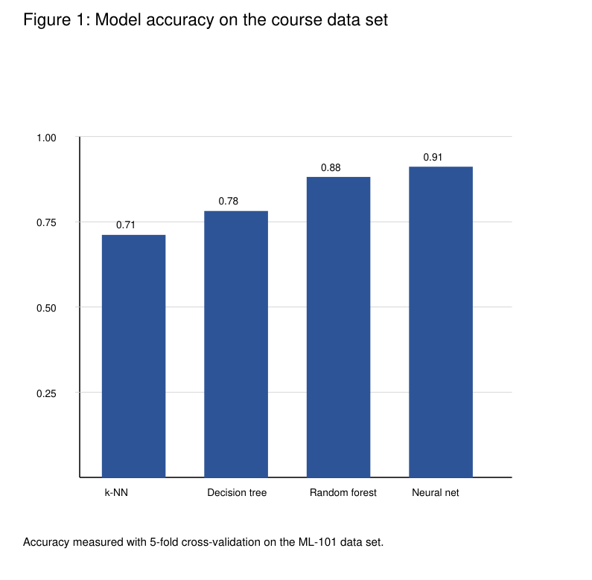
Results
Random forests and neural networks performed best
See the accuracy chart on this slide
Notes:
Speaker notes for 'Results'.

Slide 7
Key takeaways
Trees split data with simple feature tests
Gini and entropy measure how good a split is
Forests combine hundreds of trees for robust predictions
Verification code for this deck: TREE-2026-GAMMA
Notes:
Speaker notes for 'Key takeaways'.

