Slide 1
MCMP117
Fundamentals of
Operating Systems
Week 1 · The Big Picture & a History of Computing
What is a computer? What is an operating system? And how did we get here?
Electronical Communication Technology Programme · Vocational School

Slide 2
WEEK 1
Welcome
INSTRUCTOR
HOW THE SEMESTER RUNS
Asst. Prof. Dr. Hasan Oğuz, Ph.D.
Weeks 1–7: how an operating system works (theory, small C experiments)
Week 8: midterm exam
Weeks 9–14: hands-on Linux and the Bash shell
Week 15: final exam
Head of the Electronical Communication Technology Programme
Slides, lecture notes and example code for every week are in the course repository.
MCMP117 — Fundamentals of Operating Systems
Week 1 · 2

Slide 3
WEEK 1
Today’s Agenda
1
What is a computer, really?
2
What is an operating system? (a first, simple definition)
3
Why do we need one? — the purpose
4
An extended history — from punch cards to the cloud
5
Why this history matters
Next week: formal definitions, OS goals, and how operating systems are structured.
MCMP117 — Fundamentals of Operating Systems
Week 1 · 3

Slide 4
THE BIG PICTURE
What Is a Computer, Really?
Strip away the screen, the keyboard, the apps — at its core, a computer is a machine that follows instructions.
Input
Process
Output
Numbers, text, a key press, a sensor reading
A sequence of instructions — a program — acts on the input
A result: text on a screen, a file saved, a motor turning
Every computer you will ever meet — a phone, a laptop, a drone flight controller — is this same loop, over and over, billions of times a second.
MCMP117 — Fundamentals of Operating Systems
Week 1 · 4

Slide 5
THE BIG PICTURE
What Is an Operating System?
A FIRST DEFINITION (WE’LL SHARPEN THIS NEXT WEEK)
The operating system is the program that starts first when you turn the computer on, and manages everything else — so that other programs can run.
It starts first
It manages everything else
It hides the hard parts
The very first program to run when you power on a computer.
Other programs — your browser, a game, a text editor — run with its help.
You don’t need to know how the disk or memory works to save a file.
MCMP117 — Fundamentals of Operating Systems
Week 1 · 5

Slide 6
THE BIG PICTURE
Why Do We Need an Operating System? — The Purpose
Without an OS
With an OS
Only one program could use the computer at a time.
That program would have to talk to the hardware directly — the disk, the screen, the keyboard — which is hard to get right and easy to break.
This is roughly how the very first computers worked, as we’ll see shortly.
Many programs can safely share the same hardware.
You don’t need to understand the disk or the memory to use a program — the OS handles it.
Multiple people, or multiple programs, can use the same machine at once.
MCMP117 — Fundamentals of Operating Systems
Week 1 · 6

Slide 7
HISTORY
How Did We Get Here?
From a machine with no software at all, to the operating system in your pocket.
MCMP117 — Fundamentals of Operating Systems
Week 1 · 7

Slide 8
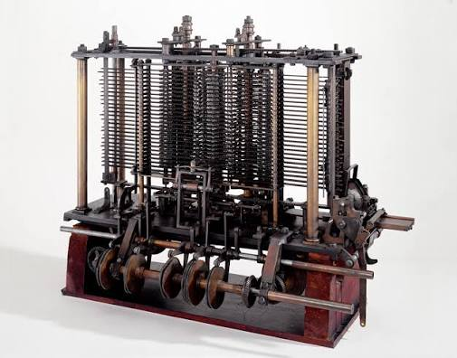
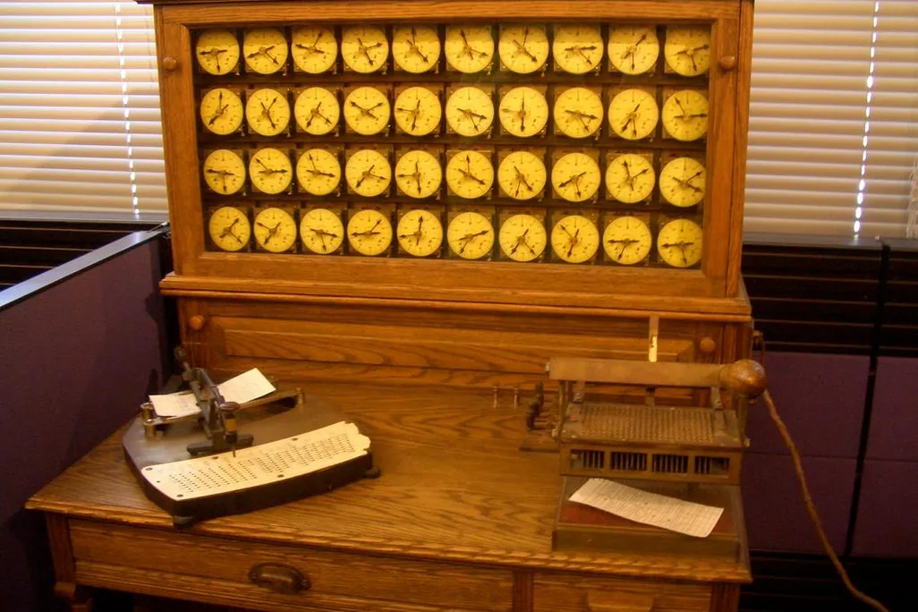
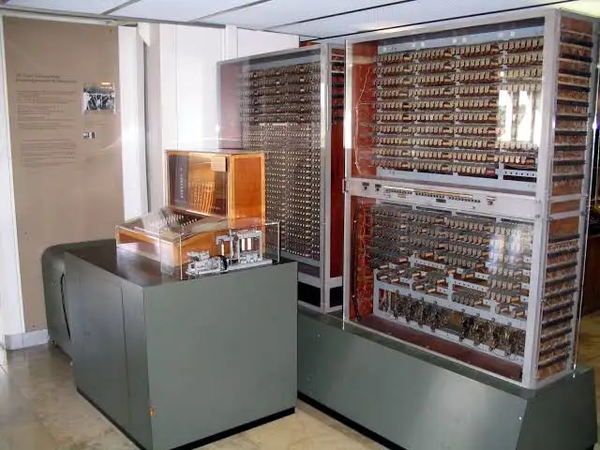
GENERATION 0 · 1837–1941
Before There Were Computers, There Were Calculators
1837–43 · Analytical Engine
1890 · Hollerith Tabulator
1936–41 · Zuse Z1–Z3
Charles Babbage designs a mechanical, general-purpose computer with a processor (“mill”) and memory (“store”), fed by punched cards. Ada Lovelace publishes the first program for it in 1843. Never fully built — shown is Babbage's trial model of the mill.
Herman Hollerith's punch-card machine counts the U.S. Census: pins pass through the holes, close an electrical circuit, and advance a dial. Years of manual counting shrink to months; his company later becomes part of IBM.
Konrad Zuse builds a series of programmable machines in Berlin. The relay-based Z3 (1941) is among the first working programmable computers. The original was destroyed in 1943 — shown is a later museum replica.
MCMP117 — Fundamentals of Operating Systems
Week 1 · 8

Slide 9
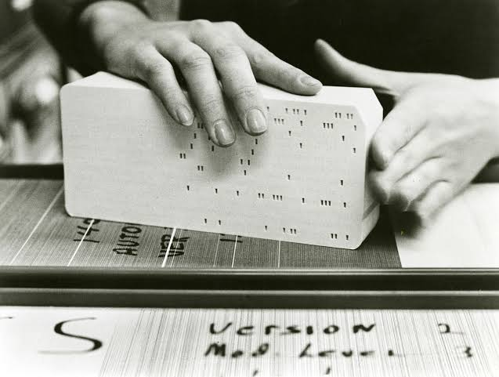
GENERATION 0 · THE FIRST INPUT DEVICE
Punch Cards — Reading Data by the Hole
HOW IT ACTUALLY WORKED
A punch card is a stiff paper card where the presence or absence of a small rectangular hole, at a specific row and column, encodes one character or digit.
Hollerith's 1890 census machine read holes mechanically, using spring-loaded pins that completed an electrical circuit through each hole.
By the 1950s–60s, punch cards carried both data and program instructions — one card per line of code was completely normal.
A dropped, out-of-order deck of cards was a real, career-defining disaster for a 1960s programmer — one motivation for later, friendlier interfaces.
A punch card being read on a card-punch/verifier machine.
MCMP117 — Fundamentals of Operating Systems
Week 1 · 9

Slide 10
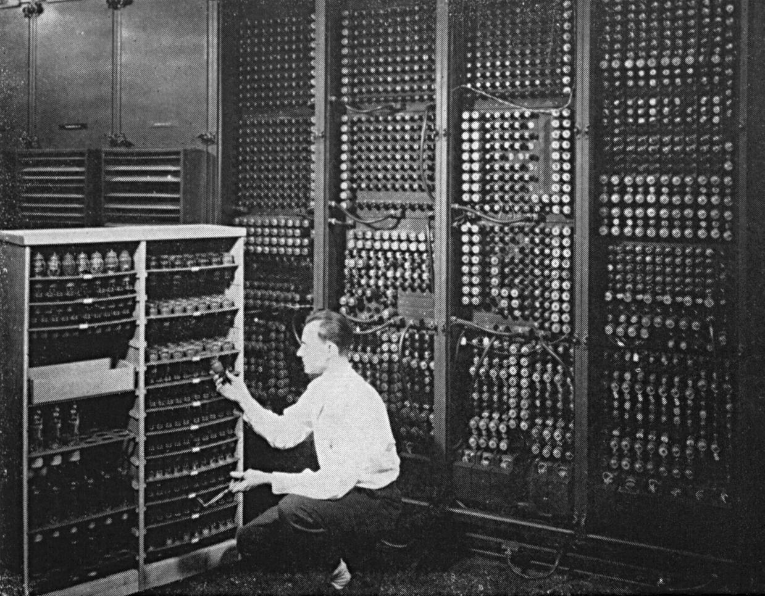
GENERATION 1 · 1945
ENIAC — Room-Sized, and Utterly Alone
THE MACHINE WITH NO OS AT ALL
Filled a 9m × 15m room and weighed about 30 tons; built at the University of Pennsylvania for the U.S. Army.
Used roughly 18,000 vacuum tubes instead of any transistor — tubes failed constantly and had to be hunted down by hand.
No monitor, no keyboard: “programming” meant physically rewiring plugboards and setting switches, which could take days.
One job ran at a time, with total control of the machine — there is no concept of “operating system” yet, because there is no other software to manage.
ENIAC (Electronic Numerical Integrator and Computer), 1945.
MCMP117 — Fundamentals of Operating Systems
Week 1 · 10

Slide 11
GENERATION 1 · 1956
GM-NAA I/O — Arguably the First Operating System
Written jointly by General Motors Research and North American Aviation for GM's IBM 704 mainframe, GM-NAA I/O automated the tedious, error-prone job of loading one program after another by hand.
The problem it solved
The idea
Why it counts as “first”
Every time one job finished on the IBM 704, an operator had to manually mount tapes and start the next one — the expensive computer sat idle in between.
Keep a small, permanent “monitor” program resident in memory, whose only job is to automatically load and run the next job in a queue.
It is the earliest widely-cited program built specifically to manage other programs — the defining trait of every OS since.
MCMP117 — Fundamentals of Operating Systems
Week 1 · 11

Slide 12
GENERATION 1–2
Batch Processing, Step by Step
The dominant style of computing from the 1950s into the 1970s — jobs, not people, are what the computer sees.
1. Punch the cards
2. Collect a batch
3. Run automatically
4. Collect the printout
A programmer writes a job on a deck of punch cards — there is no typing directly into the machine.
An operator collects many jobs from many people into one “batch” and loads them together.
The monitor program runs the whole batch, job after job, with no interaction in between.
Hours (or a day) later, the programmer collects a paper printout — and finds out then whether there was a typo.
This is also why early programmers were so disciplined about checking their work by hand — a single mistake could cost an entire day's turnaround.
MCMP117 — Fundamentals of Operating Systems
Week 1 · 12

Slide 13
GENERATION 2 · 1964
IBM System/360 — One Operating System, Many Machines
The old problem
IBM's bet
Before 1964, each IBM computer model needed its own, incompatible software — upgrading meant rewriting everything.
Design one instruction-set architecture, System/360, spanning small machines to giant mainframes, all running the same family of software.
OS/360
Why it mattered
IBM's operating system for the line — one of the largest software projects attempted up to that point, and famously over budget and late.
It proved that an OS could be a product line of its own — portable across hardware, not welded to one physical machine.
MCMP117 — Fundamentals of Operating Systems
Week 1 · 13

Slide 14
GENERATION 2 · CONCEPT
Multiprogramming — Letting the CPU Multitask
The core insight: while one job waits for slow input/output (a tape, a disk, a printer), the CPU sits idle. Why not let another job use it in the meantime?
Before
The fix
The payoff
One job holds the CPU from start to finish — even while it waits, doing nothing, for a tape to rewind.
Keep several jobs in memory at once. The moment one starts waiting on I/O, the OS switches the CPU to a job that has real work to do.
Total useful work per hour rises sharply — the same expensive mainframe gets far more done without any faster hardware.
MCMP117 — Fundamentals of Operating Systems
Week 1 · 14

Slide 15
GENERATION 2–3 · CONCEPT
Time-Sharing — Many Users, One Machine, At Once
The idea
Why it feels instant
Where it led
Instead of one batch job at a time, connect many terminals to one computer. The OS gives each user a tiny slice of CPU time, in rapid rotation.
Slices are milliseconds long and rotate dozens of times per second — far faster than a human can perceive, so each user feels like they have the whole machine.
Time-sharing systems (CTSS at MIT, then Multics, then UNIX) are the direct ancestors of every multi-user and multi-process system running today, phones included.
This is precisely the mechanism behind the CPU scheduling algorithms you will study in Weeks 4–5 (FCFS, SJF, Priority, Round Robin) — time-sharing is what makes a scheduling algorithm necessary in the first place.
MCMP117 — Fundamentals of Operating Systems
Week 1 · 15

Slide 16
INTERMISSION
10-Minute Break
Next: Multics, UNIX, and the road from the personal computer to the cloud.
MCMP117 — Fundamentals of Operating Systems
Week 1 · 16

Slide 17
GENERATION 2 · 1965–1969
Multics — The Giant That Didn't Ship (On Time)
MIT, Bell Labs, and General Electric set out to build Multics: a single time-sharing system meant to serve a whole city like a public utility — always on, endlessly expandable, deeply secure.
What it promised
What went wrong
What it left behind
Continuous operation, dynamic memory, hierarchical files and directories, and fine-grained security — genuinely ahead of its time.
The design was so ambitious that it grew slower and more expensive than planned; Bell Labs pulled out of the project in 1969.
Two Bell Labs researchers who had worked on it — Ken Thompson and Dennis Ritchie — kept many of its best ideas, and built something smaller instead.
MCMP117 — Fundamentals of Operating Systems
Week 1 · 17

Slide 18
GENERATION 2–3 · 1969–1973
UNIX Is Born From Multics' Ashes
1969
1970–72
Ken Thompson writes the first version of UNIX at Bell Labs, on a spare PDP-7 minicomputer nobody else wanted — deliberately small and simple, the opposite of Multics.
Thompson and Dennis Ritchie grow it into a small set of powerful, composable tools that do one job well and can be chained together.
1973
The philosophy
UNIX is rewritten in a new, portable language Ritchie designs for the purpose: C. This is the single decision that lets UNIX later run on almost any hardware.
“Write programs that do one thing and do it well. Write programs to work together.” This idea still shapes every Linux command you will type in Week 9.
MCMP117 — Fundamentals of Operating Systems
Week 1 · 18

Slide 19
GENERATION 4 · 1977
Apple II — The Home Computer Goes Mainstream
Designed by Steve Wozniak, sold by Apple Computer (Jobs & Wozniak) starting in 1977 — one of the first successful, mass-produced personal computers.
Shipped with color graphics and a built-in version of the BASIC programming language — ready to program the moment it was switched on.
Its open architecture (expansion slots anyone could build hardware for) created an entire third-party industry around one machine.
Popularized the idea that a computer could sit on a desk at home or in a classroom, not just in a company's machine room.
][
APPLE ][
1977
MCMP117 — Fundamentals of Operating Systems
Week 1 · 19

Slide 20
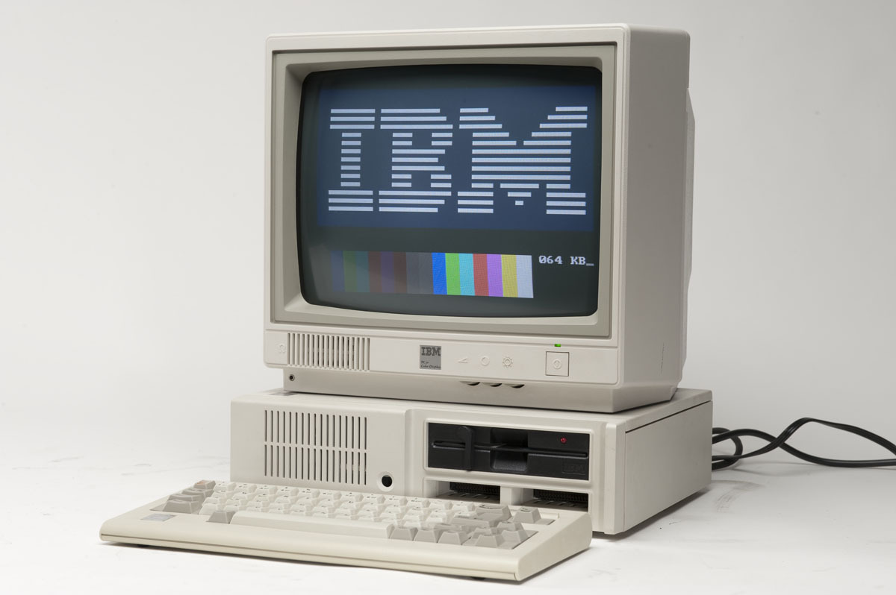
GENERATION 4 · 1981
The IBM PC and MS-DOS
ONE PERSON, ONE COMPUTER
One person, one computer, on a desk — the arrangement this course, and almost every office since, still takes for granted.
Ran MS-DOS from a removable floppy disk — no hard drive was required to get started.
Expandable through internal slots, which is part of why the IBM PC “platform” outlived any single model of it.
1991, a decade later — on hardware like this, in Helsinki, Linus Torvalds starts writing Linux.
An IBM Personal Computer (5150), with monochrome/color display, 1981.
MCMP117 — Fundamentals of Operating Systems
Week 1 · 20

Slide 21
GENERATION 4 · 1970S–1990S
Graphical Interfaces Arrive — Icons, Windows, a Mouse
Xerox PARC (1973)
Apple Macintosh (1984)
Researchers build the Alto, the first computer with overlapping windows, icons, and a mouse — mostly a research machine, never sold widely.
Apple brings PARC's ideas to a mass-market product: point-and-click, a trash can icon, real desktop metaphors, all with no typed commands required.
Microsoft Windows (1985–95)
The lasting shift
Microsoft layers a graphical shell on top of MS-DOS, refining it across versions until Windows 95 makes it the default way most people use a PC.
For most users, “typing commands to the computer” stops being the norm — though, as we will see in Weeks 9–14, it never disappears underneath the surface.
MCMP117 — Fundamentals of Operating Systems
Week 1 · 21

Slide 22
GENERATION 4–5 · 1991
Linux Is Born
“I'm doing a (free) operating system (just a hobby, won't be big and professional like GNU)” — Linus Torvalds, a 21-year-old student in Helsinki, in a 1991 Usenet post announcing his kernel.
What it was
Why it spread
Combined with GNU
A new kernel — the core of an operating system — written from scratch but deliberately UNIX-compatible in behavior and commands.
Released under the GNU General Public License: source code freely available to read, modify, and redistribute, by anyone, forever.
Paired with the GNU Project's existing free command-line tools (started by Richard Stallman in 1983), Linux plus GNU became a complete, free operating system.
MCMP117 — Fundamentals of Operating Systems
Week 1 · 22

Slide 23
GENERATION 5 · 1990S–2000S
Meanwhile: Unix and Linux Take the Server Room
While Windows won the desktop, a different, quieter competition was happening on machines most people never see: servers and supercomputers.
Stability & multi-user design
Cost
The result
Unix (and later Linux) was built from the start for many simultaneous users and long uninterrupted uptime — exactly what a server needs.
Linux is free to license, unlike commercial Unix or Windows Server — a decisive advantage once server farms grew into the thousands of machines.
By the 2000s, Linux runs the overwhelming majority of the TOP500 supercomputers and a large share of the servers powering the internet.
MCMP117 — Fundamentals of Operating Systems
Week 1 · 23

Slide 24
GENERATION 6 · 2007
The iPhone — A Phone Becomes a Computer
Apple releases the iPhone in 2007, running a full, modified version of its desktop operating system (what becomes iOS) — not a stripped-down phone OS.
What was new
Why it's an OS milestone
The ripple effect
A capacitive multi-touch screen (no stylus), a real mobile web browser, and — from 2008 — an App Store for installing new software.
It proved a full, modern, multi-tasking operating system could run on a battery-powered device that fits in a pocket.
Every major phone maker follows within two years — this is the direct trigger for the next slide.
MCMP117 — Fundamentals of Operating Systems
Week 1 · 24

Slide 25
GENERATION 6 · 2008
Android — Linux Goes Into Your Pocket
Origins
Built on Linux
Android Inc. is founded in 2003, bought by Google in 2005; the first commercial Android phone (the HTC Dream / T-Mobile G1) ships in 2008.
Android's core is a modified Linux kernel — the same lineage from Slide 22 — wrapped in a new interface, app framework, and Java-based tools.
The open strategy
Why it belongs in this course
Unlike iOS, Android is licensed to any phone manufacturer for free, which is why it now runs on the largest number of devices worldwide.
Every Android phone in this room is, underneath the app icons, running the same kernel family you will type commands into in Week 9.
MCMP117 — Fundamentals of Operating Systems
Week 1 · 25

Slide 26
GENERATION 7 · 2000S
Cloud Computing — One Machine, Acting Like Many
Server hardware kept getting more powerful, but most programs did not need a whole physical machine to themselves. Virtualization answers the mismatch.
Virtual machines
“The cloud”
Why it matters here
A hypervisor lets one physical server pretend to be several independent computers, each running its own guest operating system, isolated from the others.
Companies like Amazon (AWS, 2006) rent out virtual machines by the hour — you use someone else's data center as if it were your own computer.
This is the same isolation idea behind the containers used for software development and deployment, which is where container platforms such as Kubernetes and OpenShift (2011) come in.
MCMP117 — Fundamentals of Operating Systems
Week 1 · 26

Slide 27
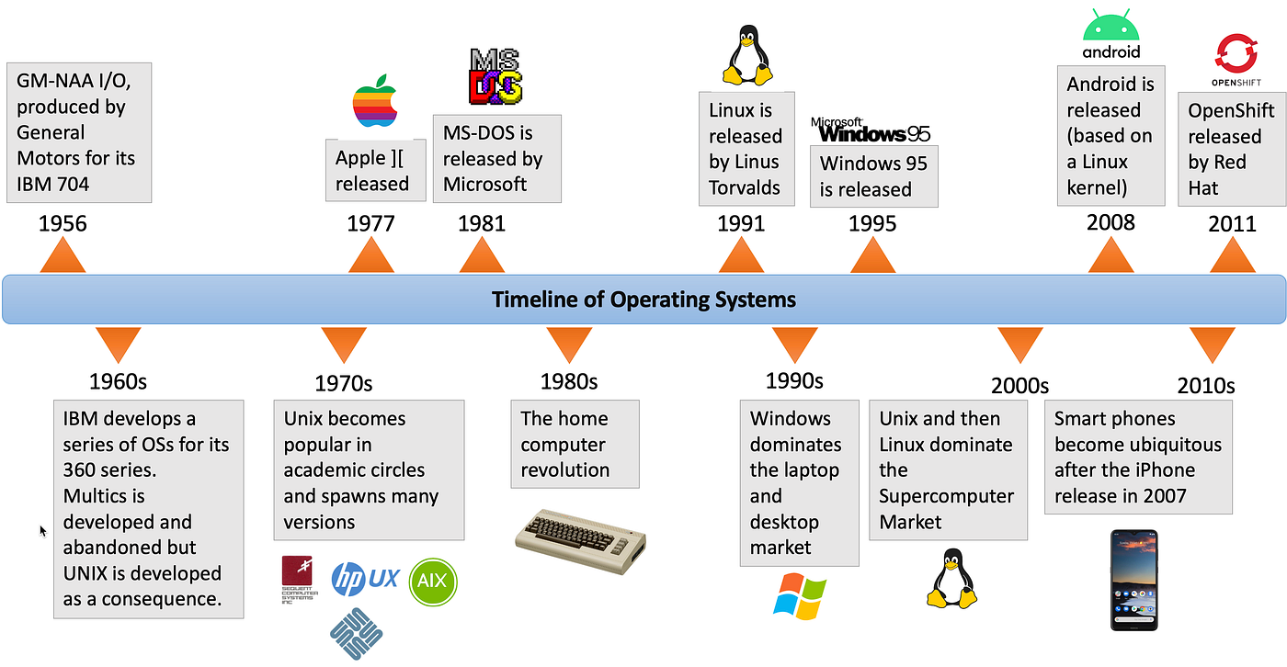
RECAP
The Full Timeline, at a Glance
Every era from this deck, on one line — from IBM's earliest OS work in the 1950s to the container platforms of the 2010s.
MCMP117 — Fundamentals of Operating Systems
Week 1 · 27

Slide 28
SYNTHESIS
Why This History Matters
Every generation solved a real problem
No OS → automation → sharing the CPU → sharing it interactively → sharing it across the world.
Old ideas never really disappear
Your phone still multiprograms, still time-shares, still batches background tasks.
This course follows the same order
We’ll study processes, scheduling, memory, and files roughly in the order they were invented to solve these problems.
MCMP117 — Fundamentals of Operating Systems
Week 1 · 28

Slide 29
WRAP-UP
Week 1 — Key Takeaways
A computer, at its core, just follows instructions: input → process → output.
A first working definition: the OS is the program that starts first and manages everything else.
We need an OS so programs can safely share hardware, and so users don’t need to manage it themselves.
History moved from no software (ENIAC) → batch → multiprogramming/time-sharing → personal computers → mobile/cloud.
Two dates worth remembering: UNIX, 1969; Linux, 1991 — the system we’ll use hands-on later this semester.
MCMP117 — Fundamentals of Operating Systems
Week 1 · 29

Slide 30
NEXT WEEK
Definitions & Structures
Week 2 will cover:
A precise, formal definition of an operating system
The OS’s design goals: convenience, efficiency, ability to evolve
The four components of a computer system
How operating systems are built: monolithic, layered, microkernel, modular
MCMP117 — Fundamentals of Operating Systems
Week 1 · 30

Slide 31
QUESTIONS?
Discussion
If you have questions after class, ask them on the course Telegram channel — everyone benefits from the answer.
MCMP117 — Fundamentals of Operating Systems
Week 1 · 31

