Slide 1
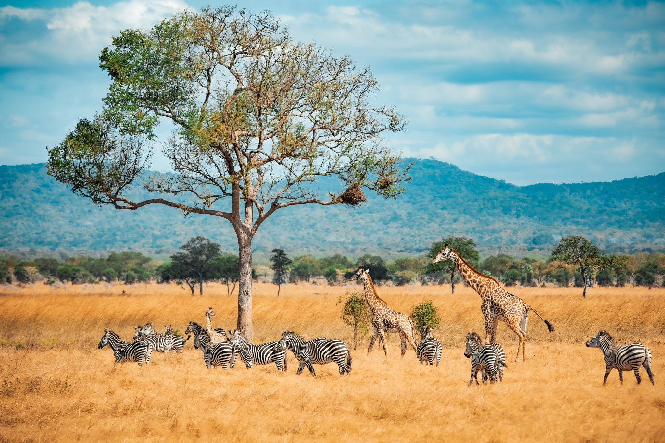
Zoolab: Cloud-Based Wildlife Research Management System
Cloud Computing and Virtualization (DIT3202)
Members
Lansana Alfred Braima
Joshua Osinga
Isatu Bah
Jennifer Martha Lamboi
Nusaibatu
Mohamed Sow
Limkokwing University Of Creative Technology
//2025

Slide 2
