Slide 1
Soccer Sage
Forecasting the Future of Soccer
Team P28
Abhishek Rao | Manav Shah | Srimadh Rao
ALDA FALL 24 – NCSU

Slide 2



Background & Motivation
Modern soccer generates massive data
  3M data points per match ( StatsPerform)
  75+ metrics per player ( StatsPerform)
  Over €10B transfer market (2023) ( TransferMarkt)
Success story
  Liverpool FC used data-driven approach for transfers ( Medium)

Slide 3
References
[1] Ulmer, Ben, Matthew Fernandez, and Michael Peterson. "Predicting soccer match results in the English premier league." Doctoral dissertation, Doctoral dissertation, Ph. D. dissertation, Stanford (2013).
  Accuracy: 50%
[2] L. Hervert-Escobar, T. I. Matis and N. Hernandez-Gress, "Prediction Learning Model for Soccer Matches Outcomes," 2018 Seventeenth Mexican International Conference on Artificial Intelligence (MICAI), Guadalajara, Mexico, 2018.
  Accuracy: 47.92%
[3] Holmes, Benjamin, and Ian G. McHale. "Forecasting football match results using a player rating based model." International Journal of Forecasting 40.1 (2024): 302-312.
  Accuracy of best model: 53.88%
[4] Shin, J., & Gasparyan, R. (2014). A novel way to soccer match prediction. Stanford University: Department of Computer Science.
[5] Luca Pappalardo, Paolo Cintia, Paolo Ferragina, Emanuele Massucco, Dino Pedreschi, and Fosca Gian-notti. 2019. PlayeRank: Data-driven Performance Evaluation and Player Ranking in Soccer via a Machine Learning Approach. ACM Trans. Intell. Syst. Technol. 10, 5, Article 59 (September 2019).

Slide 4
Dataset Overview
Dataset
  European Soccer Database (2008-2016) comprising of 5 major leagues, 10,000+ matches, 25,000+ players.
  The dataset’s rich, interconnected information on matches, player attributes, and team metrics allows us to extract valuable insights.
Can we use the dataset to
  Predict match outcomes?
  Identify optimal player transfers?
  Optimize team’s performance?

Slide 5
Our Approach
Methodology
  Comprehensive Exploratory Data Analysis (EDA)
  Data Preprocessing
  Data Transformation
  Prediction of objectives
Prediction of Match Outcomes
  Neural Networks
  Random Forest Classification
  Gradient Boosting
Prediction of Player Transfers
  Filter players that have high rating and high potential
  Forecast player ratings to show future potential and usefulness for the team

Slide 6
Data Preprocessing & Transformation
Steps
  Merging tables using unique identifiers.
  Handling missing values with average fills.
  Aggregating player, team data to analyze performance over multiple years.
Feature Engineering
  Home/Away team metrics based on players ratings.
  Match outcome encoding: Home Win (1), Draw (0), Loss (-1).
  Tactical attributes (Numerical and Categorical) encoded for model training.

Slide 7
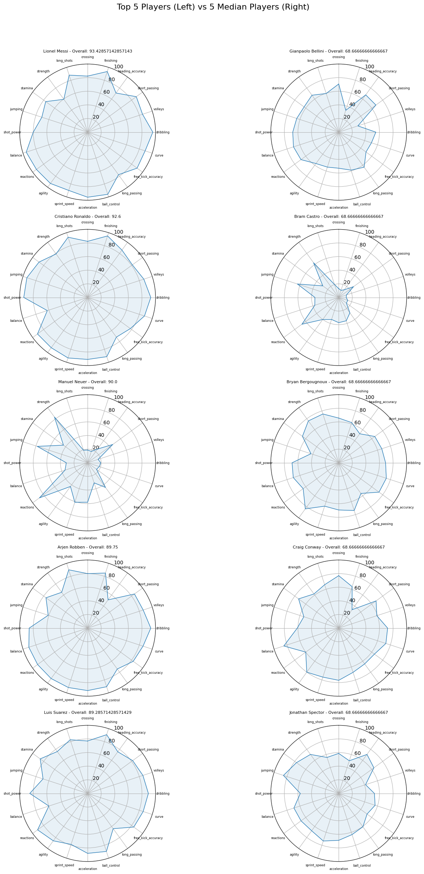
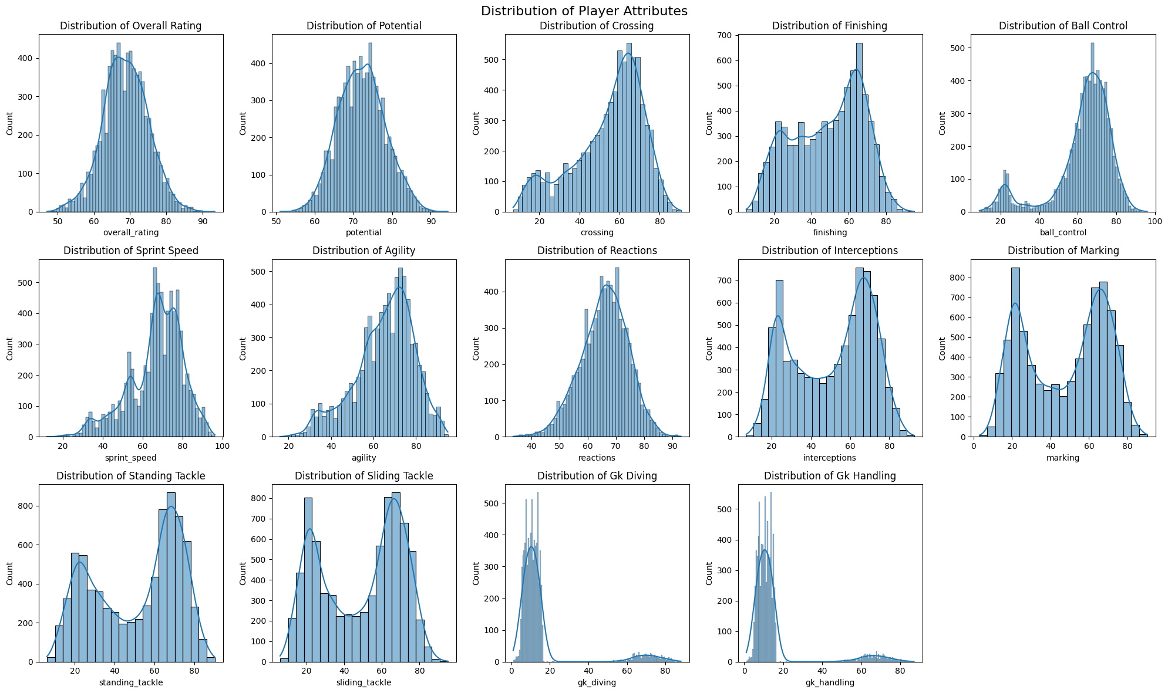
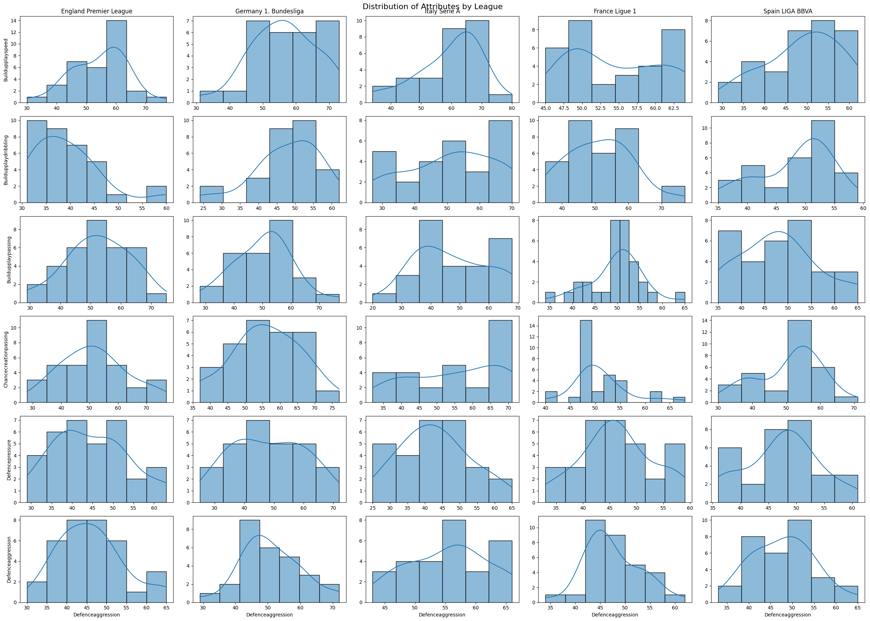
EDA Insights
Skill metrics (e.g., passing, shooting) exhibit a bell curve.
League characteristics:
  La Liga emphasizes technical passing.
  Bundesliga: Fast-paced build-up.
  Ligue 1: Defensive intensity.

Slide 8
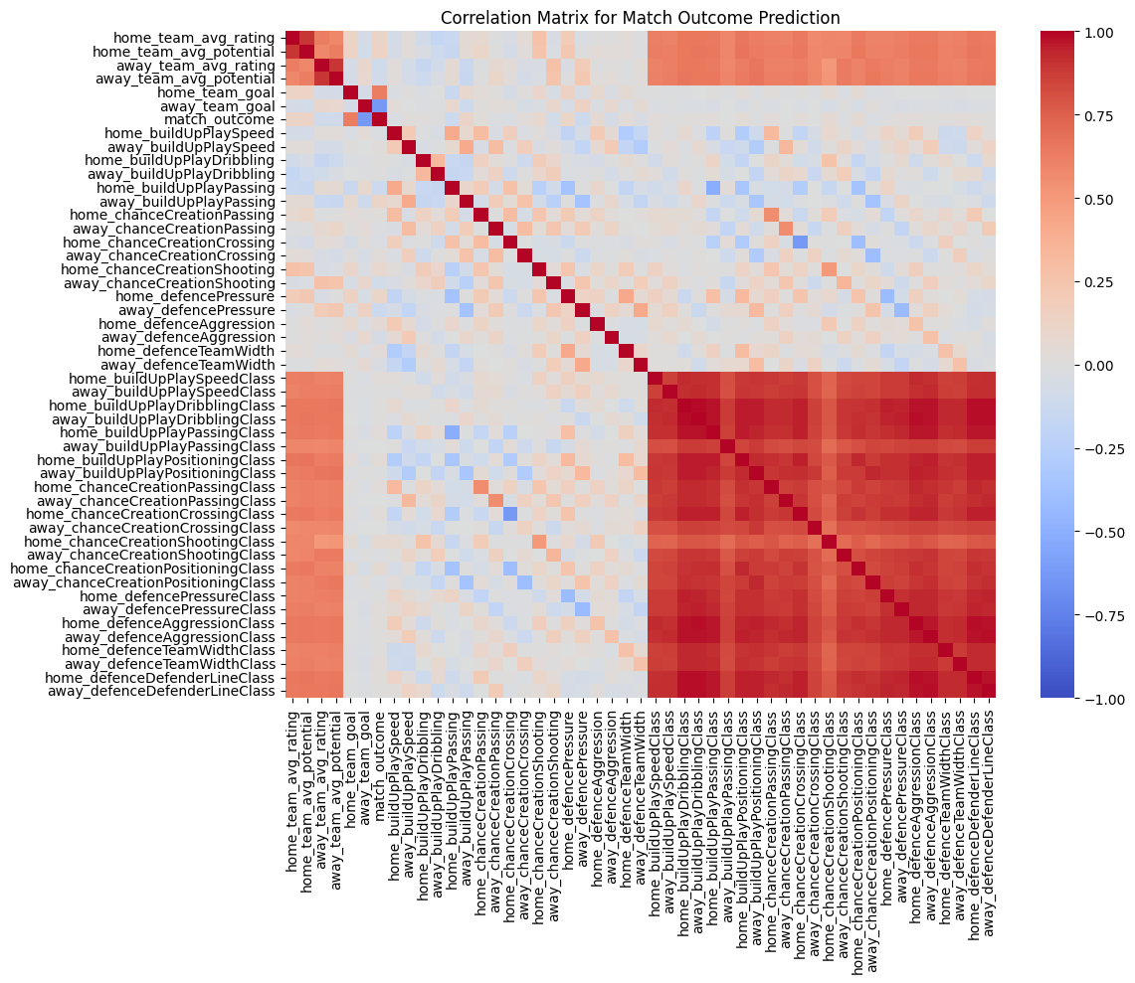
EDA Insights
We can see that lots of features are highly correlated

Slide 9
Prediction Strategy for Match Outcome
Random Forest Classifier
  Purpose: Aggregates multiple decision trees to reduce overfitting.
  Parameters: n_estimators=100, class_weight='balanced’
  Advantages: Effective for multiclass classification, Reduces overfitting, Implicit feature selection
Gradient Boosting Classifier
  Purpose: Trains sequential models to minimize classification errors by combining weak learners.
  Parameters: n_estimators=100
  Advantages: High Accuracy, Suitable for complex data patterns
Neural Network with CrossEntropy Loss
  Architecture: 2 layers (500, 100 neurons)
  Parameters: hidden_layer_sizes=(500,100), max_iter=500
  Loss: Standard CrossEntropy Loss
Neural Network(Pytorch) with Focal Loss:
  Architecture: 5 layers (128, 256, 128, 64 neurons) with dropout
  Parameters: Epochs=50, Batch_size=32, Learning_rate=0.001, Weight_decay
  Advantages : Focuses on hard-to-classify, underrepresented samples

Slide 10
Prediction Strategy for Player Transfers
Data-Driven Team Weakness Identification
  Analyzes goals scored/conceded and pre-2016 team stats (e.g., build-up, chance creation).
  Defines target roles (attacker, defender, midfielder, goalkeeper) based on deficiencies.
Targeted Player Filtering and Ranking
  Filters players by role-specific metrics using computed mean thresholds.
  Identifies top-performing and high-potential candidates based on dynamic thresholds.
Predictive Modeling for Future Potential
  Uses linear regression on historical data to project future player potential.
  Applies latest stats to generate projected potential, highlighting long-term growth.

Slide 11
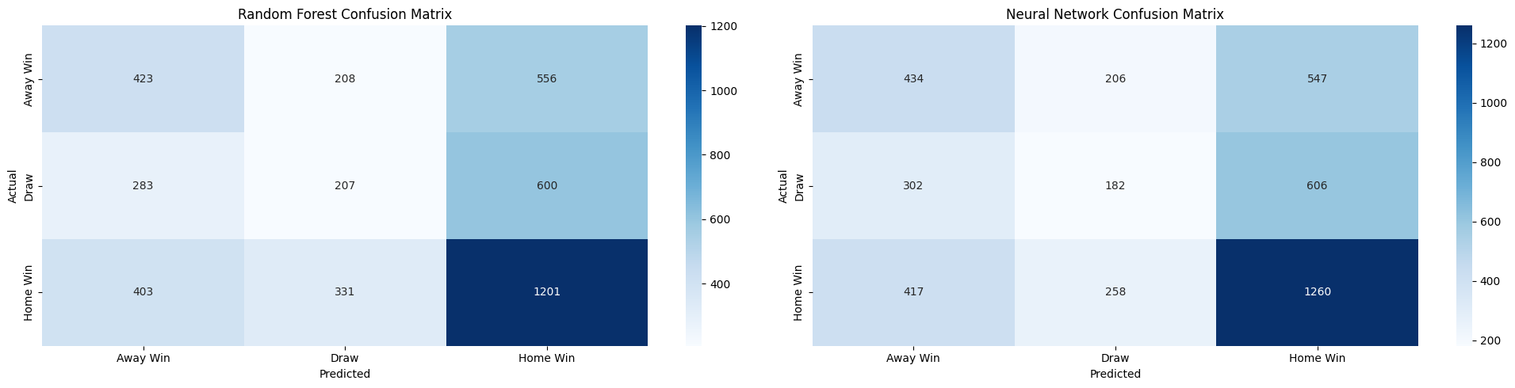
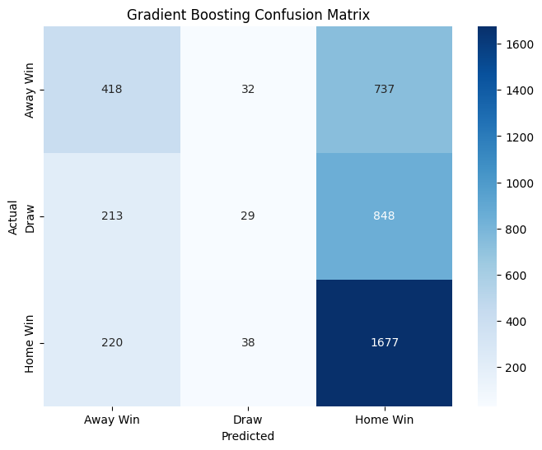
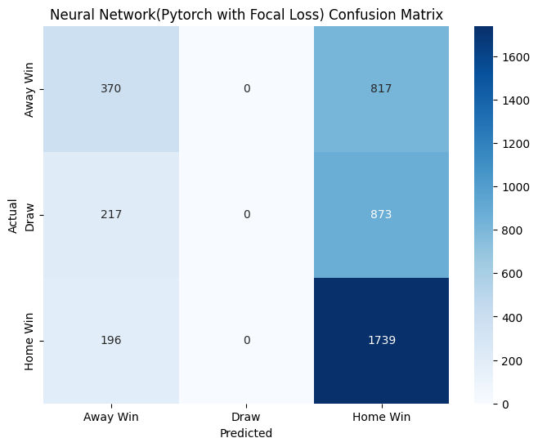
Results for Match Outcome Prediction

Slide 12
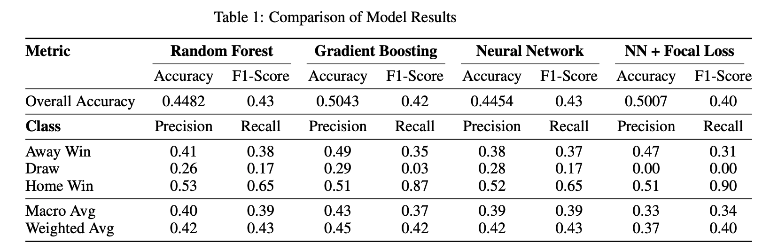
Results for Match Outcome Prediction

Slide 13
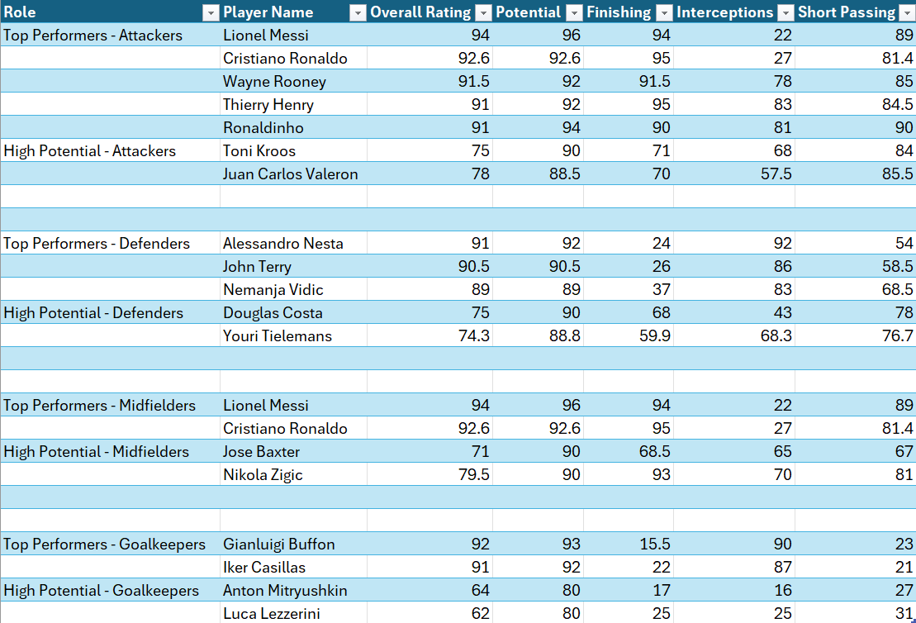
Results
Club: Liverpool FC
Weakness: Attack

Slide 14
Conclusion
Random Forest has the lowest accuracy, but it is a very simple model to implement and train, and it achieves a good F1-Score.
Gradient Boosting provides one of the best accuracies while maintaining a high F1- score, showcasing the power of ensemble models.
Neural networks tend to overfit the data and increasing the hidden layer size leads to a dramatic decrease in the F1-score due to the underrepresentation of the ‘Draw’ class.
Player transfer recommendations are an initial step for scouting reports.
Any Scope for improvement?
Handle class imbalance while maintaining accuracy.
Try ensembling different classifiers using voting methods to improve accuracy.
Improve player transfer recommendations by incorporating more features.

Slide 15
Questions?
Thank You!

