Slide 1
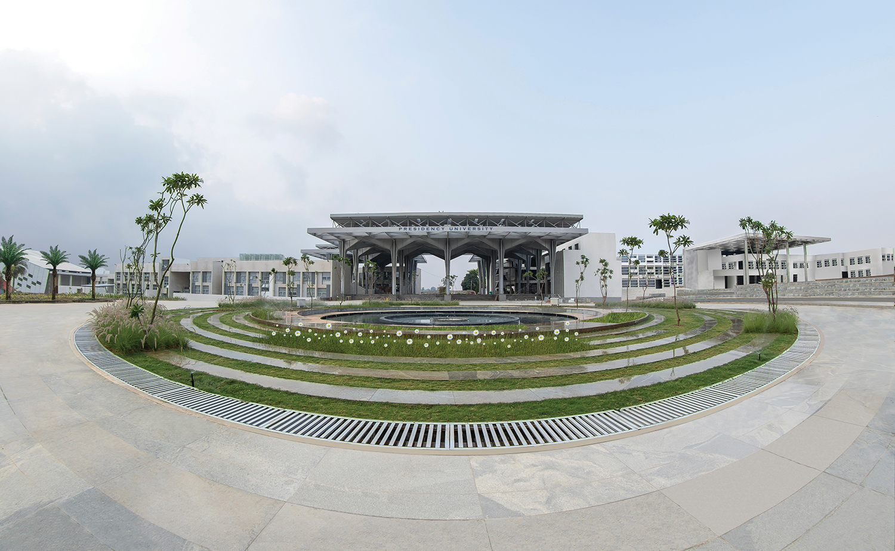

Mini Project (CSE7102)
REVIEW-2
26-09-2026
Presidency
School of Computer Science and Engineering

Slide 2
360° AI/ML Feedback on Government of India News
CSE7102 - Mini Project Review-2
Project ID: PRJ_277
Panel No: Not assigned
Group members (details pending):
Under the Supervision of,
Supervisor name not provided
Designation not provided
School of Computer Science and Engineering
Presidency University
Sl.No | Student Name | Roll Number
1
2
3
Program: CSE7102 Mini Project
HoD / Team Leader: Not provided
Project Coordinator: Not provided
School Project Coordinator: Mr. Muthuraju V

Slide 3
INDEX
Problem statement
Objectives
Literature and research basis
Methodology and architecture
Implementation progress
Individual work, links, conclusion and references

Slide 4
Problem Statement:
Context — One Government of India initiative may be reported by national and regional outlets in five languages.
Challenge — Manual collection makes those reports hard to find, compare and trace back to the original source.
Research question — How does coverage differ across the sources and languages in a selected sample?
Scope — Results describe only what this bounded search collected; they do not represent all media or readers.

Slide 5
Objectives
Collect — Search an initiative by topic, alternate names, dates, language and optional outlet.
Preserve — Store the source and discovery URLs, publication and collection times, and available article text.
Classify — Detect English, Hindi, Kannada, Tamil or Telugu and show the reasons for Government of India relevance.
Analyze — Summarize content and keep article tone separate from stance toward a named government action.
Compare — Group candidate reports, show shared topics and differences, and link every result to its evidence.

Slide 6
Literature and Research Basis
Media framing [1] — Motivates comparing which themes and details receive emphasis across reports.
Sentence-BERT [2] — Shows how texts can be compared by meaning, not only by matching exact words.
IndicNLPSuite [3] — Documents resources and benchmarks for Indian-language NLP.
Project gap — This prototype applies those ideas to five-language research but still needs human-labeled evaluation.

Slide 7
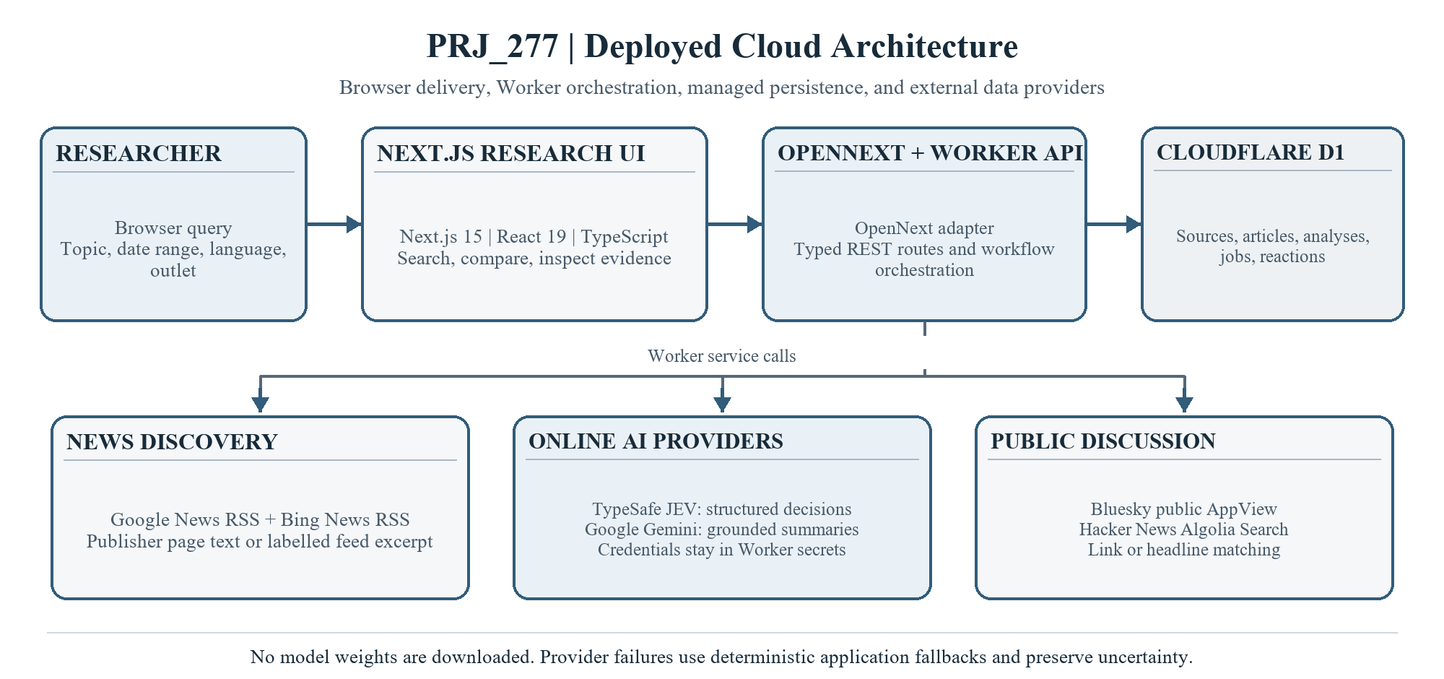
Methodology and Architecture
The Worker stores reports with source links in D1 and returns comparisons to the dashboard.

Slide 8
Implementation Progress
Completed scope — Six of ten capability groups work in the demo; 60% is feature scope, not accuracy or code completion.
Online workflow — Google and Bing News RSS feed a Cloudflare Worker, which stores collected records in D1.
AI roles — JEV supplies structured decisions; Gemini writes summaries whose supporting sentences are checked against the article.
Article 370 reaction check — No matching posts were returned. Bluesky failed with HTTP 403 and Hacker News had no match; this is not evidence of public consensus. YouTube is excluded.
Next — Broaden reaction sources and review multilingual output with human-labeled examples.

Slide 9
Individual Contribution
Implemented — News search, ingestion, language and relevance scoring, article analysis, story comparison and the hosted interface.
Contribution record — Team names, USNs, supervisor details and individual task allocations were not supplied, so no ownership is assumed.
Reproducibility — The repository contains setup guidance, methodology, limitations, tests and presentation materials.

Slide 10
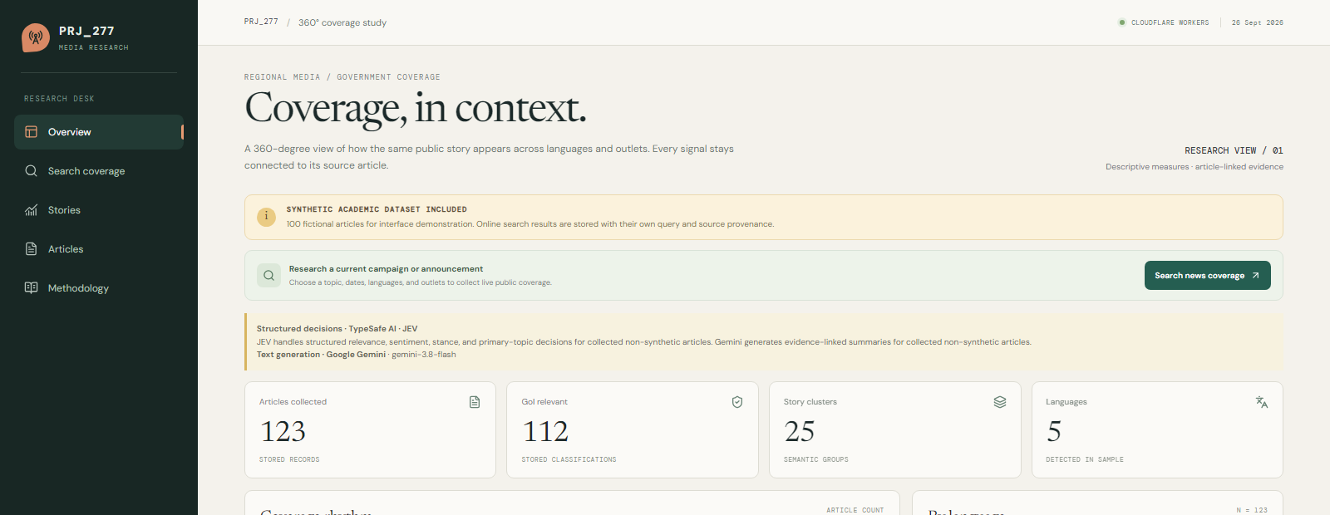
Project Links
Live demo — https://prj-277-media-research.manojhv13.workers.dev/
Public source — https://github.com/codemanojhv/prj-277-media-research
LIVE CLOUDFLARE WORKERS OVERVIEW · CAPTURED 26 SEPTEMBER 2026

Slide 11
Conclusion
The hosted demo connects topic search, source-linked storage, analysis and comparable story views.
The search is a sample: RSS coverage and publisher access limit which reports can be collected.
AI labels and summaries are prompts for review. Article tone is not the same as audience reaction.
Next — Expand reaction sources, evaluate each language with human labels, and add retry and pipeline controls.

Slide 12
References (IEEE Paper format)
[1] H. A. Semetko and P. M. Valkenburg, "Framing European politics: A content analysis of press and television news," Journal of Communication, vol. 50, no. 2, pp. 93-109, 2000, doi: 10.1111/j.1460-2466.2000.tb02843.x.
[2] N. Reimers and I. Gurevych, "Sentence-BERT: Sentence Embeddings using Siamese BERT-Networks," in Proc. EMNLP-IJCNLP, 2019, pp. 3982-3992, doi: 10.18653/v1/D19-1410.
[3] D. Kakwani et al., "IndicNLPSuite: Monolingual Corpora, Evaluation Benchmarks and Pre-trained Multilingual Language Models for Indian Languages," Findings of EMNLP, 2020, pp. 4948-4961, doi: 10.18653/v1/2020.findings-emnlp.445.

Slide 13


