Slide 1
Robot Mayhem
Coding Lego EV3 with Python

Slide 2
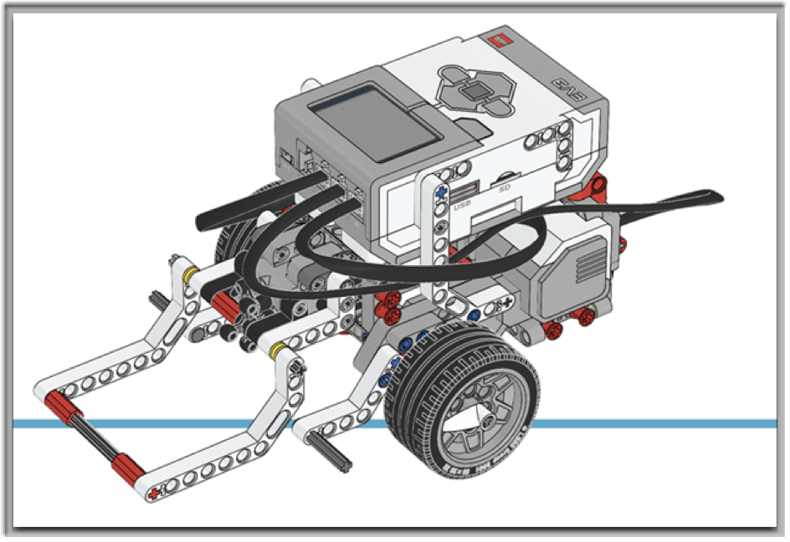
Welcome &
Ice Breaker
Renee Cocca - Principal Software Test Engineer
Mindex Inc.
Assistants - Austin & Logan

Slide 3
Getting Started with Python & EV3
VS Code
https://education.lego.com/en-us/product-resources/mindstorms-ev3/teacher-resources/python-for-ev3/
https://education.lego.com/en-us/product-resources/mindstorms-ev3/downloads/building-instructions/#building-instructions-for-core-set-models
https://github.com/rcocca/LegoPythoncode

Slide 4
Getting Started
Code:
ev3 = EV3Brick()
ev3.speaker.beep()
ev3.speaker.say(“Kidsmash at CodeMash”)

Slide 5
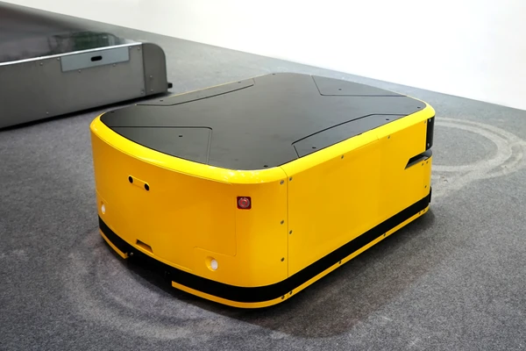
Movements
Code:
# Initialize motors
left_motor = Motor(Port.B)
right_motor = Motor(Port.C)
# Initialize wheels
robot = DriveBase(left_motor, right_motor, wheel_diameter=55.5, axel_track=104)
# Move robot forward
robot.straight(100)

Slide 6
Movements Continued
# Move robot backward
robot.straight(-100)
robot.turn(45)
Is this Right or Left?
What happens if you were to change it to -45?
Lets put some movements together now…

Slide 7
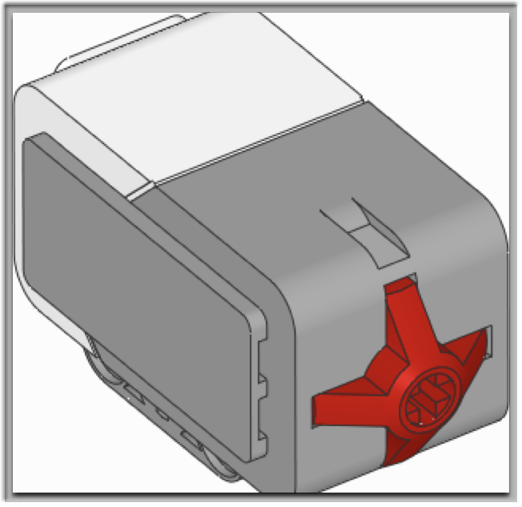
Sensors in Actions
Code:
# Initialize Touch Sensor
touch_sensor = TouchSensor(Port.S4)
# Move straight until the touch sensor is pressed
while not touch_sensor.pressed():
robot.straight(speed)
# Stop the robot
robot.stop()

Slide 8

Sensors in Actions
# Initialize Color Sensor
color_sensor = ColorSensor(Port.S1)
color_sensor = ColorSensor(Port.S1)
while color_sensor.color() != Color.BLACK: robot.drive(200, 0)
robot.stop()

Slide 9

The Mayhem Challenge
What extras can we fit in?

Slide 10
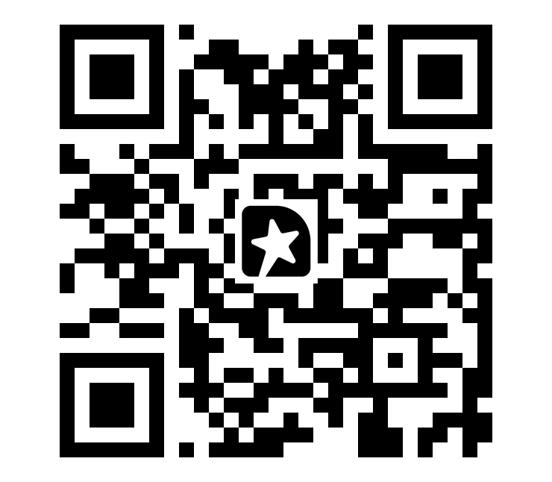
Robots on Parade
Wrap up
http://bit.ly/420sG1y
Notes:
http://bit.ly/420sG1y,

