Slide 1
IOT Project
Obstacle avoiding robot

Slide 2
Goals of the project
1) Implement obstacle avoiding robot using Shakti E class on arty7 100t
2 ) We are using LiDARs for the project. Can we do better to increase the angle we cover?
3) Design and implement more efficient algorithm including moving obstacles and also using gps.

Slide 3
Things required
RPLiDAR A1
Arty7 100T board with Shakthi C Class
ESP8266 Wifi module

Slide 4
Details of RPLiDAR
1. Typical scanning distance : 0.15m-12m
Since the max speed with which we expect our robot to move is 1m/s this scanning distance is acceptable.
2. It has an open source SDK written in C++.
3. It uses a low power consuming laser ( ~3mw)
4. Cost : Around Rs.7500
More Details : RPLiDAR Datasheet

Slide 5
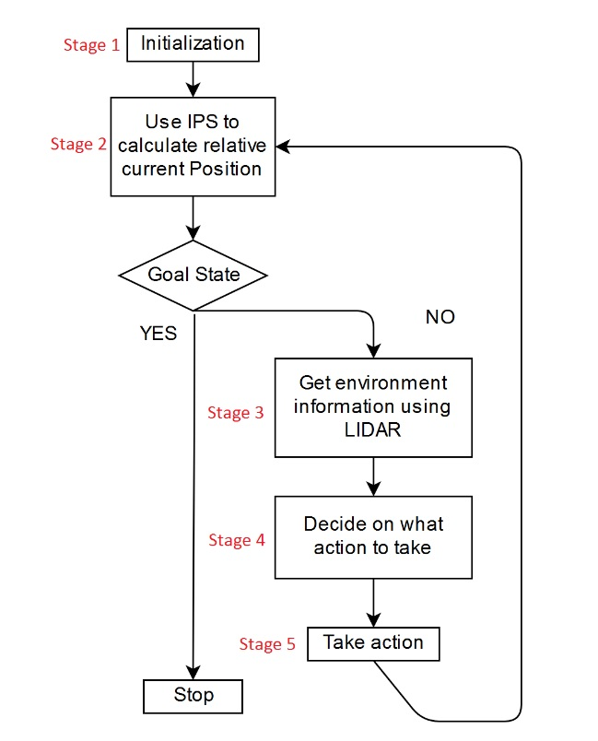
Algorithm for Obstacle avoidance
Stage 1: It is the usual initialization stage. We initialize all the devices, like LiDAR, ESP8266..
Stage 2: This is calculating the current direction of motion. To do this we find the distances of our position from 3 fixed locations at different times and use triangulation to find the direction. The 3 (or more) fixed locations are chosen as wifi spots and hence we use another device ( ESP8266 ) for reading the wifi signal strength, from which we can find the distance.

Slide 6
Stage 3 : This stage is reading information from LiDAR. RPLiDAR gives details of obstacles around it in all 360 degrees. It is up to us to filter out the data and take whatever is necessary for us. So this stage is basically data filtering.
Stage 4: It is the decision making stage. This is explained later..
Stage 5: Take action stage. From the previous stage we would have decided a direction of travel and other details and to implement those is just to drive the motors appropriately.

Slide 7
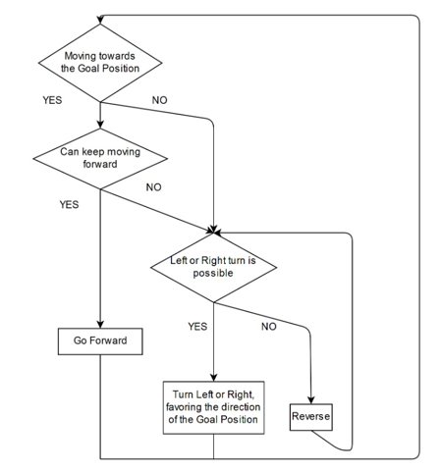
Decision making stage
We will decide a direction is possible if the relative velocity of the obstacle with respect to the vehicle is >= 0 ( i.e moving away wr.t to the vehicle). So we require (dr/dt) , for this we will calculate distance of the obstacle in that direction at two time instances using LiDAR and see whether the distance is increasing/decreasing and decide whether the direction is possible/not.
If relative velocity <= 0 then we have to move away from this direction, so we can check for obstacles in the left or right direction
Else, we can move in same direction and also increase our speed till the relative speed becomes 0.

