Slide 1
N QUEENS HPC(CS301) Project Prof. Bhaskar Chaudhury DA-IICT
Yatin Patel :- 201601454
Jaykishan parmar :- 201601458

Slide 2
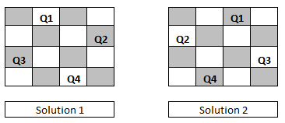
N QUEENS Problem
Example:- Input N = 4 , output:- 2.
You are Given N x N chess board and N Queens, you have to count the number of configurations of placing N queens such that no two queens can attack each other.
Input :- N (number of Queens and size of board).
Output:- Number of possible configurations.

Slide 3
Naïve Aproach :-
BackTracking Aproach :-
Generate all possible configurations of placing N queens and count those configurations that satisfies non-attacking constrains.
Algorithm :-
Count = 0
While (possible configuration)
Generate configuration
If(queens don’t attack)
Count ++
Time-Complexity:- O(n^2Pn x n^2)
Start Placing queen one by one in a column for given row and checking if placed queen on that column satisfies non-attacking constraint. If It satisfies then backtrack for below row else return.
Algorithm:-
Nqueens(queens,row,col)
If(attack(queens,row,col)==true)
return ;
queens[col] = row
If(row==size-1)
count++;
else
for(all colums)
Nqueens(queens,row+1,col)

Slide 4
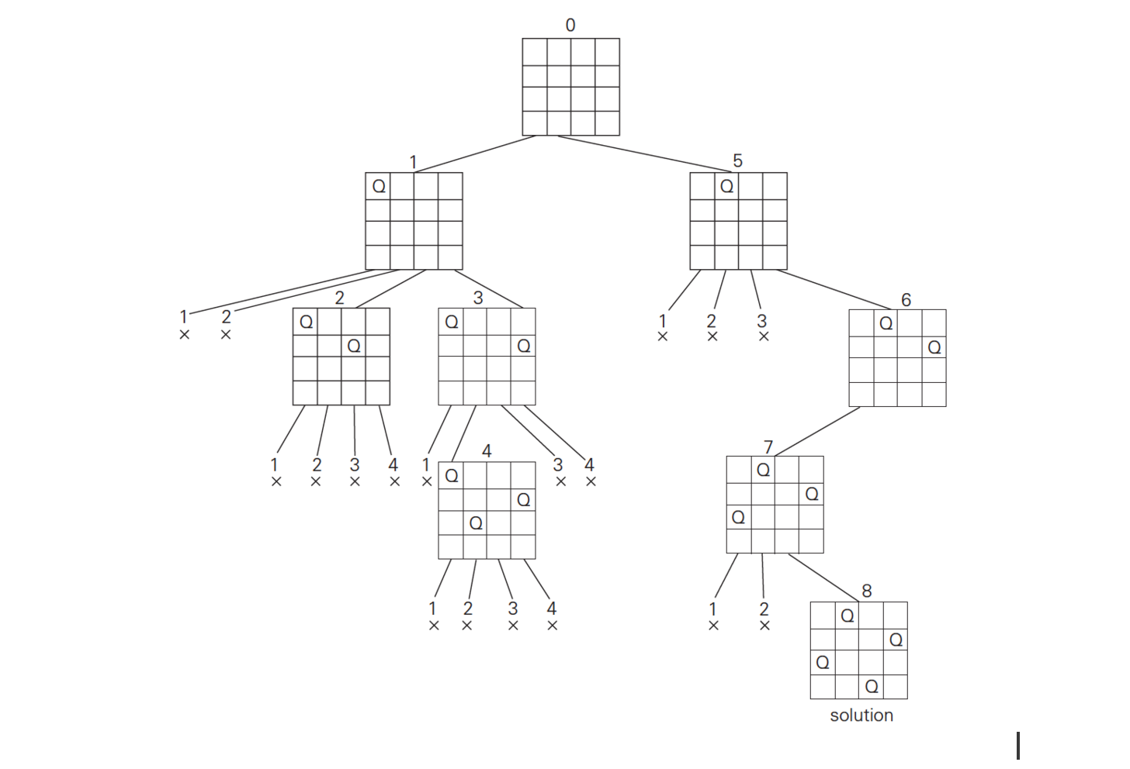
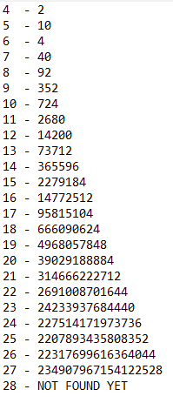
BackTracking Approach(cont.)
Time-Complexity:- O(n!)
Optimization:- due to symmetry of chess board we don’t need to place queens to all column just half of all them and final answer will be double of what we have found.

Slide 5
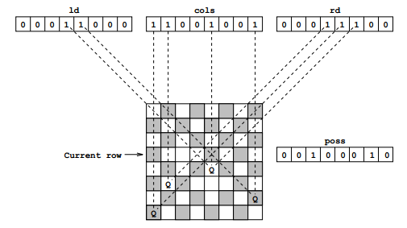
Backtracking + Bit Masking approach:-
We can optimize previous backtracking algorithm using bit masking for keeping track of current queens.
Algorithm:-
SIZE = n; bitmask = (1 << SIZE) -1;
y=left=down=right=count=0
Backtrack(y,left,down,right)
if (y == SIZE)
count++
else
bitmap = MASK & ~(left | down | right) while (bitmap)
bit = -bitmap & bitmap
bitmap ^= bit;
Backtrack(y+1, (left | bit)<<1, down | bit, (right | bit)>>1);
Time-Complexity:- O(n!)
Optimization:- due to symmetry of chess board we don’t need to place queens to all column just half of all them and final answer will be double of what we have found.

Slide 6
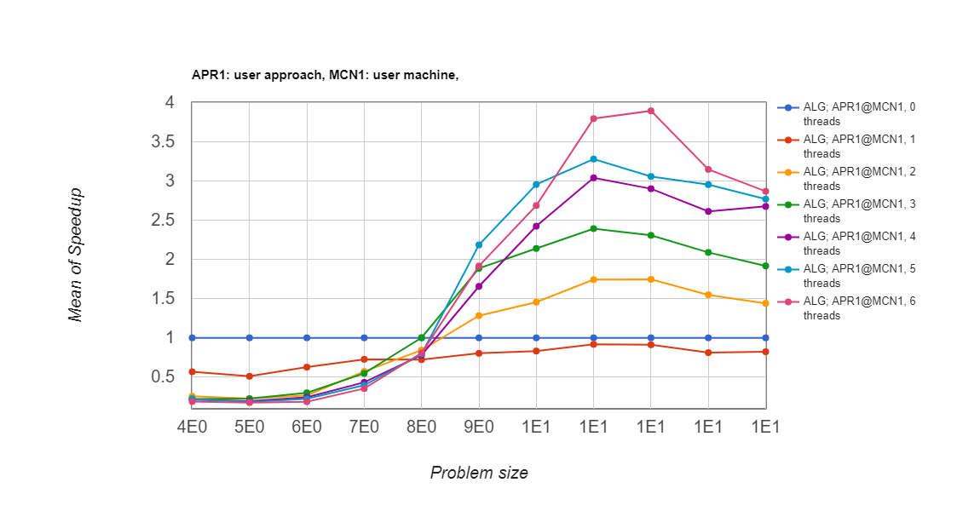
Parallelizing Backtracking (method 1):-
Let’s Generate new task at each backtrack and see what happens.
Algorithm:-
#pragma omp parallel
#pragma omp single
{
Nqueens(queens,row,col)
If(attack(queens,row,col)==true)
return ;
queens[col] = row
If(row==size-1)
#pragma omp critical
count++;
else
for(half of colums)
#pragma omp task
Nqueens(queens,row+1,col)
}
Here, For every backtrack task is generated and added to queue and from that each thread takes them and executes. Here, exact timing of executing tasks in queue is up to task scheduler. Here, task switching costs more.

Slide 7
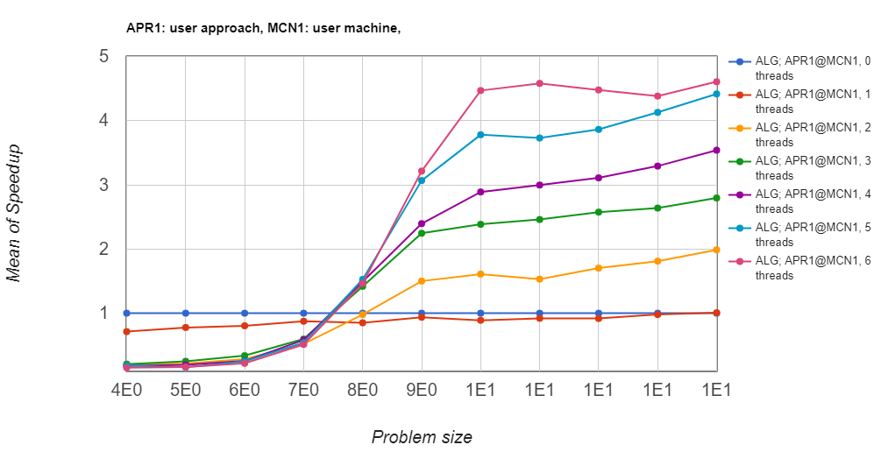
Parallelizing Backtracking (method 2):-
Let’s divide work division as each thread (0 to p) will generate solutions in which first queen (will be at first row) will be at ith column (same as thread id).
Algorithm:-
#pragma omp parallel
#pragma omp single
{
for (i=0;i<(n/2);i++)
#pragma omp task
setQueenSerial(new int[n],0,i);
}
Here, Speedup is better but not that much because of the asymmetry in the number of solutions that starts at first queen at ith column. For n = 14 distribution of solutions are as follows.

Slide 8
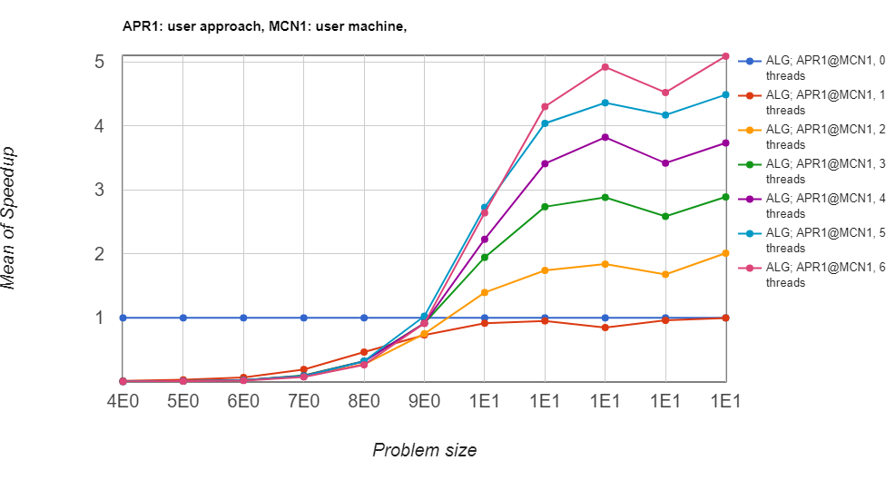
Parallelizing Backtracking (method 3):-
This method combines best parts of previous both methods. Now let’s create new child for certain level and deeper than this level search linearly.
Algorithm:-
NQueens (board, row)
for (i=0;i<(n/2);i++)
board[row] = i;
if (attack(queens,row,i)!=true) if (row < LEVEL)
#pragma omp task
NQueens(board, row+1)
else
NQueenSerial(board,row+1);

Slide 9
Parallelizing Bitmasking:-
We can parallelize bitmasking backtrack using for reduction.
Algorithm :-
Count = 0;chunk = 1;left = 0;down = 0;right=0;
bitmap = MASK & ~(left | down | right)
#pragma omp parallel for schedule(dynamic, chunk) reduction(+:count)
for (i = 0; i < n; i++)
if ((bitmap>>i)&1)
bit = 1<<i;
count += backtrack(lv+1, down|bit,(left|bit)<<1, (right|bit)>>1,mask)

Slide 10
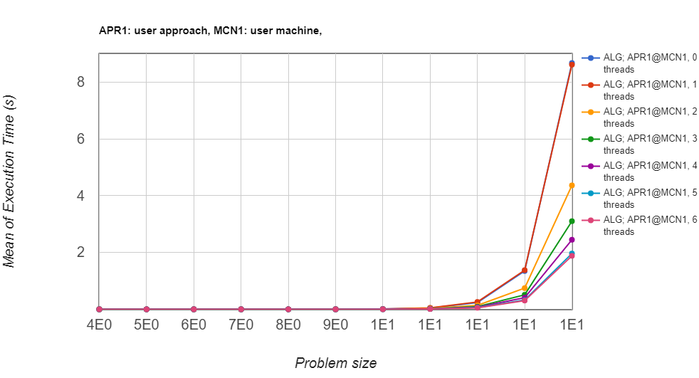
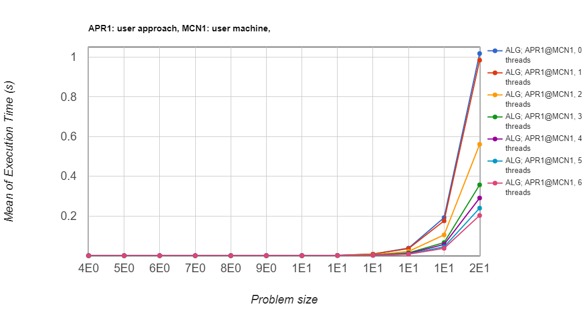
Coparision between bitmasking and backtracking
Bitmasking works faster then backtracking method because for fast attacking queen checking.
BackTracking Method
Bitmasking Method

Slide 11
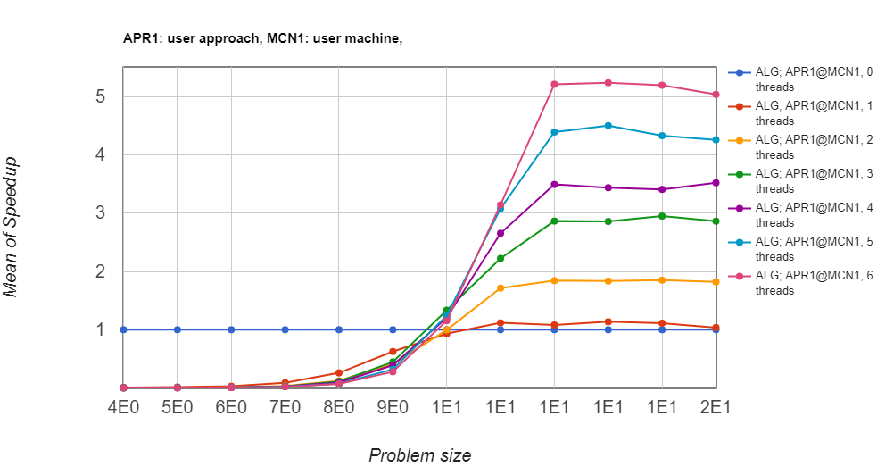
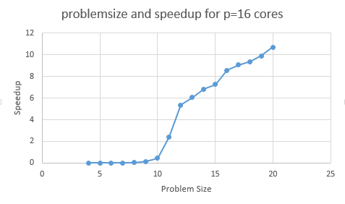
Speedup analysis

Slide 12
Conclusion
Best Method to find N-Queen Number is backtracking using bit masking.
Here for these paralyzing technics, We have more nodes then we create threads. So, as problem size increases speedup will increase.
For, next N-Queen Number N = 28, If we use our algorithm and dividing work into every nodes of cluster we can solve it in appr. 500 years.
Notes:
Here, let's take o(n!) as algorithm complexity, now , time taken for runnig algorithm is as follows for 16 processors:-
16 - 0.65
17 - 5
18 - 34
19 - 265
20 - 2042
now let's take maximum speedup 16 for all and flops per second = 1e10.
so total flops per second = 16e10
now, let's devide problem size to flops.
16!/16e10 = 130
17!/16e10 = 2223
18!/16e10 = 40014
19!/16e10 = 760281
20!/16e10 = 15205637 flops/ (flops/sec)
now, let's devide this with actual time taken it gives increasing rate for problem size,
16 - 130 / 0.65 = 200
17 - 2223 / 5 = 444
18 - 40014 / 34 = 1176
19 - 760281 / 265 = 2868
20 - 15205637 / 2042 = 7446
so here increasing rate is = 2.5 .
now for 28 = 7446 * (2.5) ^ 8
so time = opp / rate
= ((28!)/16e10) / 11361694
= into year / (10) (for 160 cores)
= 531 years
http://www-sop.inria.fr/oasis/ProActive2/apps/nqueens25.html

